Slide 2

Kaggle Facial Keypoints Detection
Given an input image of 96x96 grayscale picture. Predict 15 key points (X,Y) pairs
Left, Right Eye Center
Left, Right Eye Inner Corner
Left, Right Eye Outer Corner
Left, Right Eyebrow Inner End
Left, Right Eyebrow Outer End
Nose Tip
Left, Right Mouth Corner
Top, Bottom Mouth Lip Center

Slide 3
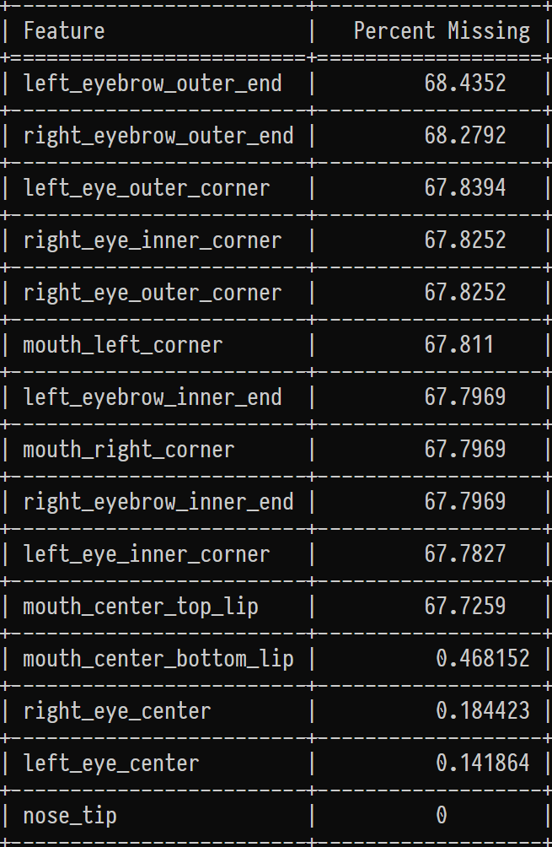
Missing Values
7049 Rows of images and key points
2140 Rows contain all features

Slide 4

Example of Initial Designs For All Features
Input Layer
Rescaling
Conv2D
MaxPooling2D
Conv2D
MaxPooling2D
Conv2D
MaxPooling2D
Dense
Dense
96x96x1
1/255.0
F 32
K 5,5
S 1,1
2,2
F 64
K 5,5
S 1,1
2,2
F 128
K 5,5
S 1,1
2,2
1024
1024
Output
19,163,166
Nadam Optimizer
https://www.tensorflow.org/guide/keras/functional
https://journalofbigdata.springeropen.com/articles/10.1186/s40537-019-0263-7
Notes:
We used the functional API since we didn’t know how the model would come together, advantageous for monitoring individual output loss but wasn’t required
Seems like a convolutional network would be a good place to start what did we do in Homework 10. ☺
Fit the Input Layer to the Image size, 96,96 rather than something larger 224,224,3. To make it quicker to train
How many layers? What kind of Kernel Sizes? What about Strides and Filters? Let’s take a guess.
How may epochs. Holy Cow no idea. Guess we’ll start with a 1000 Epochs was way too many and the model was very overtrained.
Notice there are no Batch Normalizations or Dropouts We’ll get to those later
In order to get started we’ll build a model that only takes 2140 images which have values for all key points and build and optimize a model from that

Slide 5
Results from Initial Designs For All Features
Generated five model designs in the initial development phase.
They were all overfit (expected)
1000 Epochs Takes a really long time!
CPU: 13s/epoch (3.6 Hours)
GPU: 1s/epoch (16.3 mins)
Validation Loss (MSE) could be better ~80 for all 30 outputs
We can’t recover the best weights for the model since we train for a fixed number of epochs.
Notes:
There were approximately five initial generation models. This slide summarizes all of them
Lot’s of times we’d just Ctrl C the models around 100 epochs when they weren’t looking good.

Slide 6
Example of Intermediate Designs For All Features
Input Layer
Rescaling
Conv2D
Conv2D
MaxPooling2D
Conv2D
Conv2D
MaxPooling2D
Conv2D
Conv2D
MaxPooling2D
Dense
Batch Normalization
Dense
Batch Normalization
96x96x1
1/255.0
F 32
K 3,3
S 1,1
F 32
K 3,3
S 1,1
2,2
F 64
K 3,3
S 1,1
F 64
K 3,3
S 1,1
2,2
F 128
K 3,3
S 1,1
F 128
K 3,3
S 1,1
2,2
1024
1024
Output
19,196,670
Notes:
Experiment with Dropout and Batch Normalization to prevent overfitting.
Several Experiments Failed since Dropout layers were placed after maxpooling layers instead of after convolutional layers
Experiment with Stacking Multiple Convolutional Layers before Max Pooling Layers
Two Convolutional Layers Before Max Pooling Appears to be the Best Result
Stacking of three of these layers appears to provide best results.
Experiment with number and size of output layers.
Optimal Size of Output Layers appears to be between 1024 and 2048
No more than Two Dense Layers.
Experiment with Filter Sizes Strides and Kernel Sizes
For image size of 96,96 Optimal Initial filter size of 32
No more than 256 output filters in the final convolutional layers.
Kernel size of 3,3 appears to work best. Avoid Even sized Kernels they’re not symmetrical around the output pixel
Stride of 1,1 also appears to give best results. Let’s stick with these

Slide 7
Results from Intermediate Designs For All Features
Generated around fifteen model designs in the intermediate development phase.
Early stopping with restore weights is working properly
Validation Loss (MSE) improved to ~65 for all 30 outputs
Number of Training Epochs reduced to ~400
Submission to Kaggle.
Training on 2140 Images containing all points 55th on Kaggle Leaderboard

Slide 8
Final Design For All Features
Input Layer
Rescaling
Conv2D
Batch Normalization
Conv2D
Batch Normalization
MaxPooling2D
Conv2D
Batch Normalization
Conv2D
Batch Normalization
MaxPooling2D
Conv2D
Batch Normalization
Conv2D
Batch Normalization
Conv2D
Batch Normalization
MaxPooling2D
96x96x1
1/255.0
F 32
K 3,3
S 1,1
F 32
K 3,3
S 1,1
2,2
F 64
K 3,3
S 1,1
F 64
K 3,3
S 1,1
2,2
F 128
K 3,3
S 1,1
F 128
K 3,3
S 1,1
F 128
K 3,3
S 1,1
2,2
Conv2D
Batch Normalization
Conv2D
Batch Normalization
Conv2D
Batch Normalization
MaxPooling2D
Conv2D
Batch Normalization
Conv2D
Batch Normalization
Conv2D
Batch Normalization
MaxPooling2D
Dense
Batch Normalization
Dense
Batch Normalization
F 256
K 3,3
S 1,1
F 256
K 3,3
S 1,1
F 256
K 3,3
S 1,1
2,2
F 256
K 3,3
S 1,1
F 256
K 3,3
S 1,1
F 256
K 3,3
S 1,1
2,2
2048
2048
Output
12,625,506
Notes:
Review Existing CNN Architectures for Image Classification.
Resnet 50
Resnet 101
VGG-16
VGG-19
Notice that Our Intermediate Architecture is very similar to the VGG architectures.
Code up both VGG19 and VGG16 Architectures with our input size 96x96x1
Using the Original Number of Filters and Dense Layers Specified in the VGG Architecture. Whose input is 224,224,3
Two choices, Upscale our images to 224,224,1 or cut down filters and dense layer to be smaller Chose the latter
Evaluated both full parameter and cut down versions of VGG16 and VGG19 networks.
VGG16 and VGG19 are too parameter heavy to train properly given our smaller input
VGG16 downsized produces equivalent if not better results to VGG19 downsized
Chose VGG16 downsized as final architecture
Used ReduceLROnPlateau to drive down loss

Slide 9
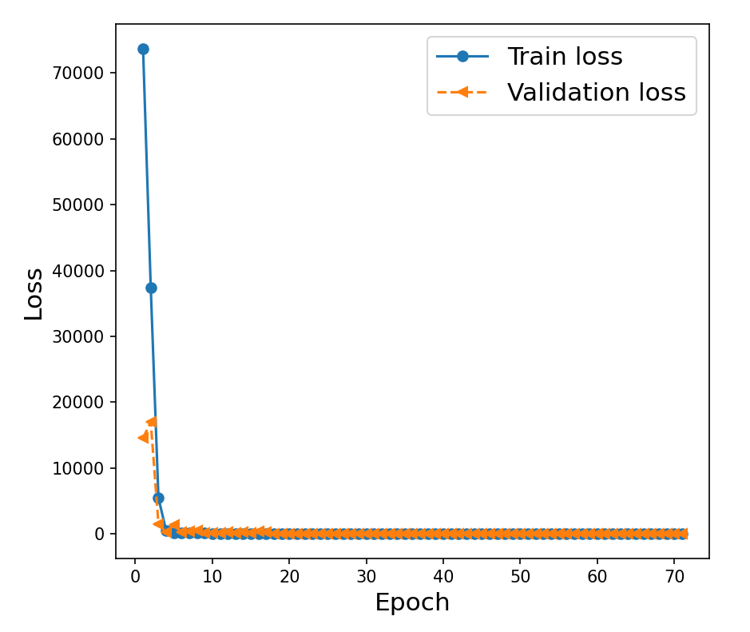
Results From Final Design For All Features
Validation Loss (MSE) ~50 for all 30 outputs
Number of Training Epochs is reduced to ~60
Submission to Kaggle
Use ReduceLROnPlateau to improve Loss
Training on 2140 Images containing all points 52nd on Kaggle Leaderboard

Slide 10
Train Final Design Individually on All Features
Left Eyebrow Outer End
Left Eyebrow Inner End
Right Eyebrow Inner End
Right Eyebrow Outer End
Left Eye Outer Corner
Left Eye Center
Left Eye Inner Corner
Right Eye Inner Corner
Right Eye Center
Right Eye Outer Corner
Save Trained Models
Load Trained Models From Disk
Assemble into a Combined model with the same image input fifteen times
Predict Fifteen individual Outputs
Assemble Results
Nose Tip
Top Mouth Lip Center
Left Mouth Corner
Right Mouth Corner
Bottom Mouth Lip Center

Slide 11
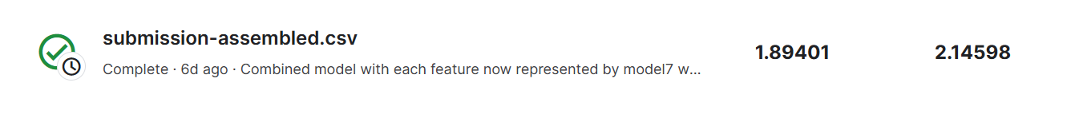
Results from Final Assembled Model
Submission to Kaggle
Training on all data 15th on Kaggle Leaderboard

Slide 12

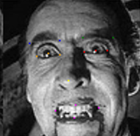
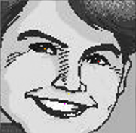
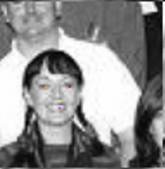
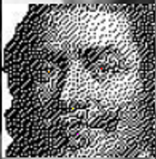
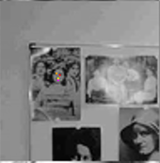
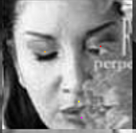
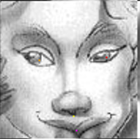
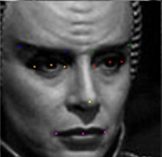
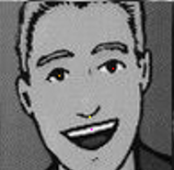
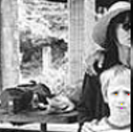
EDA
Questions from Initial EDA
For Duplicate Images with differently labeled key points. Leave them in place and let the model predict with them
Poorly Dithered Images
Nested Images
Partially Obscured Faces
I don’t know?!
Vampires/Aliens
Cartoons
Multiple People

Slide 13
EDA
Choose to do automatic outlier removal rather than hand classify each image. Used three criteria
Eye Center X Distance Less Than Twenty (Removed 38 Images)
Attempt to remove multiple people and composite images
Number of Gray Levels Less Than 110 (Removed 22 Images)
Remove cartoons or low resolution images
Number of Pixels with Same Color Greater than 1600 (Removed 21 Images)
Remove cartoons or low resolution images
Improved Kaggle Score and Validation Slightly ~.2

Slide 14
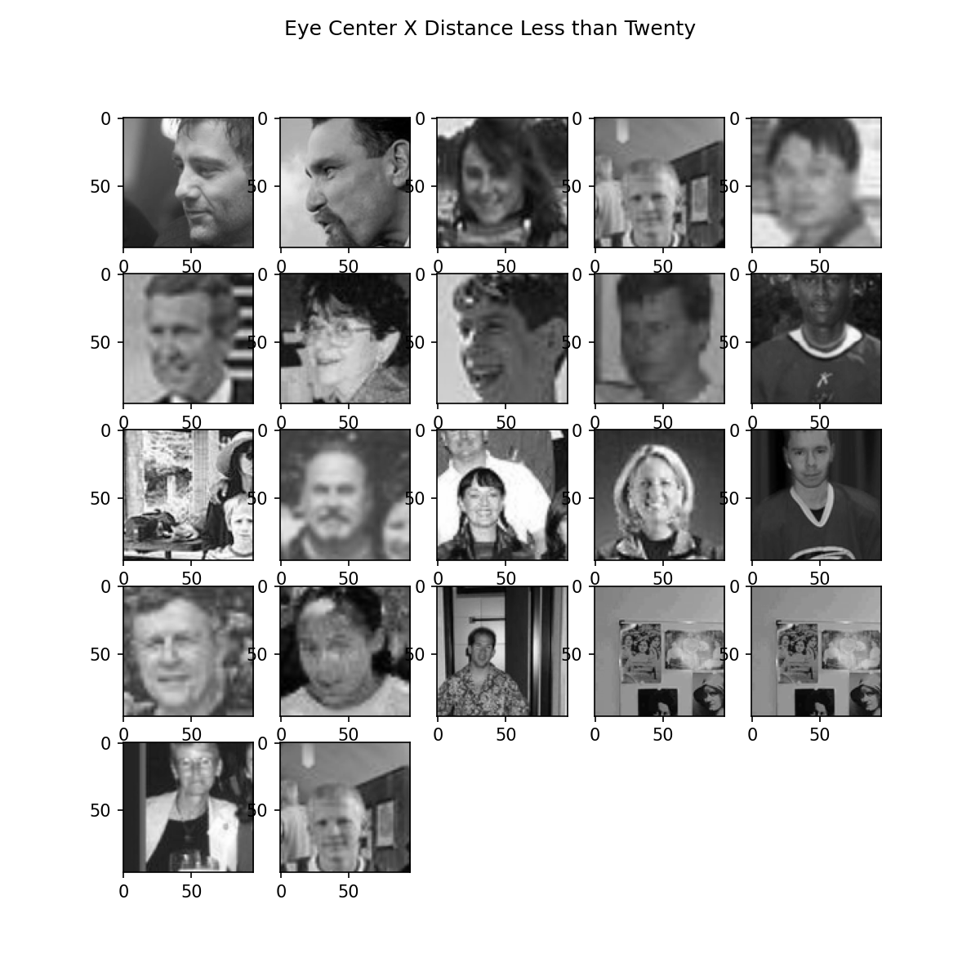
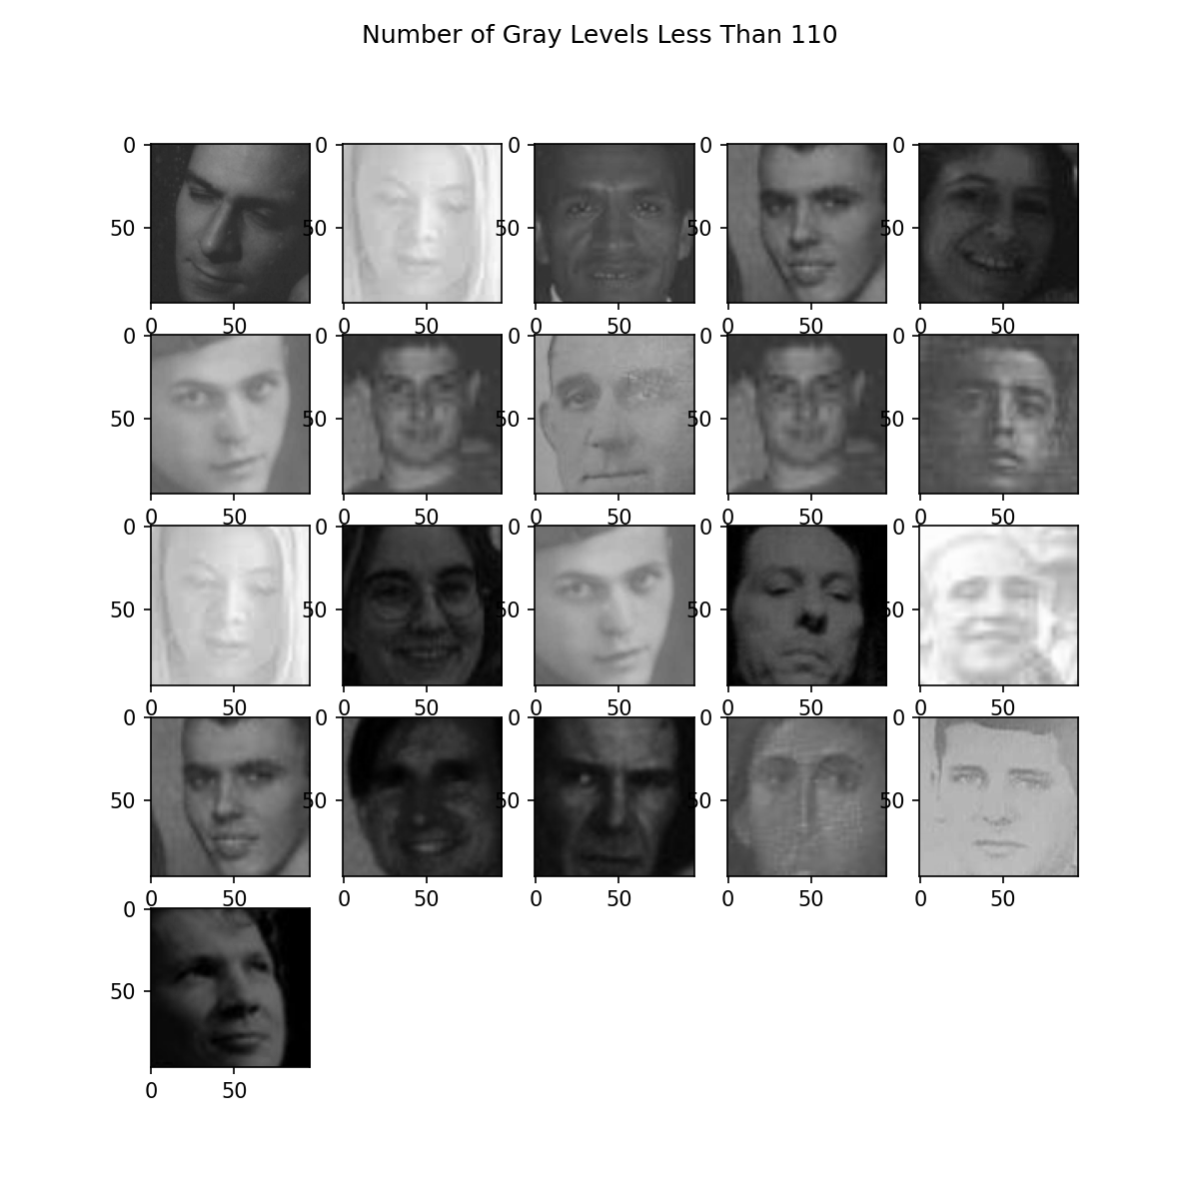
EDA

Slide 15
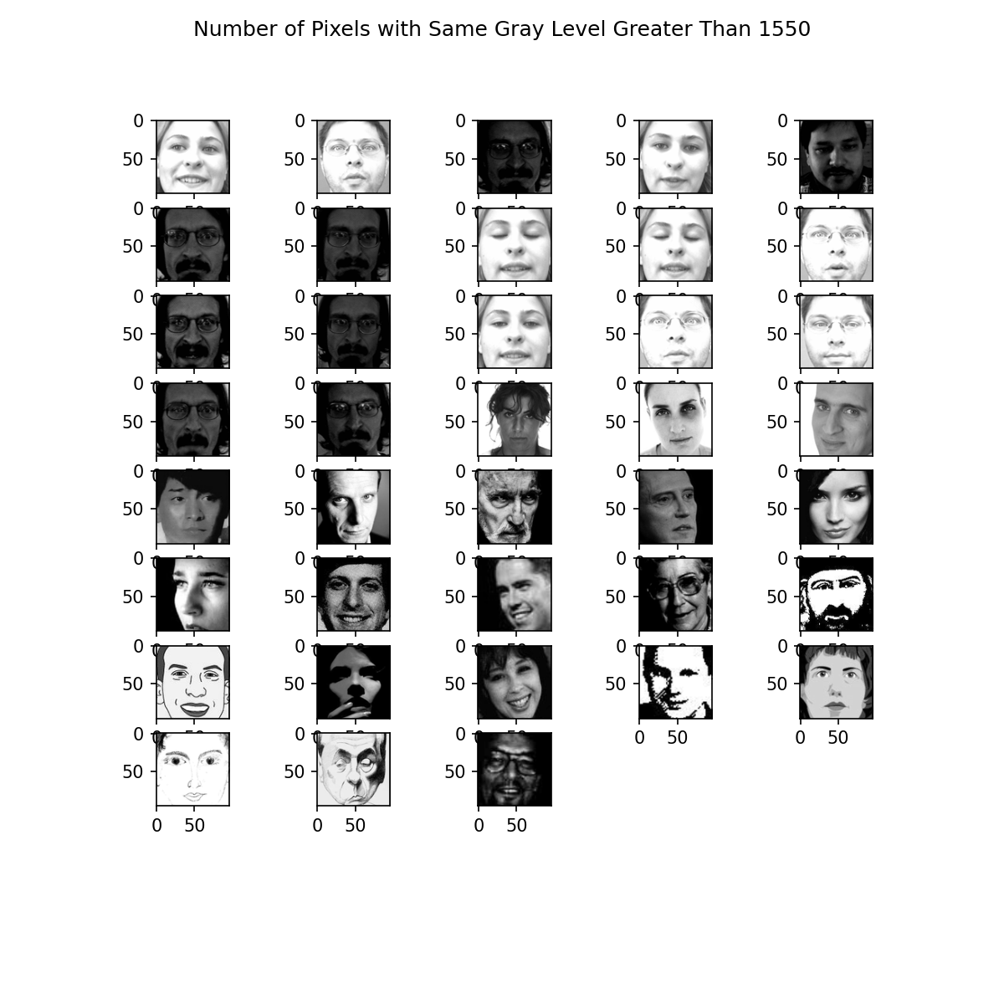
EDA

