Slide 1


2022 RNA Institute Summer Fellowship Program - Project 2 Dorentina Humolli

Slide 2
Presentation Outline
Overview of the project
Objectives and Tools
Results and Discussion
Conclusion

Slide 3

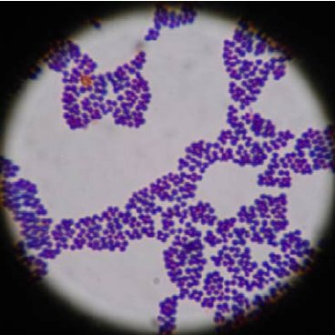
Project 2 – Overview of project
Staphylococcus aureus is Gram-positive bacteria (stain purple by Gram stain) that are cocci-shaped and tend to be arranged in clusters that are described as “grape-like.”
Multi-host bacterial pathogen responsible for important human and livestock diseases.
Contribution of the use of antibiotics in human medicine and agriculture to the emergence of antibiotic resistance.
These organisms can grow aerobically or anaerobically (facultative) and at temperatures between 18 C and 40 C.
Notes:
I would say it’s better to use active titles, rather than generic titles such as ”Overview of the project”. You could use something more eye-catching such as:
”Staphylococcus aureus is a pathogen with many hosts and resistance mechanisms” This is a complete sentence that describes the information that will be covered in this slide. That’s what I mean by active titles.

Slide 4
Objectives of the project and Tools
Assembly
Spades
Annotate
Prokka
Build core genome
Panaroo
Phylogenetic tree
RAxML
AMR genes
ABRicate
Plot the data
R-studio
Download genomes
SRA-tool kit
Phylogenetic tree
RAxML
Build a phylogenetic tree
To represent the relationship between S. aureus isolates from human, pigs and
cows.
Plot the number of isolates per host (human, pigs, cows)
Plot antimicrobial resistance genes per host
Determine which genes are more common across hosts
Expectations
The genes implicated in resistance to oxacillin (mecA), gentamicin (aac(6’)/aph(2”), aph(3’-IIIa, ant(4’)-Ia), erythromycin (ermA, ermB, ermC, and msrA), tetracyclin (tetK, tetM), blaZ which encodes β-lactamase, and penicillin.
Notes:
Objectives:
You don’t have to mention the overall objectives (the ones in bold font). I would just mention your specific objectives:
To represent the evolutionary relationships of S. aureus isolates from humans, cows, and pigs
Determine the number of available genomes for these host species
Determine which antimicrobial resistance genes are more common by host.
Expectations:
The expectations are too specific here. Those are your actual results.
Instead, you could simply mention:
More genomes of S. aureus from human than cows and pigs
Many AMR genes because S. aureus is known for widespread antimicrobial resistance

Slide 5
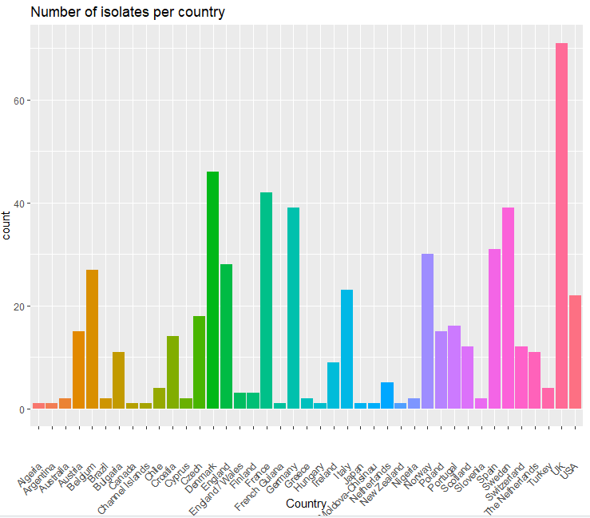
Results
S. aureus phylogeny according to host-species origin
Population genomic analysis of 571 isolates including
38 different host species and
75 clonal complexes
Isolated in 41 different countries.
Notes:
This is great. You could add another objective regarding finding out the geographical origin of isolates. If you are interested, I could also help you plot the data by continent so it is easier to see.

Slide 6
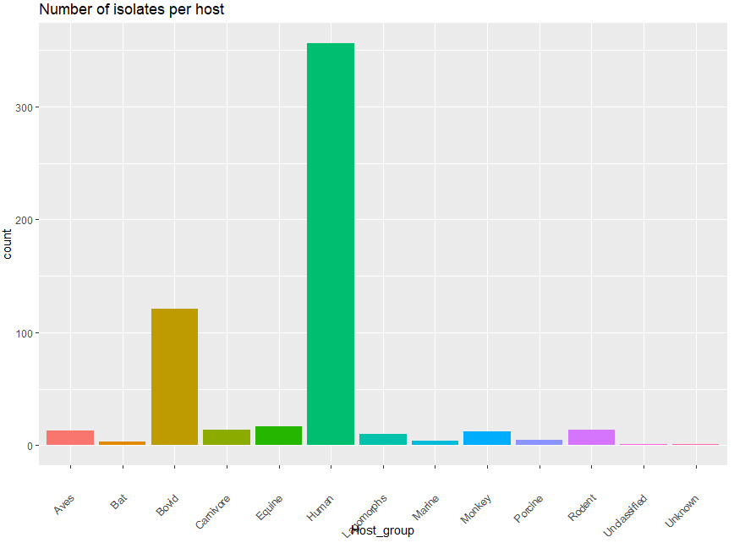
Notes:
I updated the metadata and added better names for the host groups. Also, there are ways to make this figure look better. I would say it’s best if you subset your own host groups (human, cows, and pigs) and only plot those, since other people will be talking about the others. I provided some examples on how to subsample specific host groups, so you should be able to do it.

Slide 7
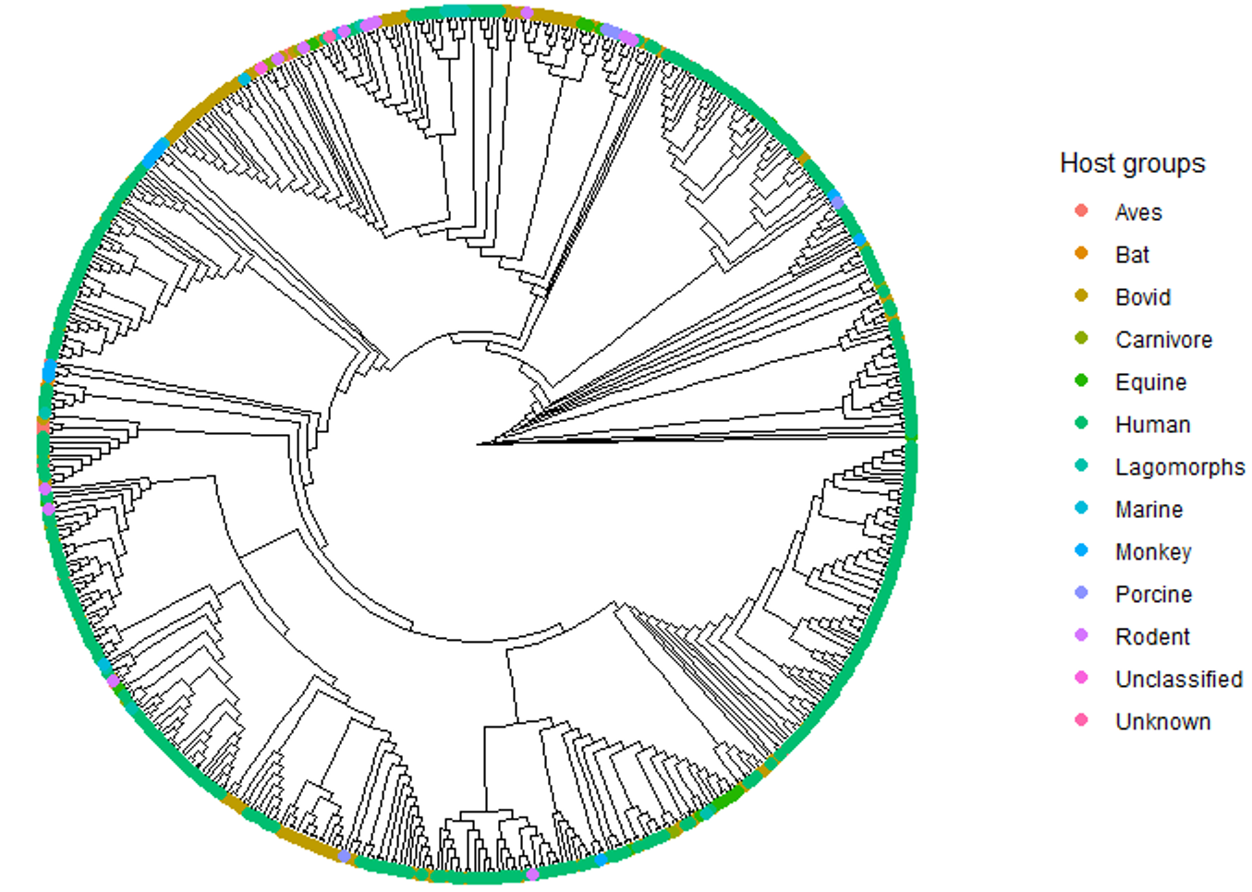
Results
S. aureus phylogeny according to host-species origin
Notes:
The phylogeny indicates the broad diversity of isolates of human origin
Teddy’s comment:
Same as my previous comment, you could also only plot your host groups here, instead of the entire dataset. In the legend, you would see only human, cows, and pigs colored. Let me know if you don’t know how to do it and I will help you.

Slide 8
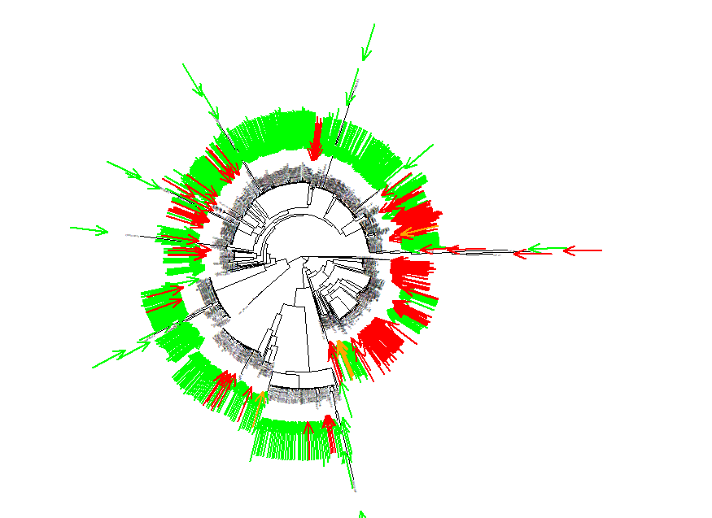
Notes:
This is probably fine, but you need to indicate what the arrows mean and what color is what.

Slide 9
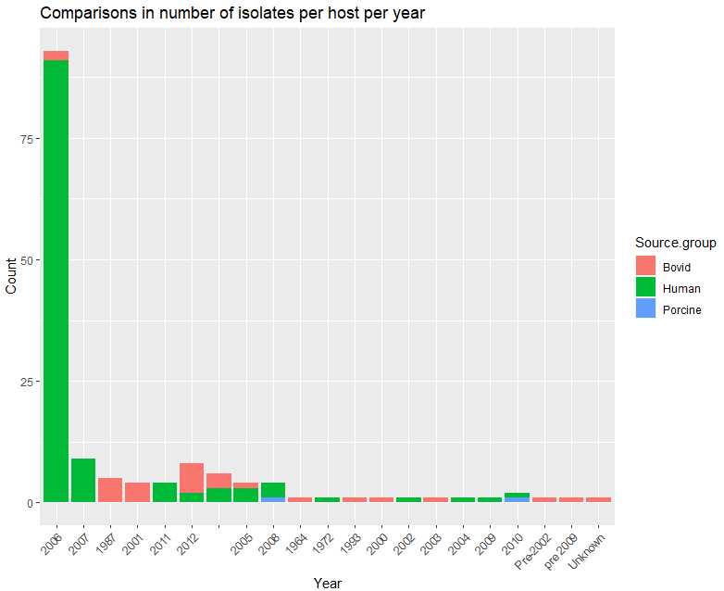
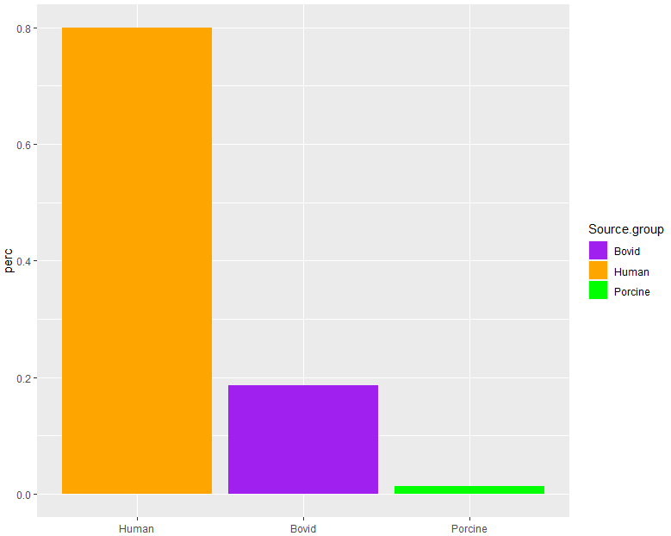
Notes:
This is what I was saying for slide 6 (left panel), but count instead of percentage. Yo need to focus on your host groups like you did on this slide.

Slide 10
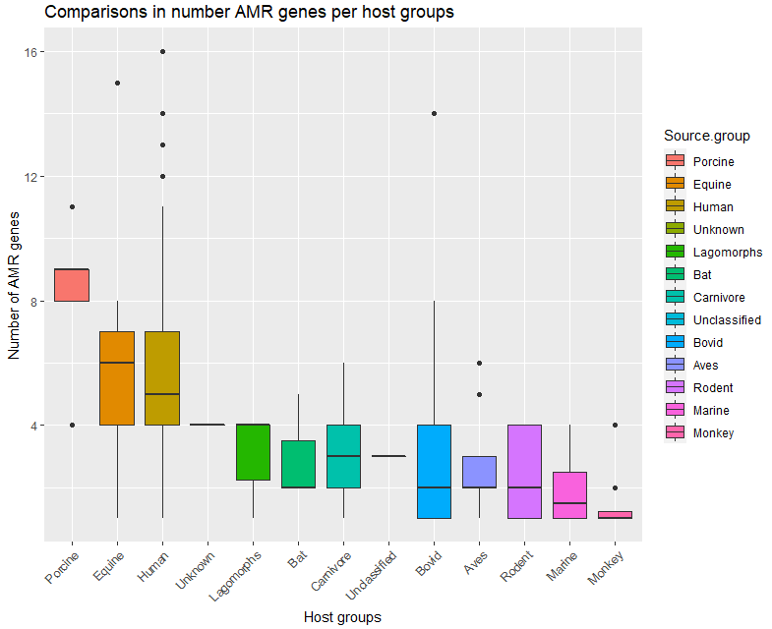
Notes:
Again, extract your host groups and plot those only (not all host groups). By the way, this is not the number of AMR genes, this is the “average AMR genes per host”. That means, this is not count totals, it is the average per host. That’s why you see more for porcine, because on average, pigs have more than the rest.

Slide 11
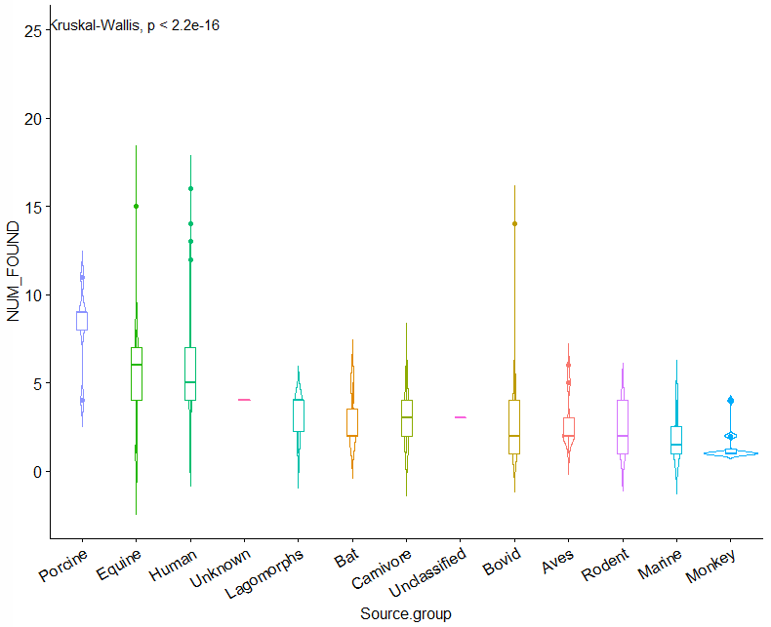
Notes:
Same comment as slide 10. I also provided examples for extracting specific host groups and plotting violin plots

Slide 12
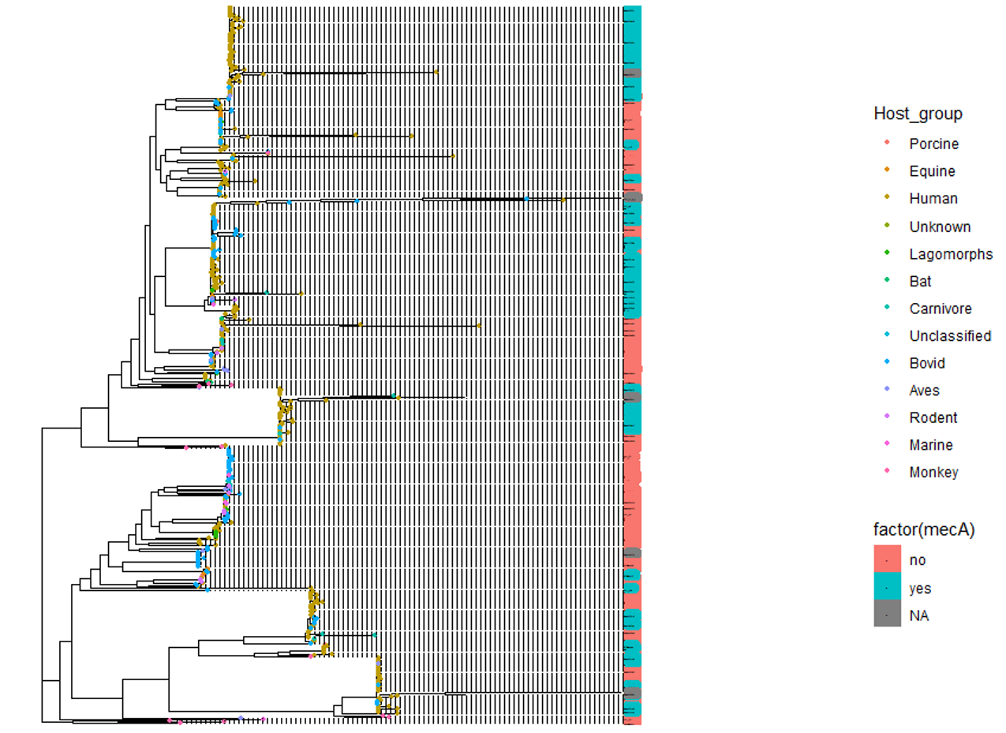
Notes:
Same comment as previous phylogeny, focus on your host groups.

Slide 13
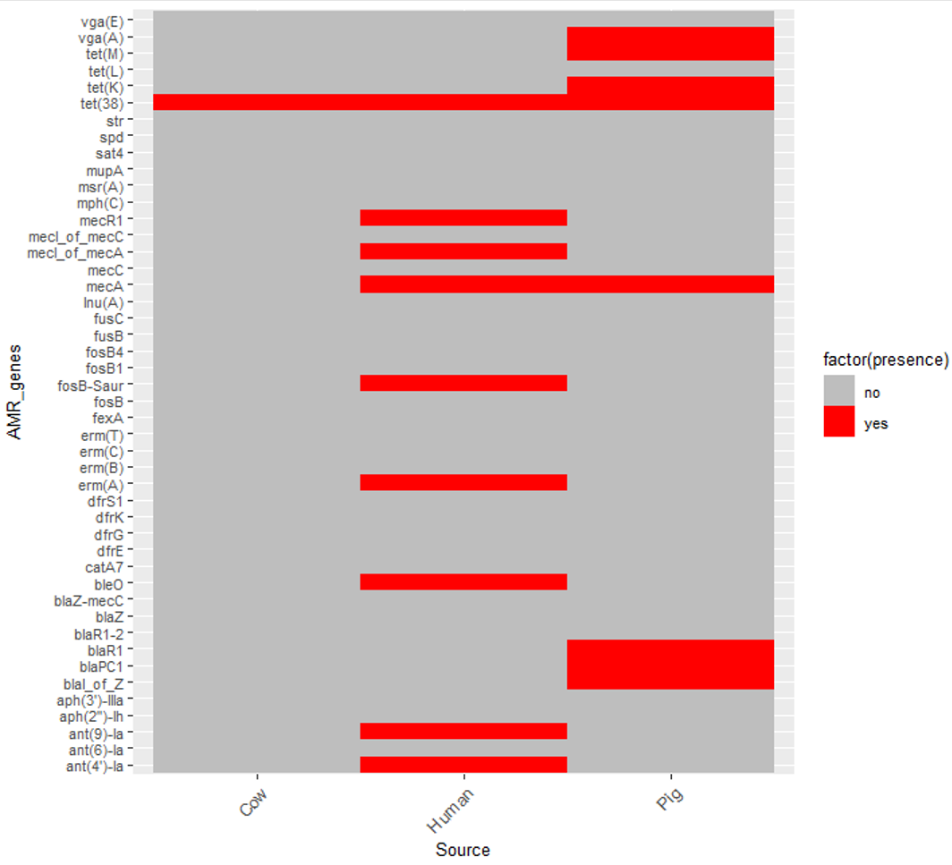
Notes:
This looks good.

