Slide 1
Improving Sampler Performance for Bayesian Models of Biochemical Thermodynamics
Teddy Groves, QMCM presentation 11/11/2020

Slide 2
Plan
What is a Bayesian model of Biochemical thermodynamics?
Why degeneracy is a problem for Bayesian thermodynamics models?
Proposed solution to the difficulty by reparameterisation
Simulation studies showing that the reparameterisation works pretty well
Discussion

Slide 3


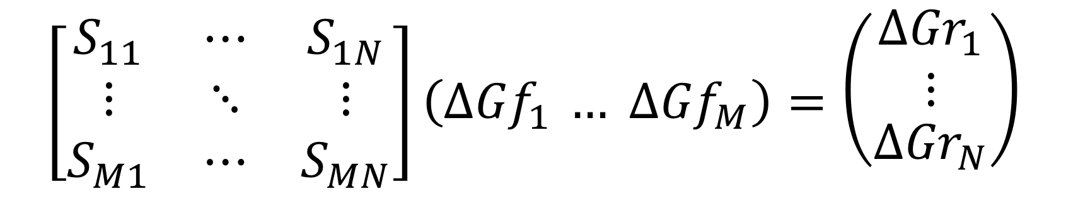
Problem
PRECISE OBSERVATIONS
STRUCTURAL KNOWLEDGE
VAGUE PRIORS
$$\left[\begin{matrix}S_{11} & ⋯ & S_{1N} \\ ⋮ & ⋱ & ⋮ \\ S_{M1} & ⋯ & S_{MN}\end{matrix}\right]\left({∆Gf}_{1 }… {∆Gf}_{M}\right)=\left({\begin{aligned}{∆Gr}_{1} \\ ⋮\end{aligned} \atop {∆Gr}_{N}}\right)$$

Slide 4
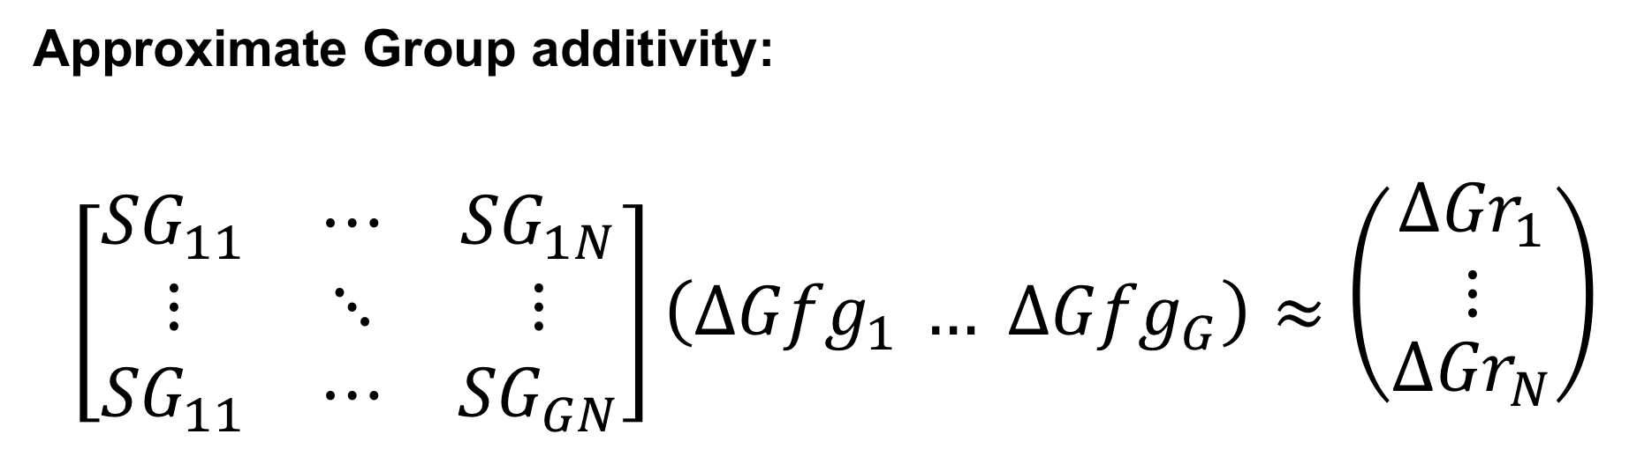
Some extra structural information
Approximate Group additivity:
$$\left[\begin{matrix}{SG}_{11} & ⋯ & {SG}_{1N} \\ ⋮ & ⋱ & ⋮ \\ {SG}_{11} & ⋯ & {SG}_{GN}\end{matrix}\right]\left({∆Gfg}_{1 }… {∆Gfg}_{G}\right)≈\left({\begin{aligned}{∆Gr}_{1} \\ ⋮\end{aligned} \atop {∆Gr}_{N}}\right)$$

Slide 5
Why Bayesian?
Need to synthesise group and substrate level models
Complicated setup:
Legendre transforms
Incomplete information
Study bias (measurements from the same study tend to cluster)
Downstream applications need an accurate ensemble of formation energies, not just point estimates

Slide 6
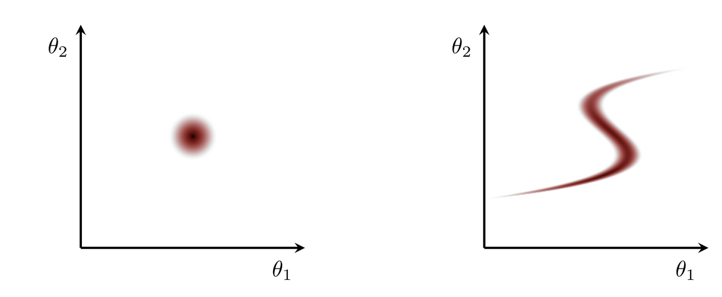
Degeneracy
Our inferences are strongly non-degenerate, or weakly degenerate, if they appear to concentrate around a single point rather than some extended, degenerate surface.
(Graphs and quote copied from a case study by Michael Betancourt)

Slide 7
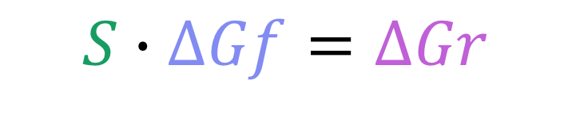
Thermodynamics models are degenerate!
Precise information about linear combinations of vague parameters
$$S∙∆Gf=∆Gr$$

Slide 8
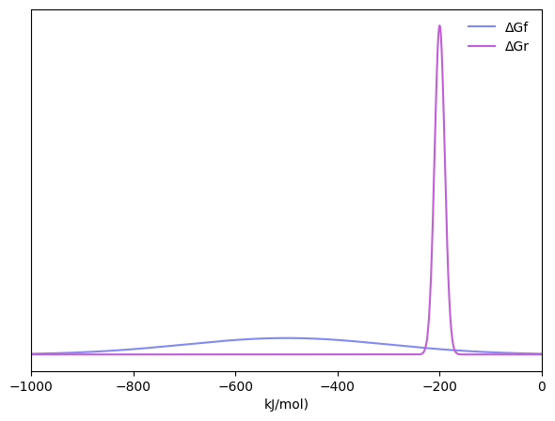
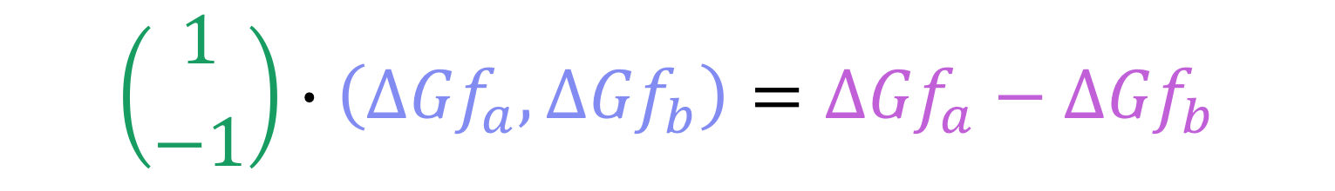
Thermodynamics models are degenerate!
$$\left({1 \atop −1}\right)∙\left({∆Gf}_{a},{∆Gf}_{b}\right)={∆Gf}_{a}−{∆Gf}_{b}$$

Slide 9
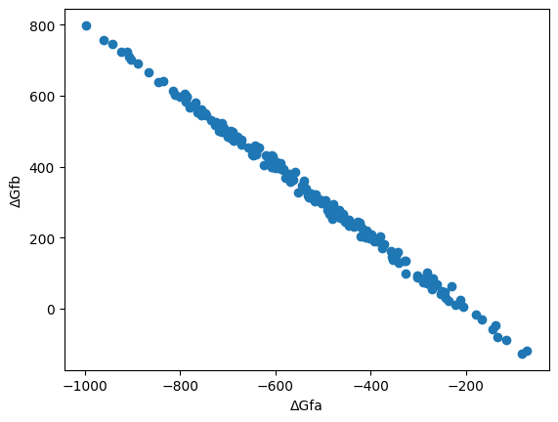
Thermodynamics models are degenerate!
$$\left({1 \atop −1}\right)∙\left({∆Gf}_{a},{∆Gf}_{b}\right)={∆Gf}_{a}−{∆Gf}_{b}$$
Vague prior
Linear combination
Precise measurement

Slide 10
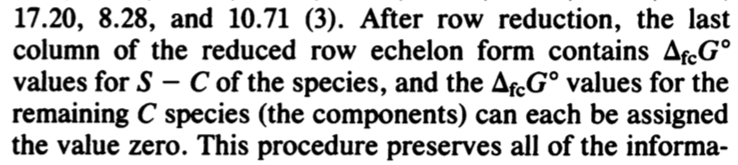
Hope?

Slide 11
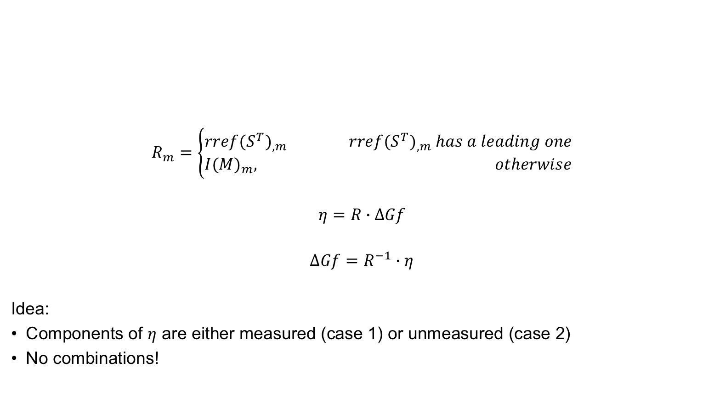
Reparameterisation strategy
$$R_{m}=\left\{\begin{aligned}{rref(S^{T})}_{,m} {rref(S^{T})}_{,m} has a leading one \\ {I(M)}_{m}, otherwise\end{aligned}\right.$$
$$η=R∙∆Gf$$
$$∆Gf=R^{−1}∙η$$
Idea:
Components of $η$ are either measured (case 1) or unmeasured (case 2)
No combinations!

Slide 12

Example
$$S=\left[\begin{matrix}0 & 0 & −1 \\ 0 & −1 & 1 \\ 0 & −1 & 0 \\ 1 & 2 & 0\end{matrix}\right]$$
$$rref(S^{T})=\left[\begin{matrix}1 & 0 & 1 & 0 \\ 0 & 1 & 1 & 0 \\ 0 & 0 & 0 & 1\end{matrix}\right]$$
$$R=\left[\begin{matrix}1 & 0 & 1 & 0 \\ 0 & 1 & 1 & 0 \\ 0 & 0 & 1 & 0 \\ 0 & 0 & 0 & 1\end{matrix}\right]$$
$$∆Gf=R^{−1}∙η=\left(\begin{matrix}η_{1}−η_{3} \\ η_{2}−η_{3} \\ η_{3} \\ η_{4}\end{matrix}\right)$$

Slide 13
Implementation: naïve parameterisation
parameters {
real<lower=0> tau; // how approximate is group additivity, generally?
vector[N_cpd] theta; // compound formation energies
vector[N_grp] gamma; // group formation energies
}
model {
target += normal_lpdf(theta | prior_theta[1], prior_theta[2]);
target += normal_lpdf(gamma | prior_gamma[1], prior_gamma[2]);
target += normal_lpdf(tau | prior_tau[1], prior_tau[2]);
target += normal_lpdf(theta | G * gamma, tau);
target += normal_lpdf(y | S' * theta, sigma);
}

Slide 14
Implementation: Reparameterisation
parameters {
real<lower=0> tau;
vector[N_cpd] eta_cpd; // i.e. R * compound formation energy
vector[N_grp] eta_grp; // i.e. RG * group formation energy
}
transformed parameters {
vector[N_cpd] theta = R_inv * eta_cpd;
vector[N_grp] gamma = RG_inv * eta_grp;
}
model {
// same as before!
}

Slide 15
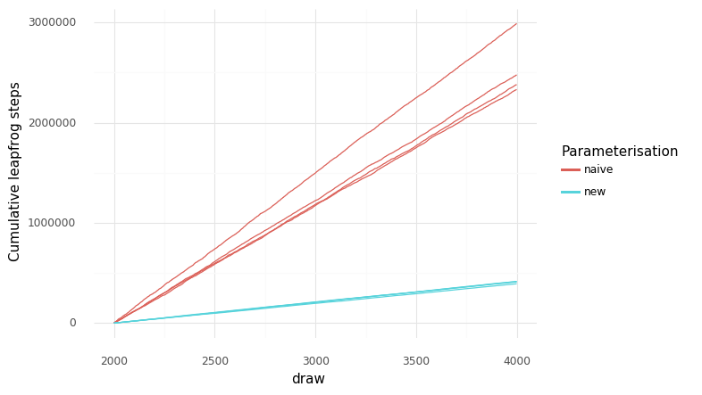
Simulation Study 1: Toy dataset
4 reactions
6 metabolites
4 groups
More or less realistic stoichioimetry, true parameter values and group decompositions
Sampling time per chain on my computer: ~18 seconds vs ~ 4 seconds

Slide 16
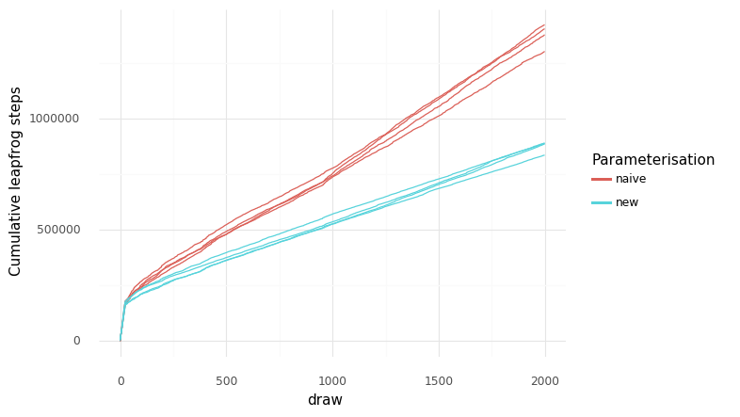
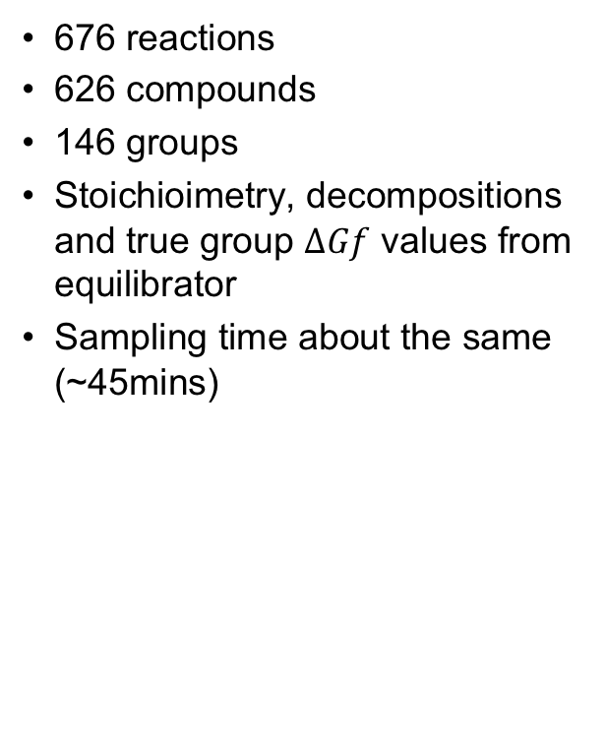
Simulation Study 2: big dataset
676 reactions
626 compounds
146 groups
Stoichioimetry, decompositions and true group $∆Gf$ values from equilibrator
Sampling time about the same (~45mins)

Slide 17
Discussion
Generally the reparameterisation works
Tradeoff of less degeneracy vs big matrix multiplication
Good news: Stan will soon get faster matrix arithmetic
Is there a better reparameterisation strategy?
Any further optimisations?

Slide 18
Plan
Statistics paper presenting the reparameterisation strategy and simulation studies
Paper presenting the results of fitting a big model

Slide 19
Thanks for listening!
GitHub repository
Alberty paper
Bayesian workflow paper
Essay about degeneracy

