Slide 1
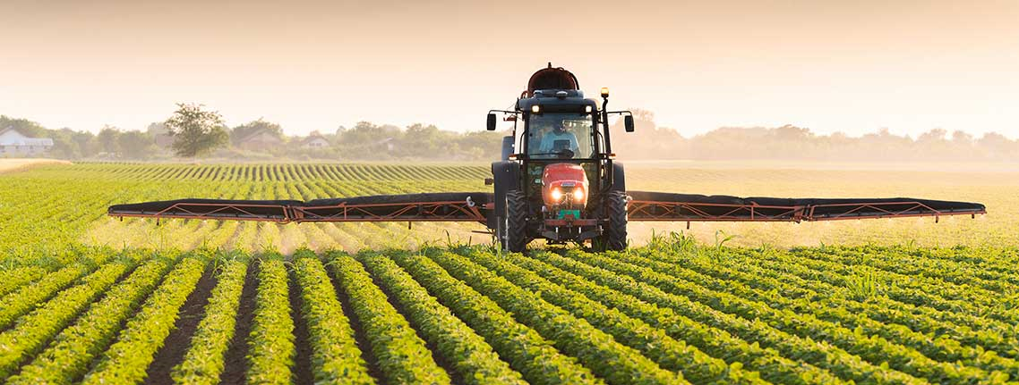
AGRITEC
One app to solve every Agro based problem
Team No: 20
Team Members:
Kevin Peter
Jaideep Singh
Kashish Goel

Slide 2


Farmer suicide rates are increasing

Slide 3


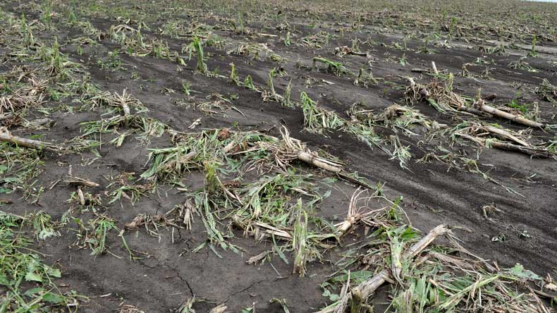
What are the main reasons?
They don’t get good revenue from their crops.
They use low quality pesticides due to less investments from the government which leads to less yield
Unpredictable weather conditions (droughts, floods etc) cause heavy losses to farmers

Slide 4

Agrimarket
Agrimarket is the feature in our app which helps farmers to get the best price for their crops and farmers can also buy products in a very low price.
*The products are stored on an online database which can be easily accessed through Firebase and SQLite

Slide 5
Agrimarket
Through this feature farmers can buy all the basic requirements in one place such as:
Fertilizers
Irrigation Equipment
Fuel
Seeds
Chemicals (Pesticides and Insecticides)

Slide 6
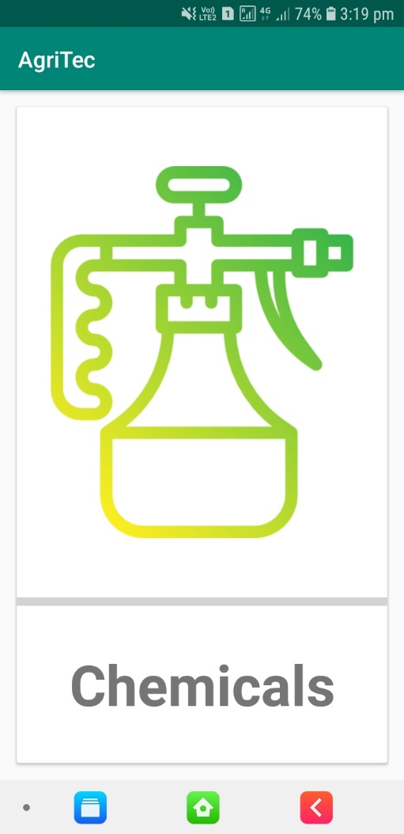
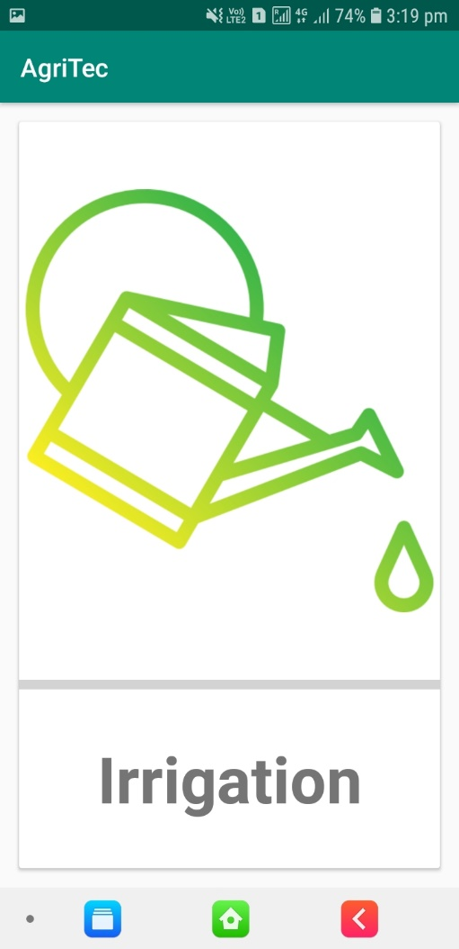
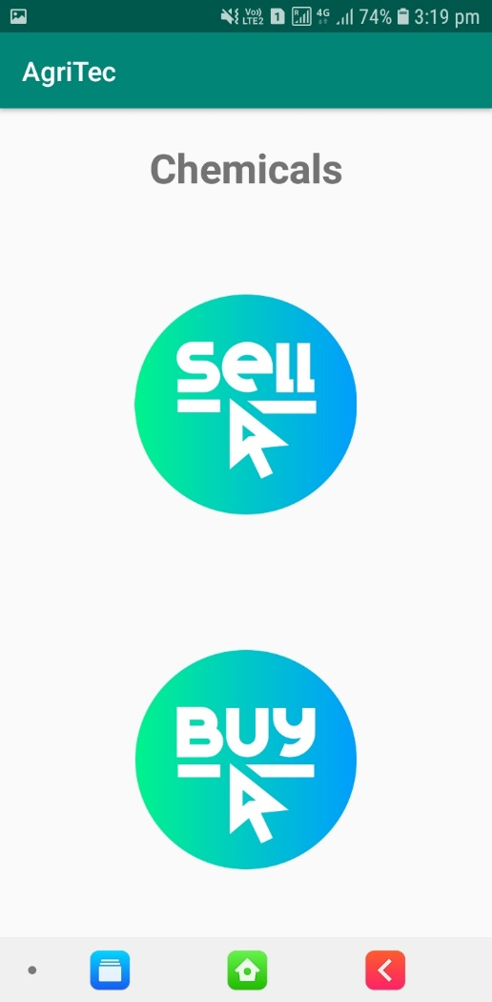
Agrimarket interface

Slide 7
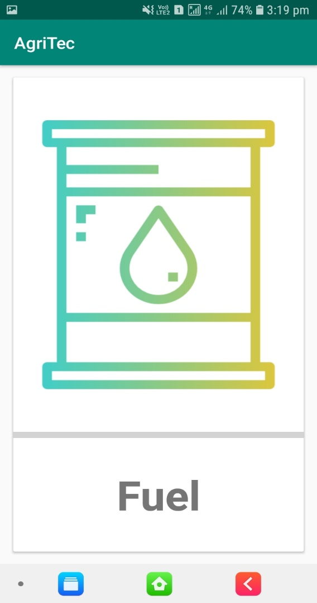

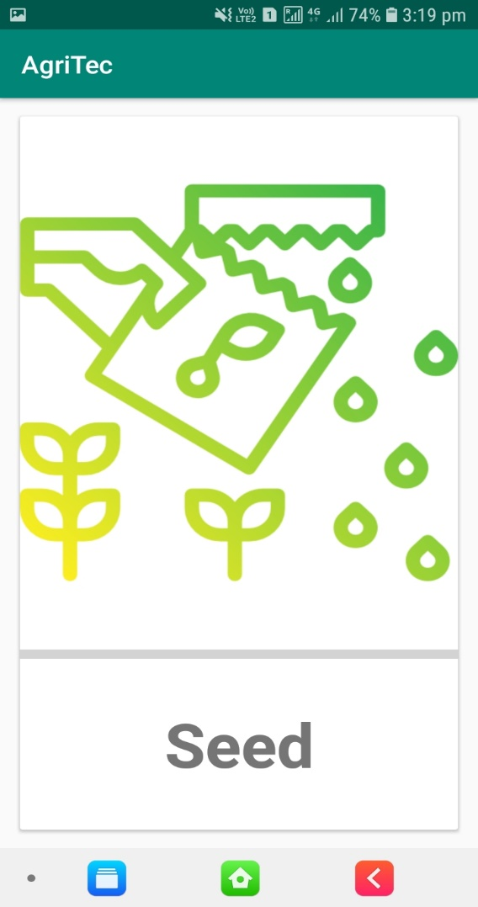

Slide 8
AgriSpray
Agrispray is the feature which helps farmers to spray pesticides more efficiently by providing weather forecasts, whether there will be heavy rainfall or just a slight drizzle.
Farmers can save their time by not irrigating plants when there will be rainfall and also can harvest earlier before a thunderstorm.

Slide 9
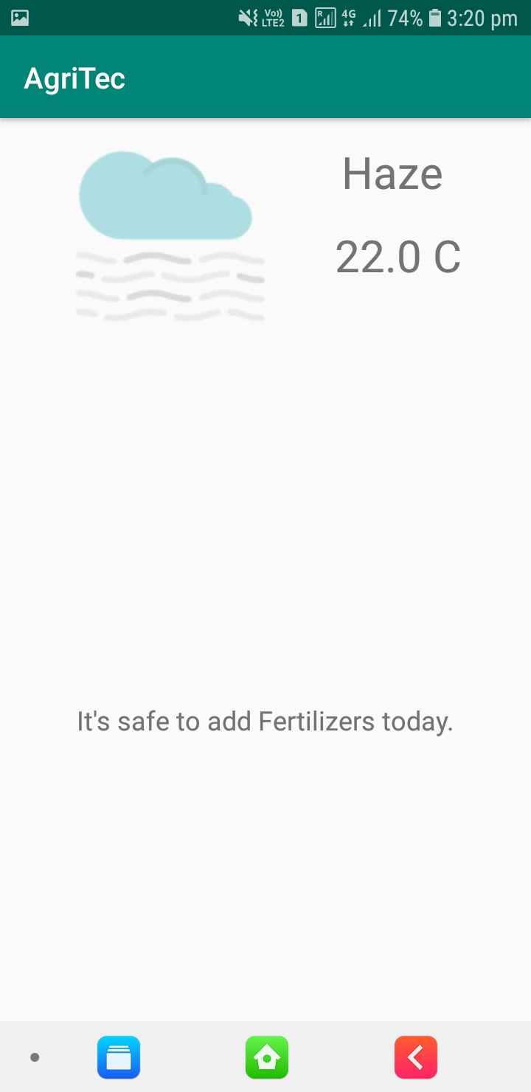
This is an example based on the city of Jaipur, where the app displays the weather conditions and decides whether or not the fertilizers need to be added to the soil

Slide 10
Agridetect
Agridetect helps farmers detect plant diseases and find remedies for them through the press of a single button.
By taking a photo of the plant, the app will detect the plant species, disease and precautions to be taken to prevent further damage.

Slide 11
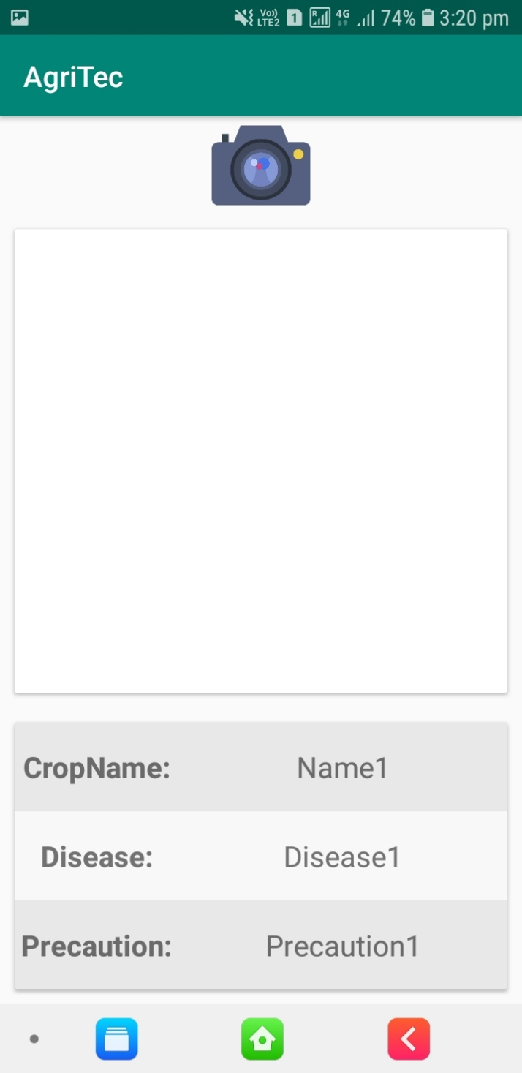
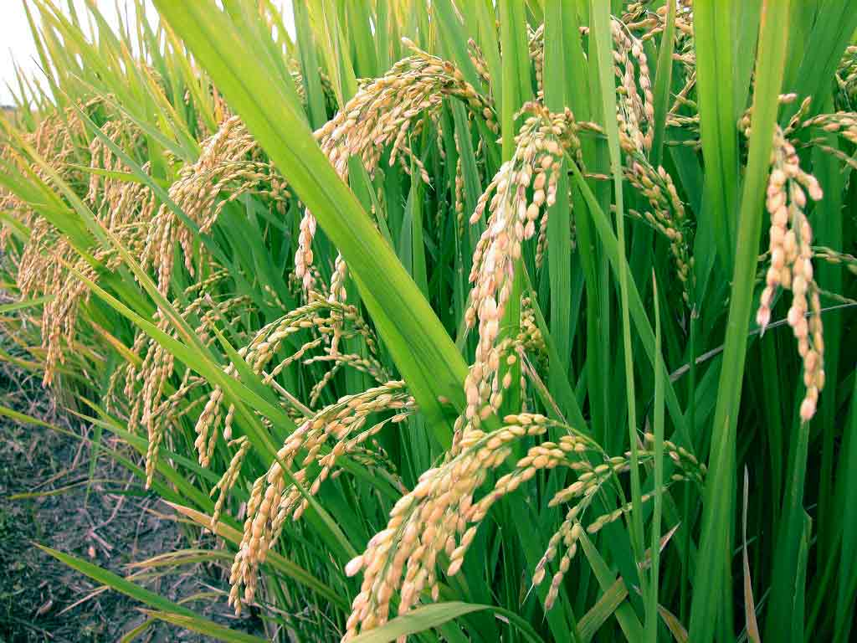
The dataset containing various information about the crops is collected from Kaggle, and through Machine Learning algorithms ,the plant species is identified, along with any ailments if present.
If any ailments are detected, it reports the necessary steps to be taken to remove the disease.

Slide 12
Agrihelp
Agrihelp is a customer care service by Agritec where all the queries of farmers are resolved.
Rather than travelling long distances to the nearest government help desk, they can receive professional help from experts online who can guide them through whatever problems they are facing.

Slide 13
How will the app generate revenue?
Through commissions received from various Agricultural product sellers to place their advertisements within the app.
The advertisements will only be related to agriculture to generate interest and so that most users (farmers) will click on them and get redirected to the product’s website rather than closing it altogether.

Slide 14
Thank You!

