Slide 1


Getting around Ethiopia just got easier. Much easier.
E-ADRASHA
Tewodros Hailegeberel
Confidential and Proprietary. Copyright (c) by E-Adrasha. All Rights Reserved.

Slide 2

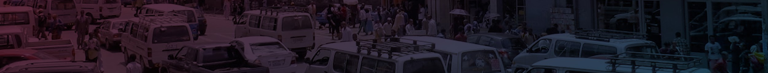
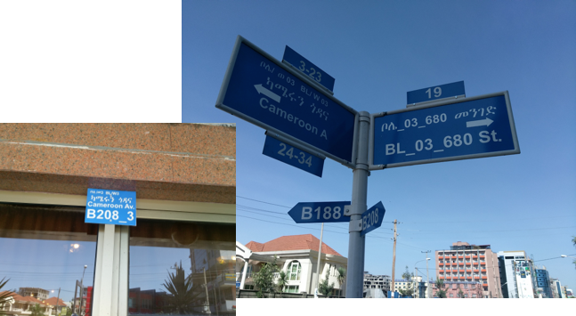
The Problem
Ethiopia is in the midst of transforming into a middle income country.
To get location data in Addis Ababa, Ethiopia, users rely on word of mouth information to find their destination and other information.
Taxis often have to rely on their passengers to get to their destination if they don’t know the area very well.
Currently there is no digital platform that will provide location based information for any type of consumer to use.
Some locations and roads are also not well known by everyone in the city, thus getting round the city is very hard because most people rely on known information. If a new road is constructed and it’s the easiest path to their destination, people will not be able to know about it.

Slide 3
The Solution
We are collecting over 300 type of categories like:
Schools
Government offices
Buildings with building names
Hospitals
Clinics
Condos
Residential homes, and more
Using this data, we’ve created a geolocator that will enable users to find their destination or locations.
We’ve also enriched the data by adding hours of operation for business and foot traffic data, car parking information, number of seats a business has. We believe this information will help users and business to use our data.
Out data and application is multi language where users can search using native language (Amharic).

Slide 4
The Advantage
We are one of a kind startups in Addis Ababa with a large amount of data collected in the city.
We also have the ability to quickly add data to our database when there is a change in the city.
The current city and government administration have accepted our solution for finding information using mobile application.
Because we have started the data collection and built a mobile app, we are in a good position to take advantage of working with government agencies and business.

Slide 5
Benefits of Our Application
Adrasha’s location information for businesses, residences, facilities, tourist attractions or anything in the city is an addition to public welfare.
All users can benefit in finding commercial and public services as well as driving navigation to POIs needed, with real-time traffic information.
We are providing data plus logistic services to both clients and customers.
Transit
Real-time driving navigation routes, with traffic updates and travel time.
Goods & Services
Efficient and updated routes for delivery and pick-up of freight, goods, and services.
Tourism
Directions to historical and cultural sites, markets, and several tourist attractions, commercial, government locations.
Notes:
Societal benefits- Geospatial technology can play a role in emergencies—such as helping people prepare for a natural disaster by highlighting flood-risk areas.
Consumer benefits
Geo-spatial Maps help increase efficiency and reduce travel time
Business benefits
Maps help make small and large businesses more visible, productive and profitable. By providing useful facts such as store hours, contact information and reviews, maps help drive sales—particularly important for small businesses that may find potential new customers without incurring additional advertising costs.

Slide 6
Possibilities of our data use
Emergency -Route Optimization for emergency management agencies
Determining locations as well as best route for getting to fire emergencies
Ambulance services for hospitals
Utilities Based services - Assist tracking in water leakage and problems ….and electrical issues For instance for Addis Ababa Water Authority and The ELPA
Logistic/shipping and tourism markets- Improving local delivery by the Ethiopian Post Office, DHL, FedEx or Local Shipping EMS and Ethiopian tourism agency.

