Slide 1
Homework Assignment #2
Shell

Slide 2
Outline
Introduction
Unix Variables
  PATH
Related Functions
  fork() and wait()
  Exec Family
  Internal Command
  External Command
Background Execution
Output Redirection
Command History
Exercise

Slide 3
Introduction (1/3)
A shell is a program that acts as an interface between a user and the operating system
user
shell
OS

Slide 4
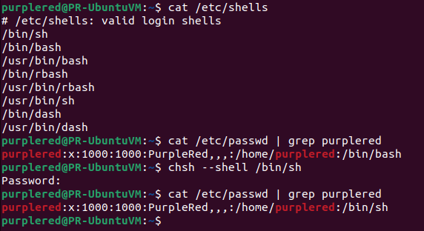
Introduction (2/3)
change current user's login shell

Slide 5
Introduction (3/3)
A shell command can be …
  Internal: the code to be executed is part of the shell
    Running these commands does not require searching their path by the system
    Example: cd, pwd, echo, export
  External: the code to be executed resides in a separate binary file
    Running these commands requires searching PATH by the system
    Example: ls, cp

Slide 6
Outline
Introduction
Unix Variables
  PATH
Related Functions
  fork() and wait()
  Exec Family
  Internal Command
  External Command
Background Execution
Output Redirection
Command History
Exercise

Slide 7
Unix Variables (1/3)
A Unix variable allows passing information from the shell to programs
Standard Unix variables are split into two categories
  Shell variables
  Environment variables

Slide 8
Unix Variables (2/3)
Example of shell (local) variables
  argv: an array of command/program arguments
  cwd: the full pathname of the current directory
  gid: the user’s real group ID
  history: indicates the number of history events to save.
  home: initialized to the home directory of the invoker.
  owd: the old (pr previous) working directory
  path: a list of directories to look for executable commands
  prompt: the string printed before reading a command
  shell: the full pathname of the running shell
  term: the terminal type
  tty: the name of the tty (TeleTYpe) terminal
  uid: the user’s real user ID
  user: the user’s login name

Slide 9
Unix Variables (3/3)
Example of environment (global) variables
  OSTYPE: the name of the current operating system
  USER: your login name
  LOGNAME: the login-name of the user
  HOME: the path name of your home directory
  MAIL: the path to your mail inbox
  HOST: the name of the computer you are using
  DISPLAY: the name of the computer screen display
  PRINTER: the default printer
  EDITOR: the default text editor
  PATH: the directories the shell should search to find a command
  SHELL: the full pathname of the login shell

Slide 10
Outline
Introduction
Unix Variables
  PATH
Related Functions
  fork() and wait()
  Exec Family
  Internal Command
  External Command
Background Execution
Output Redirection
Command History
Exercise

Slide 11
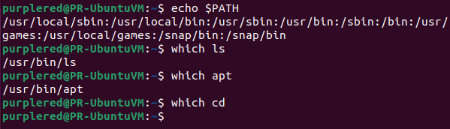
PATH (1/4)
  The shell will search PATH to find an executable file
By PATH variable, user don’t need to enter complete path to execute the external command
To know PATH(echo $PATH)
ls is the external command

Slide 12
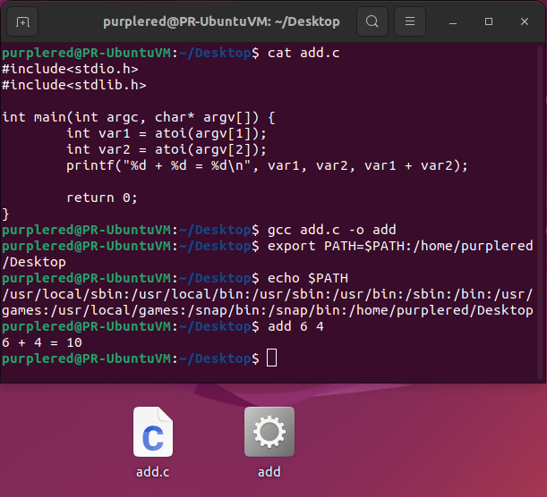
PATH (2/4)
write add.c on desktop
compile to executable file
add Desktop to PATH temporary

Slide 13
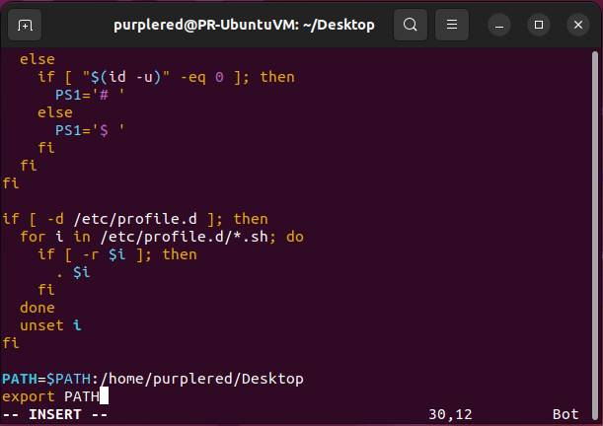
PATH (3/4)
Add path in PATH permanently
  sudo vim /etc/profile
add the following two lines on the bottom of the file

Slide 14

PATH (4/4)
Add path in PATH permanently (Cont.)
  Reboot the VM
  echo $PATH

Slide 15
Outline
Introduction
Unix Variables
  PATH
Related Functions
  fork() and wait()
  Exec Family
  Internal Command
  External Command
Background Execution
Output Redirection
Command History
Exercise

Slide 16
fork() and wait() (1/5)
The fork() system call creates new process
The fork() copies the parent's memory image so that the new process receives a copy of the address space of the parent.
Both processes continue at the instruction after the fork statement (executing in their respective memory images).
#include <unistd.h>
pid_t fork(void);

Slide 17
fork() and wait() (2/5)
Copy of memory
image
Original memory
image
Parent process
fork()
Child process

Slide 18
fork() and wait() (3/5)
process
fork()
Return child's PID
Return 0
original
process
continues
new
process

Slide 19
fork() and wait() (4/5)
The wait() Function
The parent can execute wait() to block until the child finishes
If wait() returns because the status of a child is reported, it returns the process ID of that child.
Else if an error occurs, it returns –1.
#include <sys/wait.h>
pid_t wait(int *stat_loc);
EX: wait(NULL);

Slide 20
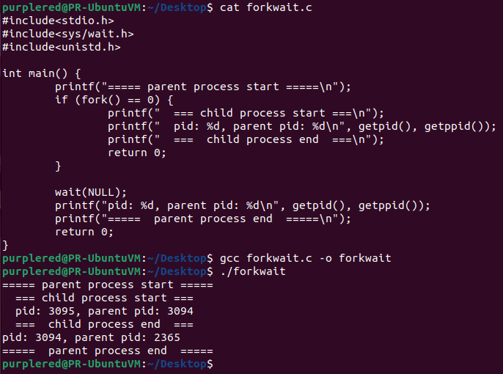
fork() and wait() (5/5)
fork()-wait() example

Slide 21
Outline
Introduction
Unix Variables
  PATH
Related Functions
  fork() and wait()
  Exec Family
  Internal Command
  External Command
Background Execution
Output Redirection
Command History
Exercise

Slide 22
  Exec Family (1/4)
The fork() function creates a copy of the calling process, but many applications require the child process to execute code that is different from that of the parent.
The exec() family provides a facility for overlaying the process image of the calling process with a new image.
Use the fork()–exec() combination for the child to execute the new program while the parent continues to execute the original code.

Slide 23
Exec Family (2/4)
Copy of memory
image
Original memory
image
Parent process
fork()
Another memory
image
Child process
exec()

Slide 24
Exec Family (3/4)
The exec() Family (cont.)
  passes the command-line arguments in an explicit list and are useful if you know the number of command-line arguments at compile time.
#include <unistd.h>
int execlp(const char *filename, const char *arg0, … /*(char *)NULL*/);

Slide 25
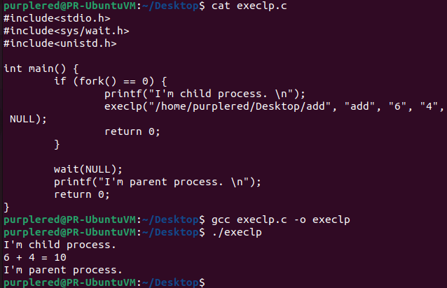
Exec Family (4/4)
Execlp() execute program defined by yourself

Slide 26
Outline
Introduction
Unix Variables
  PATH
Related Functions
  fork() and wait()
  Exec Family
  Internal Command
  External Command
Background Execution
Output Redirection
Command History
Exercise

Slide 27
Internal Command (1/5)
執行內建 command 時不得使用 fork-exec 函式
  cd: change the current working directory
  chdir() changes the current working directory of the calling process to the directory specified in path.
#include <unistd.h>
int chdir(const char *path);
EX: chdir(“/home”);

Slide 28
Internal Command (2/5)
pwd: to know the current working directory
The getcwd() function copies an absolute pathname of the current working directory to the array pointed to by buf, which is of length size.
#include <unistd.h>
char *getcwd(char *buf, size_t size);

Slide 29
Internal Command (3/5)
Export 命令用來設置環境變數
The getenv() function searches the environment list to find the environment variable name, and returns a pointer to the corresponding value string.
#include <stdlib.h>
char *getenv(const char *name);

Slide 30
Internal Command (4/5)
The setenv() function adds the variable name to the environment with the value value, if name does not already exist.
#include <stdlib.h>
int setenv(const char *name, const char *value, int overwrite);

Slide 31
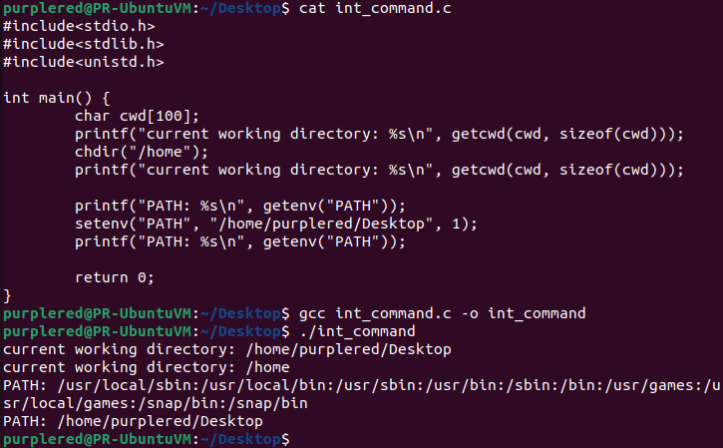
Internal Command (5/5)
Example

Slide 32
Outline
Introduction
Unix Variables
  PATH
Related Functions
  fork() and wait()
  Exec Family
  Internal Command
  External Command
Background Execution
Output Redirection
Command History
Exercise

Slide 33
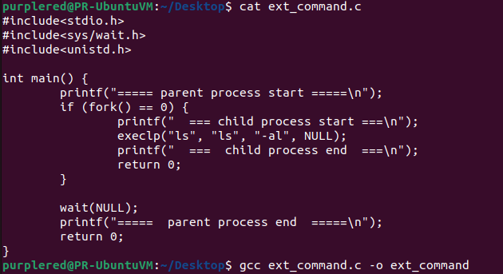
External Command (1/2)
執行External commands：fork child process後，再用exec-like函數執行外部command

Slide 34
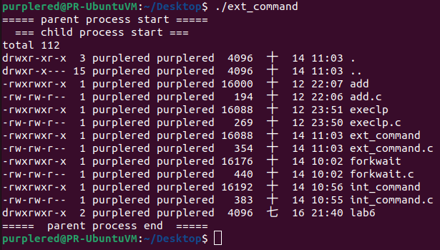
External Command (2/2)
Result (something is missing :P)

Slide 35
Outline
Introduction
Unix Variables
  PATH
Related Functions
  fork() and wait()
  Exec Family
  Internal Command
  External Command
Background Execution
Output Redirection
Command History
Exercise

Slide 36
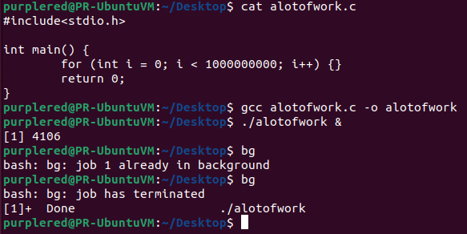
Background Execution (1/2)
當你需要在背景執行程式時，在你要執行的指令後面加 “&”
Example
Notes:
Parent 不 wait()

Slide 37
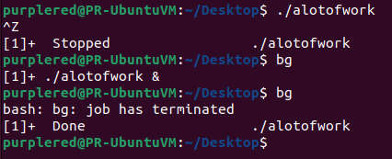
Background Execution (2/2)
bg 是 job control 的一部分（bash、zsh 等 shell 提供）
需要用 Ctrl+Z 暫停作業，才能用 bg 將它送到背景執行
Example

Slide 38
Outline
Introduction
Unix Variables
  PATH
Related Functions
  fork() and wait()
  Exec Family
  Internal Command
  External Command
Background Execution
Output Redirection
Command History
Exercise

Slide 39
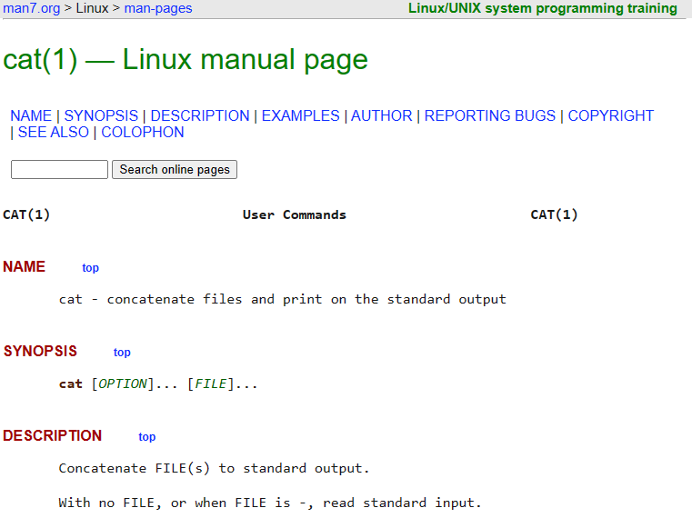
Output Redirection (1/5)
cat 為 Linux 的第一類指令 (user command)
Notes:
全名：concatenate 串接
功能：
顯示檔案內容到標準輸出
可串接多個檔案輸出
可搭配重導向（>、>>）
通常是 external command

Slide 40
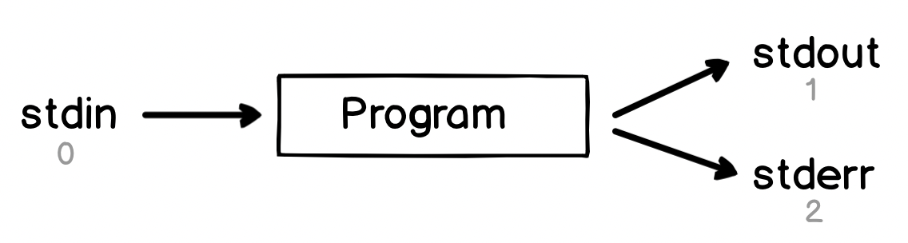
Output Redirection (2/5)
Standard Input (stdin): 0
Standard Output (stdout): 1
Standard Error (stderr): 2
Notes:
Linux 標準 I/O（Standard I/O）與輸出導向（Output Redirection） 的基本概念
程式會從 stdin 讀取輸入（通常是使用者鍵盤輸入或檔案）
程式的正常輸出透過 stdout 顯示
程式的錯誤訊息則透過 stderr 顯示（與 stdout 分開，方便區分與導向）

Slide 41
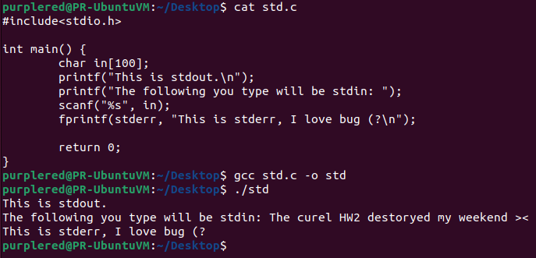
Output Redirection (3/5)
Notes:
展示 stdin, stdout, stderr

Slide 42
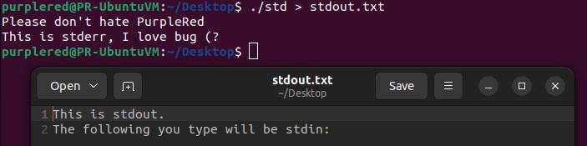
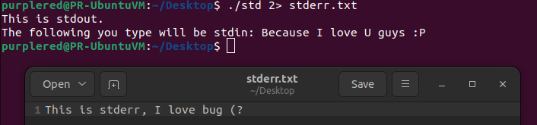
Output Redirection (4/5)
Redirect stdout to file: >
Redirect stderr to file: 2>
Notes:
> : 將 stdout 重新導向到一個檔案。如果檔案已存在，它的內容會被清空並覆蓋；如果檔案不存在，則會建立新檔案
2> : 改成輸出 stderr (覆蓋)

Slide 43
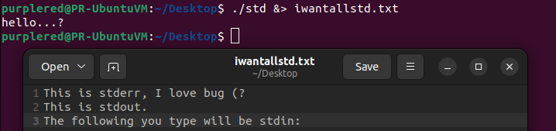
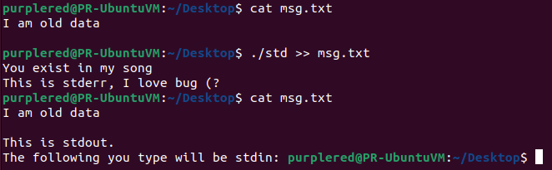
Output Redirection (5/5)
Redirect stdout and stderr to file: &>
If the file exists, append it: >>
Notes:
&> : 將 stdout 和 stderr 都導向到 file (覆蓋)
>> : 將 stdout 附加到一個檔案的末尾。如果檔案不存在，它會被建立；如果已存在，新的內容會加在舊內容的後面

Slide 44
Outline
Introduction
Unix Variables
  PATH
Related Functions
  fork() and wait()
  Exec Family
  Internal Command
  External Command
Background Execution
Output Redirection
Command History
Exercise

Slide 45
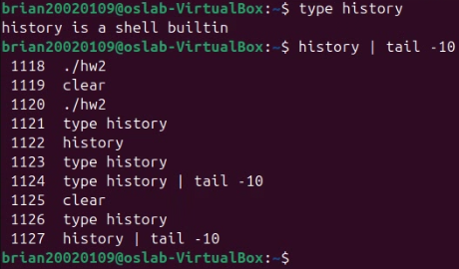
Command History (1/5)
It’s an internal command that you can check commands you typed before.

Slide 46
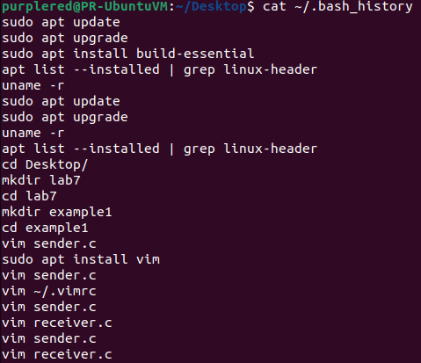
Command History (2/5)
.bash_history records what you typed before

Slide 47
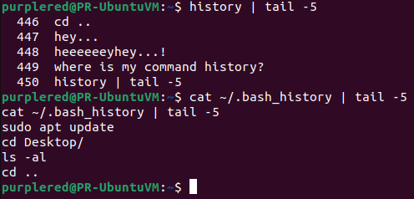
Command History (3/5)
Command history will get data from buffer. After you turn off the terminal, the data will be sent to .bash_history
Notes:
關閉 terminal 後，command 資料才會存入 .bash_history

Slide 48
Command History (4/5)
readline() will read a line from the terminal and return it
You need to install libreadline-dev package first
You also need to link the readline library while you compile the program
#include <stdio.h>
#include <readline/readline.h>
#include <readline/history.h>
char* prompt;
readline (const char *prompt);
sudo apt install libreadline-dev
gcc <source_file>.c –o <executable_file> –lreadline

Slide 49
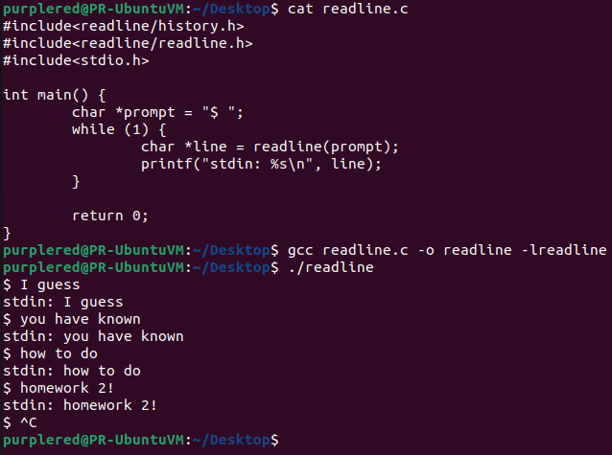
Command History (5/5)

Slide 50
Outline
Introduction
Unix Variables
  PATH
Related Functions
  fork() and wait()
  Exec Family
  Internal Command
  External Command
Background Execution
Output Redirection
Command History
Exercise

Slide 51
Exercise (1/4)
A Simple Linux Shell
  基本功能 (70%)
    印出 prompt 並可讓使用者輸入 command
      prompt 需印出 "<當前使用者>@<當前主機名稱>:<當前路徑> $ "
    接受並執行 command
      Internal commands: cd, pwd, echo, export
      External commands
      輸入 exit 結束程式
    command 執行結束後，再回到 1.

Slide 52
Exercise (2/4)
A Simple Linux Shell (Cont.)
  進階功能 (30%)
    支援 background execution (&) (10%)
      需追加實作 Internal commands: sbg
    支援 output redirection (>) (10%)
    查詢歷史 command (10%)
      按上/下鍵時，印出 prompt 及上/下一筆歷史 command
      歷史 command 印出後，按 enter 鍵可執行該歷史 command
      Internal commands: history
      列出 Simple Linux Shell 開啟後所有輸入過的指令

Slide 53
Exercise (3/4)
Upload your source code to iLearning
  Due day: 2025/11/20 23:30
  C Standard: C17
  hw2_<學號>.c (e.g. hw2_7113056099.c)
  如果有不止一個檔案，請壓縮成 hw2_<學號>.zip
Demo
  繳交完成後，需在11/20前繳交demo影片連結或前往理學大樓 1001A demo
  可預約時間: 週二 9:00-18:00 / 周四,五 9:00-13:00
  請先提前寄 email 預約
  Environment:
  Ubuntu 24.04 ONLY with build-essential package
  libreadline-dev package 不強制但建議使用

Slide 54
Exercise (4/4)
If U have any question
  TA: 陳柏安、葉弘堯
  Email: bobbob930127@gmail.com、
  nelson1128666@gmail.com

