Slide 1
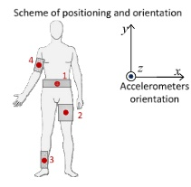
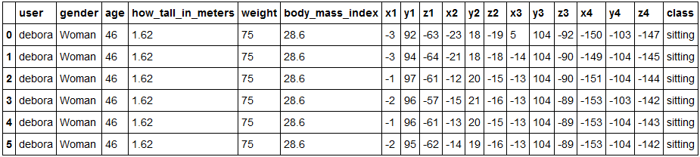
Teddy Zeng
Human Activity Recognition (HAR)
Classes: sitting, sitting down, standing, standing up, walking

Slide 2
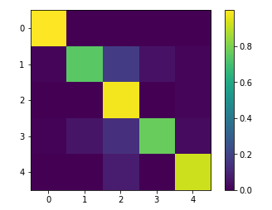

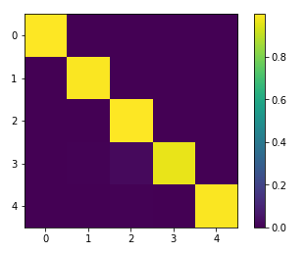

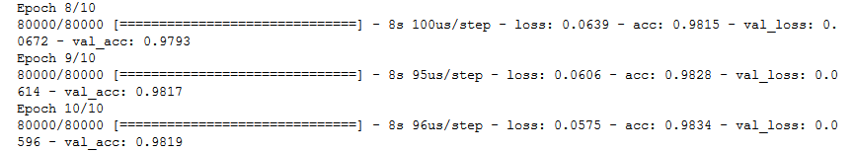
1)Logistic Regression with cross validation:
C =
2) Support Vector
Machine:
C =
Accuracy: 94.77%
3) Neural Networks:
Accuracy: > 98.3%

