Slide 1





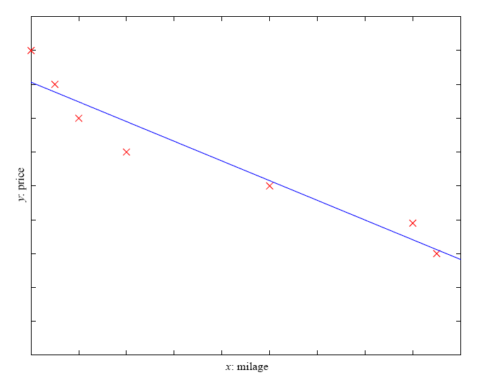
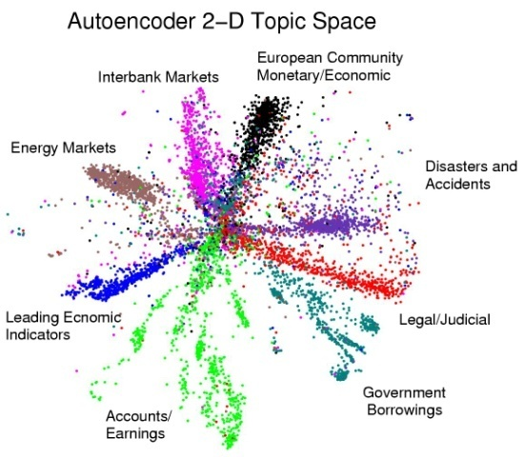
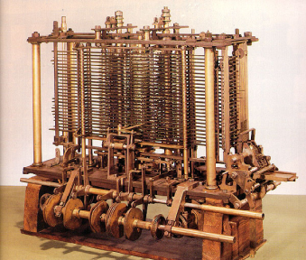
Machine Learning
CS 165B
Spring 2012

Slide 2
Course outline
Introduction (Ch. 1)
Concept learning (Ch. 2)
Decision trees (Ch. 3)
Ensemble learning
Neural Networks (Ch. 4)
Linear classifiers
Support Vector Machines
Bayesian Learning (Ch. 6)
Instance-based Learning (Ch. 8)
Clustering
Genetic Algorithms (Ch. 9)
Computational learning theory (Ch. 7)

Slide 3
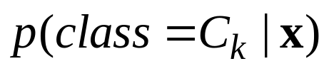
Three approaches to classification
Use Discriminant Functions directly without probabilities:
  Convert the input vector into one or more real values so that a simple operation (like threshholding) can be applied to get the class.
Infer conditional class probabilities:
  Compute the conditional probability of each class:
    Then make a decision that minimizes some loss function
    Discriminative Models.
Compare the probability of the input under separate, class-specific, Generative Models.
  E.g. fit a multivariate Gaussian to the input vectors of each class and see which Gaussian fits the test data vector best.

Slide 4
Bayesian Learning
Provides practical learning algorithms
  Assigns probabilities to hypotheses
    Typically learns most probable hypothesis
  Combine prior knowledge (prior probabilities)
  Competitive with ANNs/DTs
  Several classes of models, including:
    Naïve Bayes learning
    Bayesian belief network learning
Provides foundations for machine learning
  Evaluating/interpreting other learning algorithms
    E.g., Find-S, Candidate Elimination, ANNs, …
    Shows they output most probable hypotheses
  Guiding the design of new algorithms
Bayesian vs. Frequentist debate

Slide 5
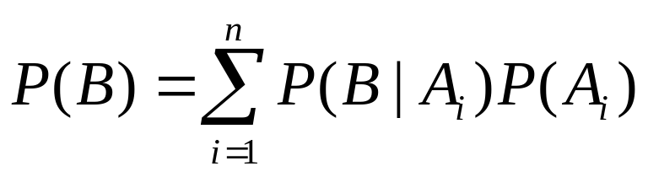
Basic formulas for probabilities
Product rule : probability P(A∧B) of a conjunction of two events A and B :
P(A∧B) = P(A|B)P(B) = P(B|A)P(A)
Sum rule: probability P(A∨B) of a disjunction of two events A and B:
P(A∨B) = P(A) + P(B) − P(A∧B)
Total probability : if events A₁, …, A_{n} are mutually exclusive with Σ_{1≤i ≤ n} P(A_{i}) = 1, then

Slide 6

Probability distributions
Bernoulli Distribution: Random Variable X takes values {0, 1}, s.t
P(X=1) = p = 1 – P(X=0)
Binomial Distribution: Random Variable X takes values {1, 2,…, n}, representing
the number of successes (X=1) in n Bernoulli trials.
P(X=k) = f(n, p, k) = C_{n}^{k} p^{k} (1-p)^{n-k}
Categorical Distribution: Random Variable X takes on values in {1,2,…k} s.t
P(X=i) = p_{i} and ∑₁^{k} p_{i} = 1
Multinomial Distribution: is to Categorical what Binomial is to Bernoulli
  Let the random variables X_{i} (i=1, 2,…, k) indicate the number of times
  outcome i was observed over the n trials.
  The vector X = (X₁, ..., X_{k}) follows a multinomial distribution with
  parameters n and p, where p = (p₁, ..., p_{k}) and ∑₁^{k} p_{i} = 1
  f(x₁,x₂,…x_{k},n,p) = P(X₁=x₁,…X_{k}=x_{k}) =

Slide 7
Basics of Bayesian Learning
P(h) - the prior probability of a hypothesis h
Reflects background knowledge; before data is observed. If no information - uniform distribution.
P(D) - The probability that this sample of the Data is observed. (No knowledge of the hypothesis)
P(D|h): The probability of observing the sample D, given hypothesis h
P(h|D): The posterior probability of h. The probability of h given that D has been observed.

Slide 8
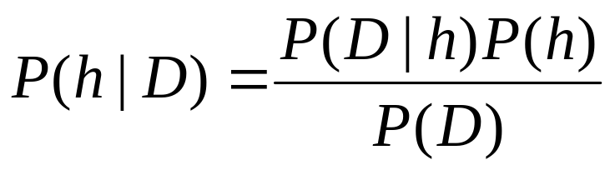
Bayes Theorem
P(h) = prior probability of hypothesis h
P(D) = prior probability of training data D
P(h|D) = (posterior) probability of h given D
P(D|h) = probability of D given h /*likelihood*/
Note proof of theorem:
from definition of conditional probabilities
e.g., P(h, D) = P(h|D) P(D)

Slide 9
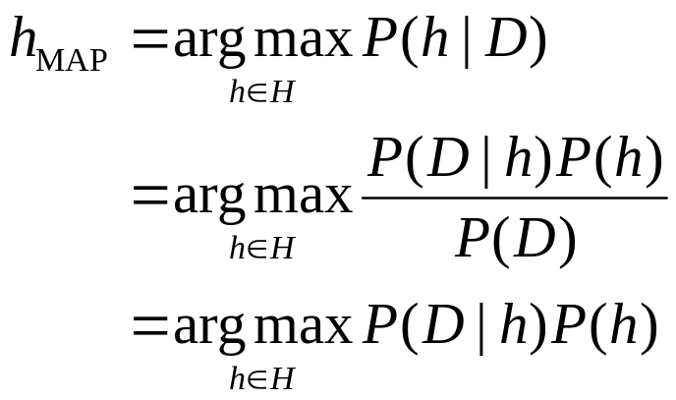
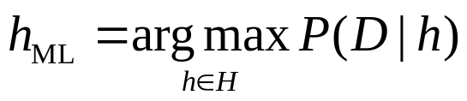
Choosing Hypotheses
The goal of Bayesian Learning: the most probable hypothesis given the training data
Maximum a Posteriori hypothesis h_{MAP}
If P(h_{i})=P(h_{j}), Maximum Likelihood (ML) hypothesis:

Slide 10
Maximum Likelihood Estimate
Assume that you toss a (p,1-p) coin m times and get k Heads, m-k Tails. What is p?
If p is the probability of Heads, the probability of the data observed is:
P(D|p) = p^{k} (1-p)^{m-k}
The log Likelihood:
L(p) = log P(D|p) = k log(p) + (m-k)log(1-p)
To maximize, set the derivative w.r.t. p equal to 0:
dL(p)/dp = k/p – (m-k)/(1-p)
Solving this for p, gives: p=k/m
The model we assumed is binomial. You could assume a different model!

Slide 11
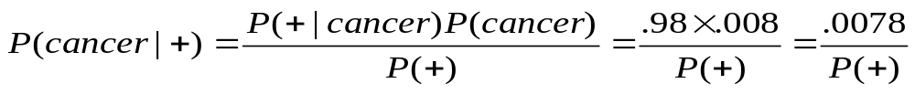
Example: Does patient have cancer or not?
A patient takes a lab test and the result comes back positive. The test returns a correct positive result in only 98% of the cases in which the disease is actually present, and a correct negative result in only 97% of the cases in which the disease is not present. Furthermore, .008 of the entire population have this cancer
P(cancer) = .008P(¬cancer) = .992
P(+|cancer) = .98 P(−|cancer) = .02
P(+|¬cancer) = .03P(−|¬cancer) = .97

Slide 12
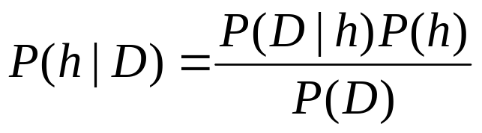
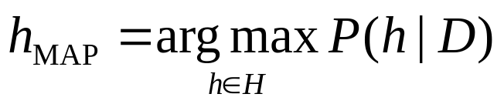
Brute Force MAP Hypothesis Learner
For each hypothesis h in H, calculate the posterior probability
Output the hypothesis h_{MAP} with the highest posterior probability
May require significant computation (large |H|)
Need to specify P(h), P(D|h) for all h

Slide 13
Coin toss example
A given coin is either fair or has a 60% bias in favor of Head.
Decide what is the bias of the coin [This is a learning problem!]
Two hypotheses: h₁: P(H)=0.5; h₂: P(H)=0.6
  Prior: P(h): P(h₁)=0.75 P(h₂ )=0.25
  Now we need Data. 1st Experiment: coin toss is H.
  P(D|h): P(D|h₁)=0.5 ; P(D|h₂) =0.6
  P(D): P(D)=P(D|h₁)P(h₁) + P(D|h₂)P(h₂ )
  = 0.5 • 0.75 + 0.6 • 0.25 = 0.525
  P(h|D):
  P(h₁|D) = P(D|h₁)P(h₁)/P(D) = 0.5•0.75/0.525 = 0.714
  P(h₂|D) = P(D|h₂)P(h₂)/P(D) = 0.6•0.25/0.525 = 0.286

Slide 14
Coin toss example
After 1st coin toss is H we still think that the coin is more likely to be fair
If we were to use Maximum Likelihood approach (i.e., assume equal priors) we would think otherwise. The data supports the biased coin better.
Try: 100 coin tosses; 70 heads.

Slide 15
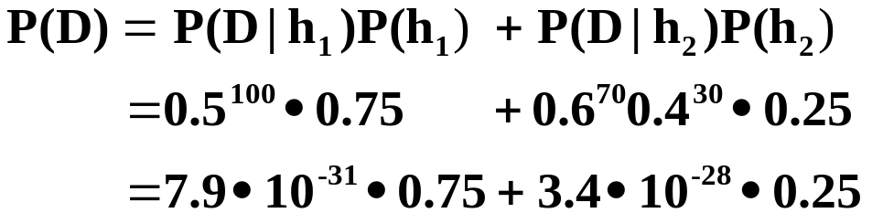
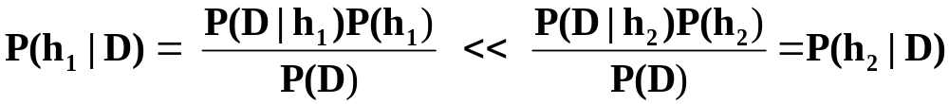
Coin toss example
Case of 100 coin tosses; 70 heads.
0.0057
0.9943

Slide 16
Example: Relation to Concept Learning
Consider the concept learning task
  instance space X, hypothesis space H, training examples D
  consider the Find-S learning algorithm (outputs most specific hypothesis from the version space VS_{H,D})
What would Bayes rule produce as the MAP hypothesis?
Does Find-S output a MAP hypothesis?

Slide 17
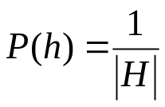
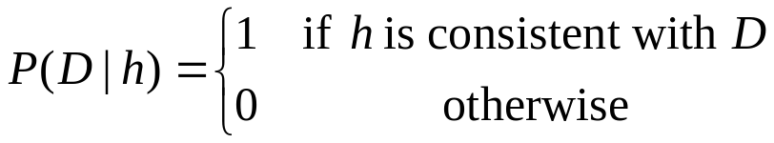
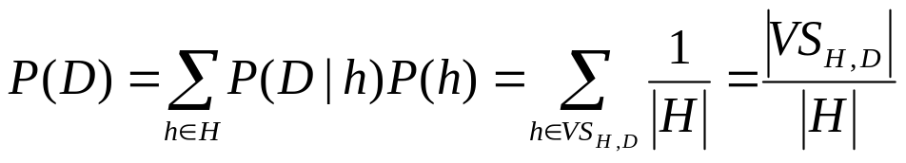
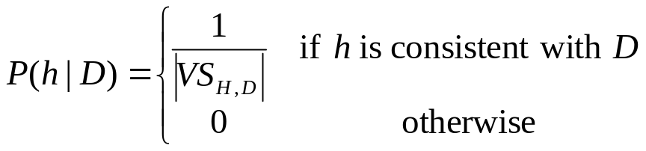
Relation to Concept Learning
Assume: given set of instances ⟨x₁,…, x_{m}⟩
D = ⟨c(x₁),…, c(x_{m})⟩ is the set of classifications
For all h in H, (uniform distribution)
Choose
Compute
Now
Every hypothesis consistent with D is a MAP hypothesis

Slide 18
Evolution of Posterior Probabilities
P(h)
P(h|D₁)
P(h|D₁∧D₂)
hypotheses
hypotheses
hypotheses
Characterization of concept learning:
use of prior instead of bias

Slide 19
(Bayesian) Learning a real-valued function
Continuous-valued target function
  Goal: learn h: X → R
  Bayesian justification for minimizing SSE
Assume
  Target function h(x) is corrupted by noise
    probability density functions model noise
    Normal iid errors (N(mean, sd))
      Observe di=h(xi) + ei, i=1,n
  All hypotheses equally likely (a priori)
Linear h
  A linear combination of basis functions

Slide 20
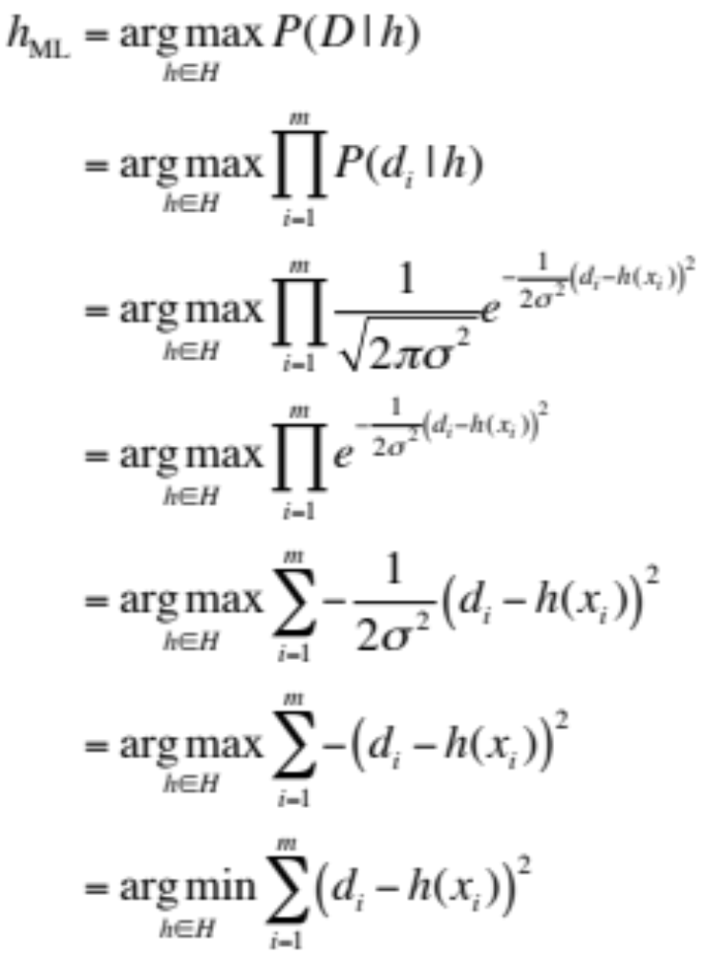
h_{ML} = Minimizing Squared Error

Slide 21
Learning to Predict Probabilities
Consider predicting survival probability from patient data
  Training examples ⟨x_{i}, d_{i}⟩ where d_{i} is either 1 or 0
  Want to learn a probabilistic function (like a coin) that for a given input outputs 0/1 with certain probabilities.
  Could train a NN/SVM to learn ratios.
Approach: train neural network to output a probability given x_{i}
Modified target function f’(x) = P( f (x) = 1)
Max likelihood hypothesis: hence need to find
P(D | h)
= Π_{i=1..m} P (x_{i} , d_{i} | h) (independence of each example)
= Π_{i=1..m} P (d_{i} | h , x_{i}) P(x_{i} | h) (conditional probabilities)
= Π_{i=1..m} P (d_{i} | h , x_{i}) P(x_{i}) (independence of h and x_{i})
Training examples for f
Learn f’ using ML

Slide 22
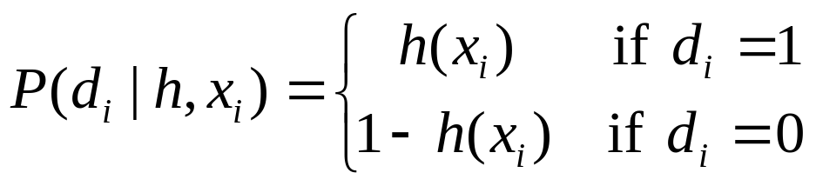
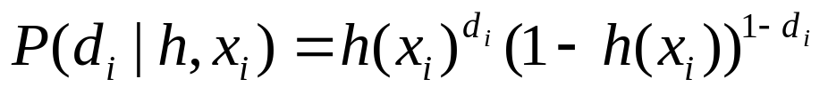
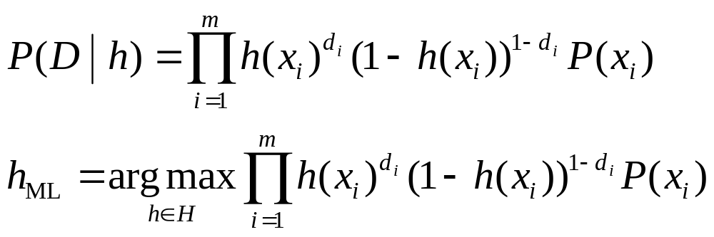
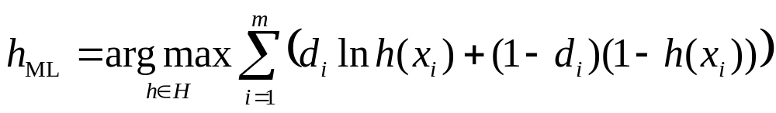
Maximum Likelihood Hypothesis
h would output h(x_{i}) for input xi. Prob that d_{i} is 1 = h(xi), and prob that d_{i} is 0 = 1-h(xi).
Cross entropy error

Slide 23
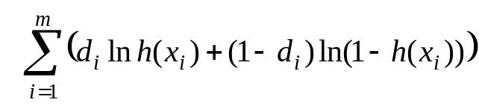
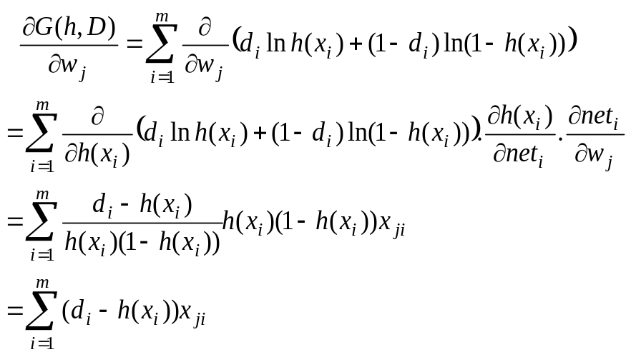
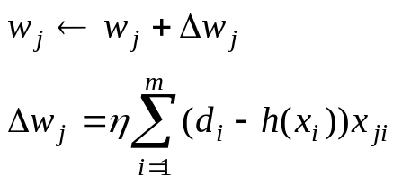
Weight update rule for ANN sigmoid unit
Go up gradient of likelihood function G(h,D) =
Weight update rule:
Same as minimizing sum of squared error for linear ANN units

Slide 24
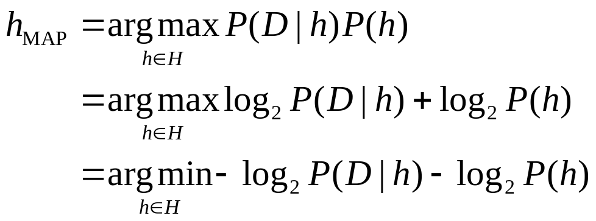
Information theoretic view of h_{MAP}
Information theory: the optimal (shortest expected coding length) code assigns −log₂p bits to an event with probability p
  Shorter codes for more probable messages
  Interpret −log₂P(h) as the length of h under optimal code for the hypothesis space
    Optimal description length of h given its probability
  Interpret −log₂P(D | h) as length of D given h under optimal code
    Assume both receiver/sender know h
  cost of encoding hypothesis + cost of encoding data given the hypothesis

Slide 25
Minimum Description Length Principle
Occam’s razor: prefer the shortest hypothesis
  Now have Bayesian interpretation
Let L_{C1}(h), L_{C2}(D | h) be optimal length descriptions of h and D|h in some encoding scheme C
  Intepretation: MAP hypothesis is one that minimizes
  L_{C1}(h) +L_{C2}(D | h)
  MDL: prefer the hypothesis h that minimizes
  h_{MDL} = argmin L_{C1}(h) + L_{C2}(D | h)
  ^{h ∈ H}
Example of decision trees
  L_{C1}(h) as related to depth of tree
  L_{C2}(D | h) as related to number of correct classifications for D
    Assume sender/receiver know sequence of x’s and knows h’s
    Receiver can compute if correct classification of each x from the h
    Hence only need to transmit misclassifications for receiver to know all
  prefer the hypothesis that minimizes
  length(h) + length(misclassifications)
Can use for pruning trees

Slide 26
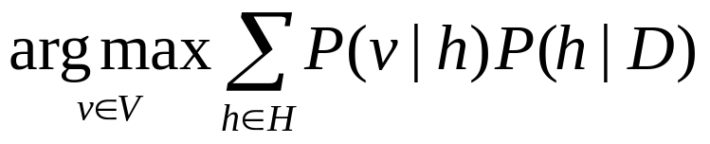
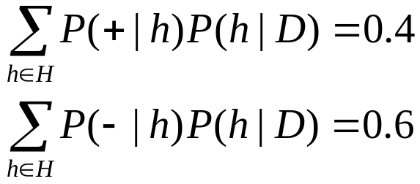
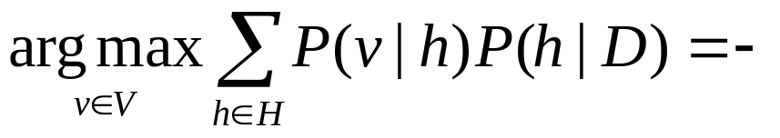
Bayes Optimal Classifier
Bayes optimal classification:
Example: H = {h₁, h₂, h₃}
  P(h₁ | D) = .4 P(− | h₁) = 0 P(+ | h₁) = 1
  P(h₂ | D) = .3 P(− | h₂) = 1 P(+ | h₂) = 0
  P(h₃ | D) = .3 P(− | h₃) = 1 P(+ | h₃) = 0

Slide 27
Simplest approximation: Gibbs Classifier
Bayes optimal classifier
  Maximizes prob that new example will be classified correctly, given, D, H, prior p’s
  provides best result, but can be expensive if too many hypotheses
Gibbs algorithm:
1. Randomly choose a hypothesis h, according to P(h|D)
2. Use h to classify new instance
Surprising fact: Assume target concepts are drawn at random from H according to priors on H. Then:
  E[error_{Gibbs}] ≤ 2E[error_{BayesOptimal}]
Suppose uniform prior distribution over H, then
  Pick any hypothesis from VS, with uniform probability
  Its expected error no worse than twice Bayes optimal

Slide 28
Simpler classification:Naïve Bayes
Along with decision trees, neural networks, nearest neighbor, one of the most practical learning methods
When to use
  Moderate or large training set available
  Attributes that describe instances are conditionally independent given classification
Successful applications:
  Diagnosis
  Classifying text documents

Slide 29
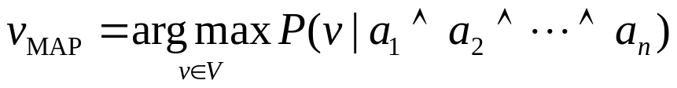
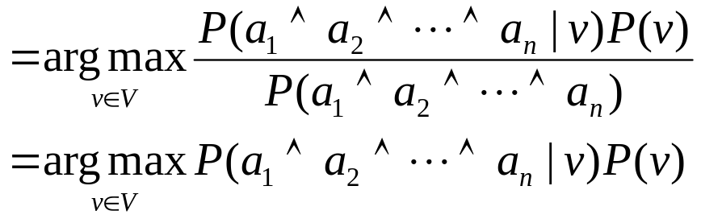
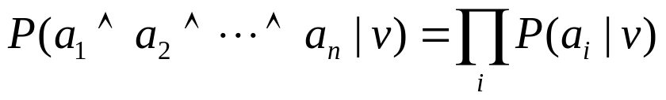
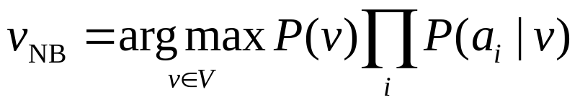
Naïve Bayes Classifier
Assume target function f : X → V
each instance x described by attributes ⟨a₁, …, a_{n}⟩
  In simplest case, V has two values (0,1)
Most probable value of f (x) is:
Naïve Bayes assumption:
Naïve Bayes classifier:

Slide 30

Example
Day | Outlook | Temp | Humidity | Wind | Tennis?
D₁ | Sunny | Hot | High | Weak | No
D₂ | Sunny | Hot | High | Strong | No
D₃ | Overcast | Hot | High | Weak | Yes
D₄ | Rain | Mild | High | Weak | Yes
D₅ | Rain | Cool | Normal | Weak | Yes
D₆ | Rain | Cool | Normal | Strong | No
D₇ | Overcast | Cool | Normal | Strong | Yes
D₈ | Sunny | Mild | High | Weak | No
D₉ | Sunny | Cool | Normal | Weak | Yes
D₁₀ | Rain | Mild | Normal | Weak | Yes
D₁₁ | Sunny | Mild | Normal | Strong | Yes
D₁₂ | Overcast | Mild | High | Strong | Yes
D₁₃ | Overcast | Hot | Normal | Weak | Yes
D₁₄ | Rain | Mild | High | Strong | No
Consider PlayTennis again
P (yes) = 9/14,
P (no) = 5/14
P(Sunny|yes) = 2/9
P(Sunny|no) = 3/5
Classify:
(sun, cool, high, strong)
P(y)P(sunny|y)P(cool|y)P(high|y)P(strong|y) = 0.005
P(n)P(sunny|n)P(cool|n)P(high|n)P(strong|n) = 0.021

Slide 31
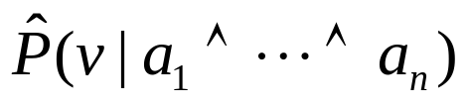
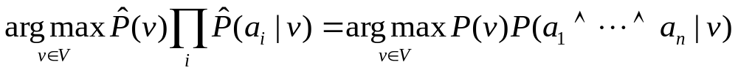
Conditional Independence
Conditional independence assumption
is often violated
but it works surprisingly well anyway
Don’t need estimated posteriors
to be correct; need only that

Slide 32
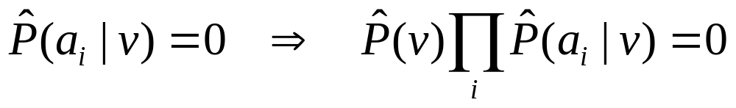
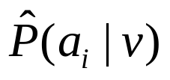
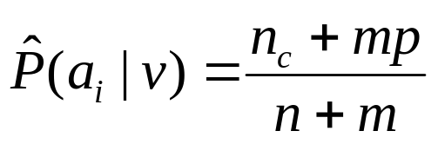
Estimating Probabilities
If none of the training instances with target value v
have attribute value a_{i} ?
Typical solution: Bayesian estimate for
  n: number of training examples with result v
  n_{c}: number of examples with result v and a_{i}
  p: prior estimate for
    Uniform priors (e.g., uniform over attribute values)
  m: weight given to prior (equivalent sample size)

Slide 33
Classify Text
Why?
  Learn which news articles are of interest
  Learn to classify web pages by topic
  Junk mail filtering
Naïve Bayes is among the most effective algorithms
What attributes shall we use to represent text documents?

Slide 34
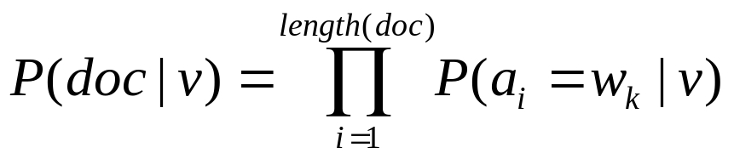
Learning to Classify Text
Target concept Interesting? : Document → {+, −}
Represent each document by vector of words
  one attribute per word position in document
Learning: Use training examples to estimate
  P (+) and P (−)
  P (doc|+) and P (doc|−)
Naïve Bayes conditional independence assumption
  P(a_{i} = w_{k}|v): probability of i ^{th} word being w_{k}, given v

Slide 35
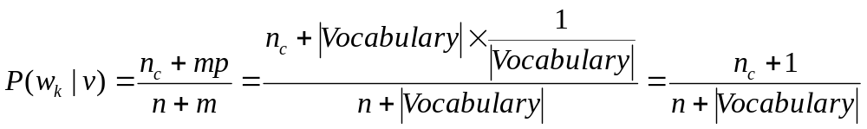
Position Independence Assumption
P (a_{i} = w_{k}|v) is hard to compute(#w=50K,#v=2,L=111)
Add one more assumption:
  ∀i ∀m P (a_{i} = w_{k}|v) = P (a_{m} = w_{k}|v)
Need to compute only P (w_{k} | v)
  2 × 50,000 terms
Estimate for P (w_{k}|v):

Slide 36
LEARN_Naïve_Bayes_Text (Examples, V)
collect all words and other tokens that occur in Examples
  Vocabulary ← all distinct words and other tokens in Examples
calculate probability terms P (v) and P (w_{k} | v)
  For each target value v in V do
  docs_{v} ← subset of Examples for which the target value is v
  P(v) ← |docs_{v}| / |Examples|
  Text_{v} ← a single document created by concatenating all members of docs_{v}
  n ← total number of words in Text_{v} (duplicates counted)
  for each word w_{k} in Vocabulary
    n_{k} ← number of times word w_{k} occurs in Text_{v}
    P (w_{k}|v) ← (n_{k} + 1) / (n +|Vocabulary|)

Slide 37
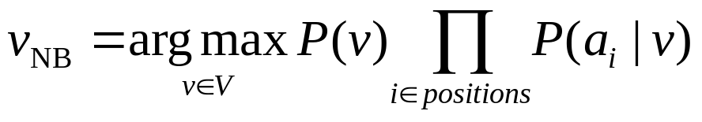
CLASSIFY_Naïve_Bayes_Text (Doc)
positions ← all word positions in Doc that contain tokens found in Vocabulary
Return

Slide 38
Example: 20 Newsgroups
Given 1000 training documents from each group
Learn to classify new documents to a newsgroup
  comp.graphics, comp.os.ms-windows.misc, comp.sys.ibm.pc.hardware, comp.sys.mac.hardware, comp.windows.x
  misc.forsale, rec.autos, rec.motorcycles, rec.sport.baseball, rec.sport.hockey
  alt.atheism, talk.religion.misc, talk.politics.mideast, talk.politics.misc, talk.politics.guns
  soc.religion.christian, sci.space sci.crypt, sci.electronics, sci.med
Naive Bayes: 89% classification accuracy

Slide 39
Conditional Independence
X is conditionally independent of Y given Z if the probability distribution governing X is independent of the value of Y given the value of Z
∀x_{i}∀y_{j}∀z_{k} P(X = x_{i}|Y = y_{j} ∧ Z = z_{k}) = P(X = x_{i}|Z = z_{k})
 [or P(X|Y,Z) = P(X|Z)]
Example: P(Thunder|Rain, Lightning) = P(Thunder|Lightning)
Can generalize to X₁…X_{n}, Y₁…Y_{m}, Z₁…Z_{k}
Extreme case:
  Naive Bayes assumes full conditional independence:
P(X₁,…,X_{n}|Z) = P(X₁,…,X_{n−1}|X_{n},Z)P(X_{n}|Z)
= P(X₁,…,X_{n−1}|Z)P(X_{n}|Z) = …
= Π_{i} P(X_{i}|Z)

Slide 40
Symmetry of conditional independence
  Assume X is conditionally independent of Z given Y
    P(X|Y,Z) = P(X|Y)
  Now,
    P(Z|X,Y) = P(X|Y,Z) P(Z|Y) / P(X|Y)
  Therefore,
    P(Z|X,Y) = P(Z|Y)
  Or, Z is conditionally independent of X given Y

Slide 41
Bayesian Belief Networks
Problems with above methods:
  Bayes Optimal Classifier expensive computationally
  Naive Bayes assumption of conditional independence too restrictive
For tractability/reliability, need other assumptions
  Model of world intermediate between
    Full conditional probabilities
    Full conditional independence
Bayesian Belief networks describe conditional independence among subsets of variables
  Assume only proper subsets are conditionally independent
  Combines prior knowledge about dependencies among variables with observed training data

Slide 42
Bayesian Belief Networks (a.k.a. Bayesian Networks)
a.k.a. Probabilistic networks, Belief nets, Bayes nets, etc.
Belief network
  A data structure (depicted as a graph) that represents the dependence among variables and allows us to concisely specify the joint probability distribution
A belief network is a directed acyclic graph where:
  The nodes represent the set of random variables (one node per random variable)
  Arcs between nodes represent influence, or dependence
    A link from node X to node Y means that X “directly influences” Y
  Each node has a conditional probability table (CPT) that defines
  P(node | parents)
Judea Pearl, Turing Award winner 2012

Slide 43
Bayesian Belief Network
Network represents conditional independence assertions:
  Each node conditionally independent of its non-descendants (what is descendent?), given its immediate predecessors (represented by arcs)
Storm
BusTourGroup
Campfire
 | S∧B | S∧¬B | ¬S∧B | ¬S∧¬B
C | 0.4 | 0.1 | 0.8 | 0.2
¬C | 0.6 | 0.9 | 0.2 | 0.8
Lightning
Campfire
Thunder
ForestFire

Slide 44
Example
X
Random variables X and Y
  X: It is raining
  Y: The grass is wet
X affects Y
Or, Y is a symptom of X
Draw two nodes and link them
P(X)
Y
P(Y|X)
Define the CPT for each node
  P(X) and P(Y | X)
Typical use: we observe Y and we want to query P(X | Y)
  Y is an evidence variable
  X is a query variable

Slide 45
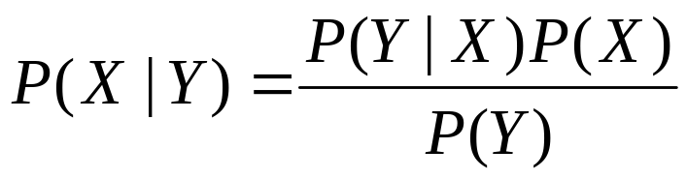
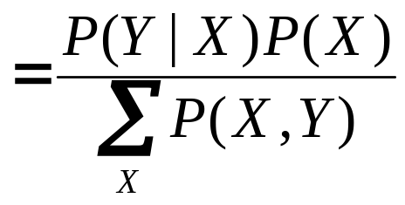
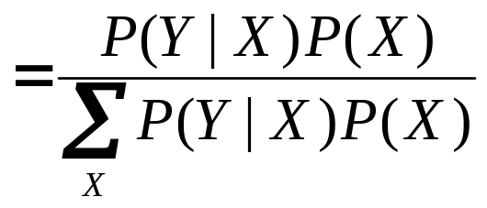
Try it…
What is P(X | Y)?
  Given that we know the CPTs of each node in the graph
X
P(X)
Y
P(Y|X)
Example
Notes:
P(X=1) = 0.7, P(Y = 1 | X = 0) = 0.8, P(Y =1 | X =1) = 0.6. P(X = 1|Y = 1)= ?

Slide 46
Belief nets represent joint probability
The joint probability function can be calculated directly from the network
  It is the product of the CPTs of all the nodes
  P(var₁, …, var_{N}) = Π_{i} P(var_{i}|Parents(var_{i}))
X
X
Y
P(X)
P(X)
P(Y)
Y
Z
P(Y|X)
P(Z|X,Y)
P(X,Y) = P(X) P(Y|X)
P(X,Y,Z) = P(X) P(Y) P(Z|X,Y)
Derivation
General case

Slide 47
Example
I’m at work and my neighbor John calls to say my home alarm is ringing, but my neighbor Mary doesn’t call. The alarm is sometimes triggered by minor earthquakes. Was there a burglar at my house?
Random (boolean) variables:
  JohnCalls, MaryCalls, Earthquake, Burglar, Alarm
The belief net shows the influence links
This defines the joint probability
  P(JohnCalls, MaryCalls, Earthquake, Burglar, Alarm)
What do we want to know?
P(B | J, ¬M)
Why not P(B | J, A, ¬M) ?

Slide 48
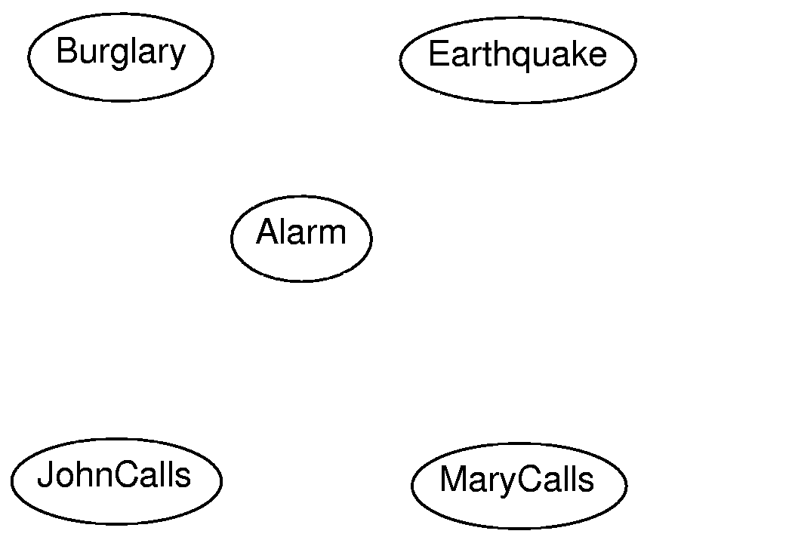
Example
Links and CPTs?

Slide 49
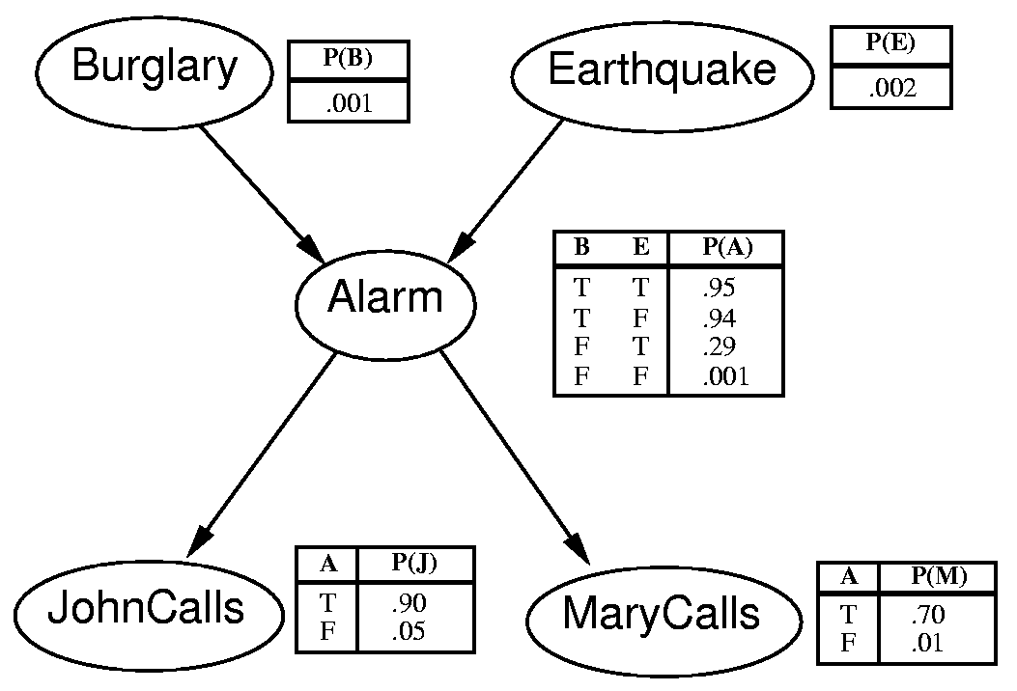
Example
Joint probability? P(J, ¬M, A, B, ¬E)?

Slide 50
Calculate P(J, ¬M, A, B, ¬E)
P(J, ¬M, A, B, ¬E) = P(B) P(¬E) P(A|B,¬E) P(J|A) P(¬M|A)
= 0.001 * 0.998 * 0.94 * 0.9 * 0.3
= 0.0002532924
How about P(B | J, ¬M) ?
Remember, this means P(B=true | J=true, M=false)

Slide 51
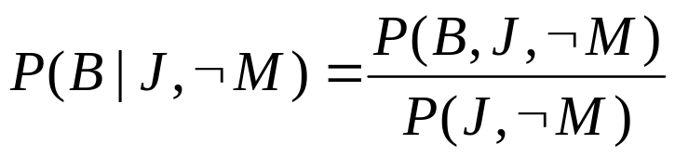
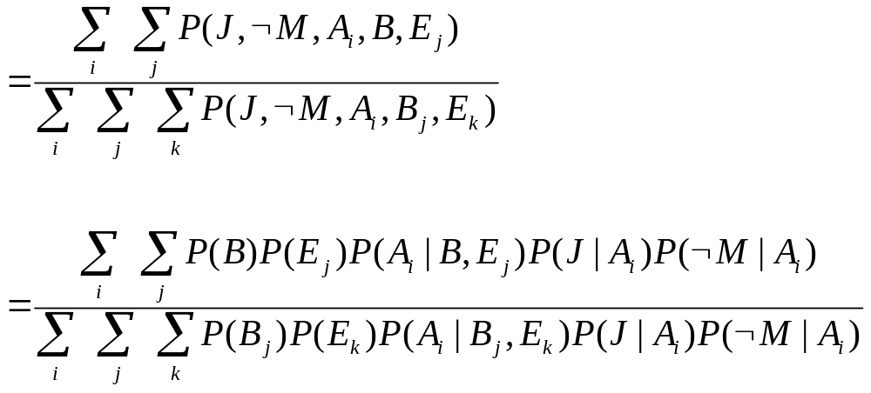
Calculate P(B | J, ¬M)
By marginalization:

Slide 52
Example
Conditional independence is seen here
  P(JohnCalls | MaryCalls, Alarm, Earthquake, Burglary) = P(JohnCalls | Alarm)
  So JohnCalls is independent of MaryCalls, Earthquake, and Burglary, given Alarm
Does this mean that an earthquake or a burglary do not influence whether or not John calls?
  No, but the influence is already accounted for in the Alarm variable
  JohnCalls is conditionally independent of Earthquake, but not absolutely independent of it

Slide 53
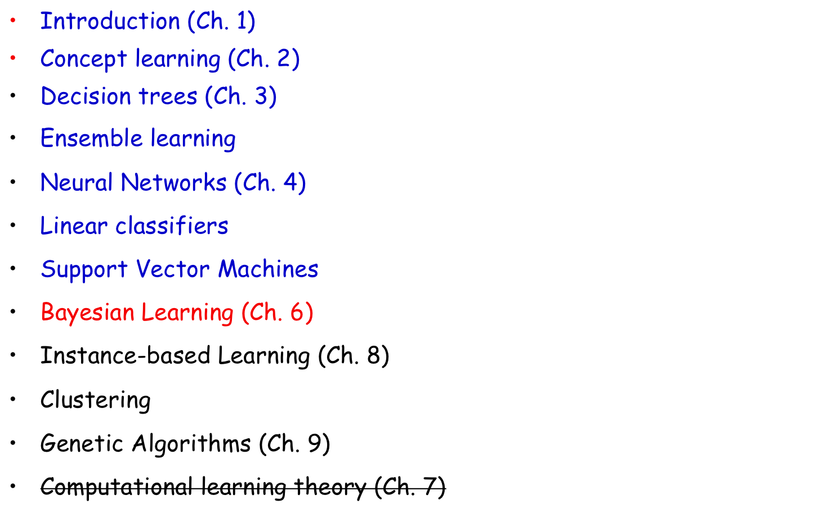
Course outline

Slide 54
Class feedback
Difficult concepts
  PCA
  Fischer’s Linear Discriminant
  Backpropagation
  Logistic regression
  SVM?
  Bayesian learning?

Slide 55
Class feedback
Pace
  Slightly fast
  Slow down on difficult parts
Difficulty of homework
  Slightly hard
Difficulty of project
  Need more structure
Other feedback
  More depth?

Slide 56
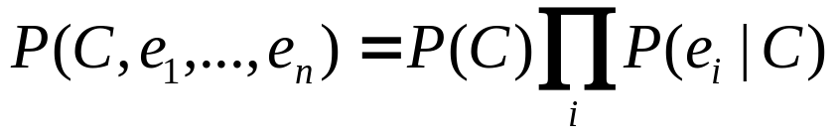
Naive Bayes model
A common situation is when a single cause directly influences several variables, which are all conditionally independent, given the cause.
P(C, e₁, e₂, e₃) = P(C) P(e₁ | C) P(e₂ | C) P(e₃ | C)
C
Rain
In general,
e₁
e₂
e₃
Wet grass
People with umbrellas
Car accidents

Slide 57


Naive Bayes model
Typical query for naive Bayes:
  Given some evidence, what’s the probability of the cause?
  P(C | e₁) = ?
  P(C | e₁, e₃) = ?
C
Rain
e₁
e₂
e₃
Wet grass
People with umbrellas
Car accidents

Slide 58
Drawing belief nets
What would a belief net look like if all the variables were fully dependent?
X₁
X₂
X₃
X₄
X₅
P(X₁,X₂,X₃,X₄,X₅) = P(X₁)P(X₂|X₁)P(X₃|X₁,X₂)P(X₄|X₁,X₂,X₃)P(X₅|X₁,X₂,X₃,X₄)
But this isn’t the only way to draw the belief net when all the variables are fully dependent

Slide 59
Fully connected belief net
In fact, there are N! ways of connecting up a fully-connected belief net
  That is, there are N! ways of ordering the nodes
A way to represent joint probability
Does not really capture causality!
For N=2
X₁
X₂
X₁
X₂
P(X₁,X₂) = ?
For N=5
X₁
X₂
X₃
X₄
X₅
P(X₁,X₂,X₃,X₄,X₅) = ?
and 119 others…

Slide 60
Drawing belief nets (cont.)
Fully-connected net displays the joint distribution
P(X₁, X₂, X₃, X₄, X₅) = P(X₁) P(X₂|X₁) P(X₃|X₁,X₂) P(X₄|X₁,X₂,X₃) P(X₅|X₁, X₂, X₃, X₄)
X₁
X₂
X₃
X₄
X₅
But what if there are conditionally independent variables?
P(X₁, X₂, X₃, X₄, X₅) = P(X₁) P(X₂|X₁) P(X₃|X₁,X₂) P(X₄|X₂,X₃) P(X₅|X₃, X₄)
X₁
X₂
X₃
X₄
X₅

Slide 61
Drawing belief nets (cont.)
What if the variables are all independent?
P(X₁, X₂, X₃, X₄, X₅) = P(X₁) P(X₂) P(X₃) P(X₄) P(X₅)
X₁
X₂
X₃
X₄
X₅
What if the links are drawn like this:
X₁
X₂
X₃
X₄
X₅
Not allowed – not a DAG

Slide 62
Drawing belief nets (cont.)
What if the links are drawn like this:
X₁
X₂
X₃
X₄
X₅
P(X₁, X₂, X₃, X₄, X₅) = P(X₁) P(X₂ | X₃) P(X₃ | X₁) P(X₄ | X₂) P(X₅ | X₄)
It can be redrawn like this:
X₁
X₃
X₂
X₄
X₅
All arrows going left-to-right

Slide 63
Belief nets
General assumptions
  A DAG is a reasonable representation of the influences among the variables
    Leaves of the DAG have no direct influence on other variables
  Conditional independences cause the graph to be much less than fully connected (the system is sparse)

Slide 64
What are belief nets used for?
Given the structure, we can now pose queries:
  Typically: P(Cause | Symptoms)
  P(X₁ | X₄, X₅)
  P(Earthquake | JohnCalls)
  P(Burglary | JohnCalls, ¬MaryCalls)
Query variable
Evidence variables

Slide 65
X
Rained
P(X)
Raining
X
P(X)
Y
Wet grass
P(Y|X)
Wet grass
Y
P(Y|X)
Worm
sighting
Z
ASK P(X|Y)
P(Z|Y)
ASK P(X|Z)

Slide 66
How to construct a belief net
Choose the random variables that describe the domain
  These will be the nodes of the graph
Choose a left-to-right ordering of the variables that indicates a general order of influence
  “Root causes” to the left, symptoms to the right
X₁
X₂
X₃
X₄
X₅
Causes
Symptoms

Slide 67
How to construct a belief net (cont.)
Draw arcs from left to right to indicate “direct influence” among variables
  May have to reorder some nodes
X₁
X₂
X₃
X₄
X₅
Define the conditional probability table (CPT) for each node
  P(node | parents)
  P(X₁)
  P(X₂)
  P(X₃ | X₁,X₂)
  P(X₄ | X₂,X₃)
  P(X₅ | X₄)

Slide 68
Example: Flu and measles
Flu
Measles
P(Flu)
P(Measles)
Fever
Spots
P(Spots | Measles)
P(Fever | Flu, Measles)
To create the belief net:
Choose variables (evidence and query)
Choose an ordering and create links (direct influences)
Fill in probabilities (CPTs)

Slide 69
Example: Flu and measles
F
M
P(F)
P(M)
V
S
P(V | F, M)
P(S | M)
CPTs:
P(F) = 0.01
P(M) = 0.001
P(S| M) = [0, 0.9]
P(V| F, M) = [0.01, 0.8, 0.9, 1.0]
Compute P(F | V) and P(F | V, S).
Are they equivalent?
How about P(V | M) and P(V | M, S)?

Slide 70
Independence
Variables X and Y are independent if and only if
  P(X, Y) = P(X) P(Y)
  P(X | Y) = P(X)
  P(Y | X) = P(Y)
We can determine independence of variables in a belief net directly from the graph
  Variables X and Y are independent if they share no common ancestry
    I.e., the set of { X, parents of X, grandparents of X, … } has a null intersection with the set of {Y, parents of Y, grandparents of Y, … }
X, Y dependent
X
Y

Slide 71
Conditional Independence
X and Y are (conditionally) independent given E iff
  P(X | Y, E) = P(X | E)
  P(Y | X, E) = P(Y | E)
{X₁,…,X_{n}} and {Y₁,…,Y_{m}} are conditionally independent given {E₁,…,E_{k}} iff
  P(X₁,…,X_{n} | Y₁, …, Y_{m}, E₁, …,E_{k}) = P(X₁,…,X_{n} | E₁, …,E_{k})
  P(Y₁, …, Y_{m} | X₁,…,X_{n}, E₁, …,E_{k}) = P(Y₁, …, Y_{m} | E₁, …,E_{k})
We can determine conditional independence of variables (and sets of variables) in a belief net directly from the graph
Independence is the same as conditional independence given empty E

Slide 72

Conditional independence and d-separation
Two sets of nodes, X and Y, are conditionally independent given evidence nodes, E, if every undirected path from a node in X to a node in Y is blocked by E. Also called d-separation.
A path is blocked given E if there is a node Z on the path for which one of the following holds:
Cases 1 and 2:
variable Z is in E
Case 3:
variable Z or
its descendants
is not in E

Slide 73
Path Blockage
Three cases:
  Common cause
Blocked
Blocked
Unblocked
Active
E
E
X
Y
X
Y

Slide 74
Path Blockage
Three cases:
  Common cause
  Intermediate cause
Blocked
Blocked
Unblocked
Active
X
X
E
E
Y
Y

Slide 75
Path Blockage
Three cases:
  Common cause
  Intermediate cause
  Common Effect
Blocked
Blocked
Unblocked
Active
X
Y
X
Y
A
A
C
X
Y
C
A
C

Slide 76

Examples
R
G
W
P(W | R, G) = P(W | G)
Rain
Wet
Grass
Worms
T
F
C
P(T | C, F) = P(T | F)
Tired
Flu
Cough
W
M
I
P(W | I, M) ≠ P(W | M)
Work
Money
Inherit
P(W | I) = P(W)
Notes:
Also, the computational proofs

Slide 77
Examples
X
Z
Y
X ind. of Y? X ind. of Y given Z?
Yes
Yes
X
Z
Y
X ind. of Y? X ind. of Y given Z?
No
Yes
X
Z
Y
X ind. of Y? X ind. of Y given Z?
No
Yes
X
Z
Y
X ind. of Y? X ind. of Y given Z?
Yes
No
X
Y
X ind. of Y? X ind. of Y given Z?
Z
No
No
Notes:
Also, the computational proofs

Slide 78
Examples (cont.)
Z
X – wet grass
Y – rainbow
Z – rain
P(X, Y) ≠ P(X) P(Y)
P(X | Y, Z) = P(X | Z)
X
Y
X
Y
X – rain
Y – sprinkler
Z – wet grass
W – worms
P(X, Y) = P(X) P(Y)
P(X | Y, Z) ≠ P(X | Z)
P(X | Y, W) ≠ P(X | W)
Z
W
Notes:
Also, the computational proofs

Slide 79
Examples
Are X and Y independent?
Are X and Y conditionally independent given Z?
X
Y
X
Y
Z
W
Z
W
X – rain
Y – sprinkler
Z – rainbow
W – wet grass
X – rain
Y – sprinkler
Z – rainbow
W – wet grass
P(X,Y) = P(X) P(Y) Yes
P(X | Y, Z) = P(X | Z) Yes
P(X,Y) = P(X) P(Y) No
P(X | Y, Z) = P(X | Z) No
Notes:
Also, the computational proofs

Slide 80

Conditional Independence
What are the conditional independences here?
Radio and Ignition, given Battery?
Yes
Radio and Starts, given Ignition?
Yes
Gas and Radio, given Battery?
Yes
Gas and Radio, given Starts?
No
Gas and Battery, given Moves?
No
Notes:
Also, the computational proofs

Slide 81
Conditional Independence
What are the conditional independences here?
A
B
C
D
E
A and E, given null?
Yes
A and E, given D?
No
A and E, given C,D?
Yes
Notes:
Also, the computational proofs

Slide 82
Theorems
A node is conditionally independent of its non-descendants given its parents.
A node is conditionally independent of all other nodes given its Markov blanket (its parents, its descendants, and other parents of its children).

Slide 83
Why does conditional independence matter?
Helps the developer (or the user) verify the graph structure
  Are these things really independent?
  Do I need more/fewer arcs?
Gives hints about computational efficiencies
Shows that you understand BNs…
Try this applet: http://www.phil.cmu.edu/~wimberly/dsep/dSep.html

Slide 84
Case Study
Pathfinder system. (Heckerman 1991, Probabilistic Similarity Networks, MIT Press, Cambridge MA).
Diagnostic system for lymph-node diseases.
  60 diseases and 100 symptoms and test-results.
  14,000 probabilities
  Expert consulted to make net.
  8 hours to determine variables.
  35 hours for net topology.
  40 hours for probability table values.
Apparently, the experts found it quite easy to invent the links and probabilities.
Pathfinder is now outperforming world experts.

Slide 85
Inference in Bayesian Networks
How can one infer (probabilities of) values of one/more network variables, given observed values of others?
  Bayes net contains all information needed for this
  Easy if only one variable with unknown value
  In general case, problem is NP hard
    Need to compute sums of probs over unknown values
In practice, can succeed in many cases
  Exact inference methods work well for some network structures (polytrees)
  Variable elimination methods reduce the amount of repeated computation
  Monte Carlo methods “simulate” the network randomly to calculate approximate solutions

Slide 86
Learning Bayesian Networks
Object of current research
Several variants of this learning task
  Network structure might be known or unknown
    Structure incorporates prior beliefs
  Training examples might provide values of all network variables, or just some
If structure known and can observe all variables
  Then it’s easy as training a Naïve Bayes classifier
  Compute relative frequencies from observations

Slide 87
Learning Bayes Nets
Suppose structure known, variables partially observable
  e.g., observe ForestFire, Storm, BusTourGroup, Thunder, but not Lightning, Campfire...
Analogous to learning weights for hidden units of ANN
  Assume know input/output node values
  Do not know values of hidden units
In fact, can learn network conditional probability tables using gradient ascent
  Search through hypothesis space corresponding to set of all possible entries for conditional probability tables
  Maximize P(D|h) (ML hypoth for table entries)
  Converge to network h that (locally) maximizes P(D|h)

Slide 88
Gradient for Bayes Net
Let w_{ijk} denote one entry in the conditional probability table for variable Y_{i} in the network
w_{ijk} = P(Y_{i} = y_{ij}|Parents(Y_{i}) = the list u_{ik} of parents values)
  e.g., if Y_{i} = Campfire, then u_{ik} could be
  ⟨Storm = T, BusTourGroup = F⟩
Perform gradient ascent repeatedly by:
  update w_{ijk} using training data D
    Using gradient ascent up lnP(D|h) in w-space using w_{ijk} update rule with small step
    Need to calculate sum over training examples of
    P(Y_{i}=y_{ij}, U_{i}=u_{ik}|d)/w_{ijk}
      Calculate these from network
      If unobservable for a given d, use inference
  Renormalize w_{ijk} by summing to 1 and normalizing to between [0,1]

Slide 89


Gradient for Bayes Net
Let w_{ijk} denote one entry in the conditional probability table for variable Y_{i} in the network
w_{ijk} = P(Y_{i} = y_{ij}|Parents(Y_{i}) = the list u_{ik} of values)

Slide 90


Gradient Ascent for Bayes Net
w_{ijk} = P(Y_{i} = y_{ij}|Parents(Y_{i}) = the list u_{ik} of values)
Perform gradient ascent by repeatedly
  1. update all w_{ijk} using training data D
  2. then, renormalize the w_{ijk} to enssure
  Σ_{j} w_{ijk} = 1
  0 ≤ w_{ijk} ≤ 1

Slide 91

Course outline

