Slide 1
An Overview of
Learning Bayes Nets From Data
Chris Meek
Microsoft Research
http://research.microsoft.com/~meek
Notes:
Possible addition: exchangeability

Slide 2
What’s and Why’s
What is a Bayesian network?
Why Bayesian networks are useful?
Why learn a Bayesian network?

Slide 3
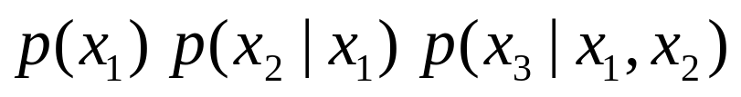
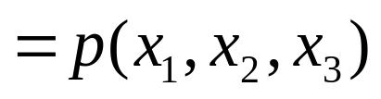
What is a Bayesian Network?
also called belief networks, and (directed acyclic) graphical models
Directed acyclic graph
  Nodes are variables (discrete or continuous)
  Arcs indicate dependence between variables.
Conditional Probabilities (local distributions)
Missing arcs implies conditional independence
Independencies + local distributions => modular specification of a joint distribution
X₁
X₂
X₃
Notes:
Refer to nodes and variables interchangably
The DAG structure encodes those independencies
that permits the factorization:
Namely, for any total ordering of the variables
consistent with the DAG:
Equivalently, each variable is independent of its
non-descendants given its parents
(Howard & Matheson 1981).

Slide 4
Why Bayesian Networks?
Expressive language
  Finite mixture models, Factor analysis, HMM, Kalman filter,…
Intuitive language
  Can utilize causal knowledge in constructing models
  Domain experts comfortable building a network
General purpose “inference” algorithms
  P(Bad Battery | Has Gas, Won’t Start)
  Exact: Modular specification leads to large computational efficiencies
  Approximate: “Loopy” belief propagation
Battery
Gas
Start
Notes:
Explaining away phenomenon
Can represent repeated structure (plates)

Slide 5
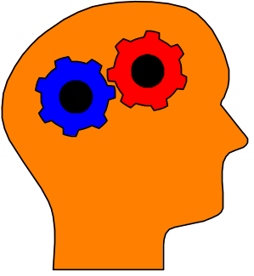
Why Learning?
knowledge-based
(expert systems)
Answer Wizard, Office 95, 97, & 2000
Troubleshooters, Windows 98 & 2000
Causal discovery
Data visualization
Concise model of data
Prediction
data-based
Notes:
Lots of data; rapidly adapting systems (e.g., collaborative filtering)

Slide 6
Overview
Learning Probabilities (local distributions)
  Introduction to Bayesian statistics: Learning a probability
  Learning probabilities in a Bayes net
  Applications
Learning Bayes-net structure
  Bayesian model selection/averaging
  Applications

Slide 7
Learning Probabilities: Classical Approach
Simple case: Flipping a thumbtack
heads
tails
True probability θ is unknown
Given iid data, estimate θ using an estimator with
good properties: low bias, low variance, consistent
(e.g., ML estimate)

Slide 8
Learning Probabilities: Bayesian Approach
heads
tails
True probability θ is unknown
Bayesian probability density for θ
p(θ)
0
1
θ
Notes:
Explicitly represents uncertainty over parameters…allows one to add more data at any time and other sorts of data and maintain the uncertainty.

Slide 9
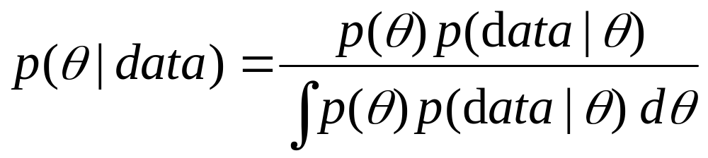
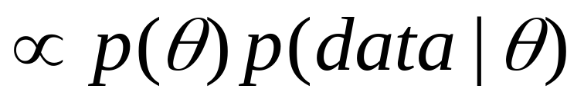
Bayesian Approach: use Bayes' rule to compute a new density for θ given data
prior
likelihood
posterior
Notes:
Likelihood → binary then one uses binomial
Mention conjugate priors → make computing posterior easy
Interpretation and assessment of prior probabilities.
Using distribuiton over theta for prediction…take expectation…if flat prior then one gets similar results as a Maximum likelihood approach.

Slide 10
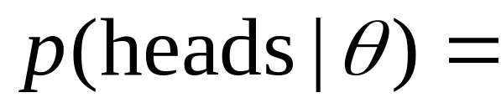

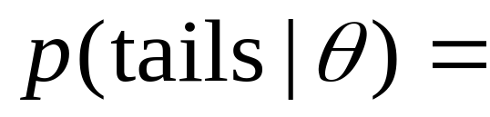
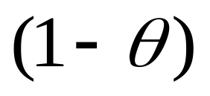
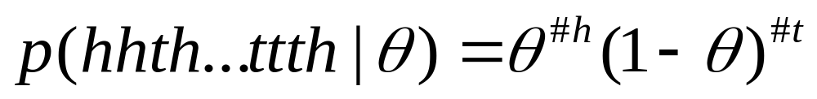
The Likelihood
“binomial distribution”

Slide 11


Example: Application of Bayes rule to the observation of a single "heads"
p(θ)
p(heads|θ)= θ
p(θ|heads)
0
1
θ
0
1
θ
0
1
θ
prior
likelihood
posterior

Slide 12
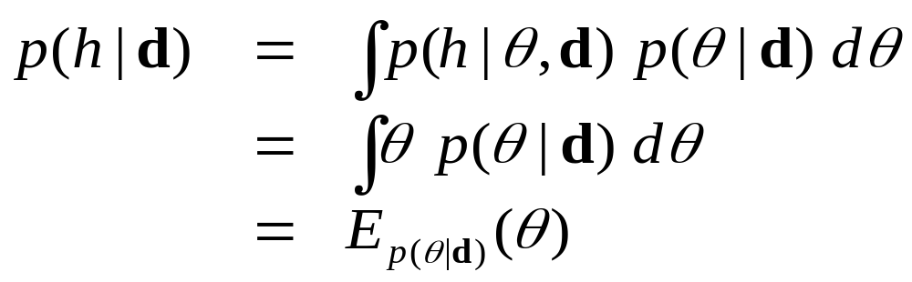
The probability of heads on the next toss
Note: This yields nearly identical answers to ML estimates
when one uses a “flat” prior

Slide 13
Overview
Learning Probabilities
  Introduction to Bayesian statistics: Learning a probability
  Learning probabilities in a Bayes net
  Applications
Learning Bayes-net structure
  Bayesian model selection/averaging
  Applications

Slide 14
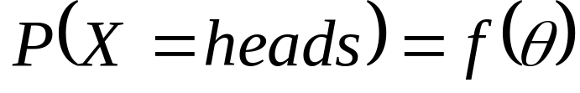
From thumbtacks to Bayes nets
Thumbtack problem can be viewed as learning
the probability for a very simple BN:
X
heads/tails
Θ
Θ
X₁
X₂
...
X_{N}
X_{i}
i=1 to N
toss 1
toss 2
toss N

Slide 15
The next simplest Bayes net
X
Y
heads/tails
heads/tails
heads
tails
“heads”
“tails”

Slide 16
The next simplest Bayes net
X
Y
heads/tails
heads/tails
?
Θ_{X}
Θ_{Y}
X_{i}
Y_{i}
i=1 to N

Slide 17
The next simplest Bayes net
X
Y
heads/tails
heads/tails
"parameter
independence"
Θ_{X}
Θ_{Y}
X_{i}
Y_{i}
i=1 to N

Slide 18
The next simplest Bayes net
X
Y
heads/tails
heads/tails
"parameter
independence"
Θ_{X}
Θ_{Y}
⇓
two separate
thumbtack-like
learning problems
X_{i}
Y_{i}
i=1 to N

Slide 19
A bit more difficult...
X
Y
heads/tails
heads/tails
Three probabilities to learn:
θ_{X=heads}
θ_{Y=heads|X=heads}
θ_{Y=heads|X=tails}

Slide 20
A bit more difficult...
X
Y
heads/tails
heads/tails
?
?
Θ_{X}
Θ_{Y|X=heads}
Θ_{Y|X=tails}
?
X₁
Y₁
case 1
X₂
Y₂
case 2

Slide 21
A bit more difficult...
X
Y
heads/tails
heads/tails
Θ_{X}
Θ_{Y|X=heads}
Θ_{Y|X=tails}
X₁
Y₁
case 1
X₂
Y₂
case 2

Slide 22
A bit more difficult...
X
Y
heads/tails
heads/tails
Θ_{X}
Θ_{Y|X=heads}
Θ_{Y|X=tails}
X₁
heads
Y₁
case 1
X₂
tails
Y₂
case 2
3 separate thumbtack-like problems

Slide 23
In general…
Learning probabilities in a BN is straightforward if
Likelihoods from the exponential family (multinomial, poisson, gamma, ...)
Parameter independence
Conjugate priors
Complete data

Slide 24
Incomplete data makes parameters dependent
X
Y
heads/tails
heads/tails
Θ_{X}
Θ_{Y|X=heads}
Θ_{Y|X=tails}
X₁
Y₁

Slide 25
Incomplete data
Incomplete data makes parameters dependent
Parameter Learning for incomplete data
Monte-Carlo integration
  Investigate properties of the posterior and perform prediction
Large-sample Approx. (Laplace/Gaussian approx.)
  Expectation-maximization (EM) algorithm and inference to compute mean and variance.
Variational methods

Slide 26
Overview
Learning Probabilities
  Introduction to Bayesian statistics: Learning a probability
  Learning probabilities in a Bayes net
  Applications
Learning Bayes-net structure
  Bayesian model selection/averaging
  Applications

Slide 27
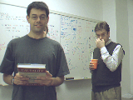
Example: Audio-video fusion
Beal, Attias, & Jojic 2002
Video scenario
Audio scenario
camera
mic.1
mic.2
l_{y}
∝τ
l_{x}
source at l_{x}
Goal: detect and track speaker
Slide courtesy Beal, Attias and Jojic

Slide 28
Separate audio-video models
Frame n=1,…,N
audio data
video data
Slide courtesy Beal, Attias and Jojic
Notes:
X: audio fft
T: time delay (phase in fft domain)
All mixtures of Gaussians

Slide 29
Combined model
α
Frame n=1,…,N
audio data
video data
Slide courtesy Beal, Attias and Jojic
Notes:
X: audio fft;
Variational used to select discrete shift for fft calculation given tau.
T: time delay (phase in fft domain)
All mixtures of Gaussians
ML solution using variational
15 frames per sec; 10 sec; 60x80 video; 512 freq bands

Slide 30
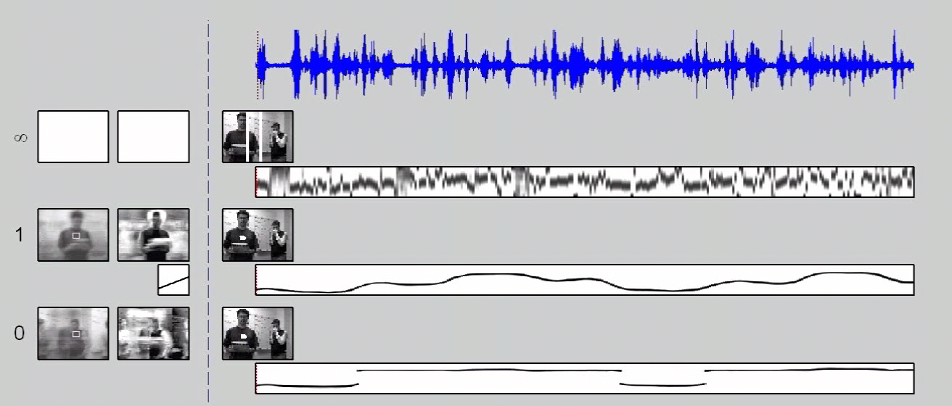
Tracking Demo
Slide courtesy Beal, Attias and Jojic
Notes:
We trained on every other frame and tested on all frames. (What we should be doing instead is sequential processing).
You're right about identifiability -- object position is identifiable up to an additive constant, which is fixed by hand.

Slide 31
Overview
Learning Probabilities
  Introduction to Bayesian statistics: Learning a probability
  Learning probabilities in a Bayes net
  Applications
Learning Bayes-net structure
  Bayesian model selection/averaging
  Applications

Slide 32
Two Types of Methods for Learning BNs
Constraint based
  Finds a Bayesian network structure whose implied independence constraints “match” those found in the data.
Scoring methods (Bayesian, MDL, MML)
  Find the Bayesian network structure that can represent distributions that “match” the data (i.e. could have generated the data).

Slide 33
Learning Bayes-net structure
Given data, which model is correct?
model 1:
X
Y
model 2:
X
Y

Slide 34




Bayesian approach
Given data, which model is correct? more likely?
model 1:
X
Y
Data d
model 2:
X
Y

Slide 35
Bayesian approach: Model Averaging
Given data, which model is correct? more likely?
model 1:
X
Y
Data d
model 2:
X
Y
average
predictions

Slide 36
Bayesian approach: Model Selection
Given data, which model is correct? more likely?
model 1:
X
Y
Data d
model 2:
X
Y
Keep the best model:
- Explanation
- Understanding
- Tractability

Slide 37
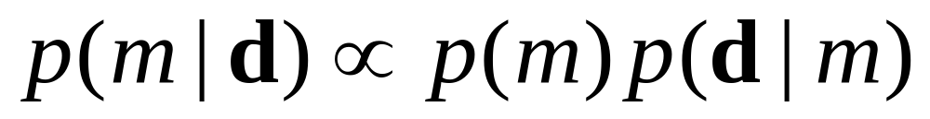
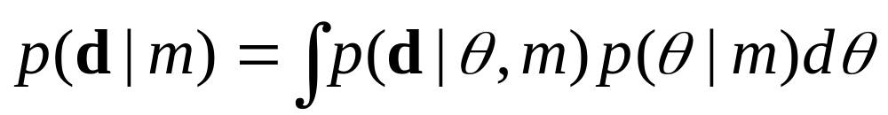
To score a model, use Bayes rule
Given data d:
model
score
"marginal
likelihood"
likelihood

Slide 38
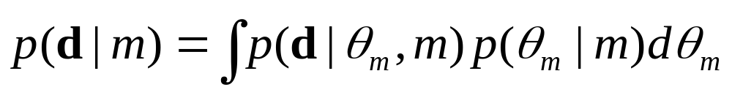
The Bayesian approach and Occam’s Razor
True distribution
Simple model
Just right
p(θ_{m}|m)
Complicated model
All distributions

Slide 39
Computation of Marginal Likelihood
Efficient closed form if
Likelihoods from the exponential family (binomial, poisson, gamma, ...)
Parameter independence
Conjugate priors
No missing data, including no hidden variables
Else use approximations
Monte-Carlo integration
Large-sample approximations
Variational methods

Slide 40
Practical considerations
The number of possible BN structures is super exponential in the number of variables.
How do we find the best graph(s)?

Slide 41
Model search
Finding the BN structure with the highest score among those structures with at most k parents is NP hard for k>1 (Chickering, 1995)
Heuristic methods
  Greedy
  Greedy with restarts
  MCMC methods
initialize
structure
score
all possible
single changes
perform
best
change
any
changes
better?
yes
no
return
saved structure

Slide 42
Learning the correct model
True graph G and P is the generative distribution
Markov Assumption: P satisfies the independencies implied by G
Faithfulness Assumption: P satisfies only the independencies implied by G
Theorem: Under Markov and Faithfulness, with enough data generated from P one can recover G (up to equivalence). Even with the greedy method!

Slide 43
Learning Bayes Nets From Data
Bayes net(s)
data
X₁
true
false
false
true
X₂
1
5
3
2
X₃
Red
Blue
Green
Red
X₁
X₂
Bayes-net
learner
...
X₃
X₄
X₅
.
.
.
X₆
.
.
.
X₇
+
prior/expert information
X₈
X₉

Slide 44
Overview
Learning Probabilities
  Introduction to Bayesian statistics: Learning a probability
  Learning probabilities in a Bayes net
  Applications
Learning Bayes-net structure
  Bayesian model selection/averaging
  Applications

Slide 45
Preference Prediction
(a.k.a. Collaborative Filtering)
Example: Predict what products a user will likely purchase given items in their shopping basket
Basic idea: use other people’s preferences to help predict a new user’s preferences.
Numerous applications
  Tell people about books or web-pages of interest
  Movies
  TV shows

Slide 46
Example: TV viewing
Nielsen data: 2/6/95-2/19/95
Show1 Show2 Show3
viewer 1 y n n
viewer 2 n y y ...
viewer 3 n n n
etc.
~200 shows, ~3000 viewers
Goal: For each viewer, recommend shows they haven’t watched that they are likely to watch

Slide 47
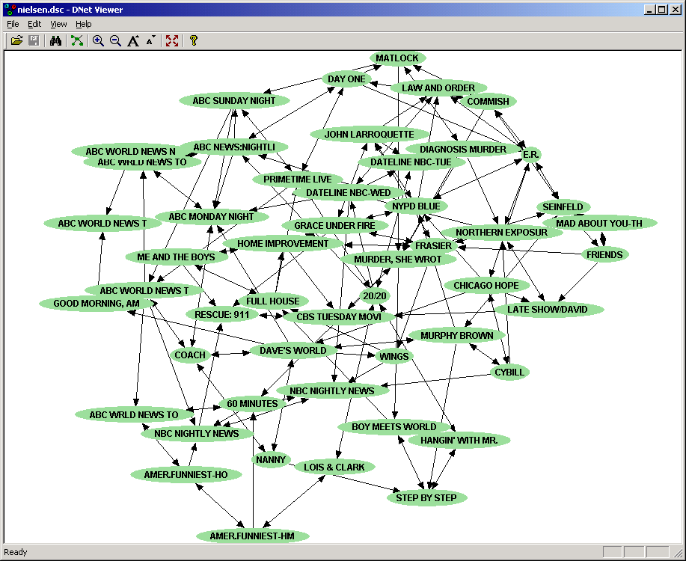

Slide 48
Making predictions
watched
watched
didn't watch
Models Inc
Law & order
Beverly hills 90210
watched
didn't watch
watched
Frasier
Mad about you
Melrose place
didn't watch
didn't watch
watched
NBC Monday
night movies
Seinfeld
Friends
infer: p (watched 90210 | everything else we know about the user)

Slide 49
Making predictions
watched
watched
Law & order
Models Inc
Beverly hills 90210
watched
didn't watch
watched
Frasier
Mad about you
Melrose place
didn't watch
didn't watch
watched
NBC Monday
night movies
Seinfeld
Friends
infer: p (watched 90210 | everything else we know about the user)

Slide 50
Making predictions
watched
watched
didn't watch
Models Inc
Law & order
Beverly hills 90210
watched
watched
Frasier
Mad about you
Melrose place
didn't watch
didn't watch
watched
NBC Monday
night movies
Seinfeld
Friends
infer p (watched Melrose place | everything else we know about the user)

Slide 51
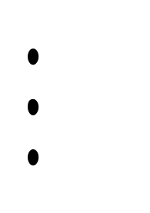
Recommendation list
p=.67 Seinfeld
p=.51 NBC Monday night movies
p=.17 Beverly hills 90210
p=.06 Melrose place

Slide 52
Software Packages
BUGS: http://www.mrc-bsu.cam.ac.uk/bugs
  parameter learning, hierarchical models, MCMC
Hugin: http://www.hugin.dk
  Inference and model construction
xBaies: http://www.city.ac.uk/~rgc
  chain graphs, discrete only
Bayesian Knowledge Discoverer: http://kmi.open.ac.uk/projects/bkd
  commercial
MIM: http://inet.uni-c.dk/~edwards/miminfo.html
BAYDA: http://www.cs.Helsinki.FI/research/cosco
  classification
BN Power Constructor: BN PowerConstructor
Microsoft Research: WinMine http://research.microsoft.com/~dmax/WinMine/Tooldoc.htm

Slide 53
For more information…
Tutorials:
K. Murphy (2001) http://www.cs.berkeley.edu/~murphyk/Bayes/bayes.html
W. Buntine. Operations for learning with graphical models. Journal of Artificial Intelligence Research, 2, 159-225 (1994).
D. Heckerman (1999). A tutorial on learning with Bayesian networks. In Learning in Graphical Models (Ed. M. Jordan). MIT Press.
Books:
R. Cowell, A. P. Dawid, S. Lauritzen, and D. Spiegelhalter. Probabilistic Networks and Expert Systems. Springer-Verlag. 1999.
M. I. Jordan (ed, 1988). Learning in Graphical Models. MIT Press.
S. Lauritzen (1996). Graphical Models. Claredon Press.
J. Pearl (2000). Causality: Models, Reasoning, and Inference. Cambridge University Press.
P. Spirtes, C. Glymour, and R. Scheines (2001). Causation, Prediction, and Search, Second Edition. MIT Press.

