Slide 1

Bayesian Networks: A Tutorial
Weng-Keen Wong
School of Electrical Engineering and Computer Science
Oregon State University

Slide 2

Introduction
Suppose you are trying to determine if a patient has inhalational anthrax. You observe the following symptoms:
The patient has a cough
The patient has a fever
The patient has difficulty breathing

Slide 3
Introduction
You would like to determine how likely the patient is infected with inhalational anthrax given that the patient has a cough, a fever, and difficulty breathing
We are not 100% certain that the patient has anthrax because of these symptoms. We are dealing with uncertainty!

Slide 4

Introduction
Now suppose you order an x-ray and observe that the patient has a wide mediastinum.
Your belief that that the patient is infected with inhalational anthrax is now much higher.

Slide 5
Introduction
In the previous slides, what you observed affected your belief that the patient is infected with anthrax
This is called reasoning with uncertainty
Wouldn’t it be nice if we had some methodology for reasoning with uncertainty? Why in fact, we do…

Slide 6
Bayesian Networks
HasAnthrax
HasCough
HasFever
HasDifficultyBreathing
HasWideMediastinum
In the opinion of many AI researchers, Bayesian networks are the most significant contribution in AI in the last 10 years
They are used in many applications eg. spam filtering, speech recognition, robotics, diagnostic systems and even syndromic surveillance

Slide 7
Outline
Introduction
Probability Primer
Bayesian networks
Bayesian networks in syndromic surveillance

Slide 8

Probability Primer: Random Variables
A random variable is the basic element of probability
Refers to an event and there is some degree of uncertainty as to the outcome of the event
For example, the random variable A could be the event of getting a heads on a coin flip

Slide 9
Boolean Random Variables
We will start with the simplest type of random variables – Boolean ones
Take the values true or false
Think of the event as occurring or not occurring
Examples (Let A be a Boolean random variable):
  A = Getting heads on a coin flip
  A = It will rain today
  A = The Cubs win the World Series in 2007

Slide 10
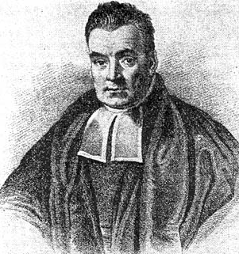
Probabilities
We will write P(A = true) to mean the probability that A = true.
What is probability? It is the relative frequency with which an outcome would be obtained if the process were repeated a large number of times under similar conditions*
The sum of the red and blue areas is 1
P(A = true)
*Ahem…there’s also the Bayesian definition which says probability is your degree of belief in an outcome
P(A = false)

Slide 11
Conditional Probability
P(A = true | B = true) = Out of all the outcomes in which B is true, how many also have A equal to true
Read this as: “Probability of A conditioned on B” or “Probability of A given B”
H = “Have a headache”
F = “Coming down with Flu”
P(H = true) = 1/10
P(F = true) = 1/40
P(H = true | F = true) = 1/2
“Headaches are rare and flu is rarer, but if you’re coming down with flu there’s a 50-50 chance you’ll have a headache.”
P(F = true)
P(H = true)

Slide 12
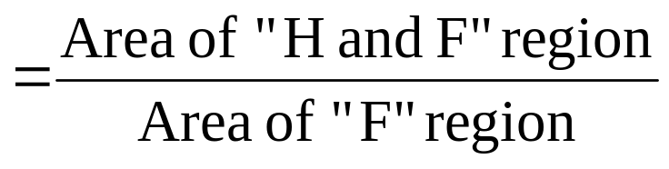
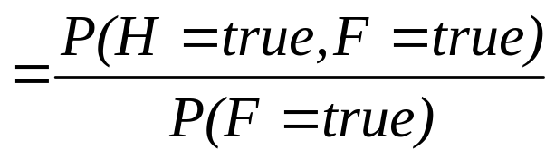
The Joint Probability Distribution
We will write P(A = true, B = true) to mean “the probability of A = true and B = true”
Notice that:
P(H=true|F=true)
P(F = true)
P(H = true)
In general, P(X|Y)=P(X,Y)/P(Y)

Slide 13
The Joint Probability Distribution
Joint probabilities can be between any number of variables
eg. P(A = true, B = true, C = true)
For each combination of variables, we need to say how probable that combination is
The probabilities of these combinations need to sum to 1
A | B | C | P(A,B,C)
false | false | false | 0.1
false | false | true | 0.2
false | true | false | 0.05
false | true | true | 0.05
true | false | false | 0.3
true | false | true | 0.1
true | true | false | 0.05
true | true | true | 0.15
Sums to 1

Slide 14
The Joint Probability Distribution
A | B | C | P(A,B,C)
false | false | false | 0.1
false | false | true | 0.2
false | true | false | 0.05
false | true | true | 0.05
true | false | false | 0.3
true | false | true | 0.1
true | true | false | 0.05
true | true | true | 0.15
Once you have the joint probability distribution, you can calculate any probability involving A, B, and C
Note: May need to use marginalization and Bayes rule, (both of which are not discussed in these slides)
Examples of things you can compute:
P(A=true) = sum of P(A,B,C) in rows with A=true
P(A=true, B = true | C=true) =
P(A = true, B = true, C = true) / P(C = true)

Slide 15
The Problem with the Joint Distribution
Lots of entries in the table to fill up!
For k Boolean random variables, you need a table of size 2^{k}
How do we use fewer numbers? Need the concept of independence
A | B | C | P(A,B,C)
false | false | false | 0.1
false | false | true | 0.2
false | true | false | 0.05
false | true | true | 0.05
true | false | false | 0.3
true | false | true | 0.1
true | true | false | 0.05
true | true | true | 0.15

Slide 16
Independence
Variables A and B are independent if any of the following hold:
P(A,B) = P(A) P(B)
P(A | B) = P(A)
P(B | A) = P(B)
This says that knowing the outcome of A does not tell me anything new about the outcome of B.

Slide 17
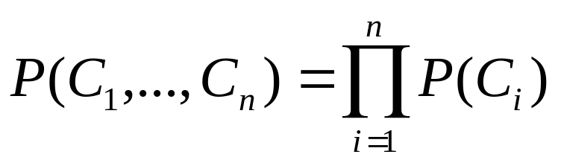
Independence
How is independence useful?
Suppose you have n coin flips and you want to calculate the joint distribution P(C₁, …, C_{n})
If the coin flips are not independent, you need 2^{n} values in the table
If the coin flips are independent, then
Each P(C_{i}) table has 2 entries and there are n of them for a total of 2n values

Slide 18
Conditional Independence
Variables A and B are conditionally independent given C if any of the following hold:
P(A, B | C) = P(A | C) P(B | C)
P(A | B, C) = P(A | C)
P(B | A, C) = P(B | C)
Knowing C tells me everything about B. I don’t gain anything by knowing A (either because A doesn’t influence B or because knowing C provides all the information knowing A would give)

Slide 19
Outline
Introduction
Probability Primer
Bayesian networks
Bayesian networks in syndromic surveillance

Slide 20
A Bayesian Network
A Bayesian network is made up of:
1. A Directed Acyclic Graph
A
B
C
D
2. A set of tables for each node in the graph
A | P(A)
false | 0.6
true | 0.4
A | B | P(B|A)
false | false | 0.01
false | true | 0.99
true | false | 0.7
true | true | 0.3
B | D | P(D|B)
false | false | 0.02
false | true | 0.98
true | false | 0.05
true | true | 0.95
B | C | P(C|B)
false | false | 0.4
false | true | 0.6
true | false | 0.9
true | true | 0.1

Slide 21
A Directed Acyclic Graph
Each node in the graph is a random variable
A node X is a parent of another node Y if there is an arrow from node X to node Y eg. A is a parent of B
A
B
C
D
Informally, an arrow from node X to node Y means X has a direct influence on Y

Slide 22
A Set of Tables for Each Node
A | P(A)
false | 0.6
true | 0.4
A | B | P(B|A)
false | false | 0.01
false | true | 0.99
true | false | 0.7
true | true | 0.3
Each node X_{i} has a conditional probability distribution P(X_{i} | Parents(X_{i})) that quantifies the effect of the parents on the node
The parameters are the probabilities in these conditional probability tables (CPTs)
B | C | P(C|B)
false | false | 0.4
false | true | 0.6
true | false | 0.9
true | true | 0.1
A
B
B | D | P(D|B)
false | false | 0.02
false | true | 0.98
true | false | 0.05
true | true | 0.95
C
D

Slide 23
A Set of Tables for Each Node
Conditional Probability Distribution for C given B
B | C | P(C|B)
false | false | 0.4
false | true | 0.6
true | false | 0.9
true | true | 0.1
For a given combination of values of the parents (B in this example), the entries for P(C=true | B) and P(C=false | B) must add up to 1
eg. P(C=true | B=false) + P(C=false |B=false )=1
If you have a Boolean variable with k Boolean parents, this table has 2^{k+1} probabilities (but only 2^{k} need to be stored)

Slide 24
Bayesian Networks
Two important properties:
Encodes the conditional independence relationships between the variables in the graph structure
Is a compact representation of the joint probability distribution over the variables

Slide 25
Conditional Independence
The Markov condition: given its parents (P₁, P₂),
a node (X) is conditionally independent of its non-descendants (ND₁, ND₂)
P₁
P₂
ND₁
X
ND₂
C₁
C₂

Slide 26
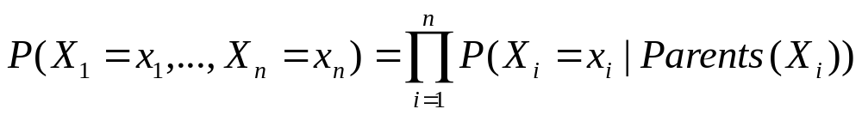
The Joint Probability Distribution
Due to the Markov condition, we can compute the joint probability distribution over all the variables X₁, …, X_{n} in the Bayesian net using the formula:
Where Parents(X_{i}) means the values of the Parents of the node X_{i} with respect to the graph

Slide 27
Using a Bayesian Network Example
Using the network in the example, suppose you want to calculate:
P(A = true, B = true, C = true, D = true)
= P(A = true) * P(B = true | A = true) *
P(C = true | B = true) P( D = true | B = true)
= (0.4)*(0.3)*(0.1)*(0.95)
A
B
C
D

Slide 28
Using a Bayesian Network Example
Using the network in the example, suppose you want to calculate:
P(A = true, B = true, C = true, D = true)
= P(A = true) * P(B = true | A = true) *
P(C = true | B = true) P( D = true | B = true)
= (0.4)*(0.3)*(0.1)*(0.95)
This is from the graph structure
A
B
These numbers are from the conditional probability tables
C
D

Slide 29
Inference
Using a Bayesian network to compute probabilities is called inference
In general, inference involves queries of the form:
P( X | E )
E = The evidence variable(s)
X = The query variable(s)

Slide 30
Inference
HasAnthrax
HasCough
HasFever
HasDifficultyBreathing
HasWideMediastinum
An example of a query would be:
P( HasAnthrax = true | HasFever = true, HasCough = true)
Note: Even though HasDifficultyBreathing and HasWideMediastinum are in the Bayesian network, they are not given values in the query (ie. they do not appear either as query variables or evidence variables)
They are treated as unobserved variables

Slide 31
The Bad News
Exact inference is feasible in small to medium-sized networks
Exact inference in large networks takes a very long time
We resort to approximate inference techniques which are much faster and give pretty good results

Slide 32
One last unresolved issue…
We still haven’t said where we get the Bayesian network from. There are two options:
Get an expert to design it
Learn it from data

Slide 33
Outline
Introduction
Probability Primer
Bayesian networks
Bayesian networks in syndromic surveillance

Slide 34
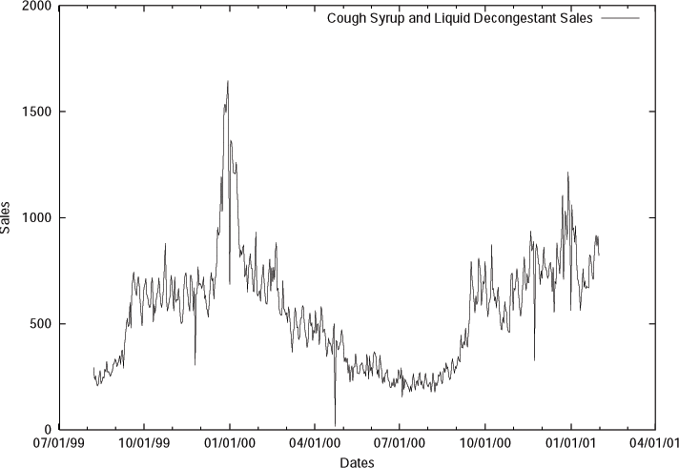
Bayesian Networks in Syndromic Surveillance
From: Goldenberg, A., Shmueli, G., Caruana, R. A., and Fienberg, S. E. (2002). Early statistical detection of anthrax outbreaks by tracking over-the-counter medication sales. Proceedings of the National Academy of Sciences (pp. 5237-5249)
Syndromic surveillance systems traditionally monitor univariate time series
With Bayesian networks, it allows us to model multivariate data and monitor it

Slide 35
What’s Strange About Recent Events (WSARE) Algorithm
Bayesian networks used to model the multivariate baseline distribution for ED data
Date | Time | Gender | Age | Home Location | Many more…
6/1/03 | 9:12 | M | 20s | NE | …
6/1/03 | 10:45 | F | 40s | NE | …
6/1/03 | 11:03 | F | 60s | NE | …
6/1/03 | 11:07 | M | 60s | E | …
6/1/03 | 12:15 | M | 60s | E | …
: | : | : | : | : | :

Slide 36
Population-wide ANomaly Detection and Assessment (PANDA)
A detector specifically for a large-scale outdoor release of inhalational anthrax
Uses a massive causal Bayesian network
Population-wide approach: each person in the population is represented as a subnetwork in the overall model

Slide 37
Population-Wide Approach
Anthrax Release
Global nodes
Location of Release
Time of Release
Interface nodes
Each person in the population
Person Model
Person Model
Person Model
Note the conditional independence assumptions
Anthrax is infectious but non-contagious

Slide 38
Population-Wide Approach
Anthrax Release
Global nodes
Location of Release
Time of Release
Interface nodes
Each person in the population
Person Model
Person Model
Person Model
Structure designed by expert judgment
Parameters obtained from census data, training data, and expert assessments informed by literature and experience

Slide 39
Person Model (Initial Prototype)
Anthrax Release
Time Of Release
Location of Release
…
…
Gender
Age Decile
Age Decile
Gender
Home Zip
Home Zip
Anthrax Infection
Other ED
Disease
Anthrax Infection
Other ED
Disease
Respiratory
from Anthrax
Respiratory CC
From Other
Respiratory
from Anthrax
Respiratory CC
From Other
Respiratory
CC
Respiratory
CC
ED Admit
from Anthrax
ED Admit
from Other
ED Admit
from Anthrax
ED Admit
from Other
Respiratory CC
When Admitted
Respiratory CC
When Admitted
ED Admission
ED Admission

Slide 40
Person Model (Initial Prototype)
Anthrax Release
Time Of Release
Location of Release
…
…
Female
20-30
Gender
50-60
Male
Age Decile
Age Decile
Gender
Home Zip
Home Zip
Anthrax Infection
Other ED
Disease
Anthrax Infection
Other ED
Disease
15213
15146
Respiratory
from Anthrax
Respiratory CC
From Other
Respiratory
from Anthrax
Respiratory CC
From Other
Respiratory
CC
Respiratory
CC
ED Admit
from Anthrax
ED Admit
from Other
ED Admit
from Anthrax
Unknown
ED Admit
from Other
False
Respiratory CC
When Admitted
Respiratory CC
When Admitted
Yesterday
ED Admission
never
ED Admission

Slide 41
What else does this give you?
Can model information such as the spatial dispersion pattern, the progression of symptoms and the incubation period
Can combine evidence from ED and OTC data
Can infer a person’s work zip code from their home zip code
Can explain the model’s belief in an anthrax attack

Slide 42
Acknowledgements
Andrew Moore (for letting me copy material from his slides)
Greg Cooper, John Levander, John Dowling, Denver Dash, Bill Hogan, Mike Wagner, and the rest of the RODS lab

Slide 43
References
Bayesian networks:
“Bayesian networks without tears” by Eugene Charniak
“Artificial Intelligence: A Modern Approach” by Stuart Russell and Peter Norvig
Other references:
My webpage
http://www.eecs.oregonstate.edu/~wong
PANDA webpage
http://www.cbmi.pitt.edu/panda
RODS webpage
http://rods.health.pitt.edu/

