Slide 1

MAVEN
Data: 22.04.2015 Adrian Dafinoiu, Adrian Zamfirescu, Petrus Prangate

Slide 2
Topics
What is Maven?
Maven Objective
Maven POM
Maven Build Lifecycle
Maven Repositories
Unit Testing using Junit and Maven
Maven Build Profiles
Maven Plugins

Slide 3
What is Maven?
1

Slide 4
Maven is a project management and comprehension tool which provides developers a complete build lifecycle framework and also it offers ways to manage the following:
Builds
Documentation
Reporting
Dependencies
SCMs
Releases
Distribution

Slide 5
Simplifies and standardizes the project build process.
Handles compilation, distribution, documentation, team collaboration and other tasks seamlessly.
Increases reusability and takes care of most of build related tasks.

Slide 6
Maven Objective
2

Slide 7
Maven primary goal is to provide developer:
A comprehensive model for projects which is reusable, maintainable, and easier to comprehend.
Plugins or tools that interact with this declarative model.
Maven project structure and contents are declared in an xml file, pom.xml referred as Project Object Model (POM), which is the fundamental unit of the entire Maven system.

Slide 8
Maven POM
3

Slide 9
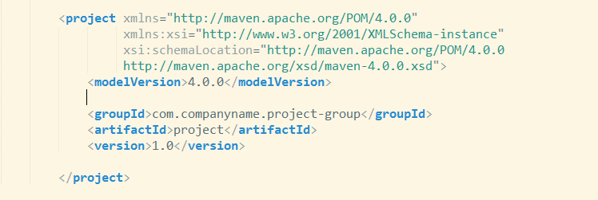
POM stands for Project Object Model. It is fundamental Unit of Work in Maven. It is an XML file. It always resides in the base directory of the project as pom.xml. It should be noted that there should be a single POM file for each project.

Slide 10
Node | Description
groupId | This is an Id of project's group. This is generally unique amongst an organization or a project. For example, a banking group com.company.bank has all bank related projects.
artifactId | This is an Id of the project. This is generally name of the project. For example, consumer-banking. Along with the groupId, the artifactId defines the artifact's location within the repository.
version | This is the version of the project. Along with the groupId, it is used within an artifact's repository to separate versions from each other. For example: com.company.bank:consumer-banking:1.0 com.company.bank:consumer-banking:1.1.

Slide 11
Maven Build Lifecycle
4

Slide 12
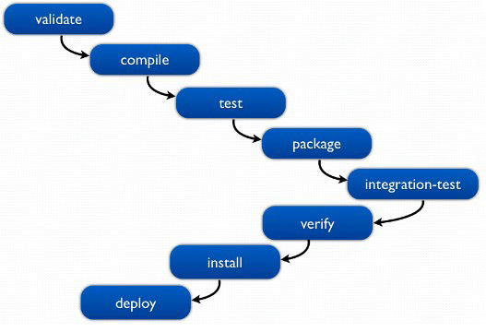
A typical Maven Build Lifecycle

Slide 13
A typical Maven Build Lifecycle
Validate - validate the project is correct and all necessary information is available
Compile - compile the source code of the project
Test - test the compiled source code using a suitable unit testing framework. These tests should not require the code be packaged or deployed
Package - take the compiled code and package it in its distributable format, such as a JAR.
Note: any of the colors defined can be used for the table

Slide 14
A typical Maven Build Lifecycle
Integration-test - process and deploy the package if necessary into an environment where integration tests can be run
Verify - run any checks to verify the package is valid and meets quality criteria
Install - install the package into the local repository, for use as a dependency in other projects locally
Deploy - done in an integration or release environment, copies the final package to the remote repository for sharing with other developers and projects.
Note: any of the colors defined can be used for the table

Slide 15
When Maven starts building a project, it steps through a defined sequence of phases and executes goals which are registered with each phase. Maven has following three standard lifecycles:
clean
default (or build)
site
A goal represents a specific task which contributes to the building and managing of a project. It may be bound to zero or more build phases. A goal not bound to any build phase could be executed outside of the build lifecycle by direct invocation.

Slide 16
Maven Repositories
5

Slide 17
In Maven terminology, a repository is a place i.e. directory where all the project jars, library jar, plugins or any other project specific artifacts are stored and can be used by Maven easily.
Maven repository are of three types:
local
central
remote

Slide 18
Local Repository
Maven local repository is a folder location on your machine. It gets created when you run any maven command for the first time.
Maven local repository keeps your project's all dependencies (library jars, plugin jars etc.).
When you run a Maven build, then Maven automatically downloads all the dependency jars into the local repository. It helps to avoid references to dependencies stored on remote machine every time a project is build.

Slide 19
Central Repository
Maven central repository is repository provided by Maven community. It contains a large number of commonly used libraries.
When Maven does not find any dependency in local repository, it starts searching in central repository using following URL: http://repo1.maven.org /maven2/
Key concepts of Central repository:
This repository is managed by Maven community.
It is not required to be configured.
It requires internet access to be searched.

Slide 20
Remote Repository
Sometimes, Maven does not find a mentioned dependency in central repository and it stops the building process and outputs an error message to the console. To prevent such situations, Maven provides the concept of Remote Repository which is the custom repository of the developer's himself containing required libraries or other project jars.

Slide 21
Unit Testing using Junit and Maven
6

Slide 22
Unit Testing
Is a level of the software testing process where individual units/components of a software/system are tested
The purpose is to validate that each unit of the software performs as designed

Slide 23
Unit Testing
Concerned with:
Functional correctness and completeness
Error handling
Checking input values
Correctness of output values
Optimizing performance

Slide 24
Unit Testing
Several Unit Testing Frameworks:
Junit - A unit testing framework for the Java programming language. JUnit has been important in the development of test-driven development.
TestNG - A multi-purpose testing framework, which means its tests can include unit tests, functional tests, and integration tests.
Jmockit - Open source framework. Tests can easily be written that will mock final classes, static methods, constructors, and so on. There are no limitations.

Slide 25
Maven Build Profiles
7

Slide 26
Maven Build Profiles
A Build profile is a set of configuration values which can be used to set or override default values of Maven build. Using a build profile, you can customize build for different environments such as Production v/s Development environments.
Profiles are specified in pom.xml file using its activeProfiles/profiles elements and are triggered in variety of ways. Profiles modify the POM at build time, and are used to give parameters different target environments. Ex: the path of the database server in the development, testing, and production environments.

Slide 27
Types of Build Profile
Build profiles are majorly of three types:
Type | Where it is defined
Per Project | Defined in the project POM file, pom.xml.
Per User | Defined in Maven settings xml file (%USER_HOME%/.m2/settings.xml)
Global | Defined in Maven global settings xml file (%M2_HOME%/conf/settings.xml)
Note: any of the colors defined can be used for the table

Slide 28
Maven Plugins
8

Slide 29
Maven is actually a plugin execution framework where every task is actually done by plugins. Maven Plugins are generally used to:
create jar file
create war file
compile code files
unit testing of code
create project documentation
create project reports

Slide 30
Thank you!

