Slide 1
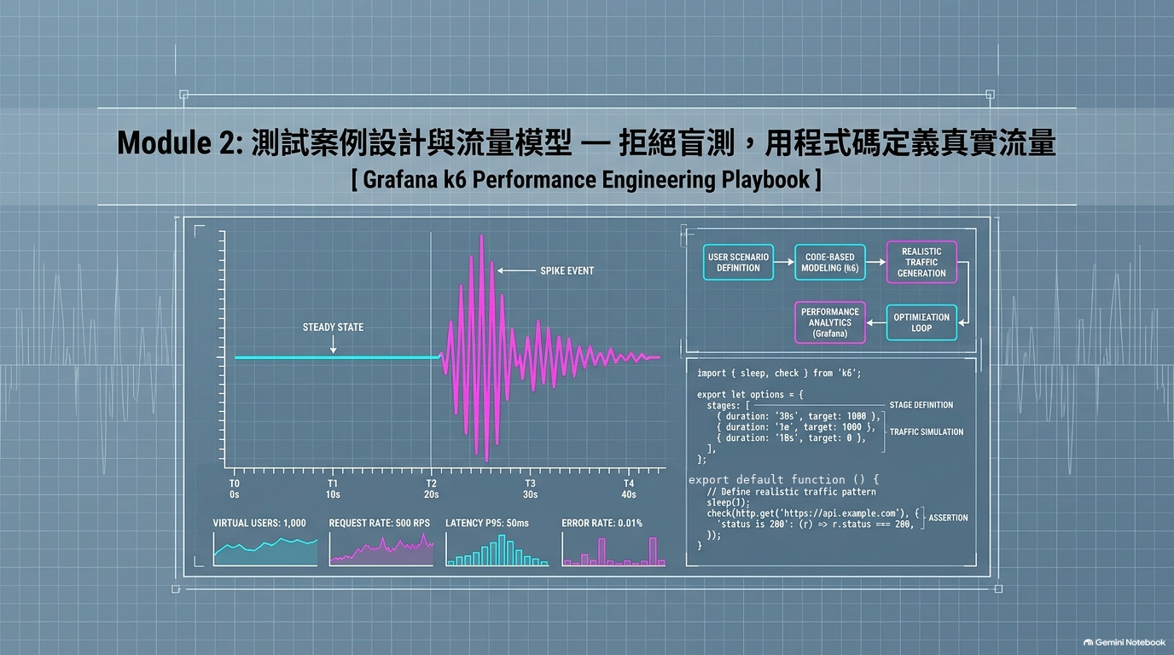
▶ 課程實戰 Codelabs：tedmax100.github.io/o11y_lab_for_dummies/k6-performance-testing/

Slide 2
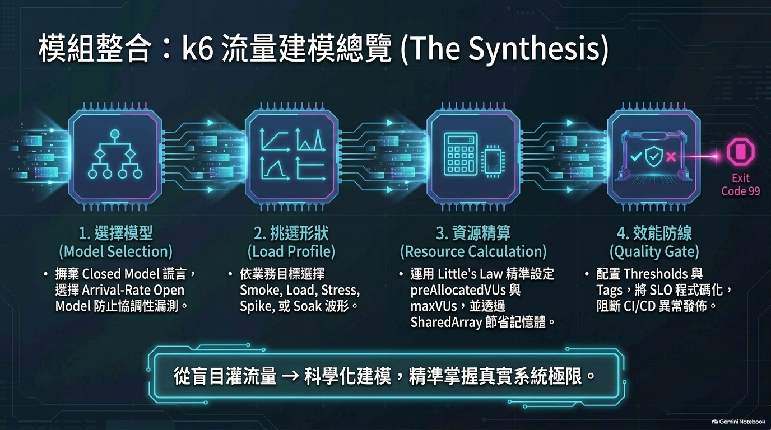
▶ 課程實戰 Codelabs：tedmax100.github.io/o11y_lab_for_dummies/k6-performance-testing/

Slide 3
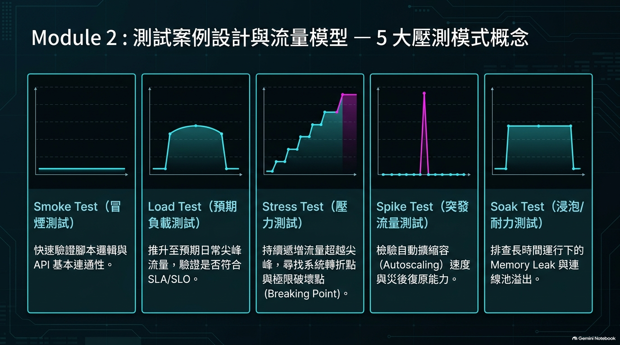
▶ 課程實戰 Codelabs：tedmax100.github.io/o11y_lab_for_dummies/k6-performance-testing/

Slide 4
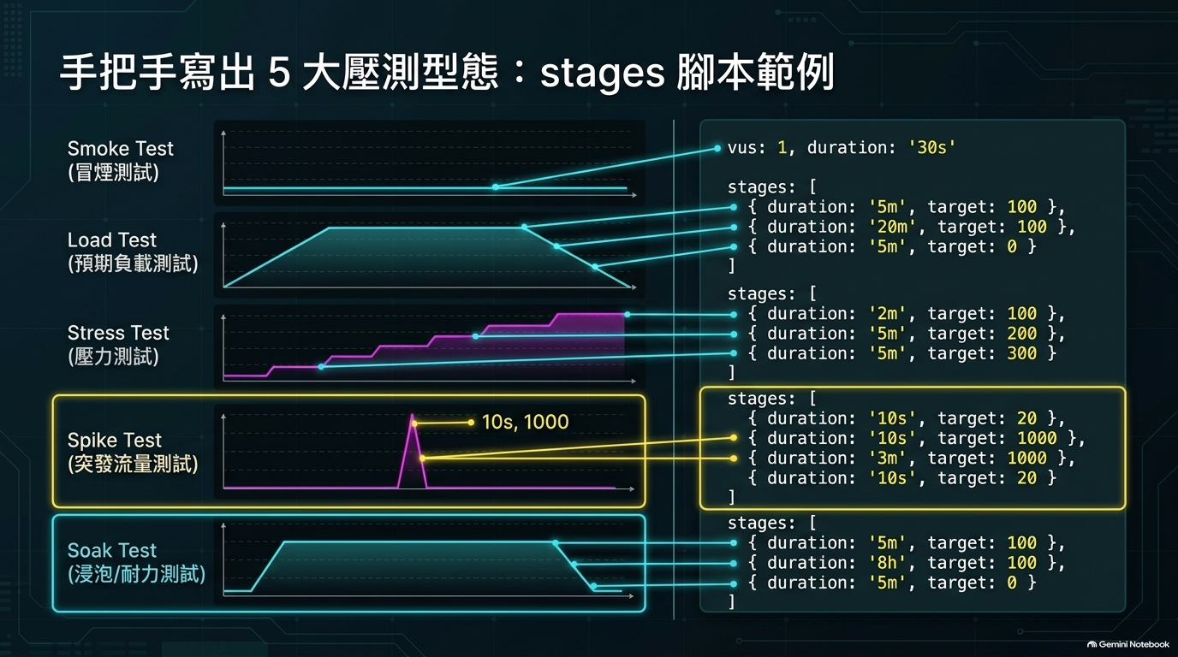
▶ 課程實戰 Codelabs：tedmax100.github.io/o11y_lab_for_dummies/k6-performance-testing/

Slide 5
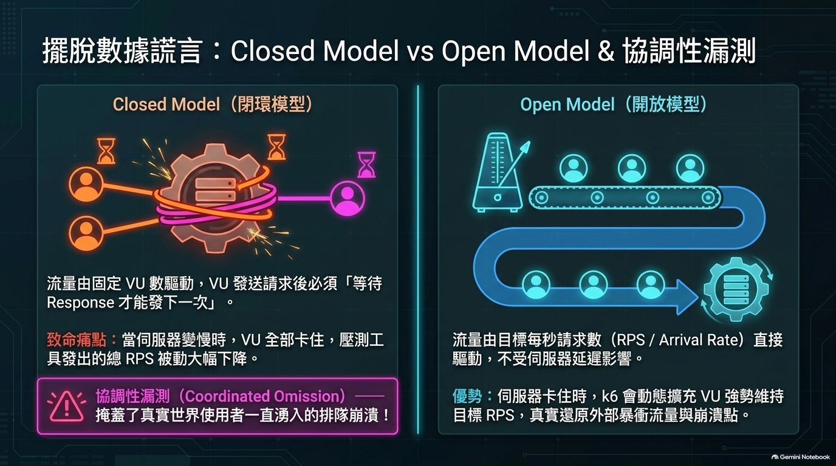
▶ 課程實戰 Codelabs：tedmax100.github.io/o11y_lab_for_dummies/k6-performance-testing/

Slide 6
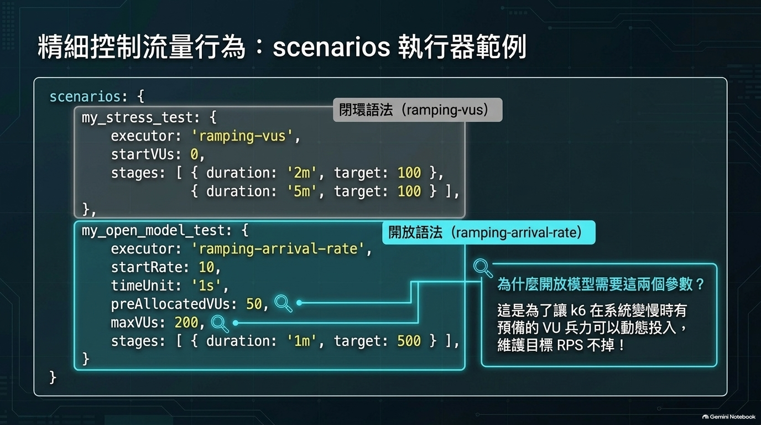
▶ 課程實戰 Codelabs：tedmax100.github.io/o11y_lab_for_dummies/k6-performance-testing/

Slide 7
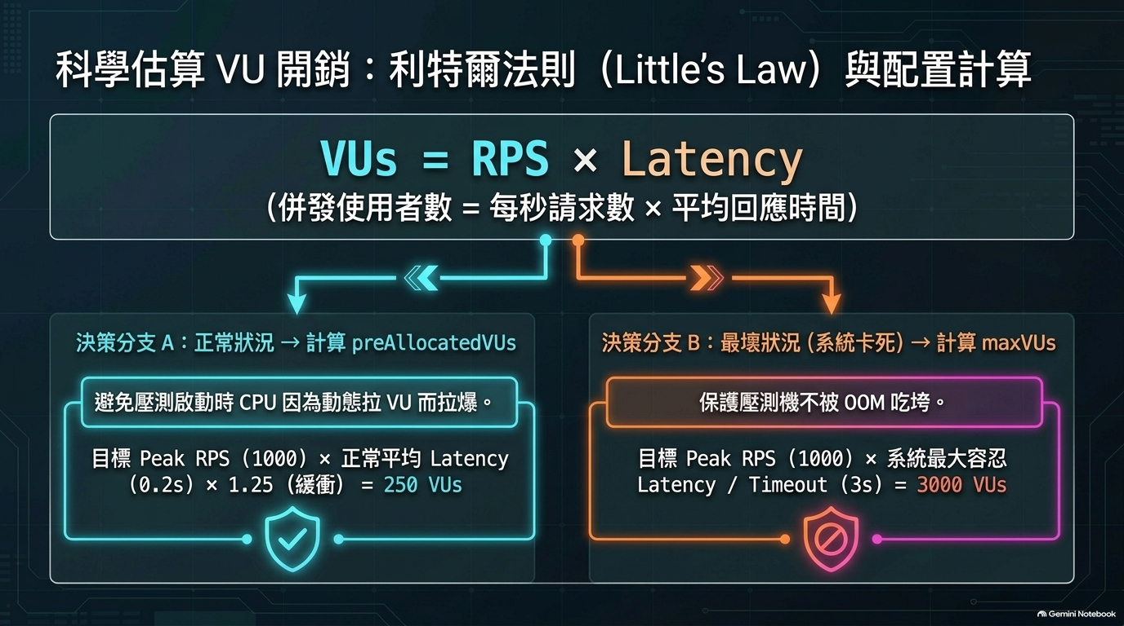
▶ 課程實戰 Codelabs：tedmax100.github.io/o11y_lab_for_dummies/k6-performance-testing/

Slide 8
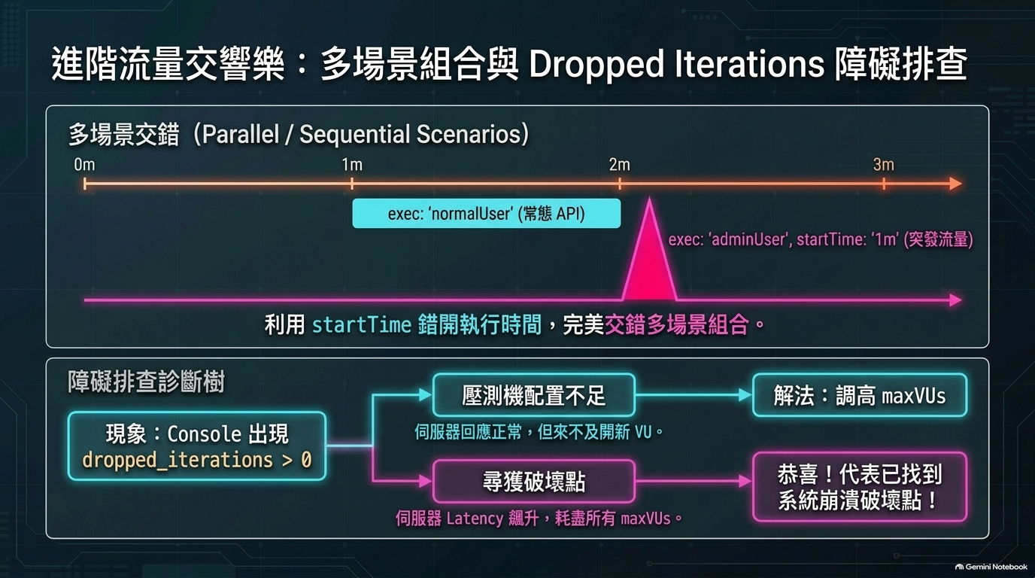
▶ 課程實戰 Codelabs：tedmax100.github.io/o11y_lab_for_dummies/k6-performance-testing/

Slide 9
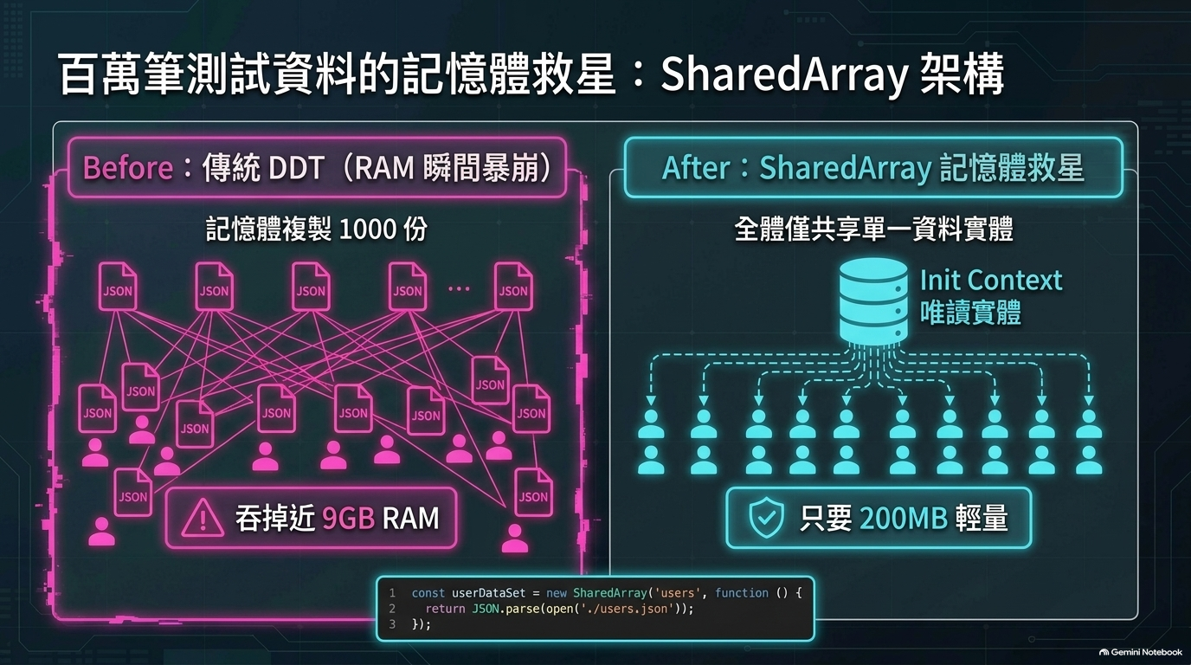
▶ 課程實戰 Codelabs：tedmax100.github.io/o11y_lab_for_dummies/k6-performance-testing/

Slide 10
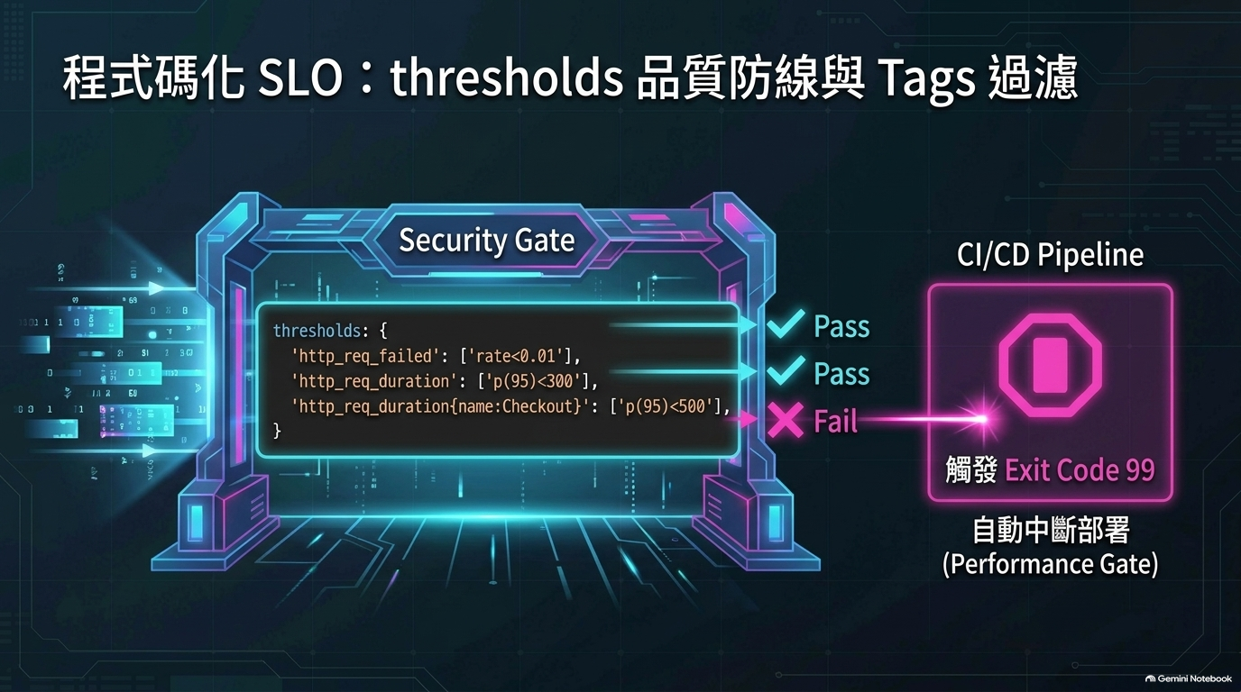
▶ 課程實戰 Codelabs：tedmax100.github.io/o11y_lab_for_dummies/k6-performance-testing/

