Slide 1

SMART INDIA HACKATHON 2026
SENTRA
Sense the Risk · Stop the Incident
Problem Statement ID – 26165
Problem Statement Title – AI/NLP Engine to Detect Serious Injury & Fatality (SIF) Precursors in OIL's Unsafe-Act / Unsafe-Condition and Near-Miss Reports
Theme – Smart Automation
PS Category – Software
Team ID – ______________ (enter from the SIH portal)
Team Name – WellDrop
Organisation – Oil India Limited
Notes:
Open with the number: OIL already collects the reports. The question is which of them could have killed someone. Team WellDrop; the engine is SENTRA.

Slide 2
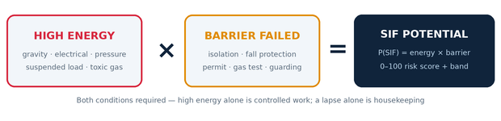
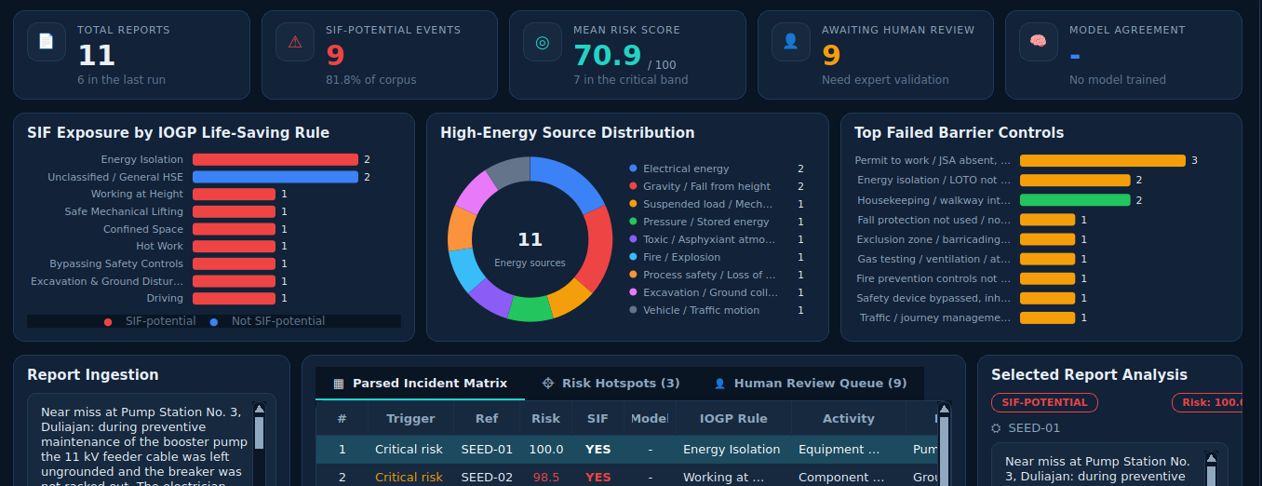
IDEA TITLE
WellDrop
SENTRA reads every UA/UC and near-miss report and flags fatal potential — on the shift it is written.
THE GAP TODAY
Reports triaged by hand, monthly or quarterly
Injuries fell 51% in 15 years — fatalities only 25.5%
Low severity ≠ low fatal potential: ~20–25% of reports carry it
WHAT MAKES IT DIFFERENT
1
Hybrid, not black box — safety rules + semantic transformer + XGBoost; the model may only add a flag, never overturn a rule
2
Evidence on every flag — matched cues and decision path, so HSE audits the reasoning before acting
3
Zero-shot rule mapping — 9 IOGP Life-Saving Rules + 2 upstream categories, with no labelled data to start
Working prototype — live dashboard, not a mock-up
4
Runs offline — deterministic mode needs no model and no network: safe for plant/air-gapped sites
74
automated tests
11
IOGP categories
0
labelled rows to start
5
Human-in-the-loop — rule/model disagreement is queued for an expert, and that decision becomes a label
Notes:
The one idea to land: SIF potential is high energy AND a failed barrier - not keyword matching, and not the severity that actually occurred. Everything else follows from that rule. The screenshot is our running prototype, not a mock-up.

Slide 3
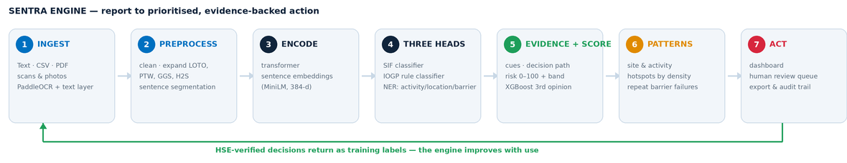
TECHNICAL APPROACH
WellDrop
TECHNOLOGY STACK
METHODOLOGY
Language & UI — Python 3.11 · PyQt6 desktop console · QThread workers
1
Rules first — auditable deterministic backbone
NLP — sentence-transformers all-MiniLM-L6-v2 · rule + prototype knowledge base
2
Semantics second — zero-shot prototypes lift recall
ML / MLOps — XGBoost · scikit-learn · MLflow experiment tracking
3
Model third — XGBoost opinion, MLflow-tracked, never an override
Ingestion — PaddleOCR · pypdfium2 PDF text layer · CSV importer
Engineering — NumPy · unittest (74 tests) · Git / GitHub
4
Loop closed — expert review produces the labels for retraining
Guardrail: if an encoder scores every prototype alike, its ranking is ignored and the rules decide.
Notes:
Walk the seven stages left to right in one sentence each. Emphasise the green return line: expert decisions come back as labels, so the engine improves with use. If asked why not an LLM: auditability - every flag names the cues that produced it.

Slide 4
FEASIBILITY AND VIABILITY
WellDrop
WHY IT IS FEASIBLE
RISKS AND HOW WE HANDLE THEM
• Laptop-class hardware — no GPU, no server
• Offline mode needs no model and no network
• Reads existing HSSE exports (CSV, PDF, scans) — crews keep reporting as they do
• Open-source stack, deployed site by site
• Already built and tested — 74 automated tests pass
No labelled SIF corpus exists
Start rule-driven; review queue produces labels; promote a model only at ≥200 labels and recall ≥0.80
1
A missed precursor (false negative)
Semantic layer may only add flags; rules are never overridden; recall-first acceptance gate
2
VIABILITY
• Low cost — open-source components, no per-seat licence
• Return from HSE screening time saved and incidents prevented
• One engine serves every asset; scales site by site
• Improves with use — each expert decision becomes a label
• Supports OIL's statutory reporting rather than replacing it
Plant networks are air-gapped
Pre-fetch the encoder and OCR models; full offline lexical mode as fallback
3
Small samples skew site rankings
Density ranked by Wilson lower bound — 2-of-2 cannot outrank 20-of-30
4
WHAT A PILOT LOOKS LIKE
Week 0 — point it at one asset's existing report export
Weeks 1–8 — HSE works the review queue; decisions become labels
Week 9 — first model trained on real labels, promoted only at the recall gate
Scanned and handwritten reports
PDF text layer first, PaddleOCR for scans, per-line confidence routed to review
5
Model drift after go-live
MLflow run history plus monitored KPIs: agreement %, unclassified share, queue age
6
Notes:
Lead with the honest risk - no labelled SIF corpus exists anywhere - then the answer: the rules work from day one and the review queue manufactures the labels. Offline mode is what makes it deployable on a plant network.

Slide 5
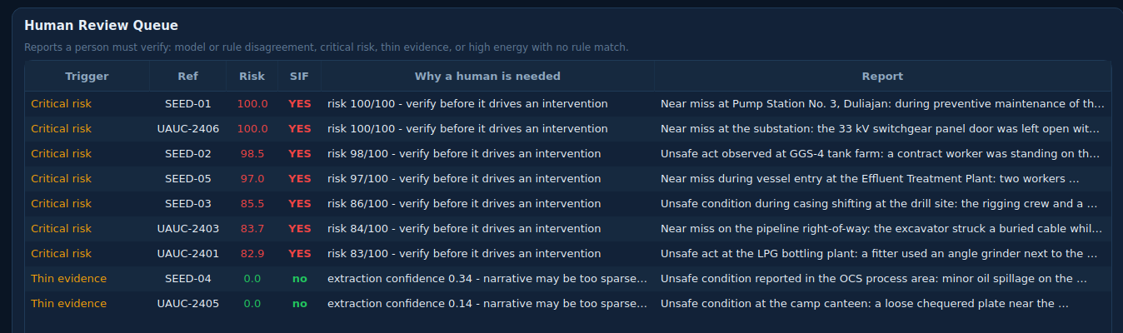
IMPACT AND BENEFITS
WellDrop
Monthly
manual triage today
Same shift
with SENTRA
20–25%
of reports hold the fatal potential
Every flag
carries its evidence
WHO BENEFITS, AND HOW
HSE teams & asset owners
• Screening effort moves from every report to the ones that can kill
• Sites and activities ranked by precursor density, not by report volume
• Recurring failed barriers named — fix the control, not the incident
Workers & contractors
• Exposure removed before the event, not investigated after it
• Reporting visibly acted on, which strengthens reporting culture
• Same protection for contractor crews, who carry much of the field risk
Economic, social & environmental
• Avoided incident cost, downtime and emergency response
• Audit-ready evidence trail for regulators and internal review
• Paperless triage; less duplicated manual review each cycle
THE HUMAN STAYS IN CHARGE
Disagreements, critical risk and thin evidence are queued with the reason attached. No report is closed, downgraded or escalated by the engine.
Each expert decision returns as a training label.
Notes:
Impact is a reallocation of attention, not a new headcount: the same HSE team spends its hours on the fifth of reports that carry fatal potential. Stress that no report is ever closed by the engine.

Slide 6
RESEARCH AND REFERENCES
WellDrop
PEER-REVIEWED RESEARCH
STANDARDS & INDUSTRY MODELS
Parikh et al. (2024), Scientific Reports
Automatic identification of incidents involving potential serious injuries and fatalities — Transformer + XGBoost, recall-first. nature.com/articles/s41598-024-58824-y
• IOGP Life-Saving Rules (2018) — the 9-rule taxonomy we map to
• EEI SIF precursor model — energy + failed barrier logic
• DEKRA, Martin & Black (2015) — SIF potential vs actual severity
• VelocityEHS PSIF classifier (2024) — commercial benchmark
1
Ganguli et al. (2021), Minerals
NLP-based machine learning on mine incident narratives. mdpi.com/2075-163X/11/7/776
2
HOW WE DIFFER FROM EXISTING TOOLS
• Commercial PSIF tools need a large labelled corpus; SENTRA starts with none
• Most classifiers output a score; SENTRA outputs the cues and the decision path
• Built for the plant — full offline mode, no cloud dependency
• Ranks by precursor density, so a small busy site is not hidden by a large one
Chang & Martinez (2024), Process Safety and Environmental Protection
NLP for spill reduction in an E&P company — causes and contributing factors.
3
Wang & Wang (2026), J. Loss Prevention in the Process Industries
Bow-tie grounded sentence-level annotation for interpretable incident analysis.
4
HOW THE RESEARCH SHAPED SENTRA
[1] recall-first evaluation and the transformer + XGBoost pairing
[2][3] evidence that NLP generalises across mining and E&P narratives
[4] barrier-level annotation — why we classify on energy and barrier, not keywords
PROTOTYPE SOURCE
github.com/tedo001/SIF — working code, 74 automated tests, operating manual
Notes:
If challenged on novelty: commercial PSIF tools need a labelled corpus and return a score; we start with none and return the evidence. Offer the repository - the code, the tests and the operating manual are public.

