Slide 1
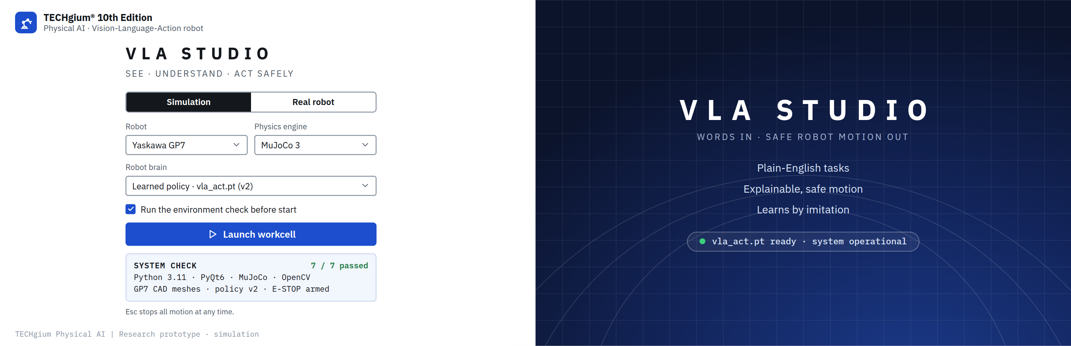
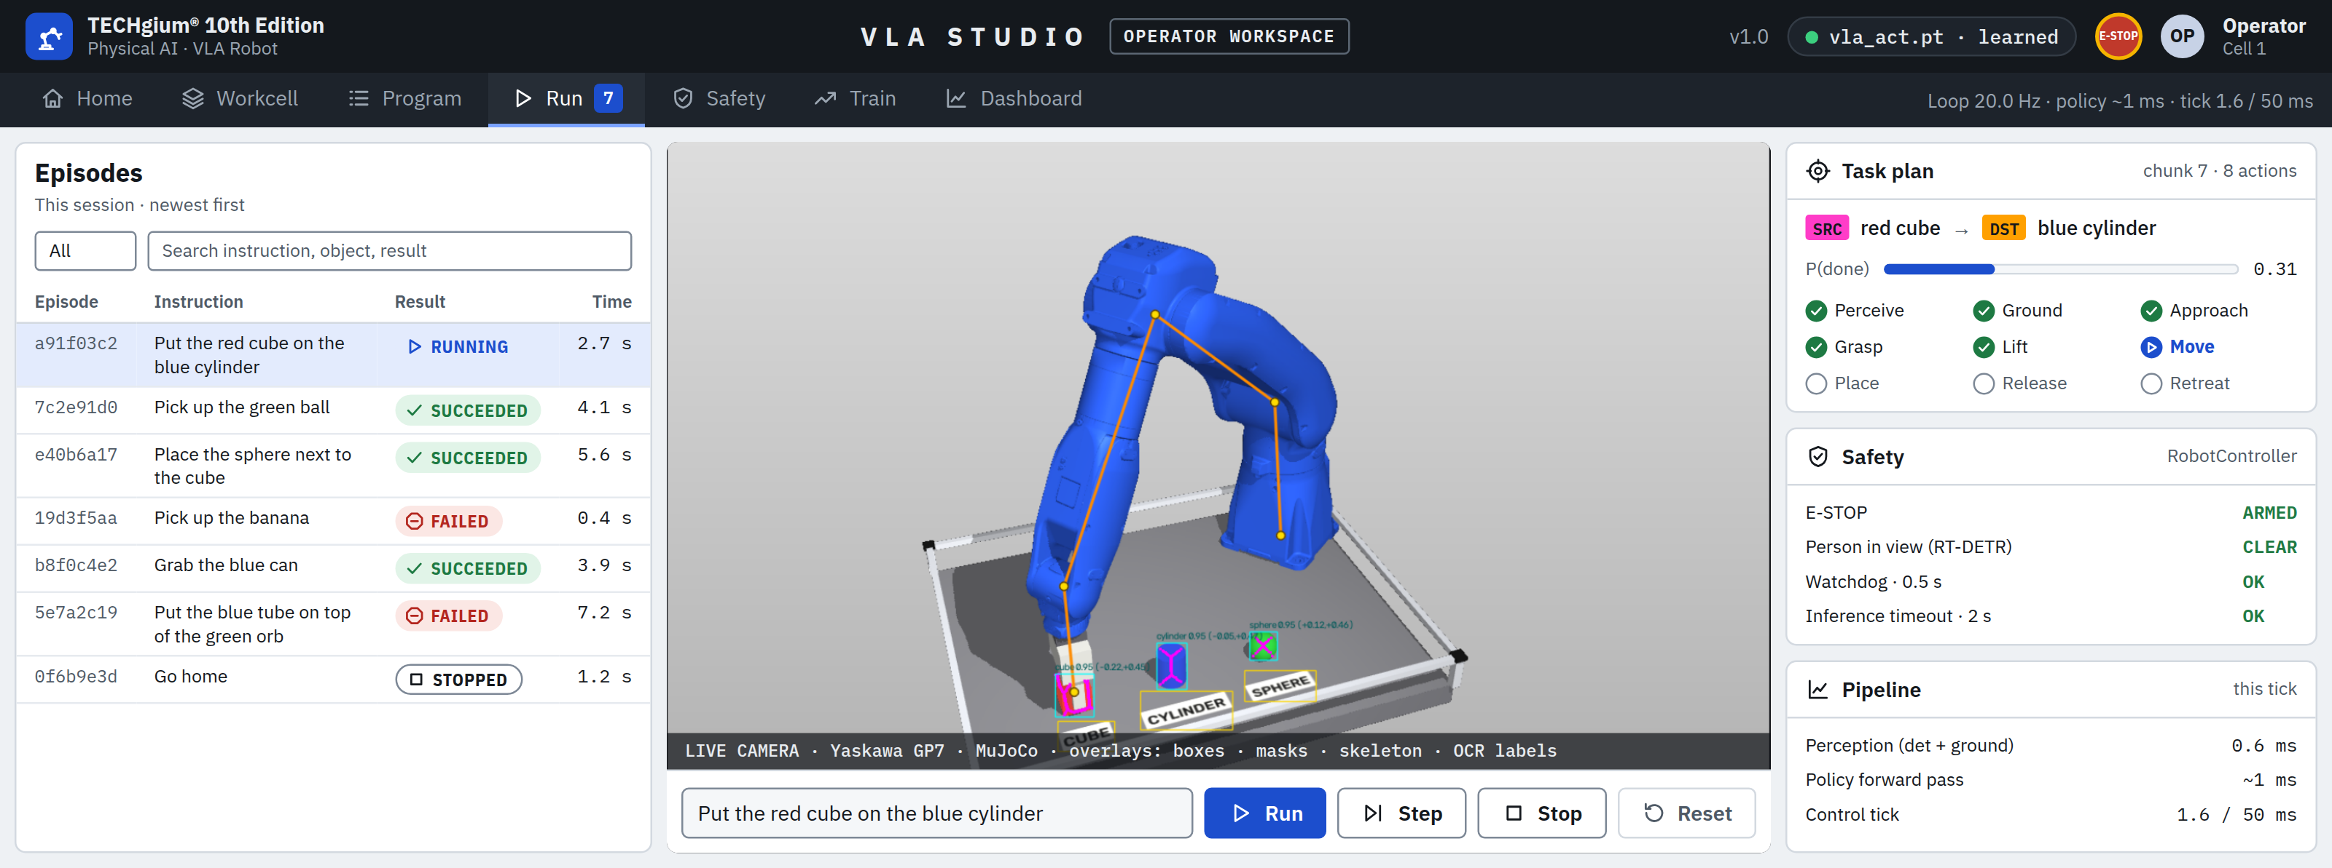
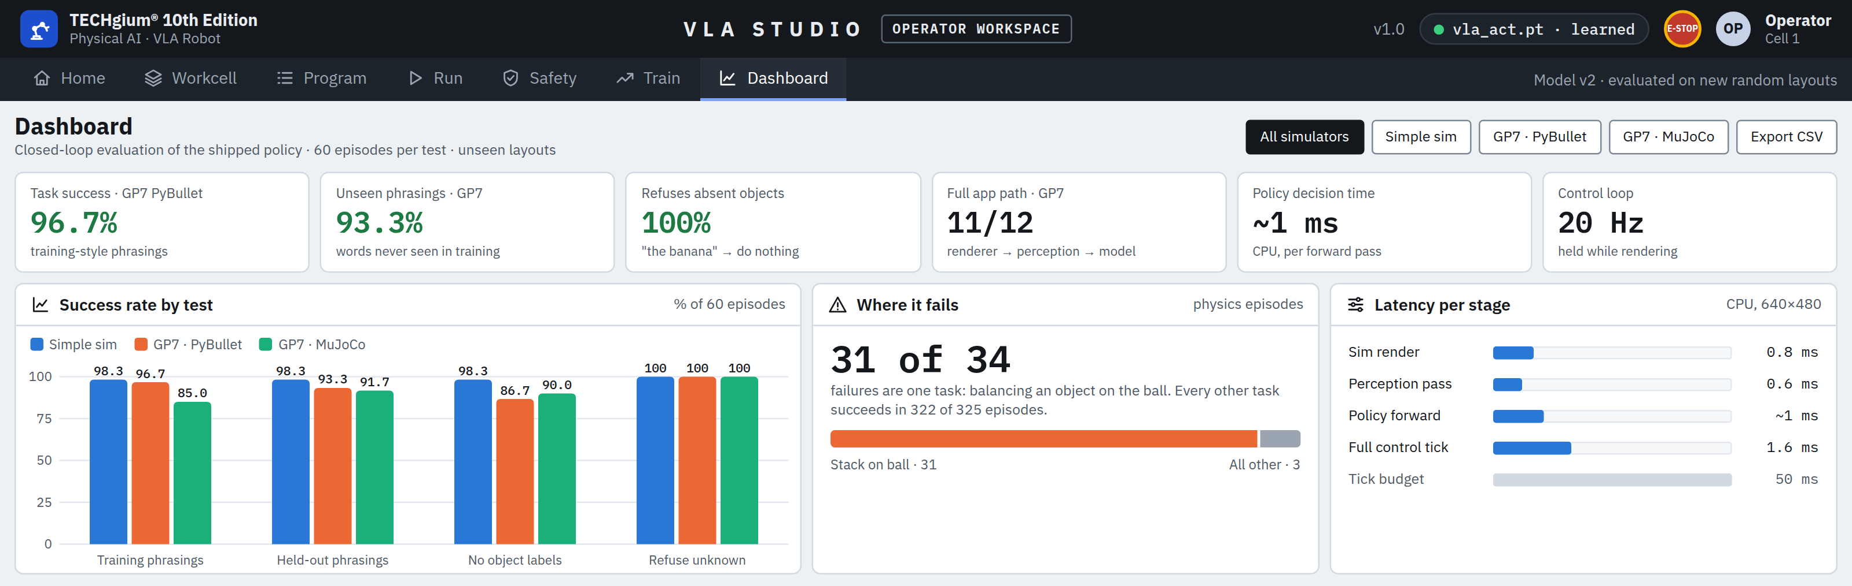










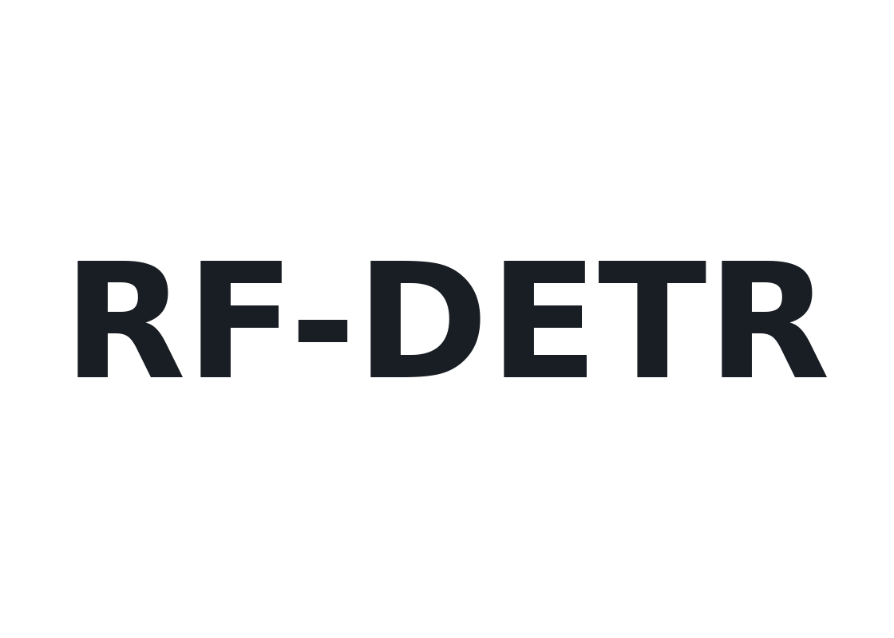

TECHNICAL APPROACH
Prototype
TASK INPUT
(Plain-English task,
Pydantic-validated)
SIMULATOR
(Yaskawa GP7,
MuJoCo / PyBullet)
PERCEPTION
(RT-DETR · RF-DETR
· PaddleOCR labels)
SCENE INDEX
(Labels → objects,
2D → 3D positions)
DONE CHECK
(2× done → stop,
unknown → refuse)
ACTION CHUNK
(8 moves + P(done))
GROUNDING
(Source + destination)
LEARNED POLICY
(Transformer, ~1 ms)
LIVE DASHBOARD
(Camera + SRC/DST overlays,
telemetry · console)
ARM MOTION
(IK joint deltas · gripper
20 Hz control loop)
ROBOT CONTROLLER
(E-STOP · person-in-view hold,
watchdog · rate limits)
EVALUATION
(96.7% GP7 success,
100% refusal)
TRAINING
(Behaviour cloning, PyTorch)
EXPERT DEMOS
(1000s of planner runs)
Tech Stack

