Slide 1
10th Edition TECHgium®
PID No.
MEDSCAN – Adaptive AI for Chest X-ray Analysis
Author 1
Photo
Author 2
Photo
Author 3
Photo
Author 4
Photo
Name 1
Name 2
Name 3
Name 4
College name, City, State

Slide 2

Challenge Statement
Develop an AI-based system to support doctors in analyzing chest X-rays.
Identify and highlight potential abnormalities in medical scans.
Adapt the level of explanation, evidence, and guidance according to the clinical situation.
Provide confidence scores and limitations for every AI finding.
Detect poor-quality or incomplete scans and request human review instead of producing unreliable results.
Allow doctors to question, correct, or reject AI-generated findings.
Evaluate whether Doctor + AI collaboration improves decision-making compared with either alone.
Ensure patient privacy, bias monitoring, and decision traceability.

Slide 3
Concept / Proposed Solution
MEDSCAN – a working desktop prototype that adapts to each doctor's chosen support mode and to the clinical situation, via an Adaptive Analysis Routing layer.
Quality Gate – 7 checks; poor or incomplete scans go to a human, with no findings.
Adaptive Router – fast screen, then only the needed specialists; normal scans exit early.
Deep Learning – DenseNet-121 classifier + PSPNet lung / heart segmentation.
Confidence Engine – stability, agreement, quality; abstains when unsure.
Doctor-chosen Modes – Guided · Concise · Second opinion · Evidence-first.
Generative AI + RAG – cited evidence and a fact-checked draft report.
Recommendations – urgency, next test, follow-up; patterns across findings.
Learns from Doctors (ML) – model retrained on Accept / Correct / Reject.
Trust & Safety – audit chain, privacy, bias reduction, Doctor + AI testing.

Slide 4
Pros and Cons of the solution
ADVANTAGES
Adapts to the Doctor – doctor-chosen modes, never assumed from seniority.
Adaptive Routing – 50% less time, 75% fewer modules on our benchmark.
Explainable – heatmap, why it matters, cited evidence, draft report.
Honest Uncertainty – confidence per finding; abstains instead of guessing.
Doctor in Control – AI suggests; the doctor decides and signs.
Traceable & Fair – audit chain, de-identification, bias reduction.
LIMITATIONS
Data Dependent – real-image check: sensitivity 0.80, specificity 0.44 (50 films).
False Results – false positives (e.g. vessels as nodules) still occur.
Generalization – performance may vary across hospitals and devices.
Routing Complexity – thresholds must be tuned per clinical context.
Hallucination Risk – LLM text is fact-checked, but still needs review.
Clinical Validation – a radiologist reader study is still required.

Slide 5
Technical Description
1. Preprocess
Load PNG / DICOM, strip identifiers, find the lungs
TECH STACK
Desktop UI
PyQt6
Imaging
NumPy · SciPy · OpenCV
2. Quality Gate
Blur, contrast, exposure, coverage – fail → human review
3. Fast Screen
Measurements + DenseNet-121 → 4 group scores
DICOM
pydicom (de-identification)
Deep model
PyTorch · TorchXRayVision
4. Adaptive Router
Context thresholds, early exit, borderline band
5. Specialists
Cardiac · Pleural · Parenchyma · Nodule (+ Grad-CAM)
Classifier
DenseNet-121 + Grad-CAM
Medical RAG
BM25 over cited guidelines
6. Confidence
TTA stability · agreement · quality · abstain
7. Explain (RAG)
Brief / standard / detailed + guideline citations
LLM (optional)
Ollama, fact-checked
Storage
SQLite · SHA-256 audit
8. Doctor & Audit
Accept / Correct / Reject / Question → hash chain

Slide 6
AI Stack: ML · DL · Generative AI
MACHINE LEARNING
DEEP LEARNING
GENERATIVE AI
Feedback-trained logistic model
Learns from Accept / Correct / Reject / Add
5-fold cross-validated; retrained at every sign-off
Calibrated: temperature scaling + subgroup thresholds (bias reduction)
DenseNet-121 (TorchXRayVision): 18 findings
PSPNet: lung + heart segmentation
Grad-CAM heatmaps for routed findings
Fused with measurements (CTR, zones, angles)
Draft radiology report: findings, impression, next steps
Medical RAG: cited guideline passages
Explanation depth set by the doctor's chosen mode
Fact-checked: invented numbers or findings are rejected
Recommendation engine on top: urgency tier, next test, follow-up and referral per finding, adjusted for confidence, nodule size, clinical context and patterns across findings (e.g. cardiomegaly + effusion → one heart-failure work-up).

Slide 7
Implementation Plan
Phase 1 — Data Preparation ✓
Synthetic phantom set with ground truth
DICOM loading + de-identification
labels.csv loader for CheXpert / MIMIC
Phase 2 — Initial AI Models ✓
PSPNet + classical lung segmentation
Measurement screen + DenseNet-121
4 region-specific specialist modules
Phase 3 — Adaptive Routing ✓
Context thresholds + early exit
Test-time augmentation confidence
Abstention + temperature scaling
Phase 4 — Doctor Interface ✓
Doctor-chosen support modes
Recommendations + draft report (GenAI)
Feedback-trained ML, audit, bias reduction
Phase 5 — Evaluation ✓ / next
Fixed vs adaptive + Doctor + AI simulation
Real-image check (50 films)
Next: CheXpert + radiologist reader study

Slide 8
Prototype Results
−50%
analysis time
−75%
specialist modules & model calls
1.00
sensitivity & specificity – unchanged
24%
scans exit early, no specialist
Benchmark: 25 synthetic chest X-ray phantoms with ground truth (6 findings + 3 poor-quality scans), built-in engine. Not clinical performance.
Same scans, same engine – only the router differs. Quality gate caught 3 of 3 poor scans; findings localised to the correct side.

Slide 9
Doctor + AI Results
0.27 vs 0.86
automation bias: confidence-guided vs over-trusting readers
0.89
rescue rate: doctor errors fixed by a correct AI call
0.80
pneumonia sensitivity on 50 real chest X-rays (AUC 0.74)
49 / 50
real films passed the quality gate after learned segmentation
Accuracy · simulated readers who follow the AI only when its confidence ≥ 0.75 · AI at real-world 15% error
Doctor + AI beats either alone when the doctor uses the AI's confidence; over-trust erases the gain - hence blinded first read and confidence on every finding.

Slide 10
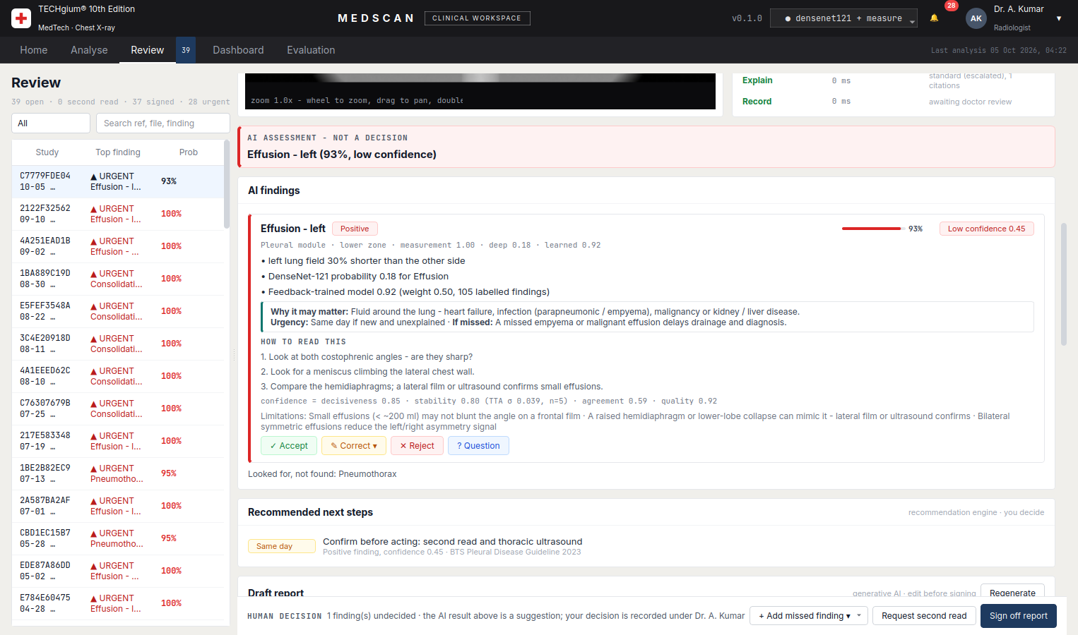
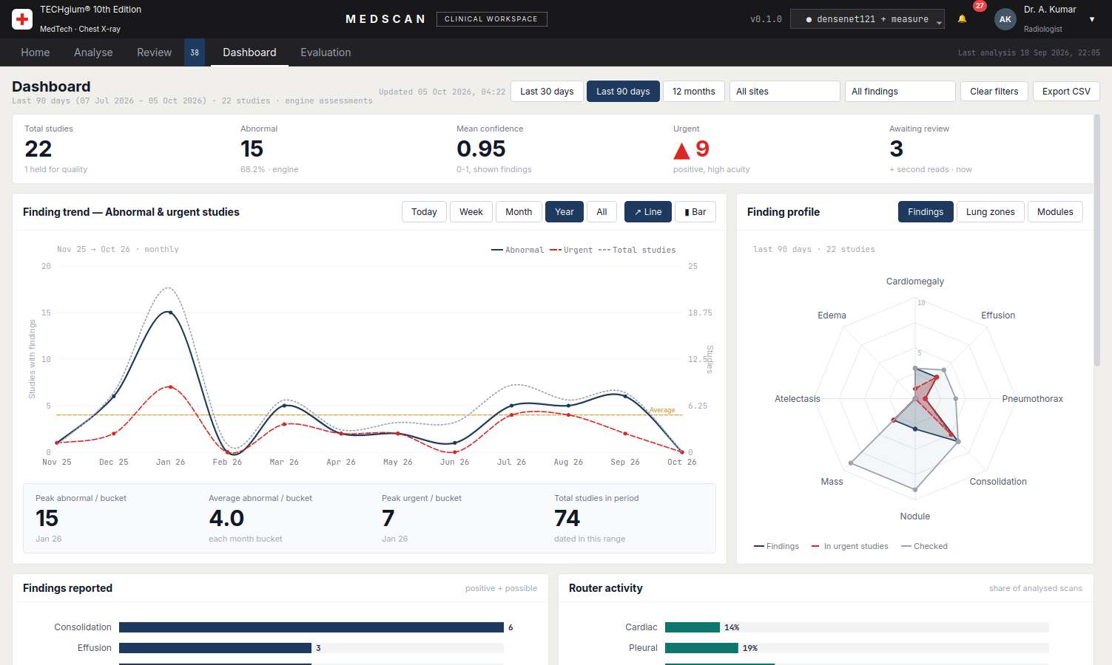
Prototype Screens
Review – Guided mode: why it matters, checklist
Dashboard – trend, finding profile, filters
Desktop app (PyQt6): doctor-chosen support modes · live 8-stage pipeline · Accept / Correct / Reject / Question · recommendations and draft report · Doctor + AI simulation · bias reduction · hash-chained audit trail.

Slide 11
Cost Estimate
COMPONENT | ESTIMATED COST
Public Medical Datasets | ₹0
Python / PyQt6 / PyTorch / OpenCV | ₹0
RAG & Open-Source Models | ₹0
Development Tools | ₹0
Local/College Computing | ₹0
Cloud GPU/API (if required) | ₹2,000–₹5,000
Estimated Total | ₹2,000–₹5,000

Slide 12
References
CheXpert – Stanford ML Group
CheXpert Dataset & Research
Human-AI Symbiosis in Chest Radiography – Radiology
Human-AI Symbiosis: Chest Radiography
Human–Machine Partnership for Chest Radiograph Diagnosis
Human–Machine Partnership Study
AI Explanation Types and Physician Trust – Radiology
AI Explanations and Physician Trust
Calibration-Based Explainability for Medical Images
Calibration-Based Counterfactual Explanations
TorchXRayVision – Cohen et al., MIDL 2022
TorchXRayVision Library & Models
Fleischner Society 2017 – Incidental Pulmonary Nodules
Fleischner Nodule Guidelines
Underdiagnosis Bias in Chest X-ray AI – Nature Medicine
AI Underdiagnosis Bias Study

Slide 13
Abstract
Doctors need different kinds of help, and the right help also depends on urgency and image quality. MEDSCAN is a working Adaptive AI chest X-ray assistant. It checks scan quality first and sends poor films to a human. It screens each scan once and routes only suspicious findings to specialist modules for the heart, pleura, lung zones and nodules. Deep learning (DenseNet-121, PSPNet segmentation) is fused with interpretable measurements. Every finding carries a probability, a confidence, why it may matter and its limits, and the engine abstains when unsure. Each doctor chooses how MEDSCAN helps them - Guided, Concise, Second opinion or Evidence-first - with no assumption about ability. Generative AI drafts a fact-checked report with cited evidence, a recommendation engine proposes next steps, and a machine-learning model retrains on doctors' Accept, Correct and Reject decisions. Decisions are kept in a hash-chained audit trail, patient data is de-identified, and subgroup thresholds reduce bias. Adaptive routing cut analysis time by 50% with no loss of accuracy on our benchmark. In simulation, doctors who used the AI's confidence beat both the AI and their own solo read. On 50 real films, pneumonia sensitivity was 0.80.

Slide 14
Thank You

