Slide 1
InOut 2018
Introduction BMS
14/03/2018
Guillaume Le Gall <guillaume.legall@imt-atlantique.fr>
Notes:
Researched contract which is funded by TI.

Slide 2
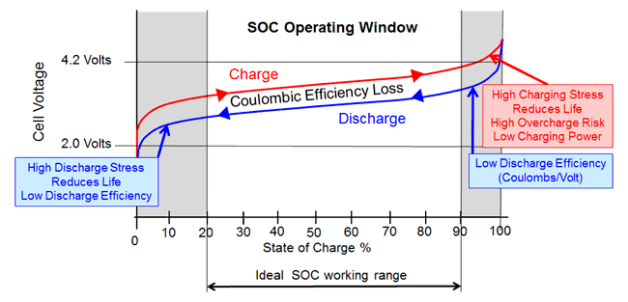
Lithium battery basics
SOC and Voltage relationship
From:
<http://www.mpoweruk.com/lithium_failures.htm>
Wireless Network for Scalable BMS
03/14/2018

Slide 3
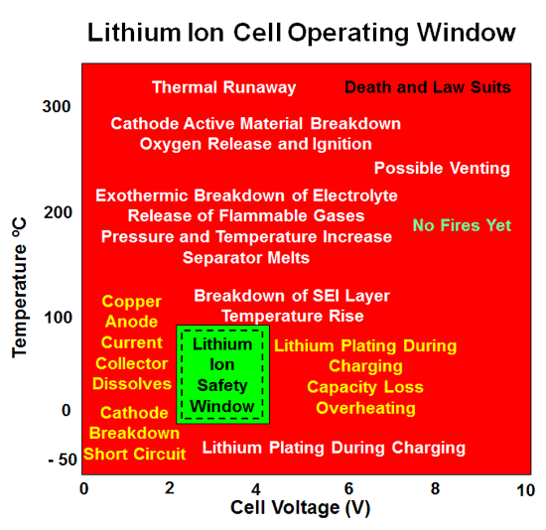
Lithium battery basics
Safety Window
From:
<http://www.mpoweruk.com/lithium_failures.htm>
Wireless Network for Scalable BMS
03/14/2018

Slide 4
BMS features
What the system has to do
Under / over temperature protection
Under / over voltage protection
Under / over current protection
  All these involve giving orders to the charger / inverter
  And / or controlling relays
State of Charge (SOC) calculation
State of Health (SOH) calculation
Cells balancing
Data reporting
  For vehicle’s dashboard, maintenance…

Slide 5
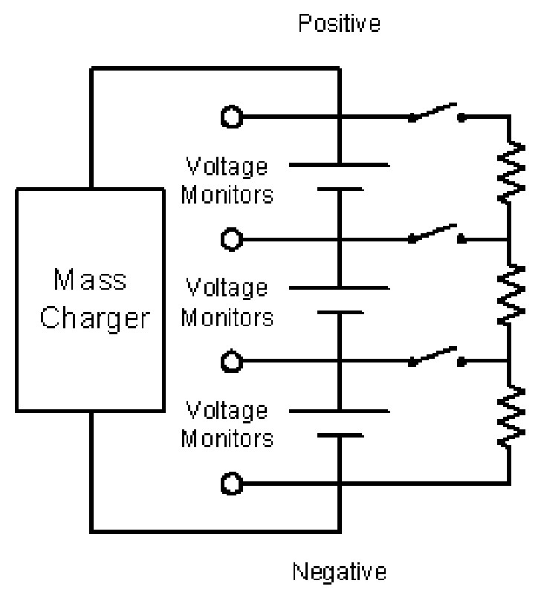
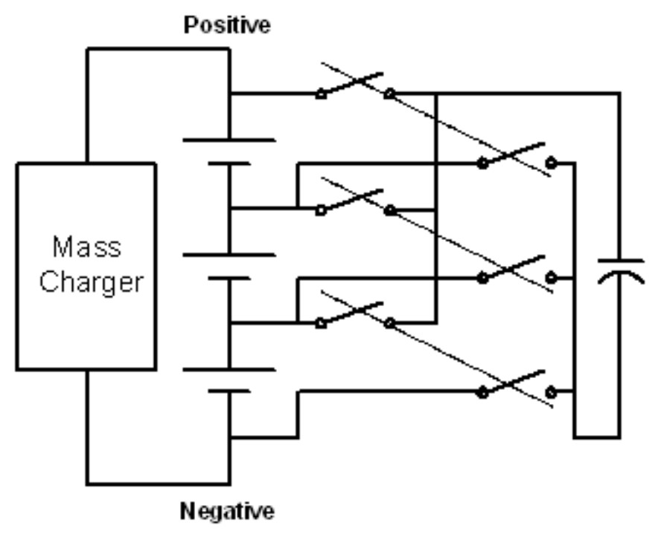
Bms state of the art
Cells balancing strategies
Dissipative resistors
Single switched capacitor
From: Jian Cao, Nigel Schofield and Ali Emadi,
« Battery Balancing Methods: A Comprehensive
Review », IEEE Vehicle Power and Propulsion Conference (VPPC), September 3-5, 2008, Harbin, China

Slide 6
Thank you.

