Slide 1




Subscribe
Publish:”26 °C”
Laptop
Publish:”26 °C”
Temperature sensor
MQTT Broker
Publish:”26 °C”
Subscribe
Publish to
Topic: “temperature”
Subscribe to
Topic: “temperature”
Mobile device

Slide 2


Register
Application Server
Application Token
Register
Device Token
Client Device

Slide 3
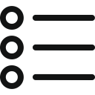
Specify Device
Group Devices
Specify Topic

Slide 4









Authentication
Facebook
Gmail
Smart Device
User
Web Server
Alert Functions
Sensor Data
MQTT Broker
User Information
Environment Data
Crawler
Database
Database
Anomaly Event

Slide 5
Spark
Spark
Spark
Yarn
MapReduce
HDFS
HDFS
HDFS
Standalone
Hadoop YARN
SIMR

Slide 6
Web UI
Web Server
Facebook
MongoDB
1.) POST authorization request.
2.) Render to Login web page.
3.) Getting User information.
4.) User authenticates request.
5.) Access token return and approves permissions..
6.) User information and Access token are stored to database.

Slide 7
Android Device
Web UI
Web Server
Firebase
MongoDB
1.) Login or Sign up request.
2.) Call the token transport function.
3.) Requiring device token through FCM SDK.
4.) Authorizing the Application, and generate device token.
5.) Return User information.
5.) POST User information.
5.) POST device token.
6.) Storing User information and device token to database.

Slide 8


Data preprocessing
Data mining
Problem understanding
Evaluation
Problem specification
Result exploitation
Data
Knowledge

Slide 9

Data cleaning
Data normalization
Data transformation
Data values imputation
?
?
3
6
?
9
Data integration
Noise identification

Slide 10
MQTT Broker
Spark Streaming
Data Transform
Out of Normal Range
False
Do Nothing,
waiting for next data
True
trigger the alert functions, sending warning message

Slide 11
MQTT Broker
Spark Streaming
Data Transform
(mapWithState)
Check Previous State
False
Initial Data State
Exist
Check the Number of Training Sample
False
Compute Mean and SD, Update Data State
Checkpoint
Enough
Previous State
Get Mean and SD Set
SH > +H or SL < -H
False
Compute Mean, SD, SH and SL, Update Data State
True
Reset SH and SL
trigger the alert functions, sending warning message

Slide 12
C1
o1
C2
o1

Slide 13
MQTT Broker
Streaming Windows
Data Transform
(foreachRDD)
Not Enough
Check Data Segments numbers
Enough
Training LOF Module
Near at 1
LOF Value
Significant greater than 1
Up to Warning Threshold
False
trigger the alert functions, sending warning message
True
Reset Warning Counter

Slide 14
MQTT Broker
Spark Streaming
Data Transform
(mapWithState)
Check Previous State
False
Initial Data State
Exist
Check the Number of Training Sample
False
Compute Mean and SD, Update Data State
Checkpoint
Enough
Previous State
Get Normal Range
Out of 3*SD Range
False
Compute Mean and SD, Update Data State
Warning Counter+1
True
True
Previous Warning type = This Warning Type
trigger the alert functions, sending warning message
False
Warning Counter Threshold
False
True
Reset Warning Counter

Slide 15
MQTT Broker
Streaming Windows
Data Transform
(foreachRDD)
Not Enough
Check Data Segments numbers
Enough
Training LOF Module
Near at 1
LOF Value
Significant greater than 1
Warning Counter+1
True
trigger the alert functions, sending warning message
Previous Warning type = This Warning Type
False
False
Warning Counter Threshold
True
Reset Warning Counter

Slide 16

User sessions (state)
Update user sessions
with user actions
mapWithState operation
Stream of user actions
Stream of user models

Slide 17
訓練資料
學習模組
資料特徵
偵測模組
偵測結果
模擬資料

Slide 18
RDD at time 1
RDD at time 2
RDD at time 3
DStream
Data from time 0 to 1
Data from time 0 to 1
Data from time 0 to 1

Slide 19
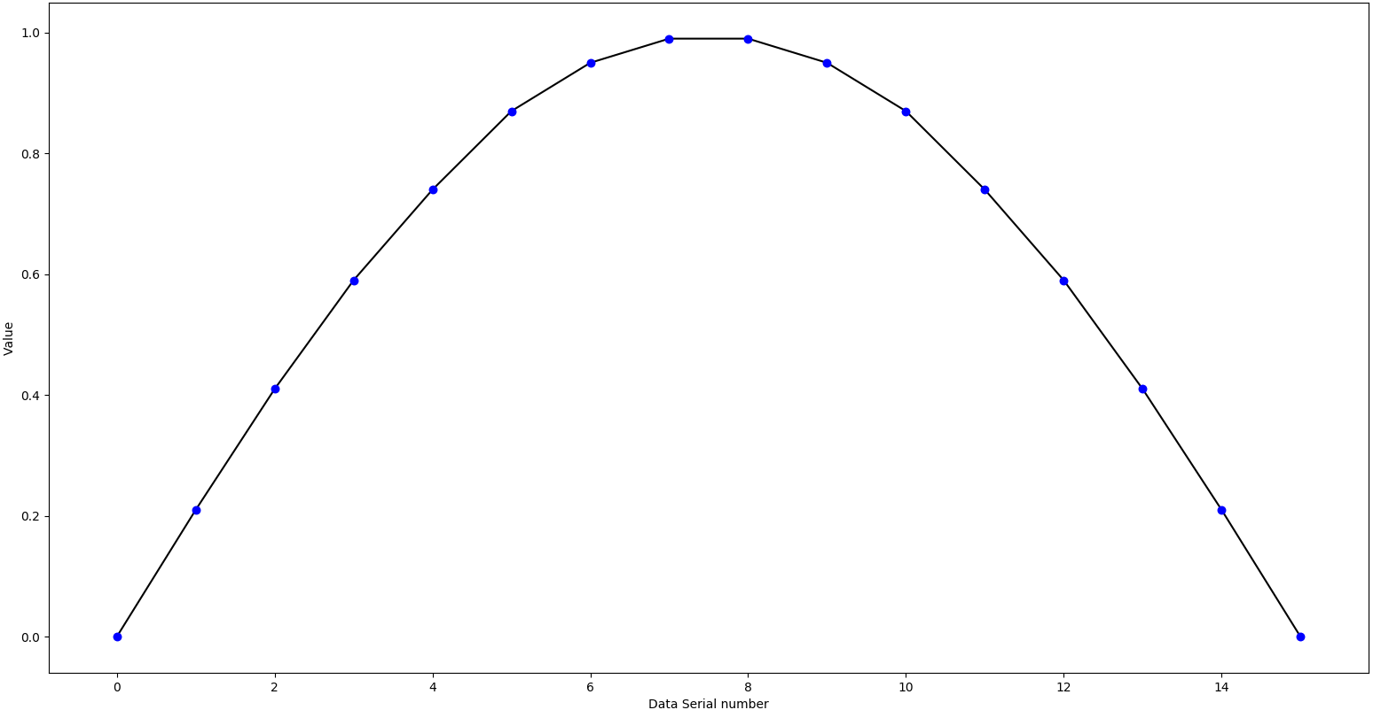
Window size : 3
Slide interval : 1
Slide when getting 1 value
After getting 3 values, create the window

Slide 20
Window size : 3
Slide interval : 1
Get Average and Standard Distribution
Get Average and Standard Distribution

Slide 21
Window size : 3
Slide interval : 1
Get Average
Get Average

Slide 22
Time 1
Time 2
Time 3
Time 4
Time 5
Original
DStream
1
3
2
9
7
windowed
DStream
1,3,2
2,9,7
Window at time 1
Window at time 3
Window at time 5

Slide 23
Worker Node 1
RDD
RDD
RDD
Worker Node 2
Data Stream
Transform
Functions
foreachRDD
RDD
Worker Node n
RDD
RDD
RDD
RDD

Slide 24
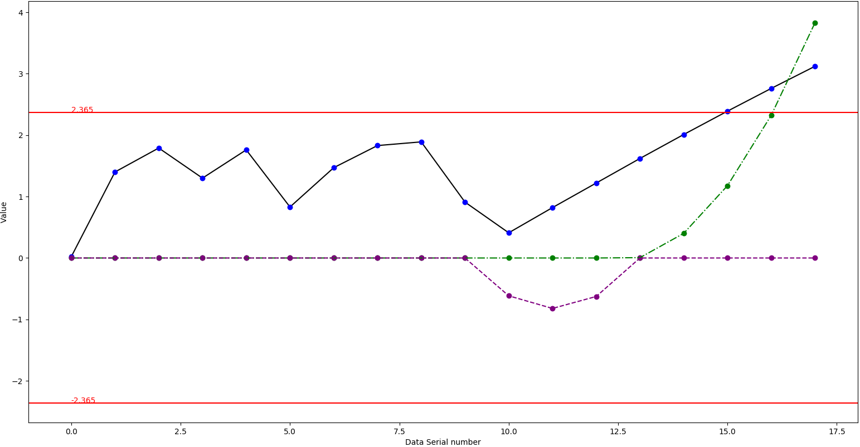
SH
SL
Anomaly

