Slide 1




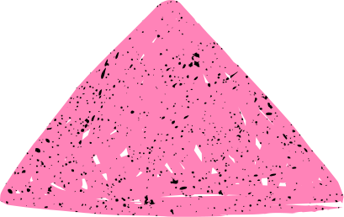
SyriaTel Customer Churn Prediction
Bridging the Future Together
Ronoh Ted
Data Scientict

Slide 2



Business problem
Data & methods
Key findings
Recommendations & next steps
Current Trends in SyriaTel
We built a model to identify customers at risk of leaving SyriaTel so we can intervene proactively.

Slide 3


Business Problem & Stakeholder Value
What is churn and why it matters (lost revenue, acquisition cost)
Stakeholder need: “Marketing needs to know who to target with retention offers.”
The telecom industry is evolving rapidly due to innovative technologies that enhance connectivity and efficiency.

Slide 4


Source & size: “3,333 customers, 21 fields”
Key feature groups (account info, usage, service calls)
Target balance: “14.5% churners, 85.5% stayers”
Data Overview

Slide 5


Iterative process: baseline → tune → compare
Models tried: Logistic Regression, Decision Tree, Random Forest
Primary metric: recall (catch as many churners as possible)
Modeling Approach

Slide 6

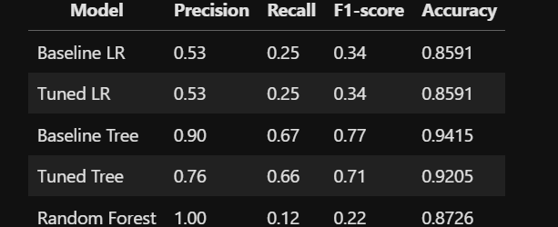

Key Results Comparison

Slide 7


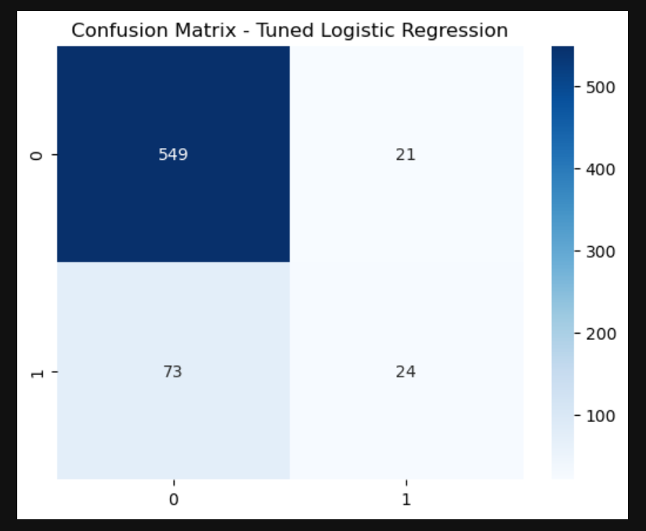
Confusion Matrix
The baseline tree offers the best balance—high precision (90%) and solid recall (67%)—resulting in the highest F1-score (0.77) and accuracy (94%). Tuning slightly lowers precision and accuracy for marginal gain in interpretability.

Slide 8



Business Impact & Recommendations
Target top 10% highest-risk customers → retain ~45 customers/month”
Revenue saved: “$1,350/month, $16,200/year”
Next steps: A/B test offers, monitor performance, retrain quarterly

Slide 9
Limitations & Risks
False negatives: 33% of churners not caught
Data drift: Model retraining needed
Feature gaps: Add survey or sentiment data in future

Slide 10
Thank You & Questions

