Slide 1
Canvas Kit

Slide 2
Table of Canvases
Business Model
Market Definition
7
1
2
Adjacent
Value Proposition
6
3
Job Map
Unmet Outcomes
5
4
Outcome Statements

Slide 3
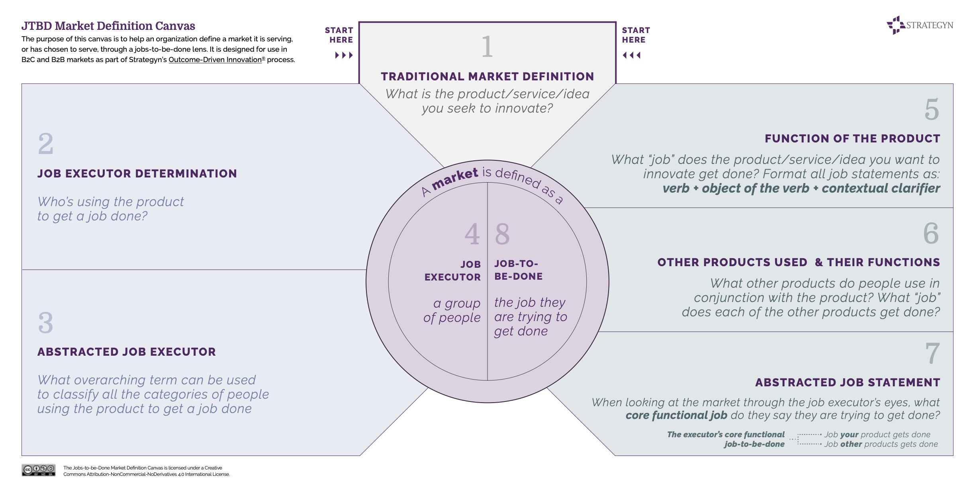

Slide 4
Adjacent Canvas

Slide 5
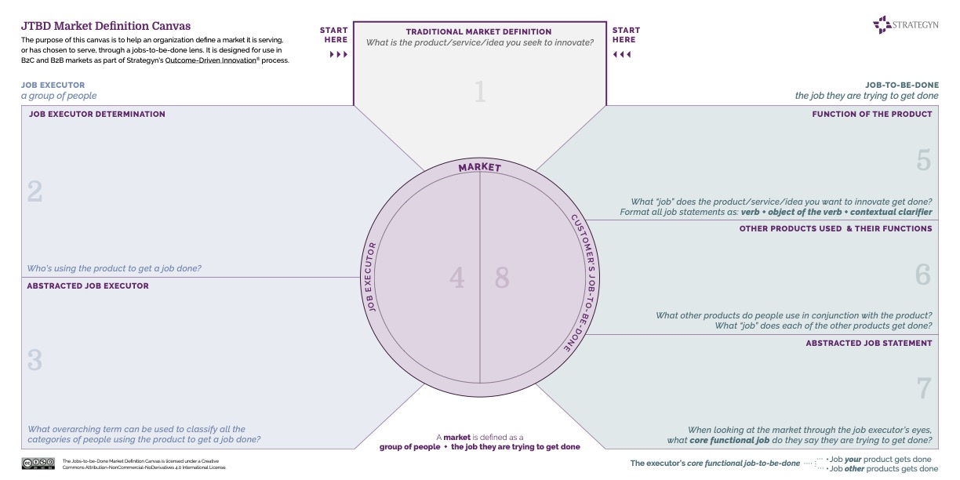

Slide 6
Job Map Canvas

Slide 7
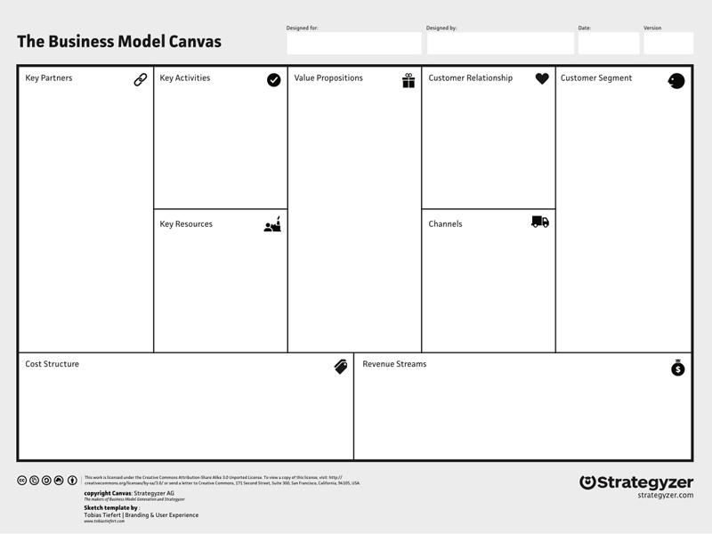


Job Steps
Desired Outcome Statement Canvas
Job Executor
Job-to-be-Done
Outcomes to Achieve
Minimize the Time it Takes to…
Outcomes to Avoid
Minimize the Likelihood that…

Slide 8
Unmet Outcome Canvas

Slide 9
Value Proposition Canvas
Job Steps

Slide 10
Business Model Canvas

