Slide 1
Version Control
Version control is a system that records changes to a file or set of files over time so that you can recall specific versions later.
Software source code is an example of a file you may want to version control, however you can do this with nearly and type of file on a computer.

Slide 2
GIT
Free and Open Source Version Control Tool
Allows you to revert files back to a previous state
Revert the entire project back to a previous state
Compare changes over time
See who last modified something that might be causing a problem
Generally means if you screw things up or lose files, you can easily recover

Slide 3
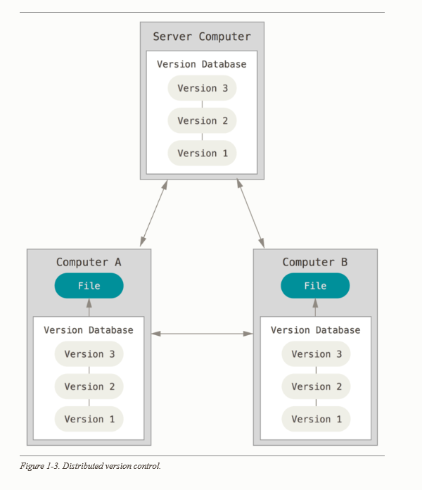
GIT – Distributed Version Control System
Clients don’t just check out the latest snapshot of the files: they fully mirror the repository. Every clone is really a full backup of all the data. If the server dies, any client repositories can be copied back up to the server to restore it.

Slide 4
Install GIT
https://git-scm.com/book/en/v2/Getting-Started-Installing-Git
Can either install it as a package or via another installer, or download the source code and compile it yourself
Link above tells you how to install on Linux, a Mac and Windows
git --version

Slide 5
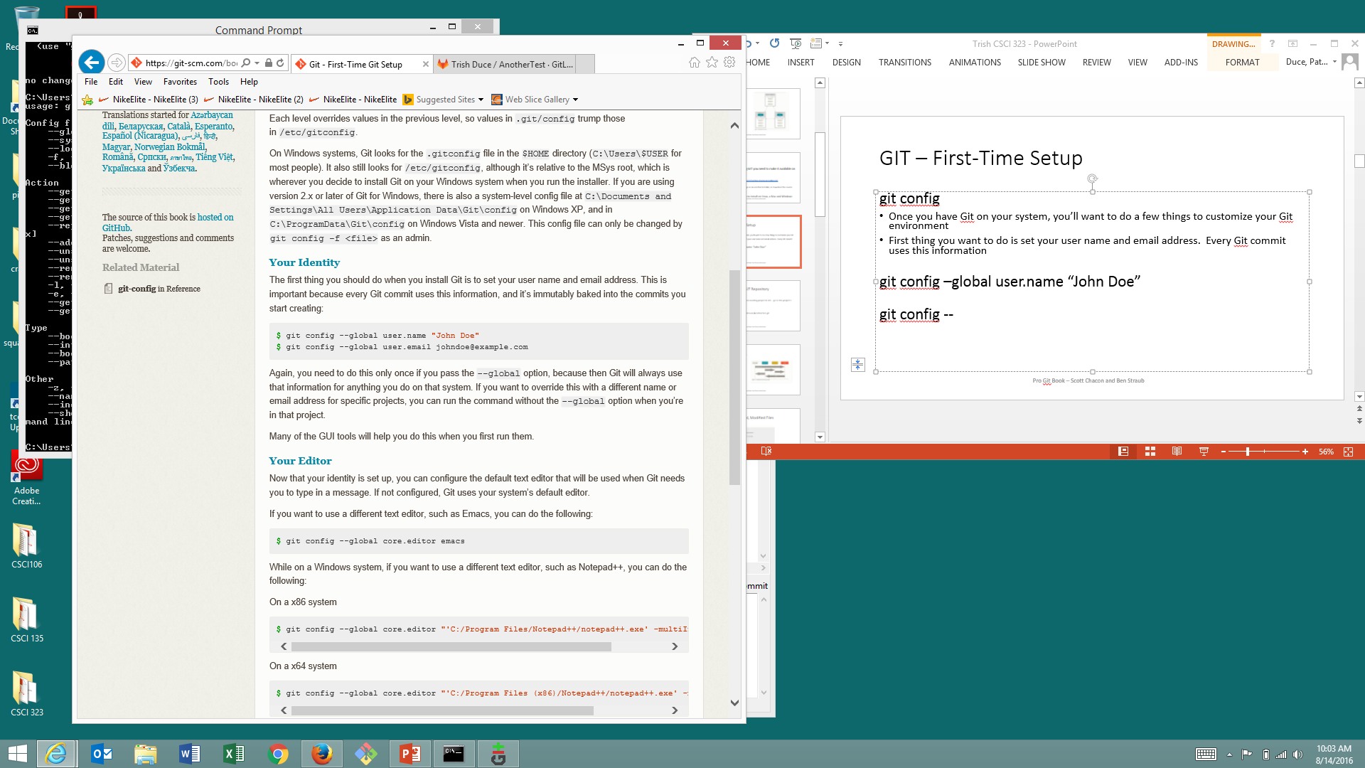
GIT – First-Time Setup
git config
Once you have Git on your system, you’ll want to do a few things to customize your Git environment
First thing you want to do is set your user name and email address. Every Git commit uses this information
check your settings with
git config --list

Slide 6
GIT – How it Stores Data
Stores data as a series of snapshots
When you make a commit, Git stores a commit object that contains a pointer to the snapshot of the content you staged. This object also contains the author’s name and email, the message that you typed, and the pointers to the commit that came directly before it.

Slide 7
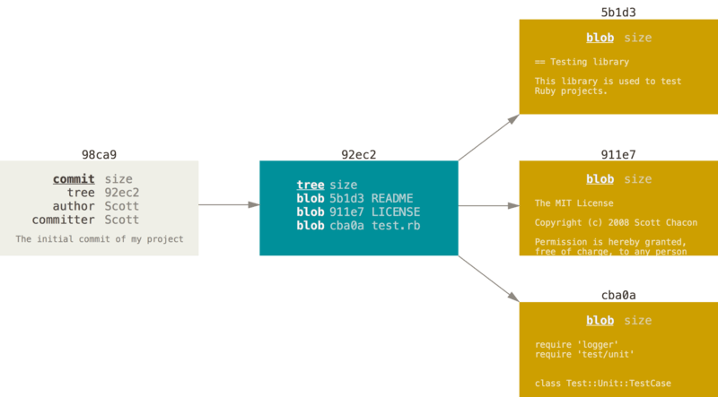
GIT – How it Stores Data
Assume you have a directory containing three files, and you stage them all and commit. Staging stores that version of the files in the Git repository (refers to them as blobs). A tree object and commit object are created. The snapshot can be recreated when needed.

Slide 8
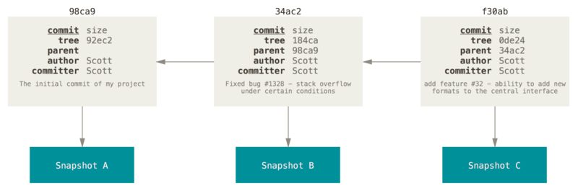
GIT – How it Stores Data
If you make some changes and commit again, the next commit stores a pointer to the commit that came immediately before it.

Slide 9
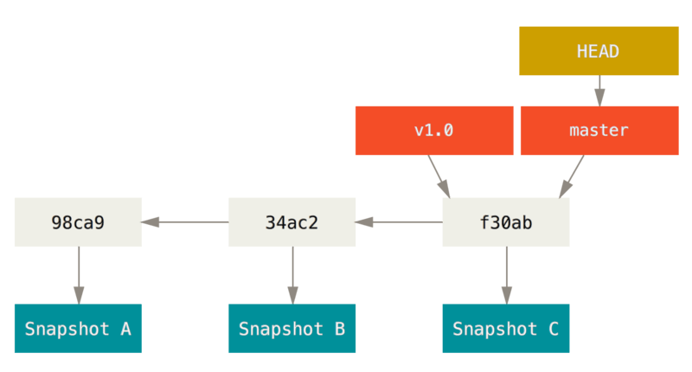
GIT – Branch
A branch is simply a movable point to one of these commits. The default branch in Git is master. (We changed this to main). As you start making commits, you’re given a master branch that points to the last commit you made. Every time you commit, it moves forward automatically

Slide 10
Getting a Git Repository
You typically obtain a Git repository in one of two ways:
You can take a local directory that is currently not under version control, and turn it into a Git repository, or
You can clone an existing Git repository from elsewhere.
In either case, you end up with a Git repository on your local machine, ready for work.

Slide 11
Initializing a Repository in an Existing Directory
If you have a project directory that is currently not under version control and you want to start controlling it with Git, you first need to go to that project’s directory.
git init

Slide 12
This creates a new subdirectory named .git that contains all of your necessary repository files — a Git repository skeleton. At this point, nothing in your project is tracked yet.
If you want to start version-controlling existing files (as opposed to an empty directory), you should probably begin tracking those files and do an initial commit. You can accomplish that with a few git add commands that specify the files you want to track, followed by a git commit:

Slide 13
Add all changes to staging
git add -A
Commit the changes along with a message
git commit -m 'initial project version'

Slide 14
Clone a repository
git clone http:….
Set up your virtual environment.
python –m venv .venv .venv\Scripts\Activate.ps1 python –m pip install –r requirements.txt

Slide 15
The Three States
Git has three main states that your files can reside in: committed, modified, and staged:
Committed means that the data is safely stored in your local database.
Modified means that you have changed the file but have not committed it to your database yet.
Staged means that you have marked a modified file in its current version to go into your next commit snapshot.

Slide 16
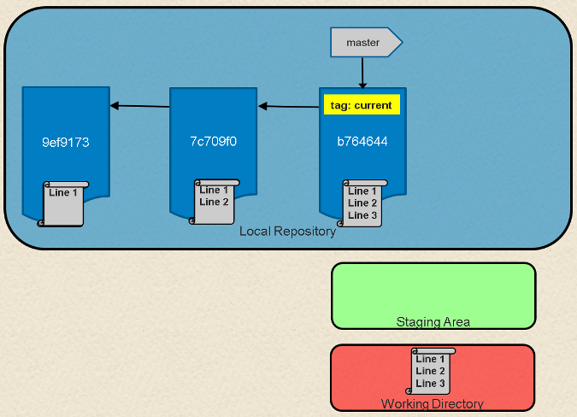

Slide 17
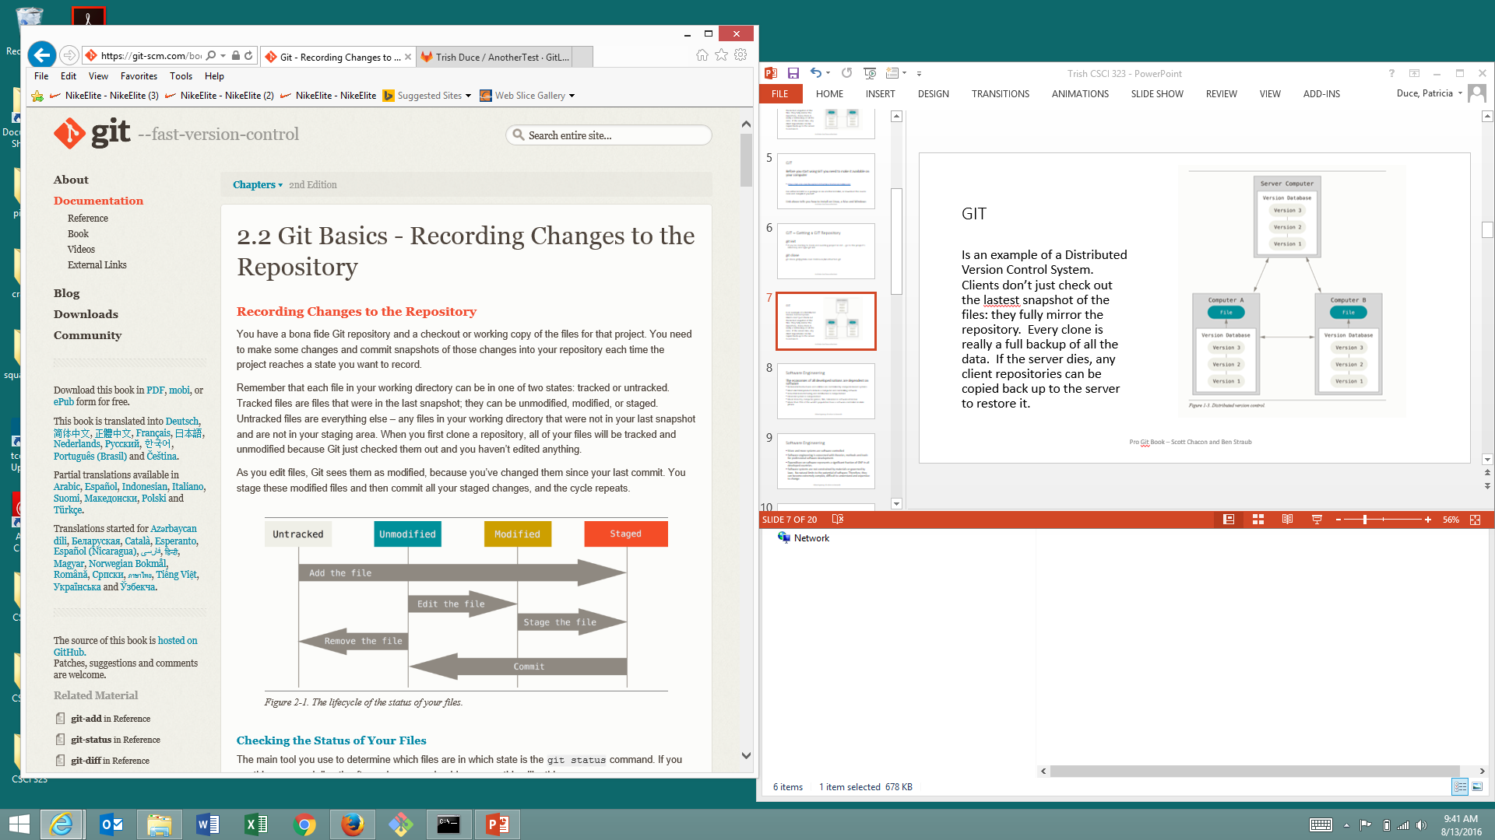
GIT – Tracked Files
git status
Untracked basically means that Git sees a file you didn’t have in the previous snapshot (commit);
git add nameoffile
to begin tracking

Slide 18
GIT
git rm name_of_file will untrack and remove file from working directory
git log view an existing commit history
git status
lots of git commands – can undo things
unstage a file
unmodify a file

Slide 19
Git Hub
It’s a good habit to create a remote repository of your code for each project. This way you have a backup in case anything happens to your computer and more importantly, it allows for collaboration with other software developers.
Remote repositories are versions of your project that are hosted on the Internet or network somewhere. Collaborating involves pushing and pulling data to and from them when you need to share work.

Slide 20
github.com
GitHub is free to use for public and open source projects.
(Work together across unlimited private repositories with a paid plan.)
Please create an account

Slide 21
GitHub
Dropdown arrow -> Your profile
Repositories
New
Repository name: test

Slide 22
Sync the local directory on our computer with the remote repository on the GitHub website.
git remote add origin https://github.com/trishduce/test.git
“push” your code to GitHub
git push -u origin master

Slide 23
GIT – Working with Remotes
To get data from your remote projects, you can run:
git fetch origin
Fetch all of the branches from the remote repository. This also downloads all of the required commits and files from the remote repository. Gives you a chance to review changes before integrating them into your copy of the project.
git diff master origin/master git merge origin/master
Merges changes into your local repository.
git pull origin (rolls git fetch and git merge into a single command) should consider a fetch/merge or pull right before you start working in your local repository

Slide 24
GIT – Working with Remotes
git remote -v
See which remote servers you have configured. If you cloned your repository, you should at least see origin – the default name Git gives to the server you cloned from.
git push origin master
When you have your project at a point you want to share, you have to push it upstream. git push [remote-name] [branch-name]

Slide 25
Create a New Repository
git clone https://github.com/trishduce/test.git cd test touch README.md git add README.md git commit –m “add README” git push –u origin master
“origin” is the default name for the connection url to the base repository on the central server.
The main branch is called “master”.

Slide 26
GIT – Working with Remotes
Adding Collaborators
Click on Settings for the Repository
Click on Collaborators under Access

Slide 27
GIT – Conflicts
Sometimes you get merge conflicts when merging, pulling or pushing a branch A merge conflict usually occurs when you have commits in your current branch which are not in the other branch, and vice versa.
During a merge if only one side changed a certain piece of code, the changes are applied. The merge conflicts occur when there are disagreeing changes. To resolve conflicts, you have to decide what the end result should be.
Need to edit file (look at conflicts), save file, stage file, commit, push

Slide 28
GitHub Desktop
https://desktop.github.com/
GitHub Desktop is an application that enables you to interact with GitHub using a GUI instead of the command line or a web browser.

Slide 29
GitHub Contributing to a Project
Forking Projects
If you want to contribute to an existing project to which you don’t have push access, you can “fork” the project. When you “fork” a project, GitHub will make a copy of the project that is entirely yours; it lives in your namespace, and you can push to it.

Slide 30
GitHub Contributing to a Project
This way, projects don’t have to worry about adding users as collaborators to give them push access. People can fork a project, push to it, and contribute their changes back to the original repository by creating what’s called a Pull Request

Slide 31
GitHub
Click on Settings of repository
Delete repository

Slide 32
Git Hub – git cheat sheet
https://education.github.com/git-cheat-sheet-education.pdf

Slide 33
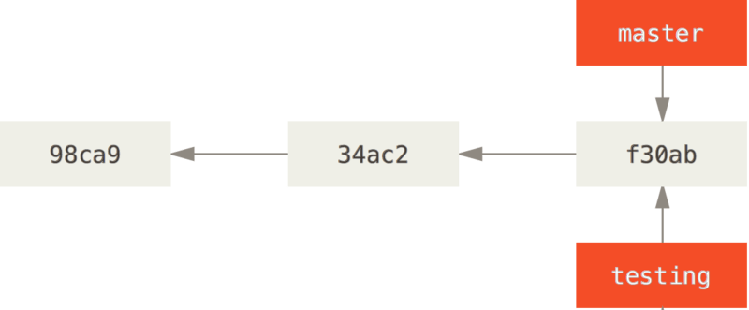
GIT – Branching
Branching means you diverge from the main line of development and continue to do work without messing with that main line.
git branch testing

Slide 34
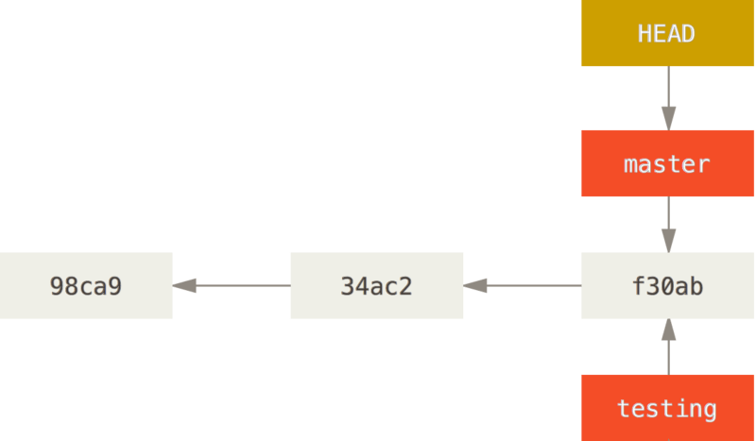
GIT – Branching
Git keeps a special pointer called HEAD to keep track of what branch you are working on. Git branch created branch but did not switch to branch.

Slide 35
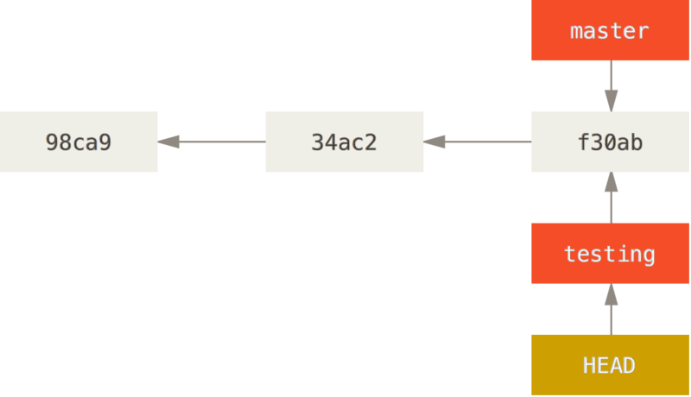
GIT – Switching Branches
git checkout testing moves HEAD to point to the testing branch

Slide 36
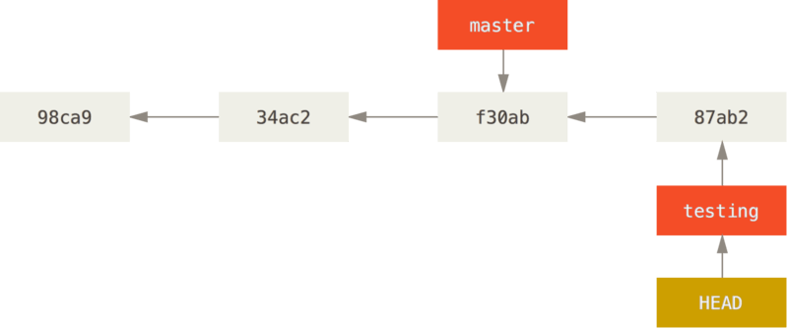
GIT –Branches
Now looks what happens if you modify a file, add it, and commit
HEAD moves forward when commit is made,
testing branch has moved forward, but you master
branch still points to the commit you were on when you
switched branches

Slide 37
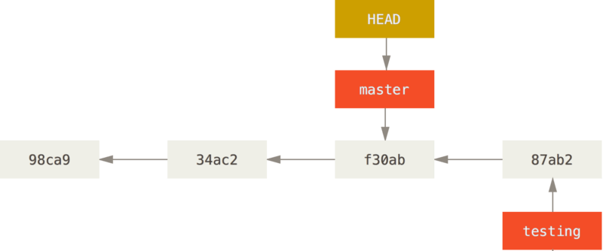
GIT –Branches
git checkout master switch back to master branch
That command did two things - HEAD pointer moved back to master
branch, and it reverted the files in your working directory back to the
snapshot that master points to.

Slide 38
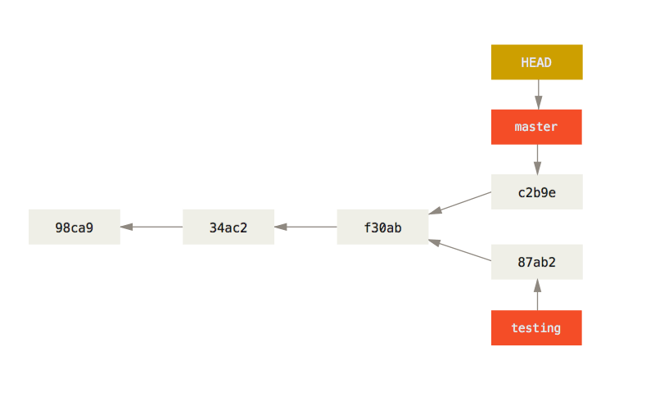
GIT –Branches
When you switch branches in Git, files in working directory revert to look like it did the last time you committed on that branch.
Did some work and made a commit in master ->

Slide 39
GIT –Branches, Example in the Real World
Let’s go through a simple example of branching and merging with a workflow that you might use in the real world. You’ll follow these steps:
Do work on a web site.
Create a branch for a new story you’re working on.
Do some work in that branch.
At this stage, you’ll receive a call that another issue is critical and you need a hotfix. You’ll do the following:
Switch to your production branch.
Create a branch to add the hotfix.
After it’s tested, merge the hotfix branch, and push to production.
Switch back to your original story and continue working.

Slide 40
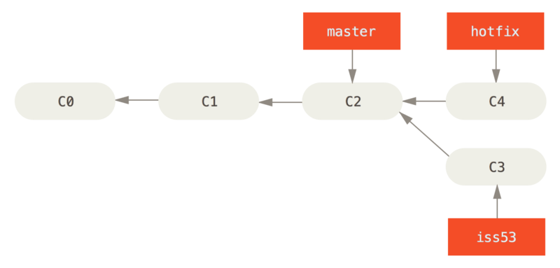
GIT –Branches, Example in the Real World

Slide 41
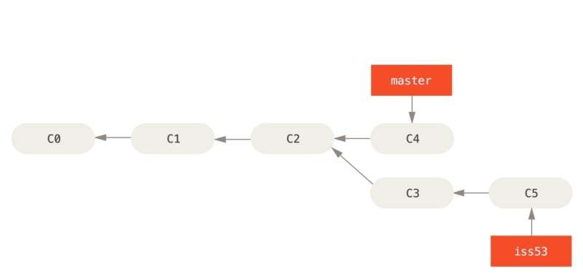
GIT –Branches, Example in the Real World
git checkout master
git merge hotfix
git branch –d hotfix

Slide 42
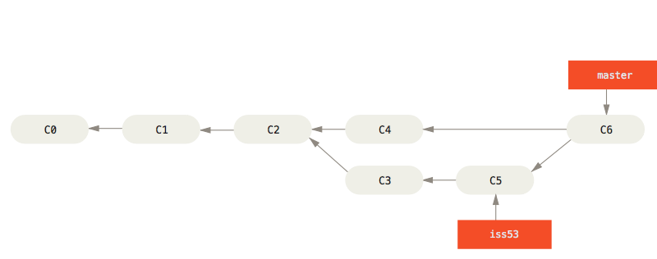
GIT –Branches, Example in the Real World
Finish work iss53 and commit
git checkout master
git merge iss53
Instead of moving branch pointer forward, Git
Creates a new snapshot that results from this
three-way merge and automatically creates a new commit that points to it, this is referred to as a merge commit, and is special in that it has more than one parent. You can now delete the branch git branch –d iss53.

Slide 43
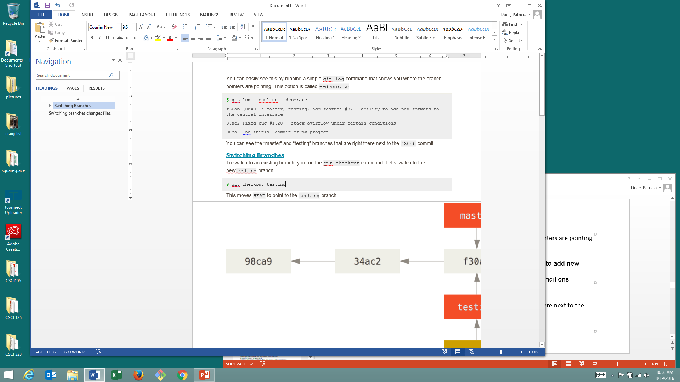
GIT – Branching
git log –oneline –decorate shows you where the branch pointers are pointing
Can see the “master” and “testing” branches that are right there next to the f30ab commit.

