Slide 1
Scrum is an agile approach for software development.
With an agile approach, you begin by creating a product backlog – a prioritized list of the features and other capabilities needed to develop a successful product.
Guided by the produce backlog, you always work on the most important or highest priority items first. When you run out of resources (such as time), any work that didn’t get completed will be of lower priority than the completed work.

Slide 2
Scrum
Work is performed in short, time boxed iterations (called Sprints)

Slide 3
Scrum
During each iteration, a self-organizing, cross-functional team does all of the work – such as designing, building and testing – required to produce completed, working features that could be put into production.

Slide 4
Scrum
Typically the amount of work in the product backlog is much greater than can be completed by a team in one short-duration iteration.
So, at the start of each iteration the team plans which high-priority subset of the product backlog to create in the upcoming iteration.

Slide 5
Scrum
At the end of the iteration, the team reviews the completed features with the stakeholders to get their feedback.

Slide 6
A stakeholder is anyone with an interest or investment in your project.
The stakeholders in each particular project will vary depending on the type of project and industry. Examples:
Project manager
Team members
Managers
Resource managers
Executives
Senior management
Company owners
Investors
Sponsors
Financiers (the people, not the cakes)
Suppliers
Vendors
Consultants
Customers
End users

Slide 7
Scrum
Based on the feedback, the product owner and team can alter both what they plan to work on next and how the team plans to do the work.

Slide 8
Scrum
At the end of each iteration, the team should have a potentially shippable product.

Slide 9
Scrum Framework
Scrum is not a standardized process where you methodically follow a series of sequential steps that are guaranteed to produce, on time and on budget, a high-quality product that delights customers.
Scrum is a framework for organizing and managing work.

Slide 10
Scrum Framework
The scrum framework is a set of values, principles, and practices.
The result will be a version of scrum that is uniquely yours.

Slide 11
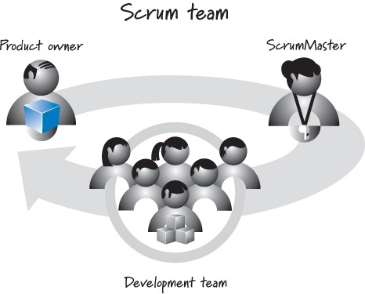
3 Scrum Roles
Responsible for guiding the team in creating and following its own process
Responsible for what will be developed and in what order.
Responsible for determining how to deliver what the product owner has asked for

Slide 12
Product Owner
The product owner is the empowered central point of product leadership. She is the single authority responsible for deciding which features and functionality to build and the order which to build them.
The product owner maintains and communicates to all other participants a clear vision of what the Scrum team is trying to achieve.

Slide 13
Product Owner
The product owner is responsible for the overall success of the solution being developed or maintained.
The product owner actively collaborates with the SrumMaster and development team and must be available to answer questions as soon as they are posed.

Slide 14
Product owner is part of Scrum Framework
Product management – not dependent on Scrum. It can and should exist with any framework or process. Product managers concentrate on defining the vision and strategy for the teams based on market research, an understanding of company goals and strategy, and by looking at the current state of success of their products.

Slide 15
ScrumMaster
The ScrumMaster helps everyone involved understand and embrace the Scrum values, principles, and practices.
The ScrumMaster acts as a coach, he has no authority to exert control over the team – Scrum Master is a leader not a manager.

Slide 16
Development Team
The development team is simply a diverse, cross-functional collection of people (architect, programmer, tester, database administrator, UI designer and so on) who are responsible for designing, building, and testing the desired product.
The development team self-organizes to determine the best way to accomplish the goal set out by the product owner. Typically 5-9 people in size.
In large development efforts – multiple scrum teams rather than 1 large team.

Slide 17
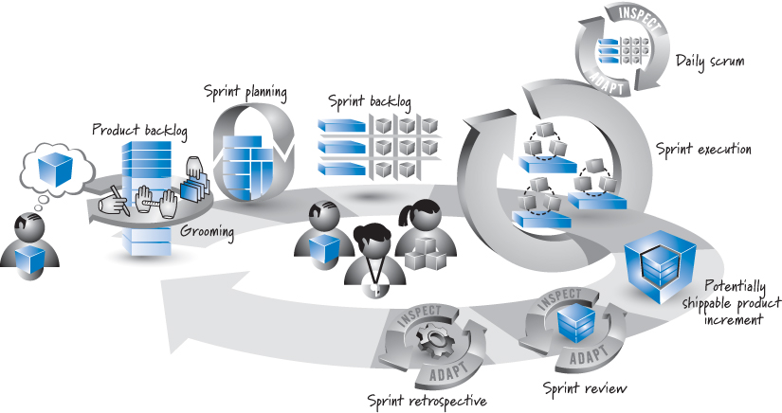
Scrum framework

Slide 18
Grooming
Tasks are called Product Backlog Items (PBI)
Creating and refining PBI’s.
Estimating the time to complete a PBI.
Prioritizing PBI’s

Slide 19
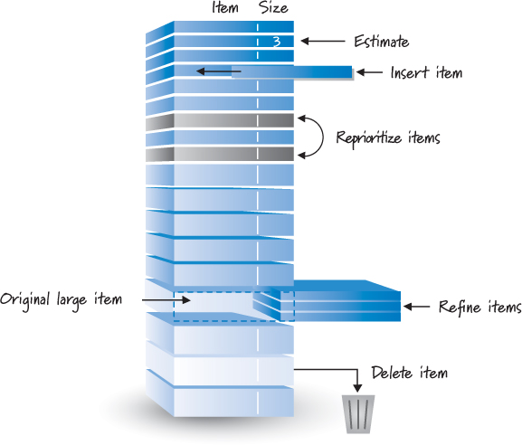
Grooming
Essential Scrum – Kenneth S. Rubin

Slide 20
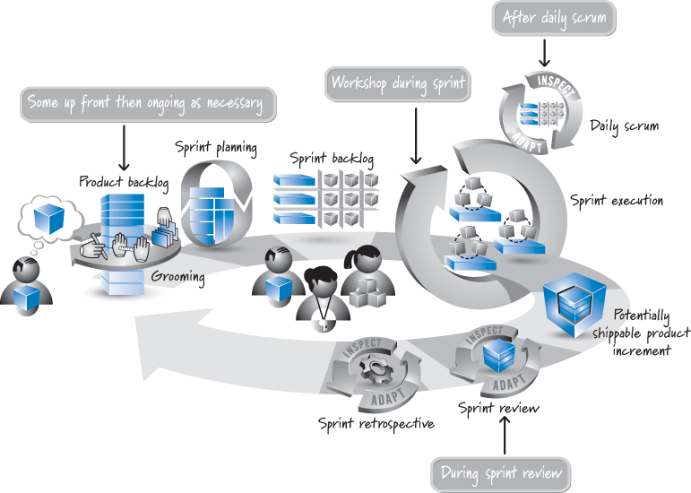
When does grooming happen?

Slide 21
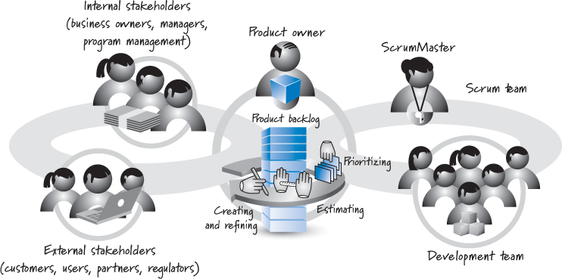
Who does it?

