Slide 1
The four basic process activities:
Specification
Development
Validation
Evolution
are organized differently in different development processes.
We are going to take a closer look at specification

Slide 2
Software Specification
Software specification or requirements engineering is the process of understanding and defining what services are required from the system and identifying the constraints on the system’s operation and development.

Slide 3
Requirements: The Reality
Customers may not be capable of describing what they desire
Customers may not actually know what they want.
Customers tend to be unaware of what design would best fulfill their desired behavior.
Customers may make unrealistic demands because they don’t know what is and isn’t feasible.

Slide 4
What is a requirement?
It may range from a high-level, abstract statement of a service that a system should provide or a constraint on a system to a detailed, formal definition of a system function.

Slide 5
Types of requirements
User requirements
Statements in natural language plus diagrams of the services the system provides and its operational constraints. Written for customers.
System requirements
A structured document setting out detailed descriptions of the system’s functions, services and operational constraints.
Different kinds of requirements are needed to communicate information about a system to different types of readers. A user requirement is quite general, the system requirements provide more specific information.

Slide 6
User and system requirements (example with a patient information system for mental health care).

Slide 7
Software system requirements are often classified as functional or non-functional requirements

Slide 8
Functional requirements
Statements of services the system should provide, how the system should react to particular inputs and how the system should behave in particular situations. What the system should do.
May state what the system should not do.
Non-functional requirements
Constraints on the services or functions offered by the system such as timing constraints, constraints on the development process, standards, etc.
Not directly concerned with the specific services delivered by the system to its users

Slide 9
Non-functional classifications
Product requirements
Requirements which specify that the delivered product must behave in a particular way e.g. execution speed, reliability, etc.
Organizational requirements
Requirements which are a consequence of organizational policies and procedures in customer’s and developer’s organization, e.g. how a user authenticates themselves to the system or e.g. development process requirement that specifies programming language; the development environment;
External requirements
Requirements which arise from factors which are external to the system and its development process e.g. regulatory requirements that set out what must be done for the system to be approved by a regulator, legislative requirements to ensure that the system operates within the law such as conforming to a privacy standard

Slide 10
Example: Mentcare system
A medical information system that maintains information about patients suffering from mental health problems and the treatments that they have received.

Slide 11
Examples of possible non-functional requirements for the Mentcare system
Product Requirement: The Mentcare system shall be available to all clinics during normal working hours (Mon - Fri, 8:30-5:30). Downtime within normal working hours shall not exceed 5 seconds in any one day.
This is an availability requirement that defines when the system has to be available and the allowed downtime each day. It says nothing about the functionality of the Mentcare system and clearly identifies a constraint that has to be considered by the system designers.

Slide 12
Examples of possible non-functional requirements for the Mentcare system
Organizational Requirement: Users of the Mentcare system shall identify themselves using their health authority identity card.
There is a standard procedure for all software where, instead of users having a login name, they swipe their identity card through a reader to identify themselves.

Slide 13
Examples of possible non-functional requirements for the Mentcare system
External Requirement: The system shall implement patient privacy provisions as set out in HStan-02-2006-priv.
The system needs to conform to privacy legislation. Must be developed in accordance with a national privacy standard.

Slide 14
3 main activities in the requirements engineering process
Requirements elicitation and analysis
What do the system stakeholders require or expect from the system?
Requirements specification
Defining the requirements in detail (in a doc)
Requirements validation
Checks the requirements for realism, consistency, and completeness.

Slide 15
Requirements elicitation
The aims of the requirements elicitation (requirements discovery) process are to understand the work that stakeholders do and how they might use a new system to help support that work.
During requirements elicitation, software engineers work with stakeholders to find out about the application domain, work activities, the services and system features that stakeholders want, the required performance of the system, hardware constraints and so on.

Slide 16
Not as easy as it may seem
Stakeholders don’t know what they really want. They may find it difficult to articulate what they want the system to do; they may make unrealistic demands because they don’t know what is and isn’t feasible
Stakeholders express requirements in their own terms. Requirements engineers, without experience in the customer’s domain, may not understand these requirements.
Different stakeholders may have conflicting requirements.
Organizational and political factors may influence the system requirements.
The requirements change during the analysis process. New stakeholders may emerge and the business environment may change.

Slide 17
3 main activities in the requirements engineering process
Requirements elicitation and analysis
What do the system stakeholders require or expect from the system?
Requirements specification
Defining the requirements in detail (in a doc)
Requirements validation
Checks the requirements for realism, consistency, and completeness.

Slide 18
Requirements Specification
The process of writing down the user and system requirements in a requirements document.
User requirements have to be understandable by end-users and customers who do not have a technical background.
System requirements are more detailed requirements and may include more technical information.

Slide 19
The software requirements document
The software requirements document is the official statement of what is required of the system developers.
It is NOT a design document. As far as possible, it should set of WHAT the system should do rather than HOW it should do it.

Slide 20
Agile methods and requirements
Many agile methods argue that producing detailed system requirements is a waste of time as requirements change so quickly.
The requirements document is therefore always out of date.
Agile methods usually use incremental requirements engineering

Slide 21
3 main activities in the requirements engineering process
Requirements elicitation and analysis
What do the system stakeholders require or expect from the system?
Requirements specification
Defining the requirements in detail (in a doc)
Requirements validation
Checks the requirements for realism, consistency, and completeness.

Slide 22
Requirements validation
Concerned with demonstrating that the requirements define the system that the customer really wants.
Requirements error costs are high so validation is very important

Slide 23
Requirements checking
Validity. Does the system provide the functions which best support the customer’s needs?
Consistency. Are there any requirements conflicts?
Completeness. Are all functions required by the customer included?
Realism. Can the requirements be implemented given available budget and technology
Verifiability. Can the requirements be checked? (Can you write a set of tests that can demonstrate that the delivered system meets each specified requirement).

Slide 24
Requirements in Scrum
Scrum views requirements as an important degree of freedom that we can manipulate to meet our business goals. (For example: if we are running out of time or money – we can drop low-value requirements, or if a high-value requirement emerges we have the ability to add it to the product)

Slide 25
Progressive Refinement
When using Scrum, not all requirements have to be at the same level of detail at the same time. Requirements that we’ll work on sooner will be smaller and more detailed than ones that we won’t work on for some time.
With sequential product development all requirements must be at the same level of detail at the same time.

Slide 26
User Stories
User stories are a convenient format for expressing the desired business value for many types of product backlog items.
A user story is an informal, general explanation of a software feature written from the perspective of the end user. Its purpose is to articulate how a software feature will provide value to the customer.

Slide 27
User Stories
A key component of agile software development is putting people first, and a user story puts end users at the center of the conversation.
These stories use non-technical language to provide context for the development team and their efforts.
After reading a user story, the team knows why they are building, what they're building, and what value it creates.

Slide 28
User stories are one of the core components of an agile program.
They help provide a user-focused framework for daily work — which drives collaboration, creativity, and a better product overall.

Slide 29
User stories are a few sentences in simple language that outline the desired outcome.
They don't go into detail. Requirements are added later, once agreed upon by the team.

Slide 30
User stories serve a number of key benefits:
Stories keep the focus on the user. A to-do list keeps the team focused on tasks that need to be checked off, but a collection of stories keeps the team focused on solving problems for real users.
Stories enable collaboration. With the end goal defined, the team can work together to decide how best to serve the user and meet that goal.
Stories drive creative solutions. Stories encourage the team to think critically and creatively about how to best solve for an end goal.
Stories create momentum. With each passing story, the development team enjoys a small challenge and a small win, driving momentum.

Slide 31
During a sprint or iteration planning meeting, the team decides what stories they’ll tackle that sprint.
Teams now discuss the requirements and functionality that each user story requires.
This is an opportunity to get technical and creative in the team’s implementation of the story. Once agreed upon, these requirements are added to the story.

Slide 32
Consider the following when writing user stories:
Definition of “done” — The story is generally “done” when the user can complete the outlined task, but make sure to define what that is
Outline subtasks or tasks — Decide which specific steps need to be completed and who is responsible for each of them.
User personas — For whom? If there are multiple end users, consider making multiple stories.
Ordered Steps — Write a story for each step in a larger process.
Listen to feedback — Talk to your users and capture the problem or need in their words. No need to guess at stories when you can source them from your customers.
Time —Since stories should be completable in one sprint, stories that might take weeks or months to complete should be broken up into smaller stories.
Once the user stories are clearly defined, make sure they are visible for the entire team.

Slide 33
User stories are often expressed in a simple sentence, structured as follows:
“As a [persona], I [want to], [so that].”

Slide 34
"As a [persona]":
Who are we building this for? We’re not just after a job title, we’re after the persona of the person. Max. Our team should have a shared understanding of who Max is. We’ve hopefully interviewed plenty of Max’s. We understand how that person works, how they think and what they feel. We have empathy for Max.

Slide 35
“Wants to”:
Here we’re describing their intent — not the features they use. What is it they’re actually trying to achieve?
This statement should be implementation free — if you’re describing any part of the UI and not what the user goal is you're missing the point.

Slide 36
“So that”:
What’s the overall benefit they’re trying to achieve? What is the big problem that needs solving?

Slide 37
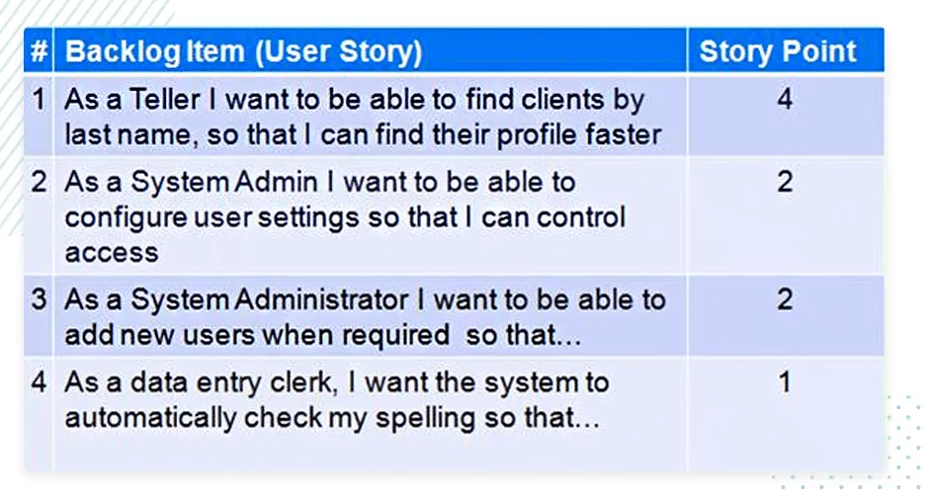

Slide 38
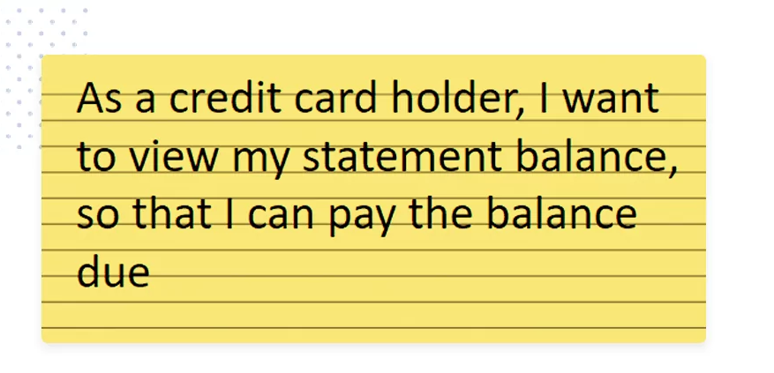

Slide 39
Product backlog is composed of backlog items (PBIs)
Features – most PBIs are features, items of functionality that will have value to the user or customer
Defects – things that need repair
Technical Improvements – move to the latest version of the Oracle DBMS
Knowledge-acquisition work

