Slide 1
There are 3 classifications of design patterns.
Creational patterns to provide object creation mechanisms that increase flexibility and reuse of existing code. Types: Abstract Factory, Builder, Factory Method, Object Pool, Prototype, Singleton.
Structural patterns to explain how to assemble objects and classes into larger structures, while keeping the structures flexible and efficient. Types: Adapter, Bridge, Composite, Decorator, Facade, Flyweight, Private Class Data, Proxy.
Behavioral patterns to take care of effective communication and the assignment of responsibilities between objects. Types: Chain of Responsibility, Command, Interpreter, Iterator, Mediator, Memento, Null Object, Observer, State, Strategy, Template Method, Visitor.

Slide 2
Singleton – Creational Pattern
Singleton pattern as the name suggests is used to create one and only instance of a class.
A singleton should be used when managing access to a resource which is shared by the entire application, and it would be destructive to potentially have multiple instances of the same class.

Slide 3
Its trivial to new-up an object of a class but how do we ensure that only one object ever gets created? The answer is to make the constructor private of the class we intend to define as singleton. That way, only the members of the class can access the private constructor and no one else.
Formally the Singleton pattern is defined as ensuring that only a single instance of a class exists and a global point of access to it exists.

Slide 4
As an example, let's say we want to model the American President's official aircraft called "Airforce One" in our software. There can only be one instance of Airforce One and a singleton class is the best suited representation.

Slide 5
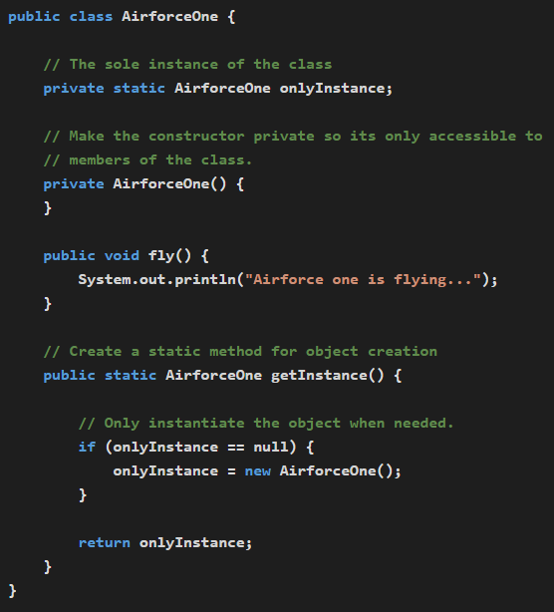
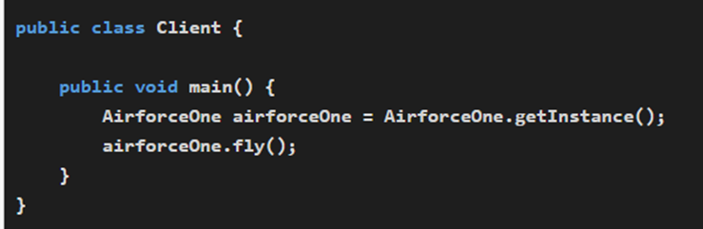

Slide 6
Iterator – Behavioral Pattern
The least expressive computer languages make no attempt to hide the inner workings of their data structures. In those languages, if you want to visit every element in an array, you have to generate the integer indexes yourself.

Slide 7
Code in such languages struggles to stay at the high level of describing programmer intent. Instead, the flow of each thought is interrupted with low-level data structure details. When code can’t abstract away the mechanics of iteration, it becomes more difficult to read and it’s more liable to errors.

Slide 8
The remedy is encapsulation. The Iterator Pattern proposes that the details about how a data structure is traversed should be moved into an “iterator” object that, from the outside, simply yields one item after another without exposing the internals of how the data structure is designed.

Slide 9
Iterating with the “for” loop
Python’s for loop abstracts the Iterator Pattern so thoroughly that most Python programmers are never even aware of the object design pattern that it enacts beneath the surface. The for loop performs repeated assignment, running its indented block of code once for each item in the sequence it is iterating over.
some_primes = [2, 3, 5]
for prime in some_primes:
print(prime)
2
3
5

Slide 10
Let’s now step behind the for loop and learn about the design pattern that powers it. The traditional Iterator Pattern involves three things:
First, there’s a container object.
This is the object that holds a collection of items (e.g., an array, list, or set).
It acts as the "repository" for the items that need to be iterated over.

Slide 11
Second, the container’s internal logic lets it corral and organize a number of item objects.
The container manages its items, organizing them internally (e.g., in an array, linked list, or other data structure).
The specifics of this organization are hidden from the outside world, encapsulating the container's complexity.

Slide 12
Finally, there’s the key to the pattern:
Instead of each container defining unique methods for traversing its items (e.g., getNext() or fetchItemAt(int index)), the pattern introduces a generic iterator.
The iterator provides a standard way to sequentially access items in the container, regardless of the container's internal structure.

Slide 13
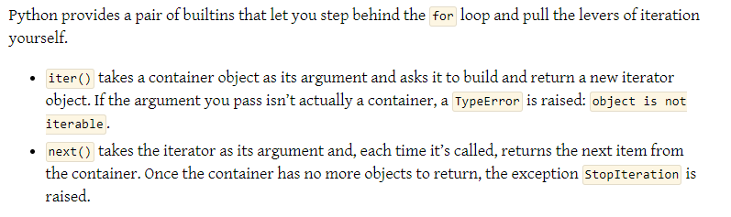

Slide 14
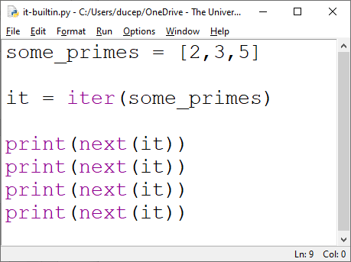

Slide 15
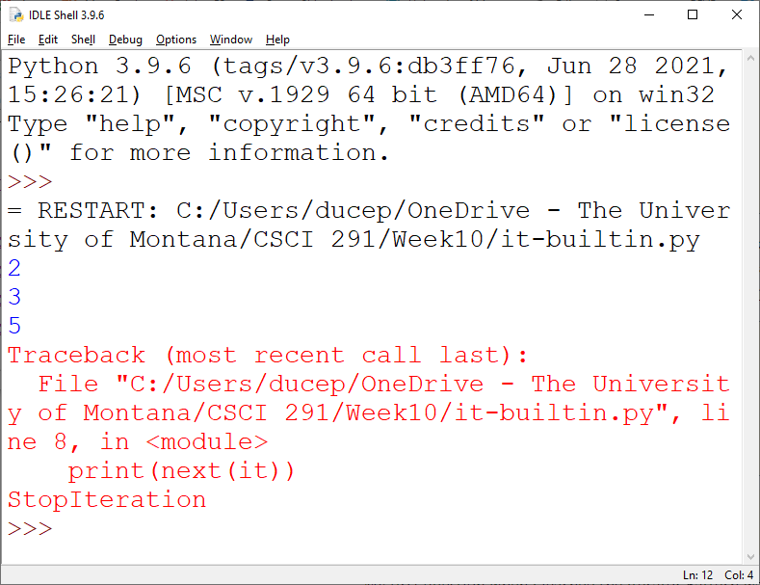

Slide 16
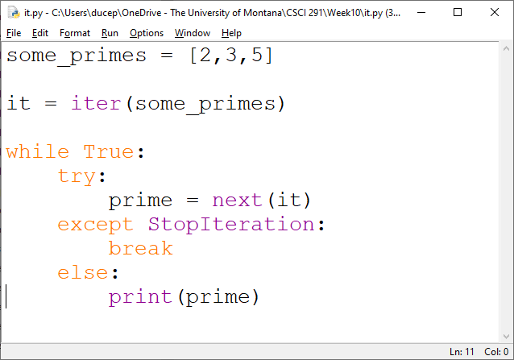
for is implemented as something like the following while loop:

Slide 17
Why does the iterator need to be a separate object from the container? Why can’t each container simply include a counter inside that reminds it which object to yield next?

Slide 18
The answer is that a single internal counter would work as long as only one for loop at a time were ever iterating over a container. But there are many situations where several for loops are working on the same container at once.

Slide 19
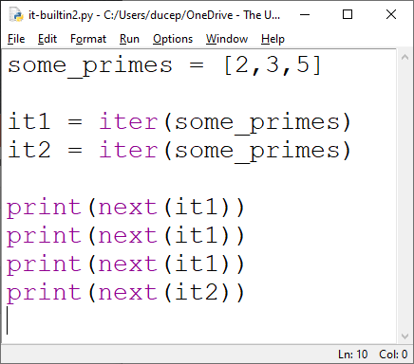
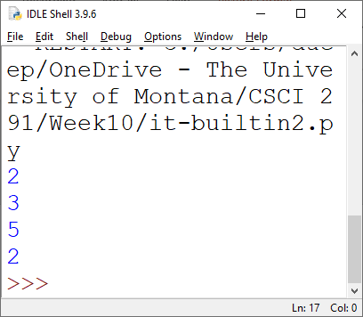

Slide 20
Iterator is a behavioral design pattern that lets you traverse elements of a collection.
Abstraction: The container's internal details are hidden. You don't need to know how items are stored or managed.
Reusability: Iterators work consistently across different types of containers. For example, whether you're working with an ArrayList, HashSet, or TreeMap in Java, you can use the same loop structure (e.g., a for-each loop).
Simplifies Code: You don’t have to manually manage indices or navigate through internal structures. The iterator handles this for you.

Slide 21
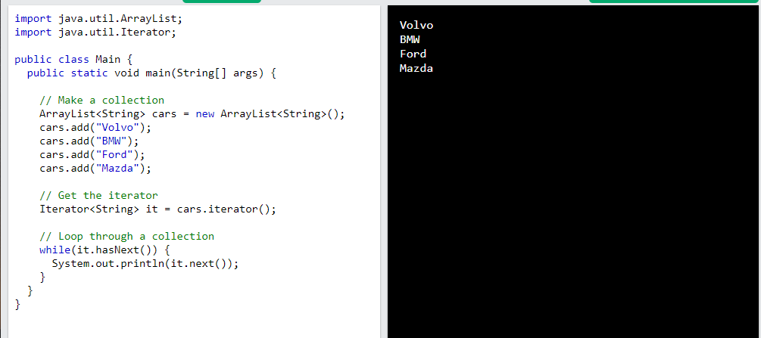

Slide 22
In most modern programming languages, iterators are built into the standard libraries for common collections (e.g., arrays, lists, sets, dictionaries).
Sometimes, programmers build their own iterators when:
They have custom data structures that do not have built-in iterator support.
They need a specific way to traverse data (e.g., skipping elements, traversing in reverse, or traversing in a non-standard order).
Java: Implementing the Iterator interface for a custom collection.
Python: Defining an iterator by implementing the __iter__() and __next__() methods in a class.

Slide 23
Benefits of the Iterator Design Pattern:
Containers focus on storing and managing items.
Iterators handle consistent traversal.
The programmer doesn't need to learn unique traversal methods for each container; a generic iterator interface simplifies the process.

