Slide 1
There are 3 classifications of design patterns.
Creational patterns to provide object creation mechanisms that increase flexibility and reuse of existing code. Types: Abstract Factory, Builder, Factory Method, Object Pool, Prototype, Singleton.
Structural patterns to explain how to assemble objects and classes into larger structures, while keeping the structures flexible and efficient. Types: Adapter, Bridge, Composite, Decorator, Facade, Flyweight, Private Class Data, Proxy.
Behavioral patterns to take care of effective communication and the assignment of responsibilities between objects. Types: Chain of Responsibility, Command, Interpreter, Iterator, Mediator, Memento, Null Object, Observer, State, Strategy, Template Method, Visitor.

Slide 2
Observer
The Observer defines a one-to-many relationship so that when one object changes state, the others are notified and updated automatically.

Slide 3
Observer
Social media helps us immensely in understanding the observer pattern.
If you are registered on Twitter then whenever you follow someone, you are essentially asking Twitter to send you (the observer) tweet updates of the person (the subject) you followed. The pattern consists of two actors, the observer who is interested in the updates and the subject who generates the updates.

Slide 4
Observer
Going back to our aircraft example, we can say that any aircraft in flight would be interested in updates from the air-traffic controller.
We can imagine that an aircraft (observer), as soon as, it is airborne would want to subscribe to updates from the air traffic (subject) controller and unsubscribe when it lands.

Slide 5
Template Method
The Template Method defines a skeleton of an algorithm in an operation, and defers some steps to subclasses.

Slide 6
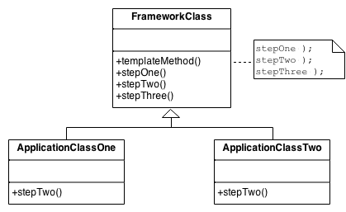
The implementation of template_method() is: call step_one(), call step_two(), and call step_three().
step_two() is a "hook" method – a placeholder. It is declared in the base class, and then defined in derived classes.

Slide 7
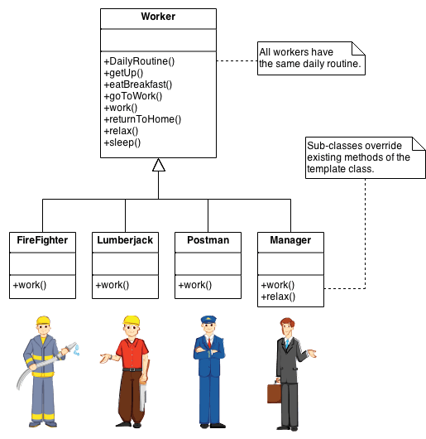
Example: daily routine of a worker.

