Slide 1
Deployment

Slide 2
There is a fundamental tension between the ease of use desired in a local Django development environment and the security and performance necessary in production.

Slide 3
Django is designed to make web developers’ lives easier, and therefore, it defaults to a local configuration when the startproject command is first run. We’ve seen this in the use of SQLite as the local file-based database, the built-in runserver command that launches a local web server in your web browser, and various default configurations in the settings.py file, including DEBUG set to True and an auto-generated SECRET_KEY.
In production, things are different. All the configurations optimized for ease of use in the development environment need to focus instead on security, performance, and scalability.

Slide 4
Hosting options
Dedicated Server: a physical server sitting in a data center that belongs exclusively to you. Generally, only the largest companies adopt this approach since it requires a lot of technical expertise to configure and maintain.
Virtual Private Server (VPS): a server can be divided into multiple virtual machines that use the same hardware, which is much more affordable than a dedicated server. This approach also means you don’t have to worry about maintaining the hardware.
Platform as a Service (PaaS): a managed VPS solution that is pre-configured and maintained, making it the fastest option to deploy and scale a website. It typically comes with a managed database, as well. The downside is that a developer cannot access the same degree of customization that a VPS or a dedicated server provides. At scale, PaaS can become quite expensive.

Slide 5
Deployment Checklist (from book using Heroku)
configure static files and install WhiteNoise
add environment variables with environs
create a .env file and update the .gitignore file
update DEBUG, ALLOWED_HOSTS, SECRET_KEY, and CSRF_TRUSTED_ORIGINS
update DATABASES to run PostgreSQL in production and install psycopg
install Gunicorn as a production WSGI server
create a Procfile
update the requirements.txt file
create a new Heroku project, push the code to it, and start a dyno web process
We could toggle many more production settings, but this list covers the most critical security and performance concerns.

Slide 6
Static Files
Static files are the images, JavaScript, and CSS used by a website.
For local usage, as long as DEBUG is set to True in settings.py, the files are served automatically by the runserver command.

Slide 7
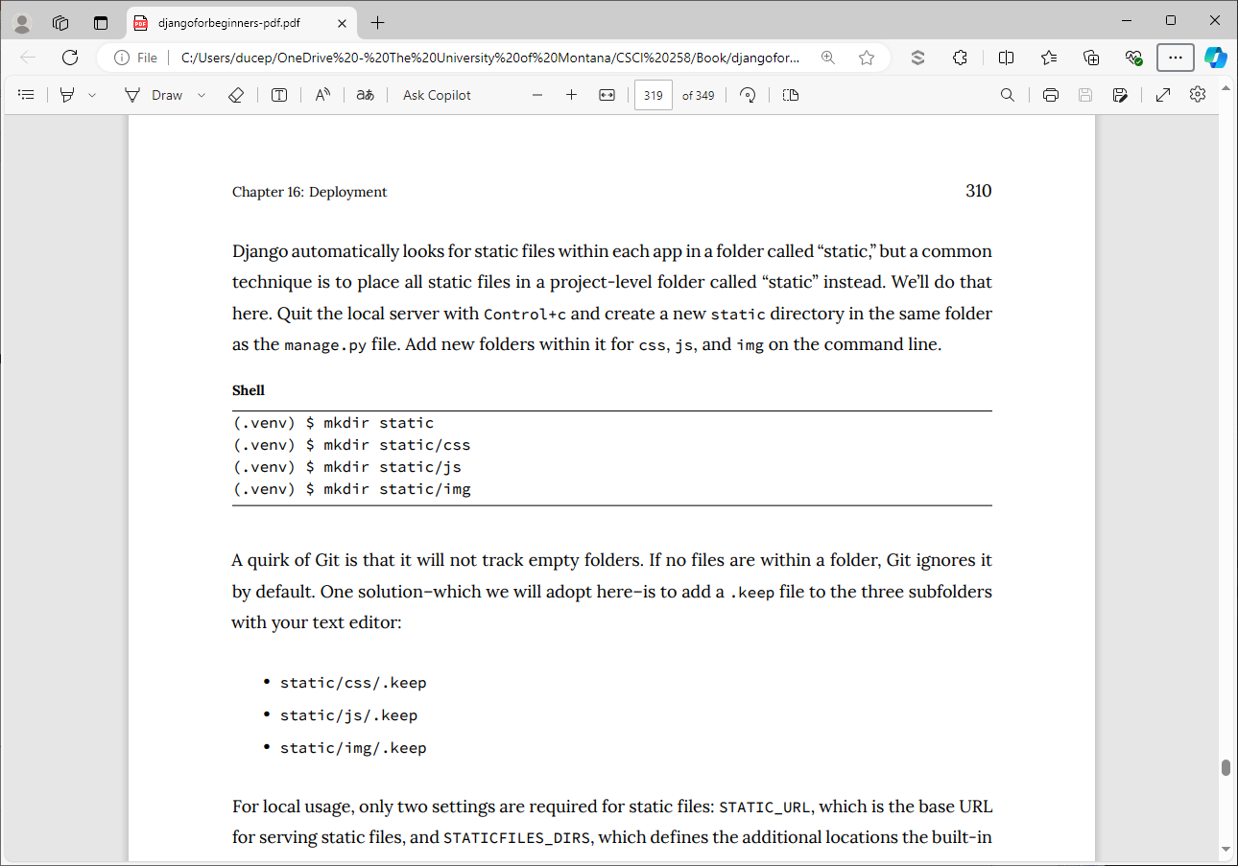

Slide 9
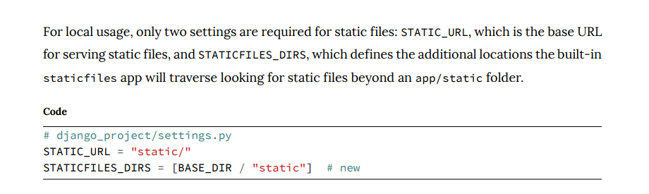

Slide 10
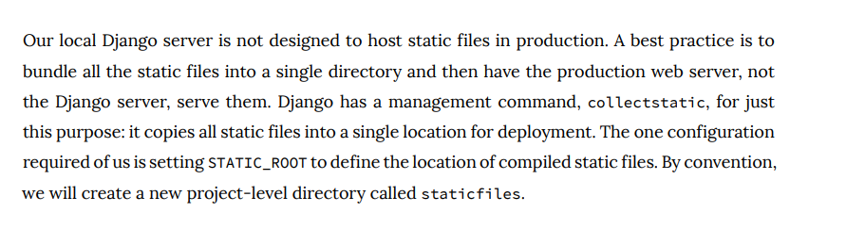
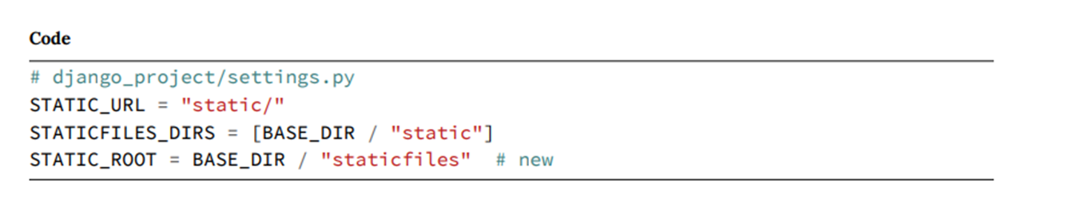
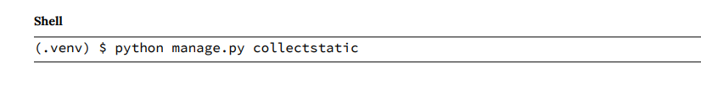

Slide 11
Look at staticfiles in my newspaper app

Slide 12
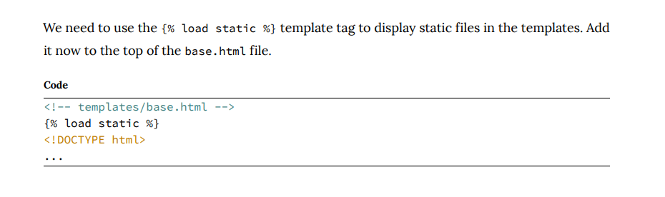

Slide 13
We will use the popular WhiteNoise third-party package optimized to serve static files from Django.
(.venv) $ python -m pip install whitenoise==6.8.0
USE VERSION 6.8.0

Slide 14
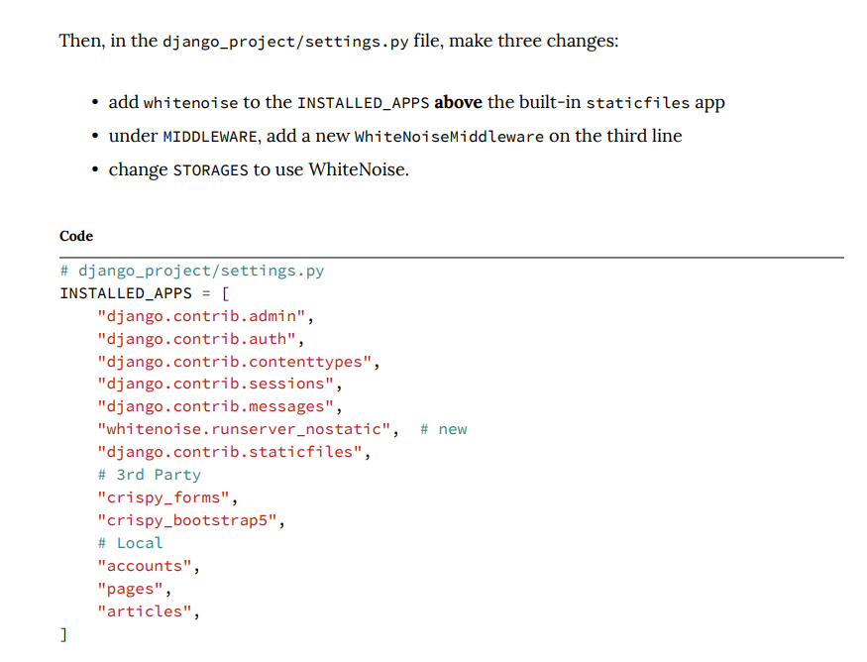

Slide 15
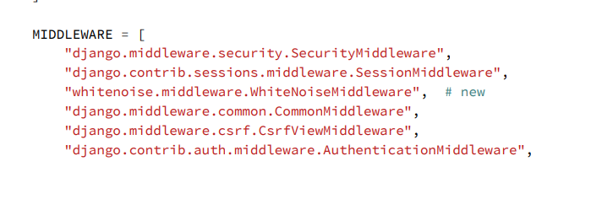

Slide 16
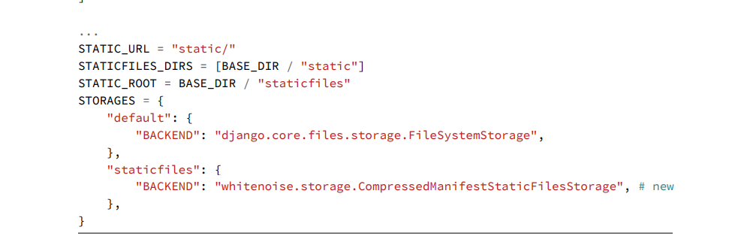

Slide 17
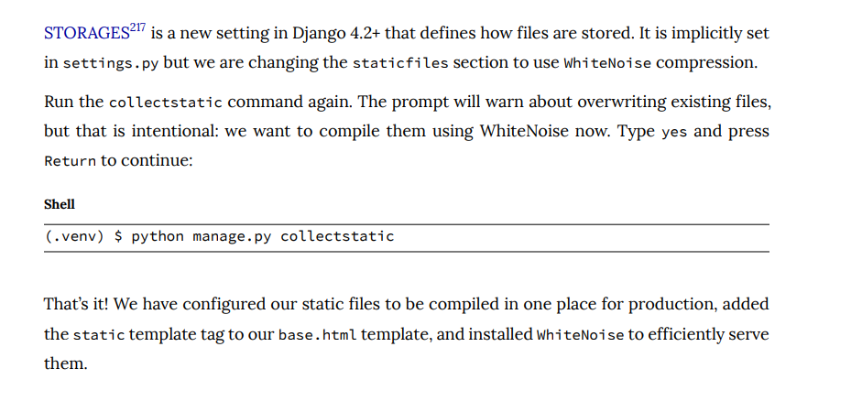

Slide 18
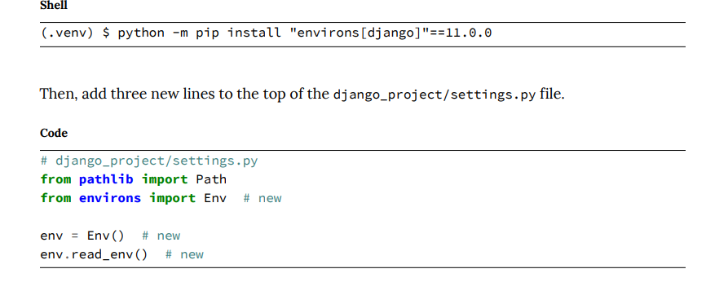
Environment variables
Multiple ways to work with environment variables – book uses:

Slide 19
Create a .env file to store environment variables
Add .env to .gitignore
Let’s look at DEBUG environment variable … when set to True…

Slide 20
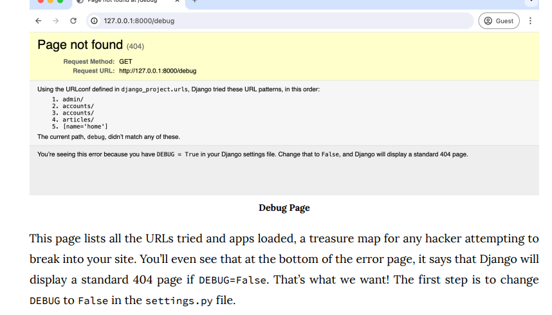

Slide 21
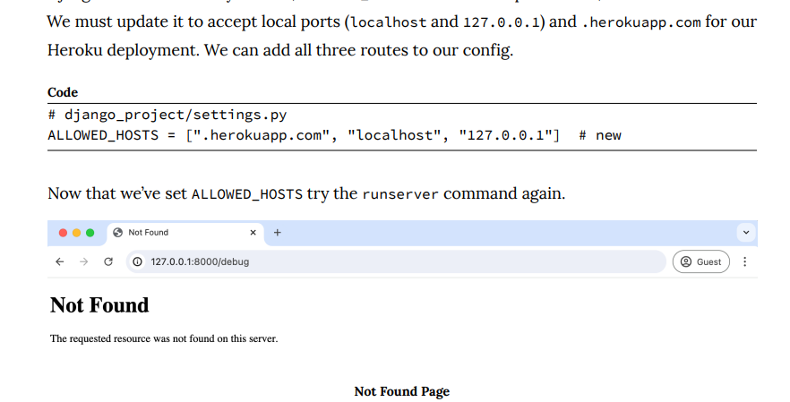
can’t set DEBUG to false until you set ALLOWED_HOSTS

Slide 22
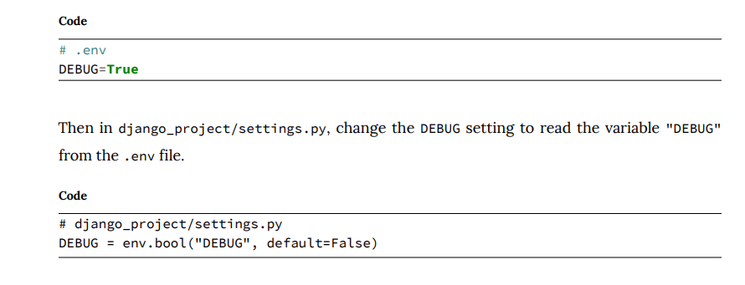

Slide 23
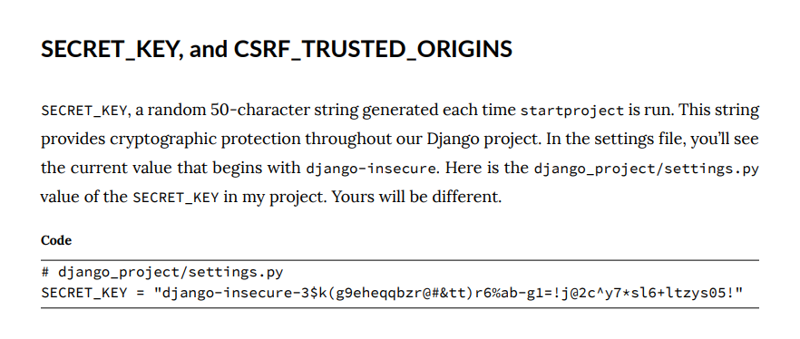

Slide 24
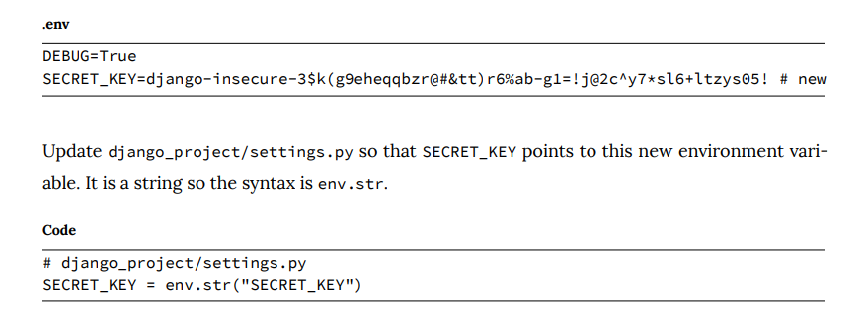

Slide 25
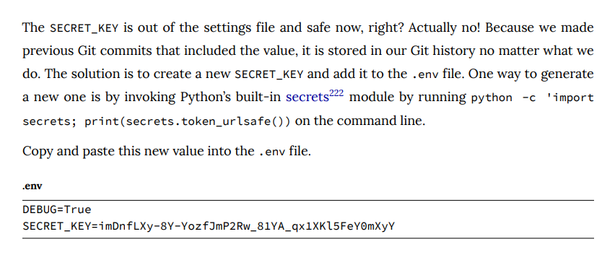

Slide 26
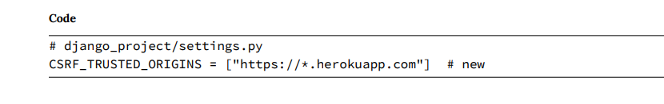
list of trusted origins for unsafe HTTP requests like POST.

Slide 27
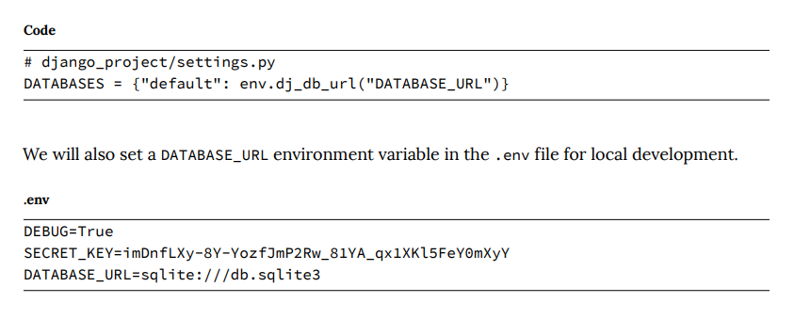

Slide 28
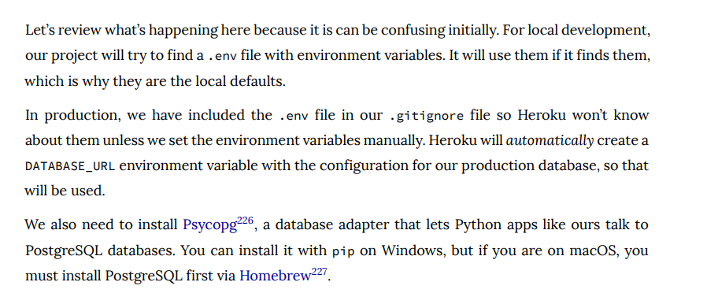

Slide 29
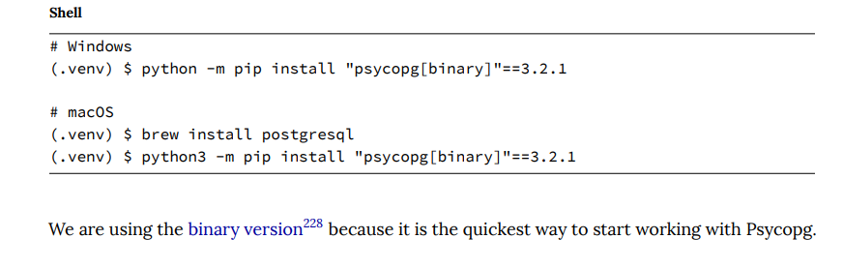
pip install psycopg-binary

Slide 30
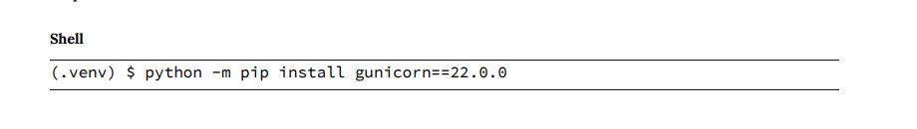

Slide 31
Heroku needs a procfile
provides instructions on running applications in their stack

Slide 32
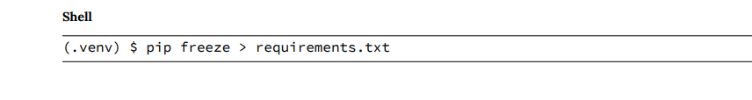

Slide 33
add, commit and push to github

