Slide 1
Software Architecture
The foundation for any software system is its architecture.
Software architecture is, simply, the organization of a system. This organization includes all components, how they interact with each other, the environment in which they operate, and the principles used to design the software.

Slide 2
A "pattern" has been defined as "an idea that has been useful in one practical context and will probably be useful in others

Slide 3
Client-Server Architecture
A client–server architecture divides an application into two parts, ‘client’ and ‘server’. Such an application is implemented on a computer network, which connects the client to the server.
The server part of that architecture provides the central functionality: i.e., any number of clients can connect to the server and request that it performs a task. The server accepts these requests, performs the required task and returns any results to the client, as appropriate.

Slide 4
Email servers, File servers, Web servers
Advantages:
It’s a centralized system that keeps all the data and its controls in one place
It brings a high level of scalability, organization, and efficiency
It allows the IT staff to change the Client and Server capacities separately
It’s cost-efficient, especially in terms of maintenance
It allows different platforms to share resources

Slide 5
Three – Tier architecture
separates applications into three logical and physical computing tiers
the presentation tier, or user interface
the application tier, where data is processed
and the data tier, where the data associated with the application is stored and managed

Slide 6
The chief benefit of three-tier architecture is that because each tier runs on its own infrastructure, each tier can be developed simultaneously by a separate development team, and can be updated or scaled as needed without impacting the other tiers.

Slide 7
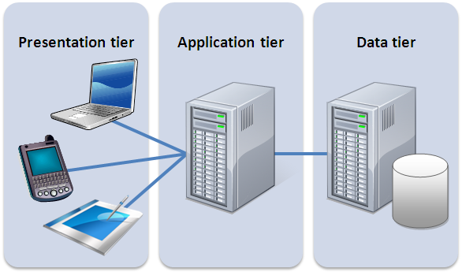

Slide 8
Tier vs. layer
In discussions of three-tier architecture, layer is often used interchangeably – and mistakenly – for tier, as in 'presentation layer' or 'business logic layer.'
They aren't the same. A 'layer' refers to a functional division of the software, but a 'tier' refers to a functional division of the software that runs on infrastructure separate from the other divisions. The Contacts app on your phone, for example, is a three-layer application, but a single-tier application, because all three layers run on your phone.
The difference is important, because layers can't offer the same benefits as tiers.

Slide 9
Pipe and Filter Architecture

Slide 10
Pipe and Filter is another architectural pattern, which has independent entities called filters (components) which perform transformations on data and process the input they receive, and pipes, which serve as connectors for the stream of data being transformed, each connected to the next component in the pipeline.

Slide 11

Data flows in one direction. It starts at a data source, arrives at a filter’s input port(s) where processing is done at the component, and then, is passed via its output port(s) through a pipe to the next filter, and then eventually ends at the data target.

Slide 12
UNIX Shell
The Pipeline is one of the defining features of the UNIX shell.
In a nutshell, it allows you to tie the output of one program to the input of another. The benefit it brings is that you don’t have to save the results of one program before you can start processing it with another. The long-term and even more important benefit is that it encourages programs to be small and simple.

Slide 13


Slide 14
Advantages
Filters can be changed without modifications to other filters.
Filters can be treated as black boxes. Users of the system don’t need to know the logic behind the working of each filter.
Re-usability. Each filter can be called and used over and over again.

Slide 15
Service-Oriented Architecture
SOA is based around the idea of breaking down an application into a set of much smaller tasks that can be performed by small independent, ‘software components’, each performing a discrete task commonly called a service.

Slide 16
A service is some functionality, typically a business process, which is packaged as a reusable software component that is:
well-defined – a software component with a clearly specified interface and outcome
self-contained – the implementation of the service is complete and independent of any product, vendor or technology
a black-box – the implementation of the service is hidden (encapsulated) from the service consumer.

Slide 17
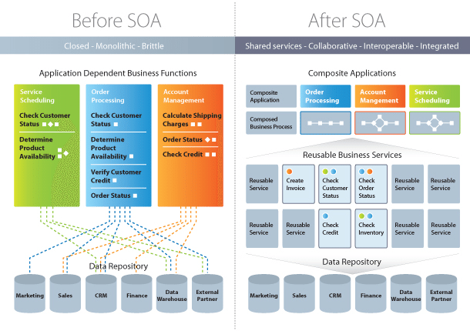

Slide 18
Django incorporates both client-server architecture and its own Model-View-Template (MVT) architecture. These two concepts describe different aspects of the framework.

Slide 19
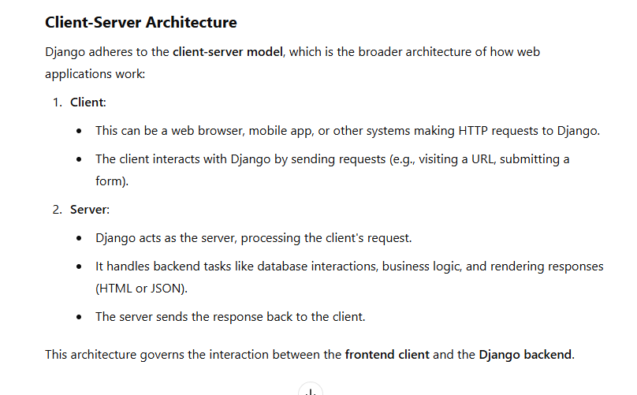

Slide 20
Model-View-Template (MVT) Architecture
Django's MVT architecture is an internal design pattern that structures how the server-side code is organized.
This pattern ensures separation of concerns within the Django server application, making it easier to maintain and scale.

Slide 21
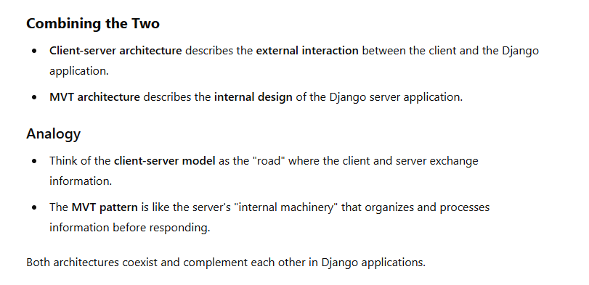

Slide 22
