Slide 1
Testing

Slide 2
unittest
Python’s unit testing framework
Supports test automation, sharing of setup and shutdown code for tests, aggregation of tests into collections, and independence of the tests from the reporting framework.

Slide 3
To achieve this, unittest supports some important concepts in an object-oriented way:

Slide 4
Test fixture
A test fixture represents the preparation needed to perform one or more tests, and any associated cleanup actions. This may involve, for example, creating temporary databases, directories, or starting a server process.

Slide 5
Test case
A test case is the individual unit of testing. It checks for a specific response to a particular set of inputs. unittest provides a base class, TestCase, which may be used to create new test cases.

Slide 6
Test suite
A test suite is a collection of test cases, test suites, or both. It is used to aggregate tests that should be executed together.
A test suite allows you to categorize test cases in such a way that they match your planning and analysis needs. Do you run functional and performance tests? Create two suites and label them accordingly.

Slide 7
Test runner
A test runner is a component which orchestrates the execution of tests and provides the outcome to the user.

Slide 8
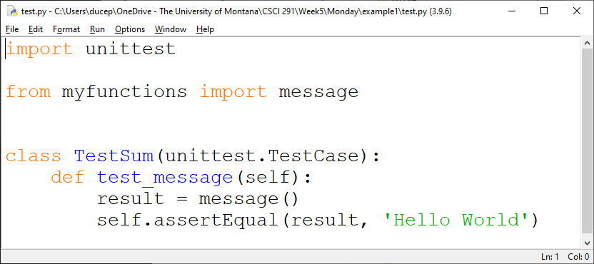
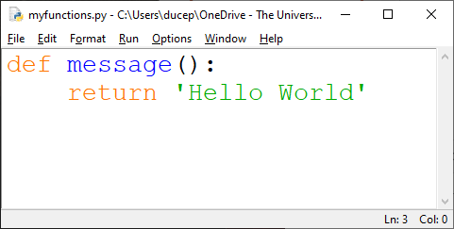
Example 1

Slide 9
If your file is test.py:
python –m unittest test

Slide 10
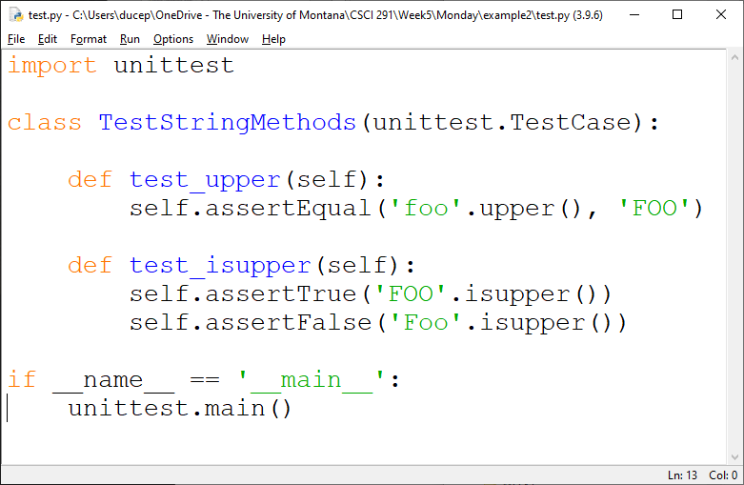
Example 2

Slide 11
if __name__ == '__main__’:
unittest.main()
This is a command line entry point. It means that if you execute the script alone by running python test.py at the command line, it will call unittest.main(). This executes the test runner by discovering all classes in this file that inherit from unittest.TestCase.

Slide 12
A testcase is created by subclassing unittest.TestCase. The two individual tests are defined with methods whose names start with the letters test. This naming convention informs the test runner about which methods represent tests.

Slide 13
assertEqual() to check for an expected result
assertTrue() or assertFalse() to verify a condition
These methods are used so the test runner can accumulate all test results and produce a report.

Slide 14
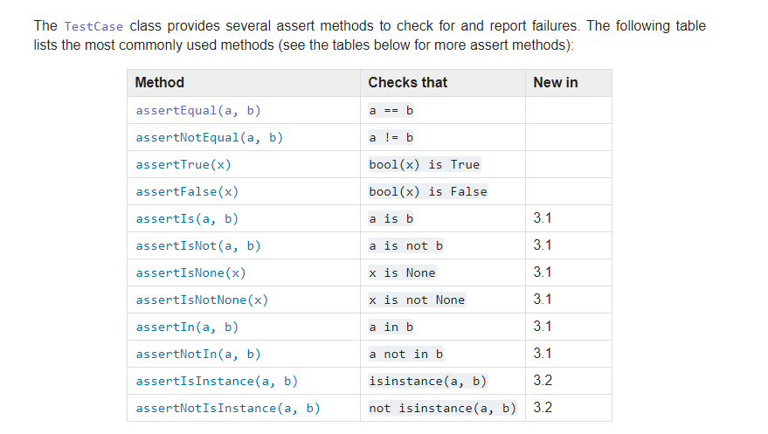

Slide 15
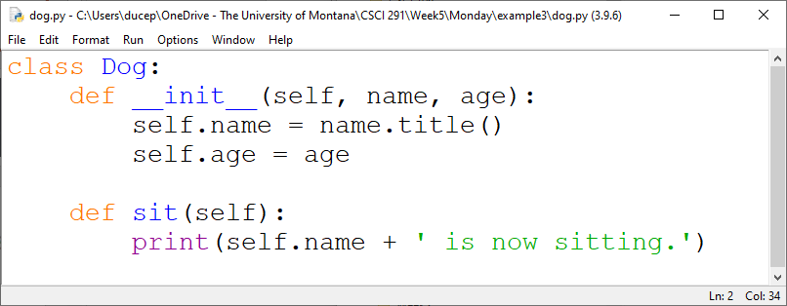
Example 3

Slide 16
The setUp() and tearDown() methods allow you to define instructions that will be executed before and after each test method.

Slide 17
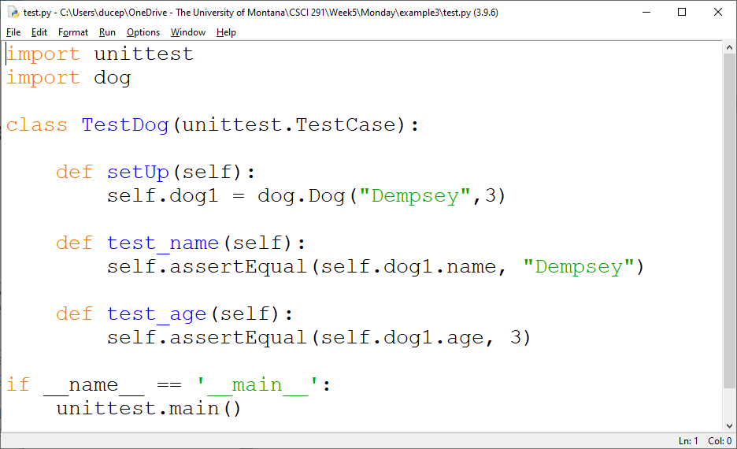

Slide 18
Django Testing
Django’s unit tests uses Python’s standard library module: unittest.
Here is an example which subclasses from django.test.TestCase, which is a subclass of unittest.TestCase that runs each test inside a transaction to provide isolation:

Slide 19
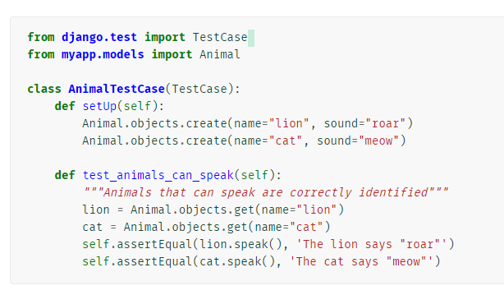

Slide 20
There are two methods that you can use for pre-test configuration (for example, to create any models or other objects you will need for the test):
setUpTestData() is called once at the beginning of the test run for class-level setup. You'd use this to create objects that aren't going to be modified or changed in any of the test methods.
setUp() is called before every test method to set up any objects that may be modified by the test (every test method will get a "fresh" version of these objects).

Slide 21
Running tests
Once you’ve written tests, run them using the test command of your project’s manage.py utility:
$ python manage.py test
Test discovery is based on the unittest module’s built-in test discovery. This will discover tests in any file named “test*.py” under the current project.

