Slide 1
Message Board

Slide 2
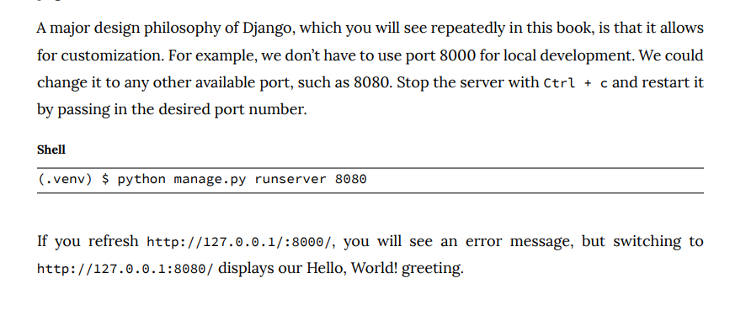

Slide 3
A database is a place to store and access different types of data, and there are two main types of databases: relational and non-relational.
A relational database stores information in tables containing columns and rows, roughly analogous to an Excel spreadsheet. The columns define what information can be stored; the rows contain the actual data.
Frequently, data in separate tables have some relation to each other,hence the term “relational database” to describe databases with this structure of tables, columns, and rows.

Slide 4
SQL (Structured Query Language) is typically used to interact with relational databases to perform basic CRUD (Create, Read, Update, Delete) operations and define the type of relationship(like a many-to-one relationship, for example).

Slide 5
Django’s ORM
An ORM (Object-Relational Mapper) is a powerful programming technique that makes working with data and relational databases much easier. In the case of Django, its ORM means we can write Python code to define database models; we don’t have to write raw SQL ourselves. And we don’t have to worry about subtle differences in how each database interprets SQL.
Instead, the Django ORM supports five relational databases: SQLite, PostgreSQL, MySQL, MariaDB, and Oracle.
It also comes with support for migrations, which provides a way to track and sync database changes over time.
The Django ORM saves developers a tremendous amount of time, which is one of the major reasons why Django is so efficient.

Slide 6
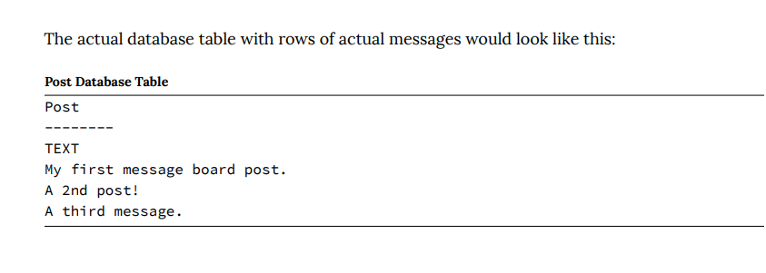
We will have only one table called “Post” and a single field, “text,” containing the contents of a message.

Slide 7
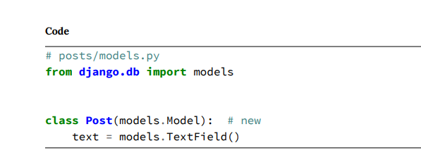
Django imports a module, models, to help us build new database models that will “model” the characteristics of the data in our database

Slide 8
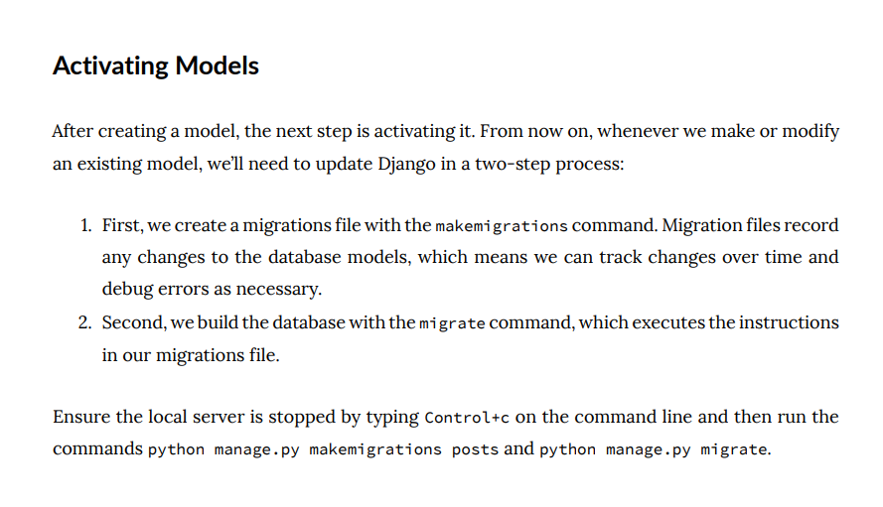

Slide 9
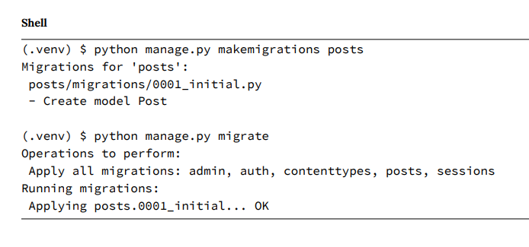

Slide 10
Django Admin
One of Django’s killer features is its robust admin interface that visually interacts with data.
To use the Django admin, we must first create a superuser who can log in. In your command line console, type
python manage.py createsuperuser
and respond to the prompts for a username, email, and password:

Slide 11
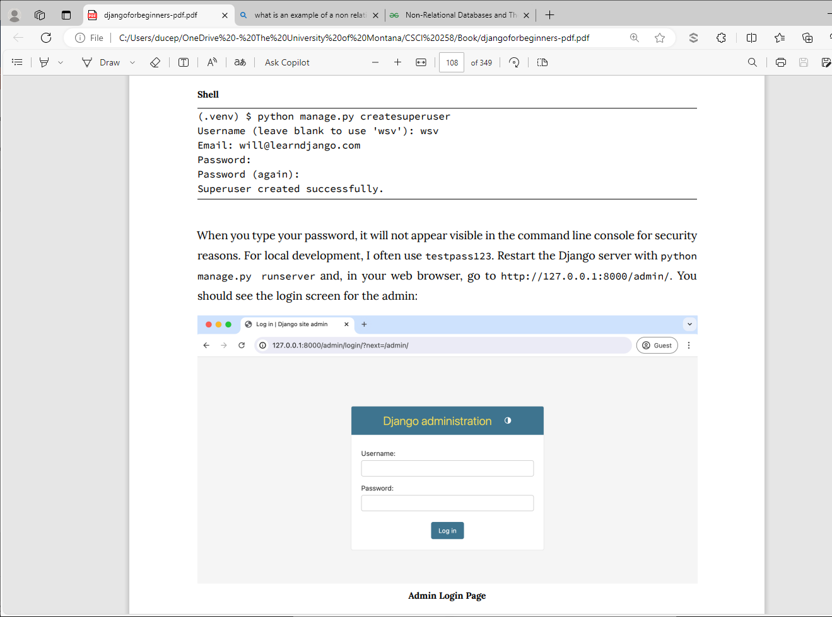

Slide 13
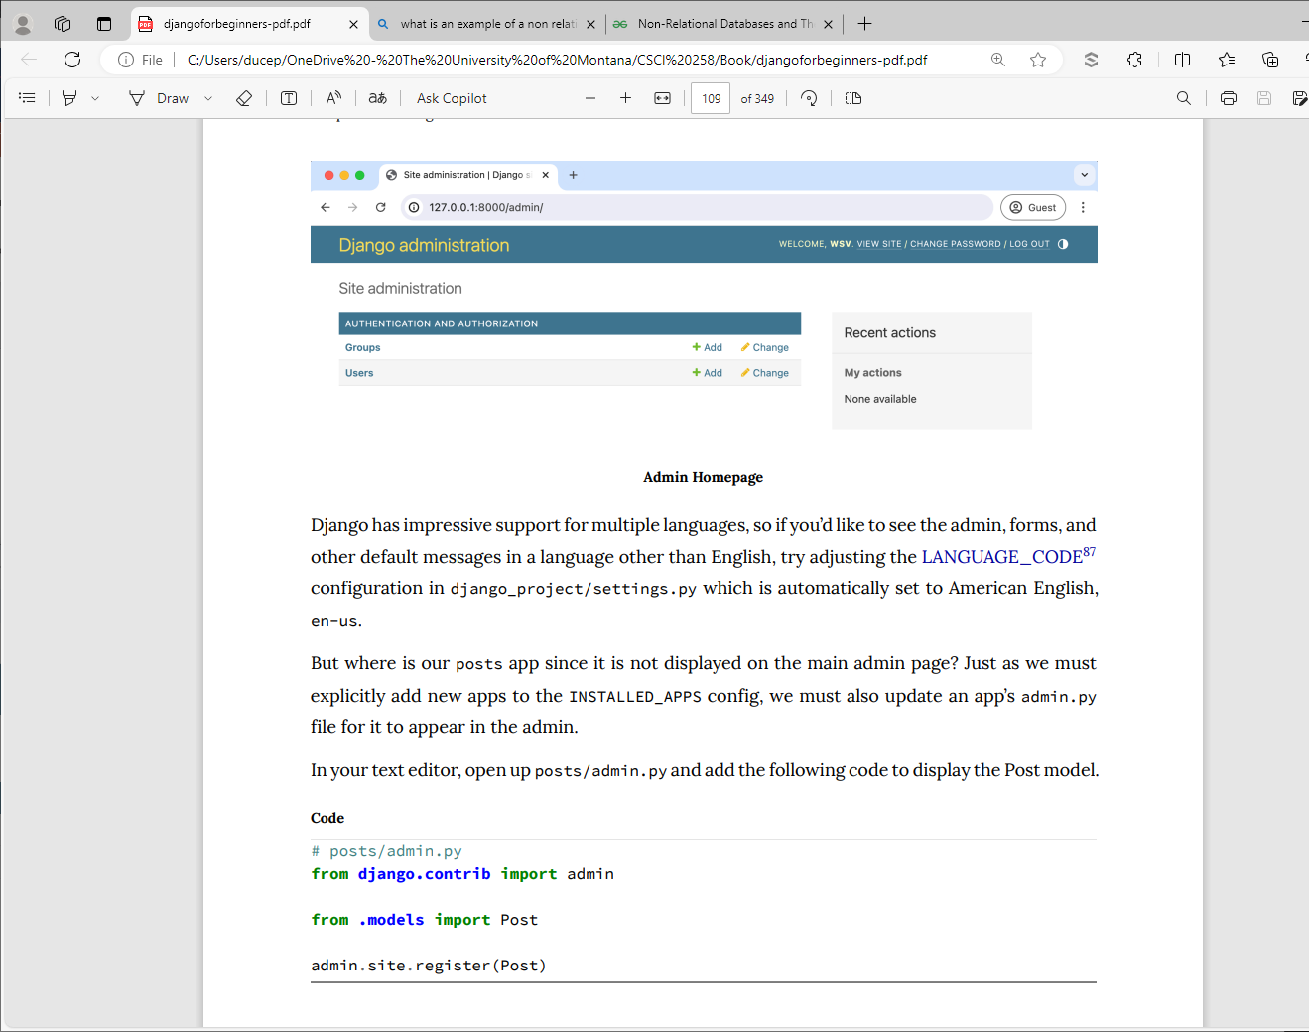

Slide 15
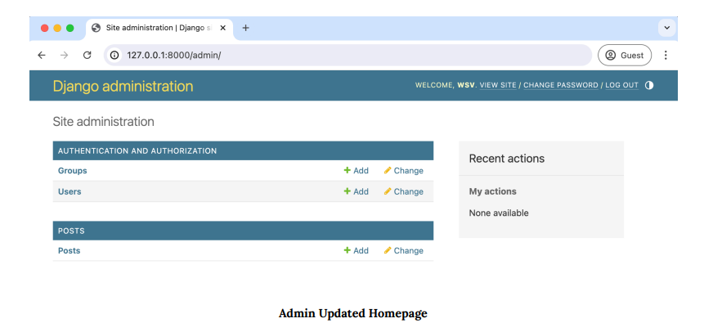

Slide 16
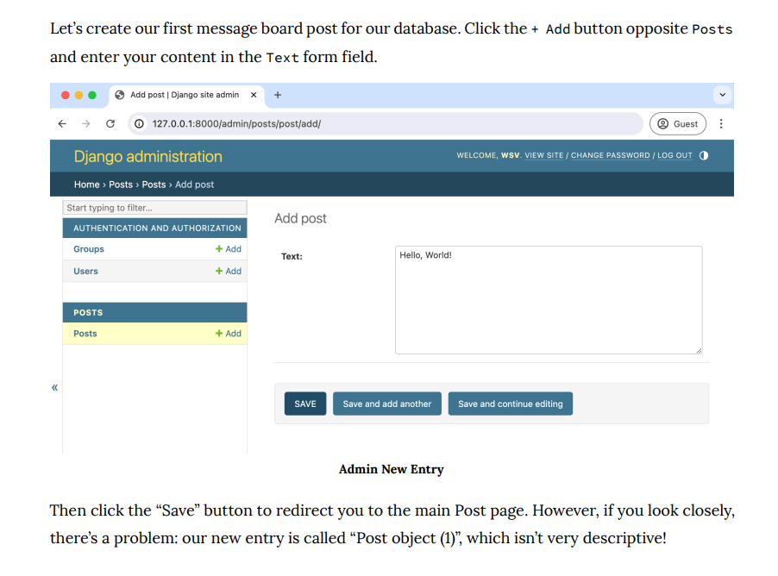

Slide 17
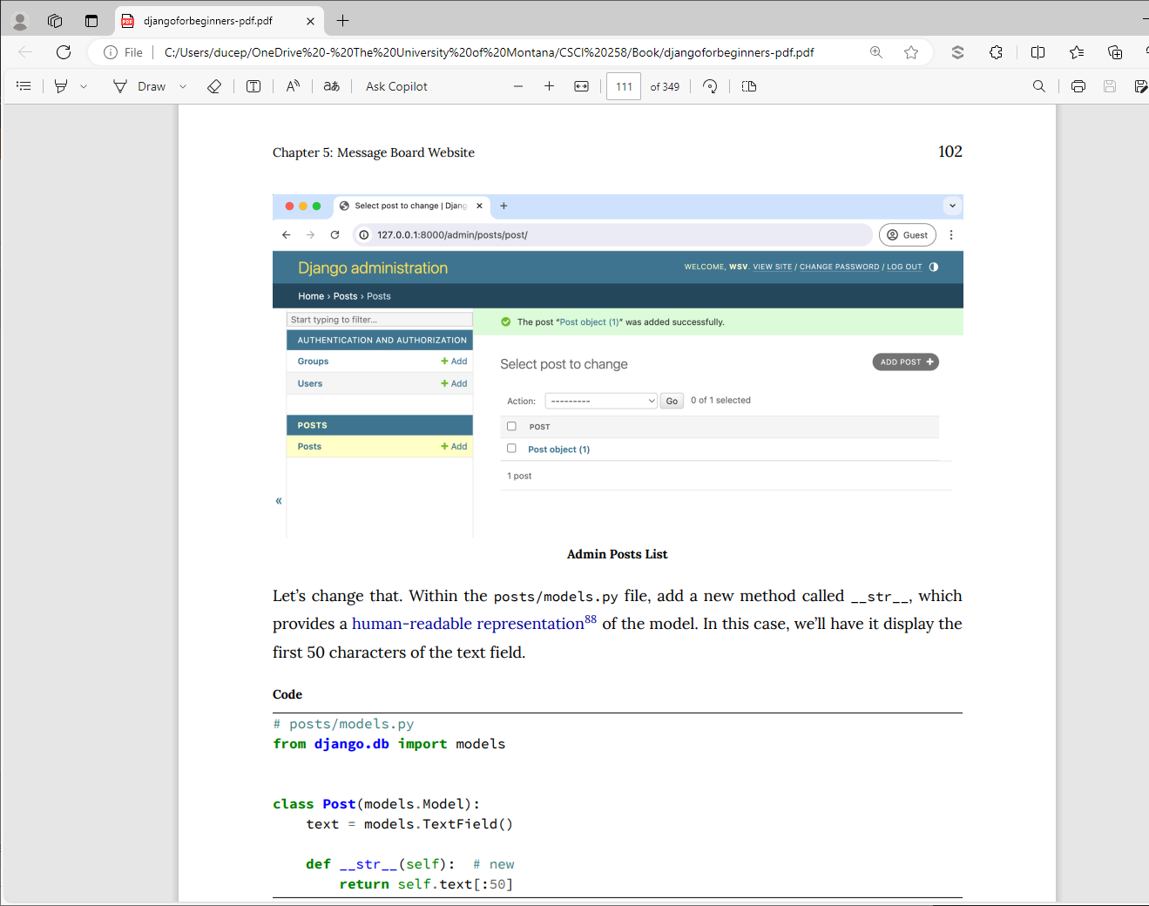

Slide 19
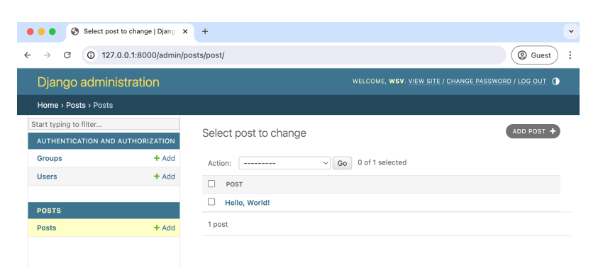

Slide 20
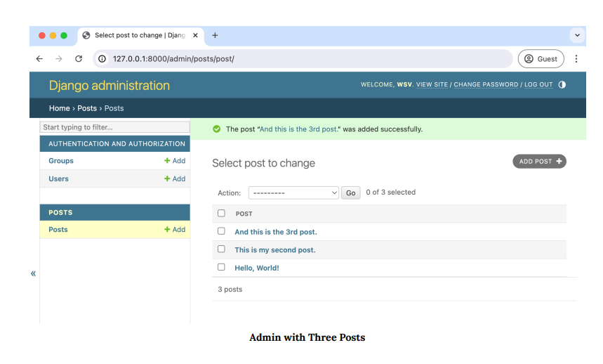

Slide 21
To display our message board posts on the homepage we have to wire up a view, template, and URL. This pattern should start to feel familiar now.

Slide 22
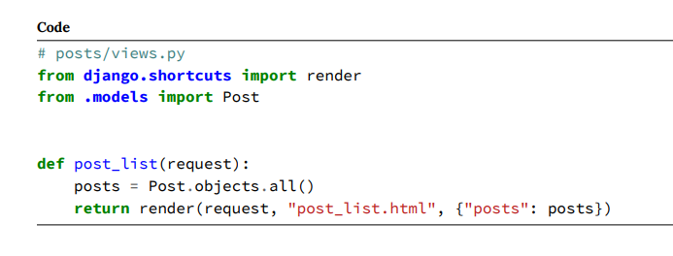
On the first line, we import the render() shortcut function, which combines a template with a context dictionary and returns an HttpResponse object. Then, we import our database model, Post, from the models.py file.

Slide 23
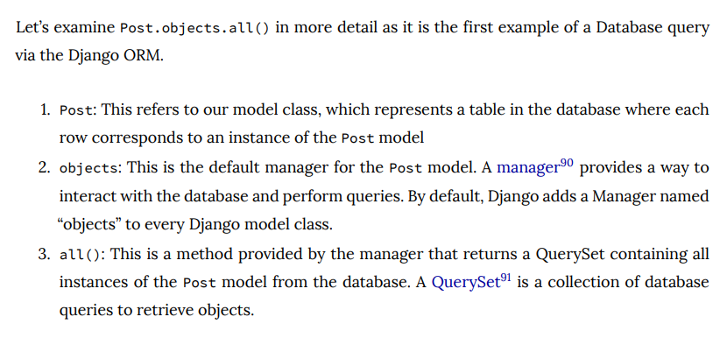

Slide 24
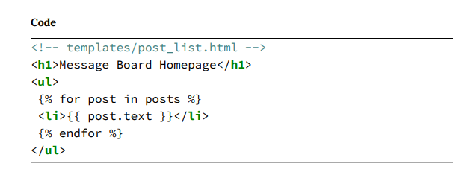

Slide 25
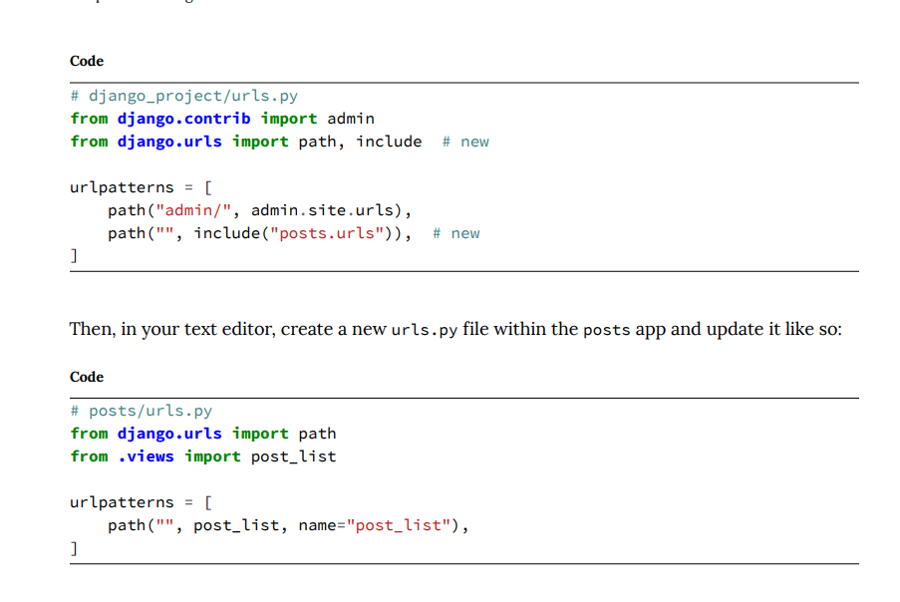

Slide 26
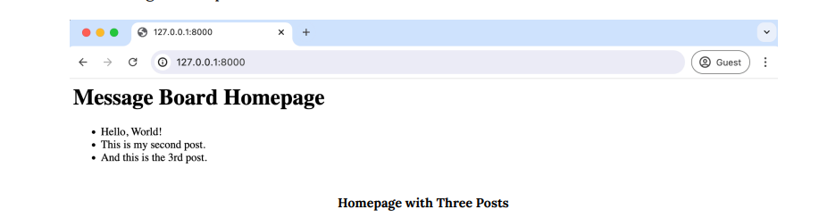

Slide 27
Listing out all items in a database model is so common that a generic class-based view exists for this, too, called ListView.

Slide 28
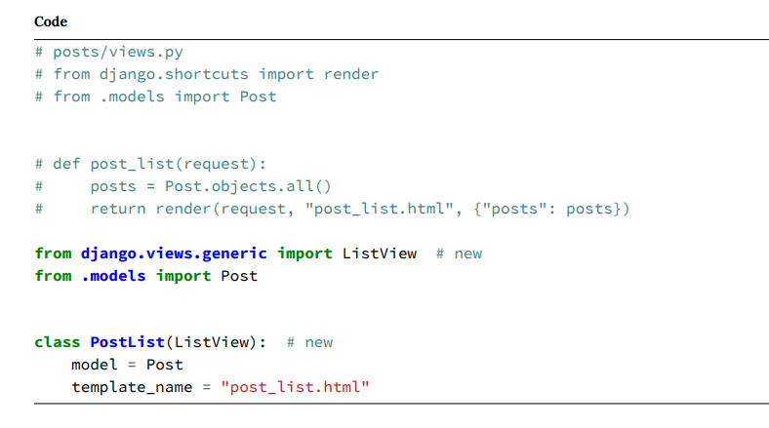

Slide 29
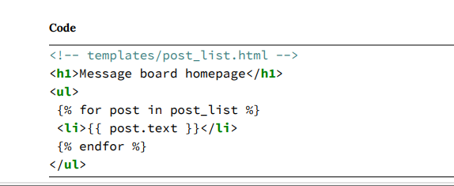
By default, ListView returns a context variable called <model>_list, where <model> is our model name. Since our model is named post, we need to loop over post_list with our for loop. The rest of the template remains the same.

Slide 30
