Slide 1
Blog

Slide 2
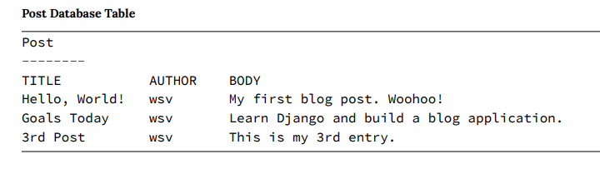
For our Blog website, we want a database table called Post with three fields: Title, Author, and Body.

Slide 3
Remember that the models.py file is the single, definitive source of information about our data, containing the necessary fields and behaviors of the stored data.
We can write Python in a models.py file, and the Django ORM will translate it into SQL.

Slide 4
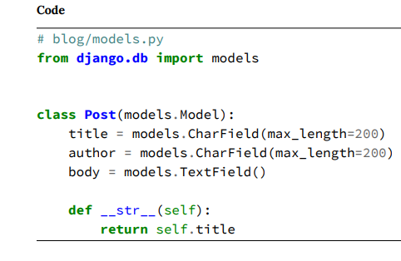
At the top of the file, we import the models module and then create a class, Post, that extends it. The Post class has three fields (think of them as columns) for title, author, and body. Each field must have an appropriate field type. The first two use CharField, meaning a Character Field with a maximum character length of 200, while the third uses TextField, intended for a large amount of text.

Slide 5
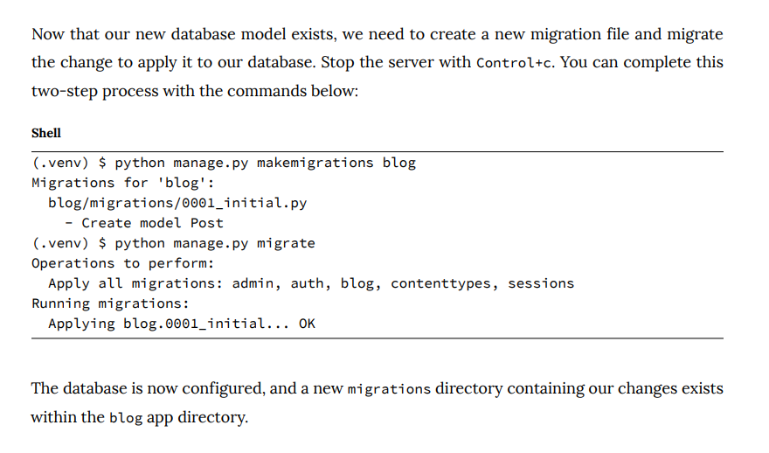

Slide 6
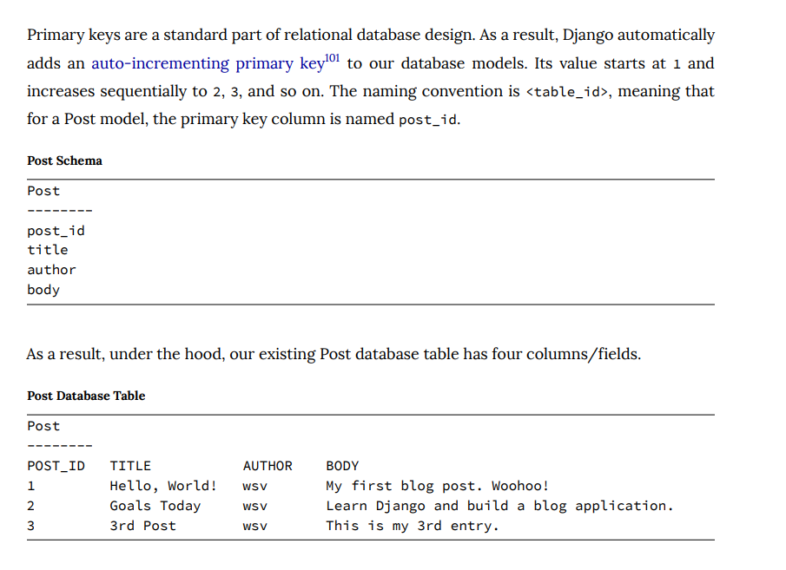

Slide 7
Authentication is a common–and challenging to implement well–feature on websites.
Django has an entire built-in authentication system that we can use.
We will use the Django auth user model.

Slide 8
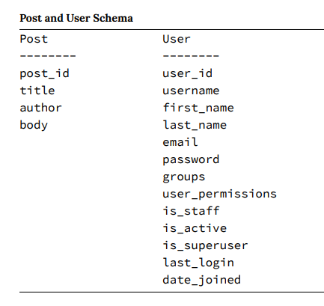

Slide 9
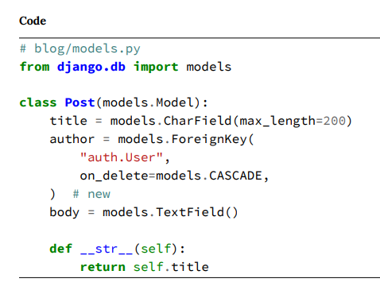
We want the author field in Post to link to the User model so that each post has an author corresponding to a user.
We can do this by linking the User model primary key, user_id, to the Post.author field. A link like this is known as a foreign key relationship. Foreign keys in one table always correspond to the primary keys of a different table.
The ForeignKey field defaults to a many-to-one relationship, meaning one user can be the author of many different blog posts but not the other way around.

Slide 10
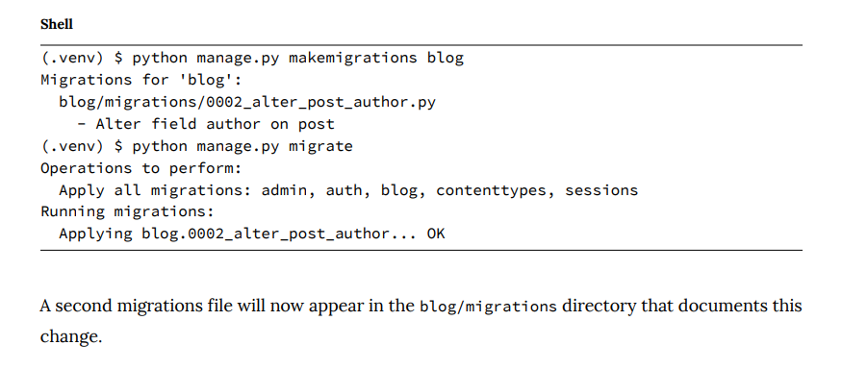
Since we have updated our database models again, we should create a new migrations file and then migrate the database to apply it.

Slide 11
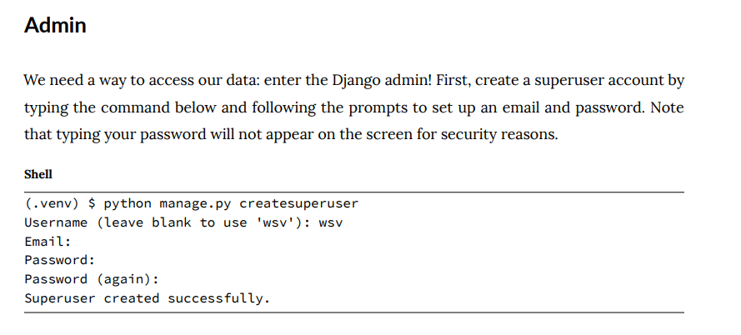
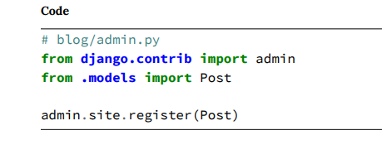

Slide 12
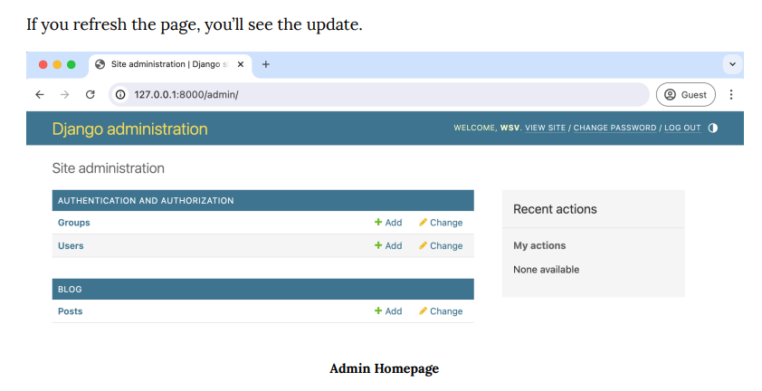

Slide 13
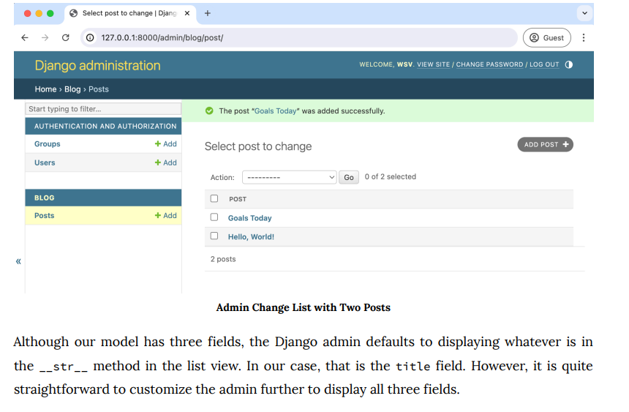

Slide 14
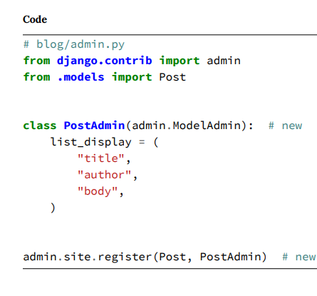
To do this, we can extend ModelAdmin by creating a new class, PostAdmin. Within it, we can set list_display to control what is shown on the admin change list page. We also must register both the model, Post, and the extended ModelAdmin class we’ve created, PostAdmin, at the bottom of the file.

Slide 15
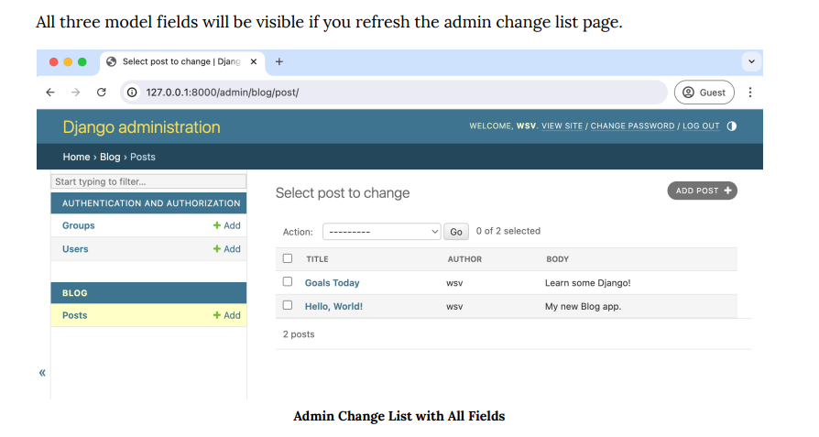

Slide 16
Static files
Static files are the Django community’s term for additional files commonly served on websites, such as CSS, fonts, images, and JavaScript.
Even though we haven’t added any to our project yet, we are already relying on core Django static files—custom CSS, fonts, images, and JavaScript—to power the look and feel of the Django admin.
In production, things are more complex, it is far more efficient to combine all static files across a Django project into a single location in production.

Slide 17
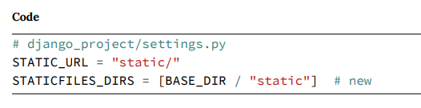
By default, Django will look within each app for a folder called “static”.
As Django projects grow in complexity over time and have multiple apps, it is often simpler to reason about static files if they are stored in a single, project-level directory. That is what we will do.

Slide 18
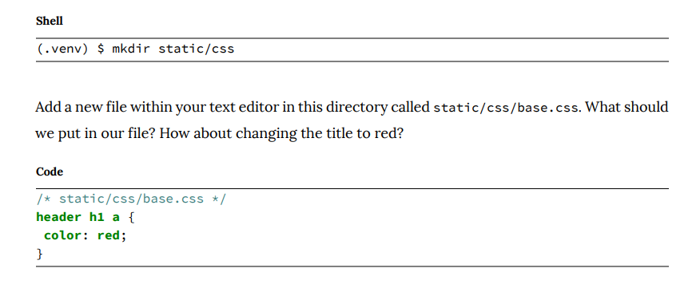

Slide 19
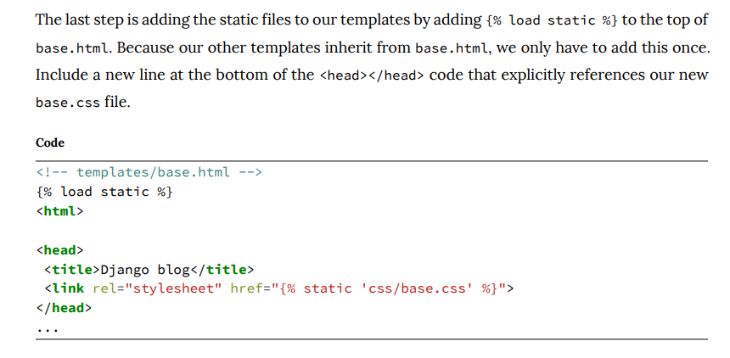

Slide 20
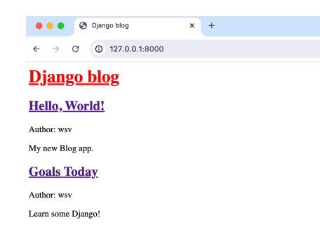

Slide 21
Then you will jazz up things by adding more css

Slide 22
Individual Blog Pages
Now, we can add functionality for individual blog pages. We need to create a new view, URL, and template to do that.
You should be getting a feel for the pattern.

Slide 23
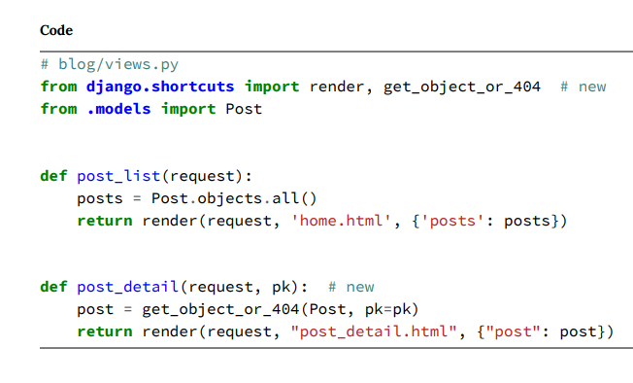
At the top of our views file, import the shortcut function get_object_or_- 404(), which calls the get QuerySet method to return an object or raises a Http404 error if unsuccessful.
We will name the view function post_detail as it represents the detailed view of a blog post. It accepts two parameters: the first, request, is an instance of the HttpRequest object; the second, pk, is a parameter extracted from the URL that identifies the specific blog post to be displayed by its primary key.

Slide 24
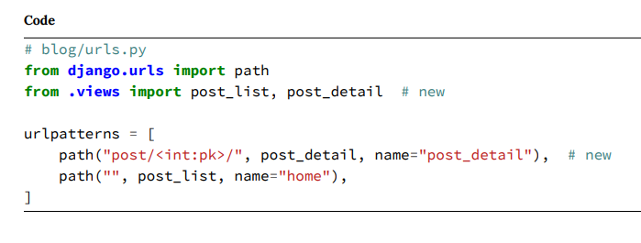
This pattern will look a bit strange initially as it is our first use of a Django path converter. Up to this point, we have hardcoded our URL routes, but it is more common to use variables.
In this case, we specify that individual posts will start at post/, but then we use int to specify that the captured value from the URL should be treated as an integer and the variable’s name passed to the view is pk.

Slide 25
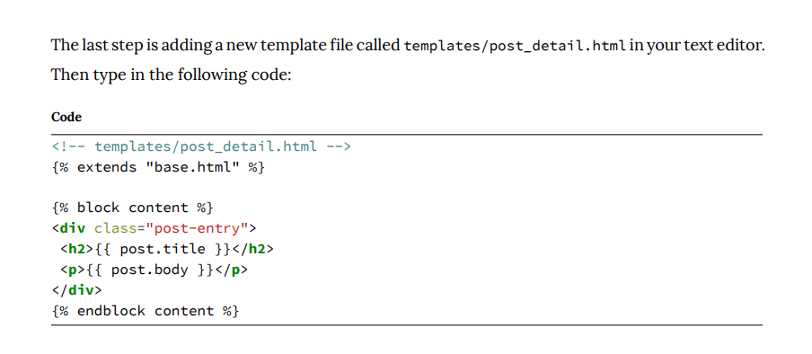
At the top, we specify that this template inherits from base.html. The template context variable post contains information from this particular blog post, and we can display individual fields using post.title and post.body.

Slide 26
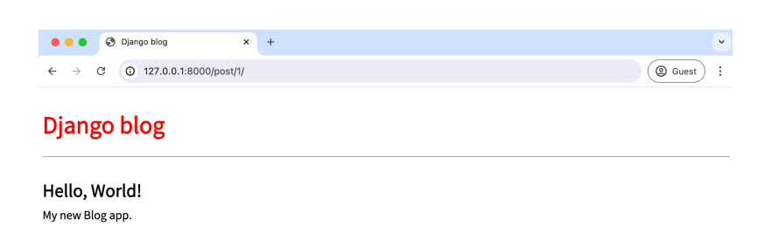

Slide 27
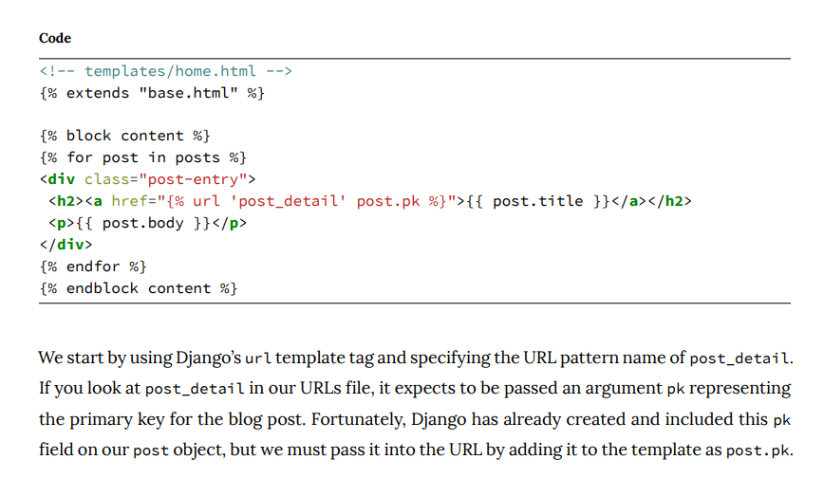

Slide 28
Currently, we are using the url template tag, which means that every time we want to display an individual blog post in this template or other templates, we must repeat the pattern {% url 'post_detail' post.pk %}. If the URL pattern changes, we need to update every template where the URL is constructed, which increases the risk of errors.

Slide 29
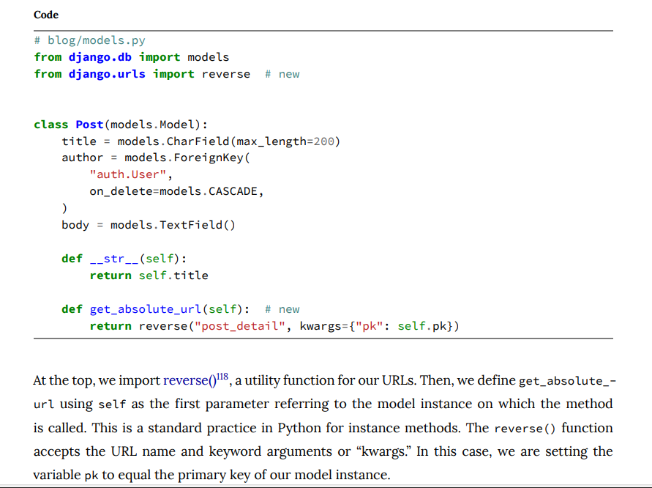

Slide 30
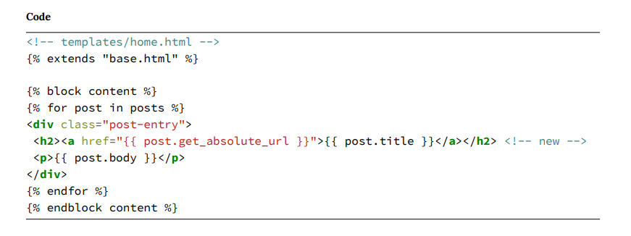
URL paths can and do change over a project’s lifetime. With the previous method, if we changed the post detail view and URL path, we’d have to go through all our HTML and templates to update the code, a very error-prone and hard-to-maintain process. By using get_absolute_url() instead, we have one place, the models.py file, where the canonical URL is set, so our templates don’t have to change

