Slide 1
Chapter 7: Forms

Slide 2
Switch over to class-based views. Less code, less error prone.

Slide 3
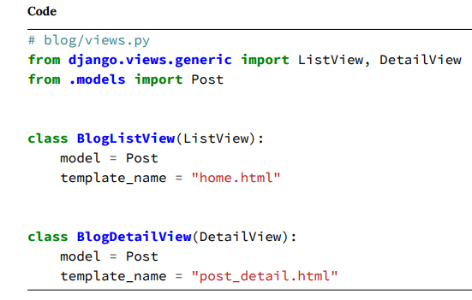
At the top, we import the generic views ListView and DetailView, along with our model, Post. We used ListView previously in the Message Board app, but DetailView is new. It is used for detail pages and has a format extremely similar to ListView. We pass in the generic class-based view and define the model and template for both views.

Slide 4
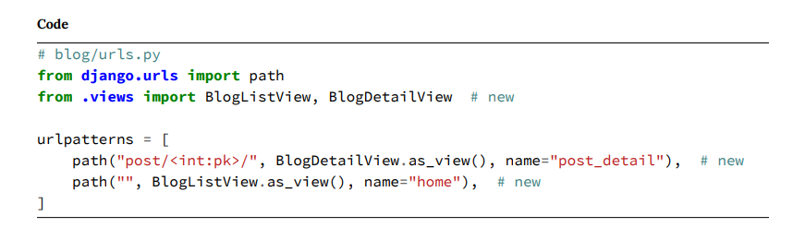
Then, we update the second argument in both routes, specifying the view name and adding as_view() to transform the class into a callable view function.

Slide 5
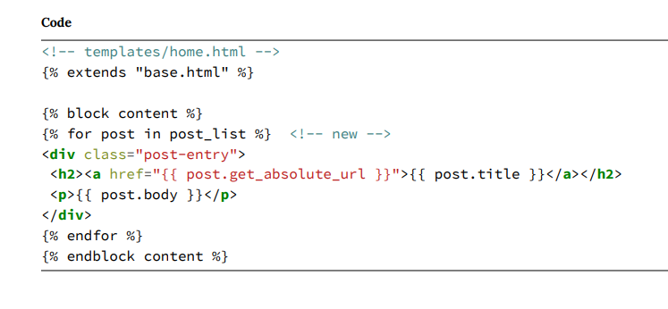
The final update is to our template. Previously, in our function-based list and detail views, we named the context object posts and post respectively. But for the GCBV ListView, you need to know that the default naming pattern is <model>_list; since our model is Post, the context
object will be post_list.

Slide 6
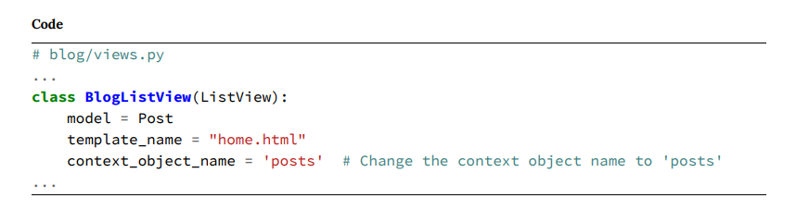
Could rename context object if you want to.

Slide 7
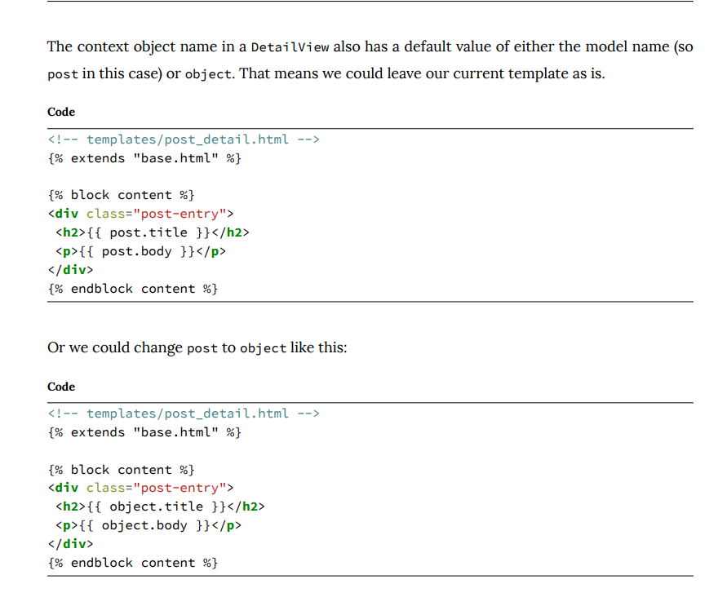

Slide 8
Classy Class-Based Views, a website dedicated to describing the full methods and attributes for each Django GCBV.

Slide 9
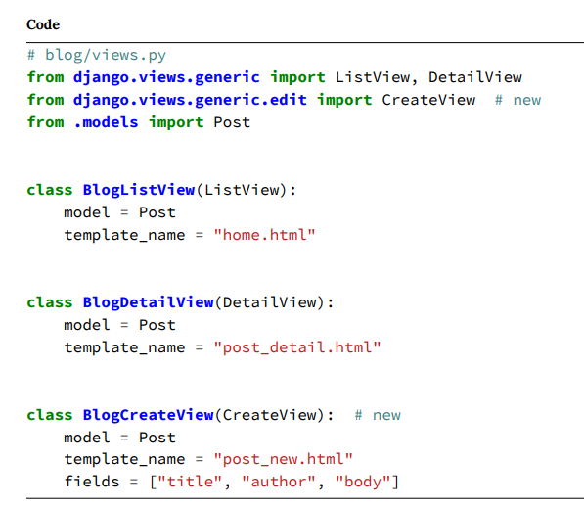
CreateView
At the top we import CreateView from the django.views.generic.edit module. Then we create a class, BlogCreateView, that extends CreateView, specifying the model, Post, the template name, post_new.html, and the database fields we want visible on the form, which are title, author, and body. That’s it! The function-based version of this view is much, much longer.

Slide 10
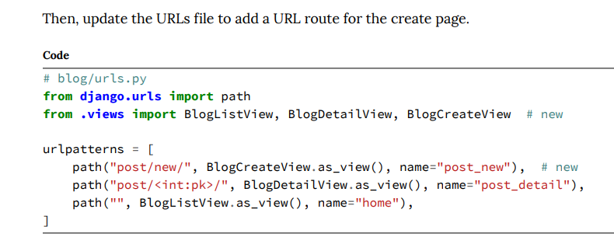

Slide 11
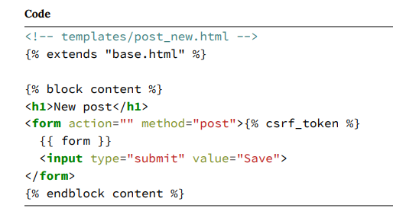
Let’s break down what we’ve done:
• on the top line, we extended our base template.
• use HTML <form> tags with the POST method since we’re sending data. If we were receiving data from a form, for example, in a search box, we would use GET.
• add a {% csrf_token %} which Django provides to protect our form from cross-site request forgery. You should use it for all your Django forms.
• then, to output our form data use {{ form }} to render the specified fields.
• finally, specify an input type of submit and assign the value “Save”.

Slide 12
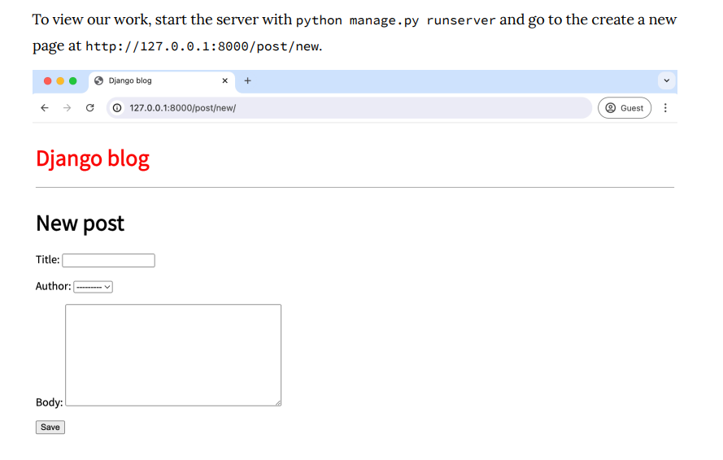

Slide 13
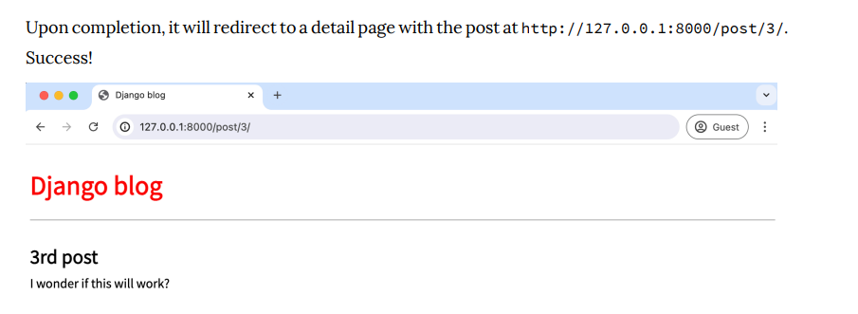

Slide 14
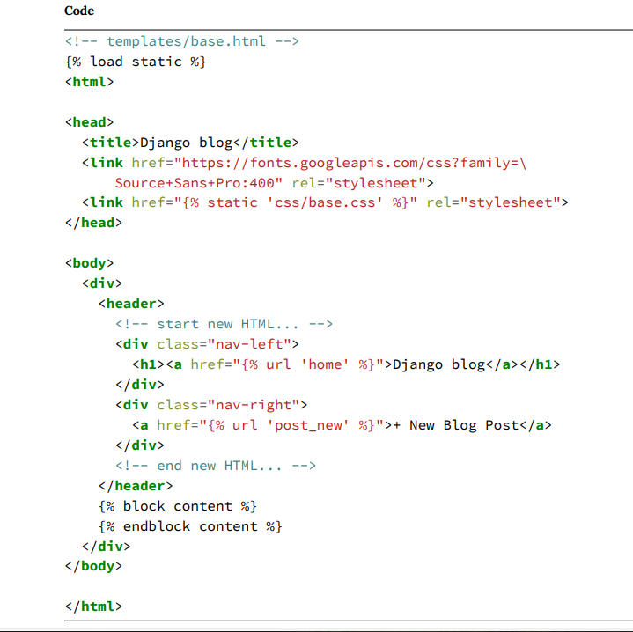

Slide 15
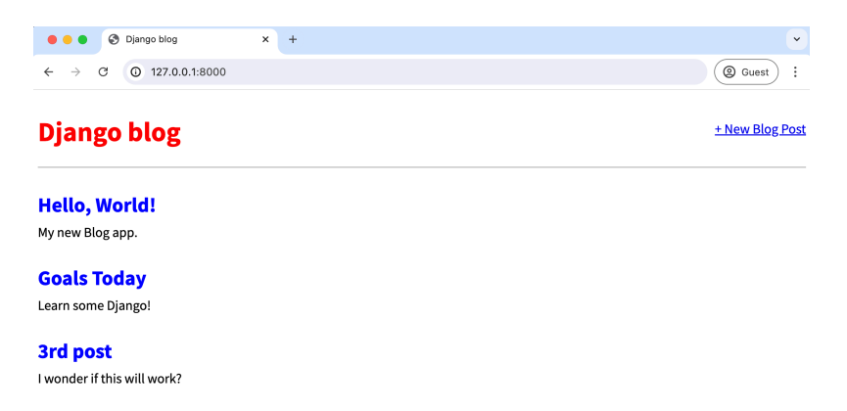

Slide 16
If we were to create this functionality using function-based views, we’d need a dedicated blog/forms.py file and a much longer view explaining how to handle the form, validate the data, and save it to the database. By using CreateView instead, we rely on built-in code to handle all these issues.

Slide 17
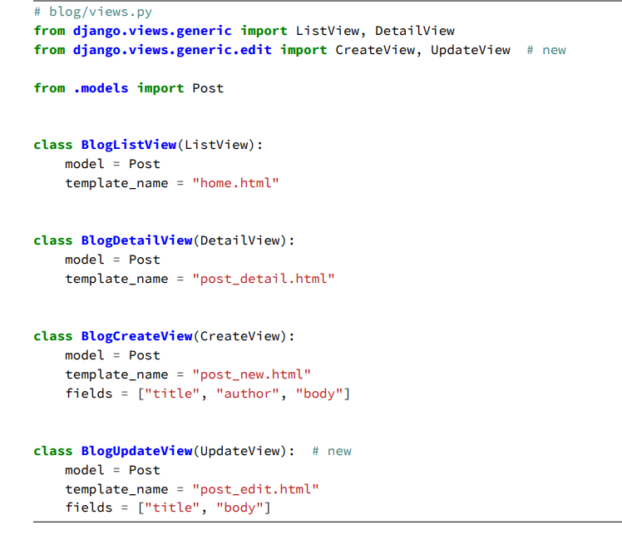
Notice that we are not including “author” in the fields because we assume that the author of a post will not change during editing. We only want the title and body text to be available to update

Slide 18
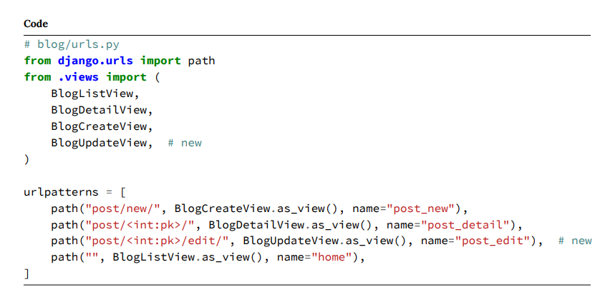

Slide 19
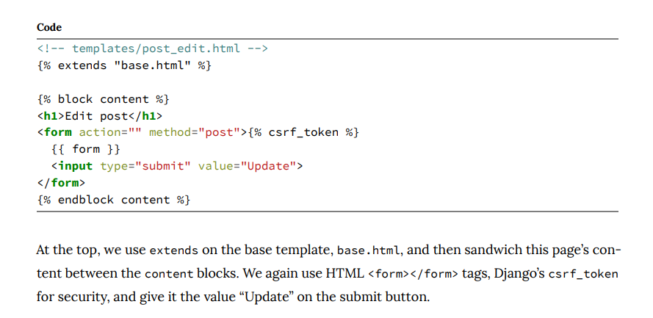

Slide 20
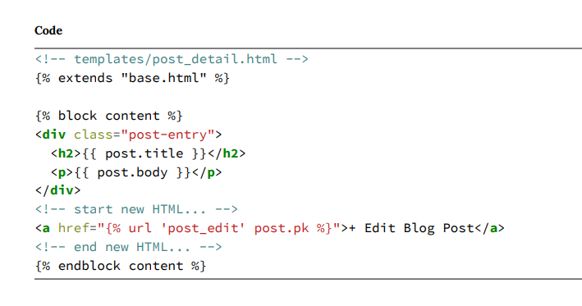

Slide 21
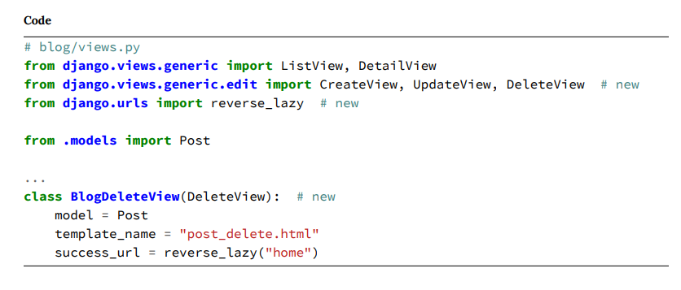
DeleteView
DeleteView requires a model, template name, and success URL. We have supplied all three here. Remember, after a blog post is deleted, we have to redirect the user somewhere. In this case, that is our homepage at the URL name of “home”.
You may have noticed that both CreateView and UpdateView also have redirects yet we did not have to specify a success_url. Why is this? If available, Django, by default, will use the get_absolute_url() on the model object, a handy feature, but you would only know about it from reading a book like this or deeply reading the docs.

Slide 22
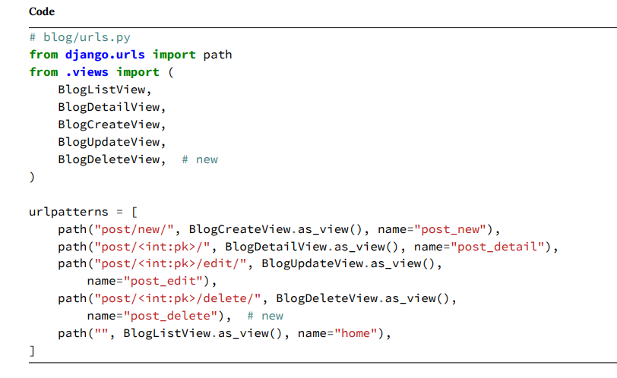

Slide 23
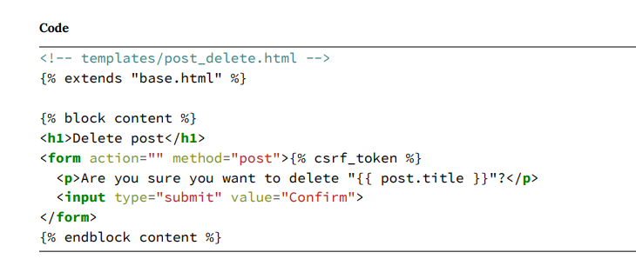

Slide 24
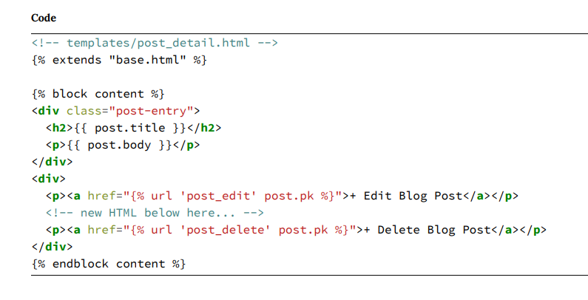

Slide 25
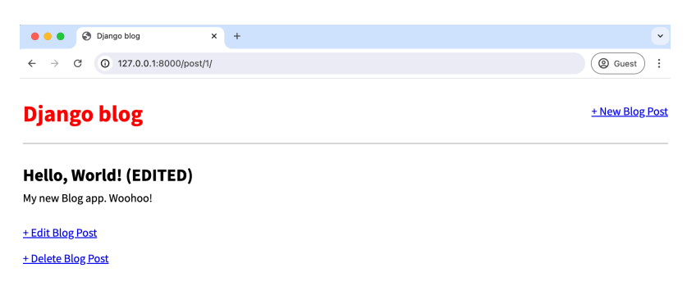

Slide 26
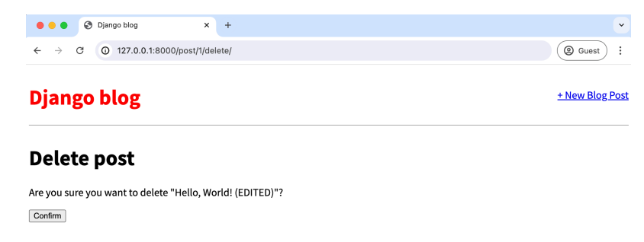

Slide 27
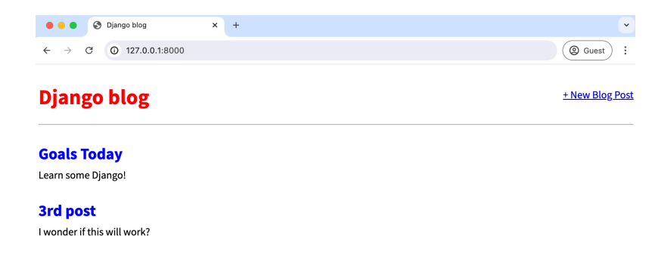

Slide 28
Fortunately, Django has a powerful, battle-tested, built-in user authentication system that we can use and customize as needed.
Whenever you create a new project, by default, Django installs the auth app, which provides us with a User object containing:
• username
• password
• email
• first_name
• last_name
We will use this User object to implement login, logout, and signup in our blog application.

Slide 29
Django provides us with a default view for a login page via LoginView. All we need to add is a URL pattern for the auth system, a login template, and a minor update to our django_project/settings.py file.

Slide 30
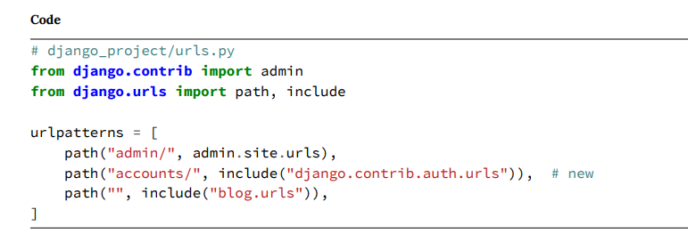
First, update the django_project/urls.py file. We’ll place our login and logout pages at the accounts/ URL: a one-line addition to the next-to-last line.

Slide 31
As the LoginView documentation notes, by default, Django will look within a templates directory called registration for a file called login.html for a login form. So we need to create a new directory within templates called registration.

Slide 32
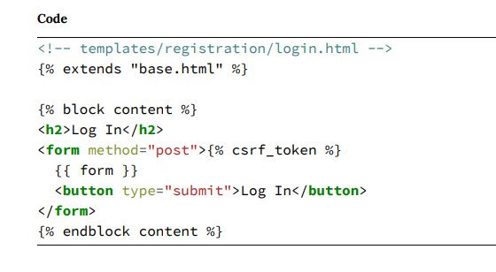

Slide 33
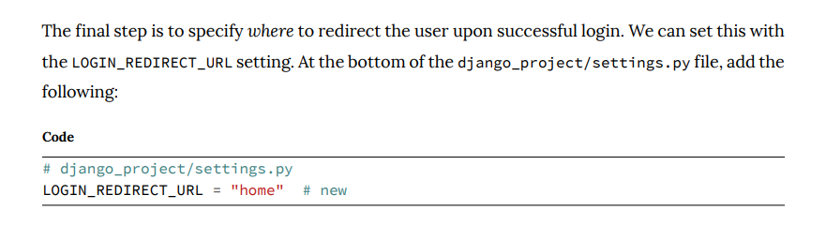

Slide 34
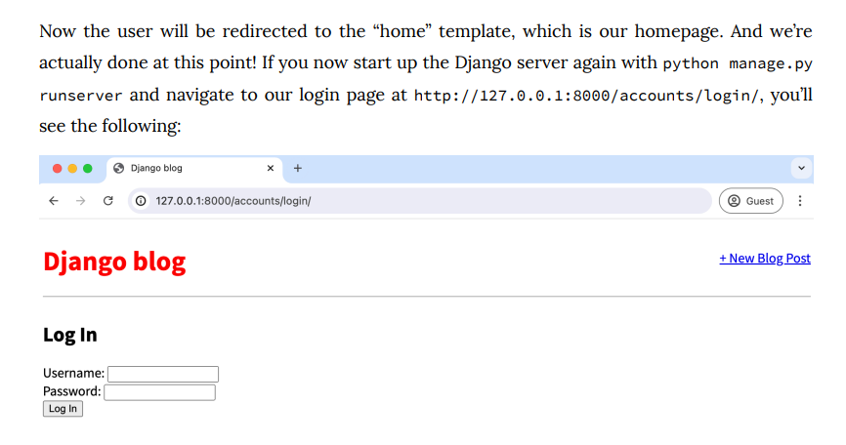
Upon entering the login info for our superuser account, we are redirected to the homepage. Notice that we didn’t add any view logic or create a database model because the Django auth system automatically provided both for us. Thanks, Django

Slide 35
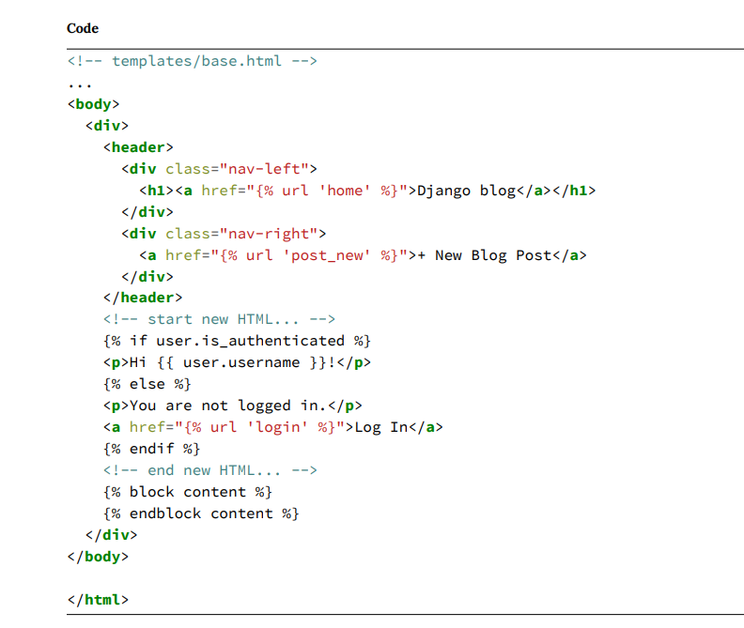

Slide 36
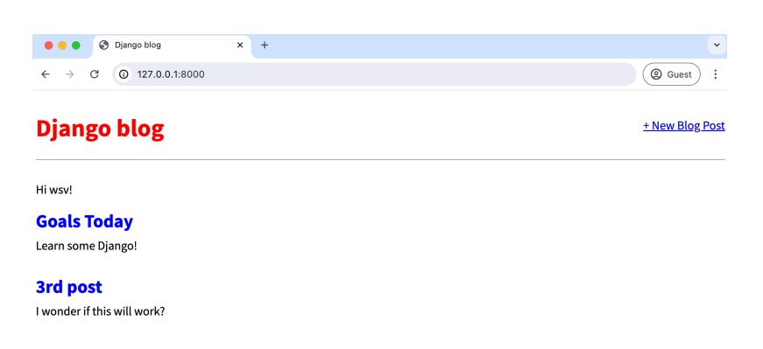

Slide 37
Logout
SignUp

