Slide 1
Company Website

Slide 2
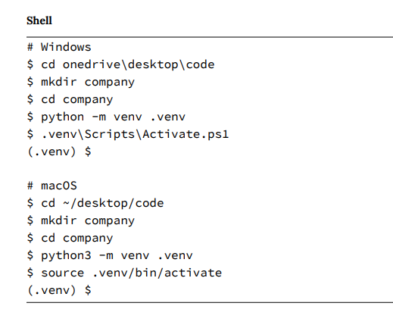

Slide 3
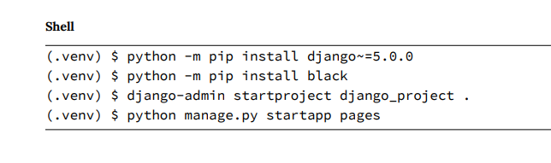

Slide 4
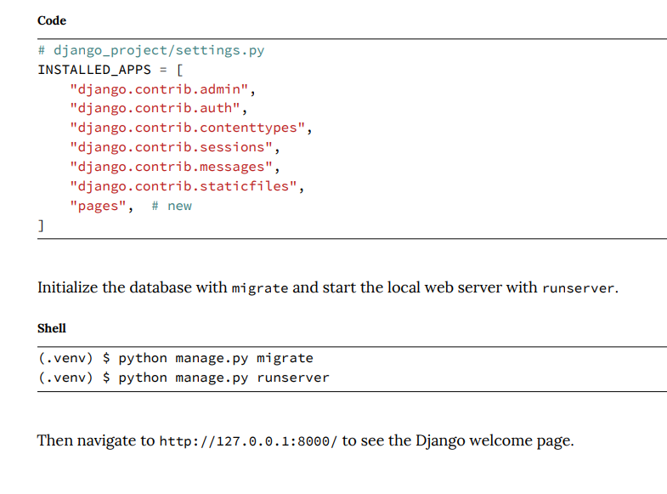

Slide 5
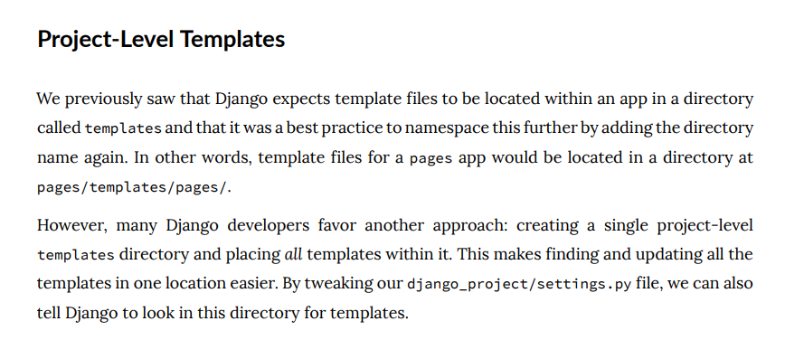

Slide 6
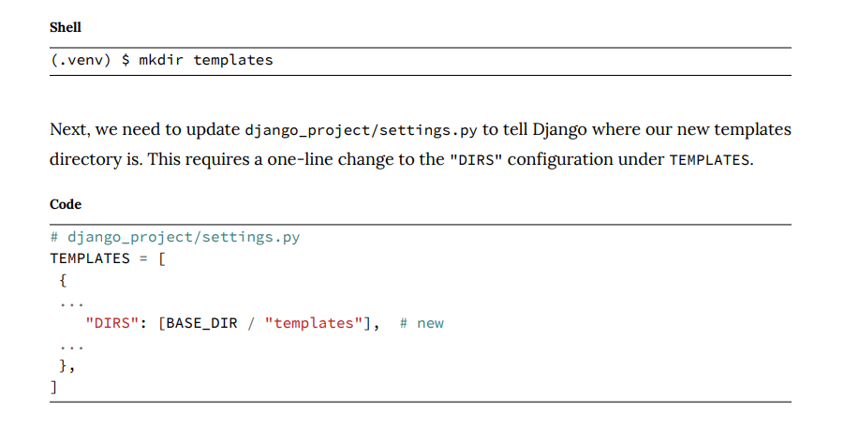

Slide 7
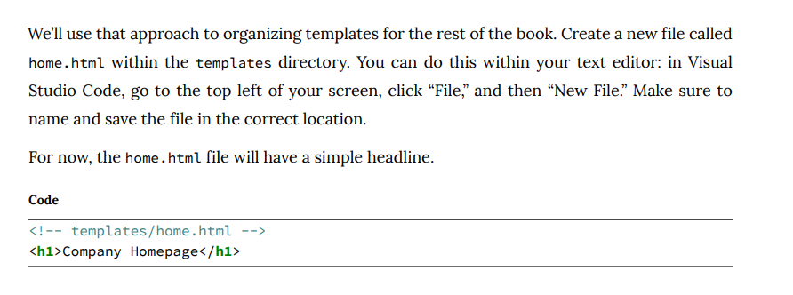

Slide 8
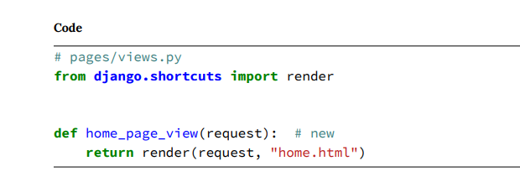

Slide 9
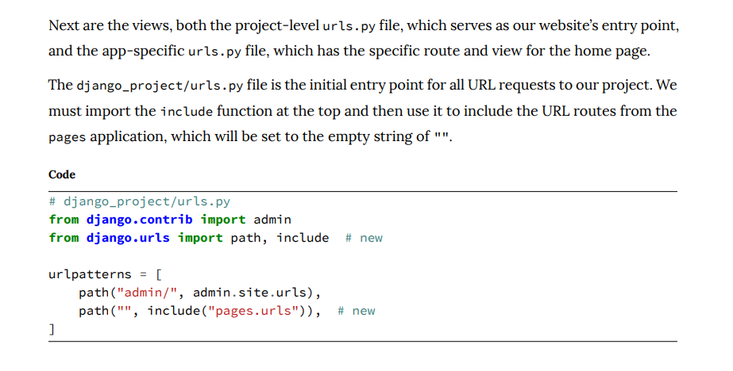

Slide 10
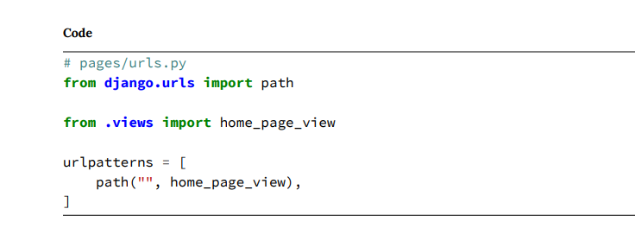

Slide 11
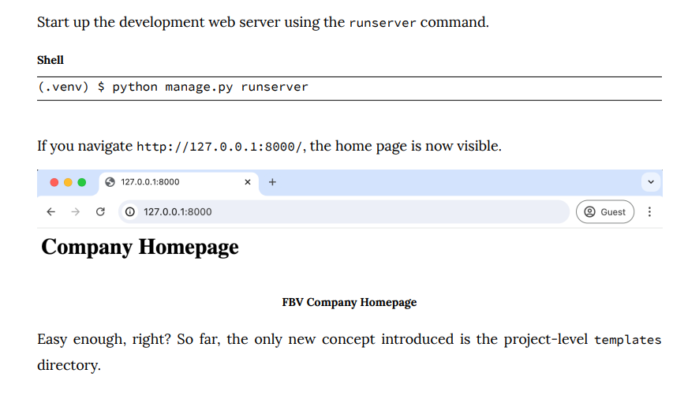

Slide 12
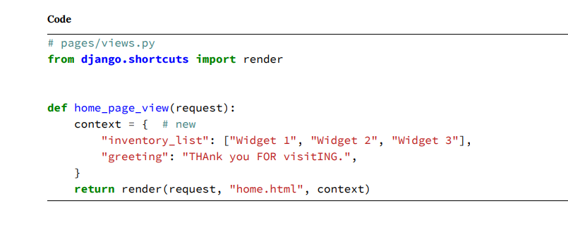

Slide 13
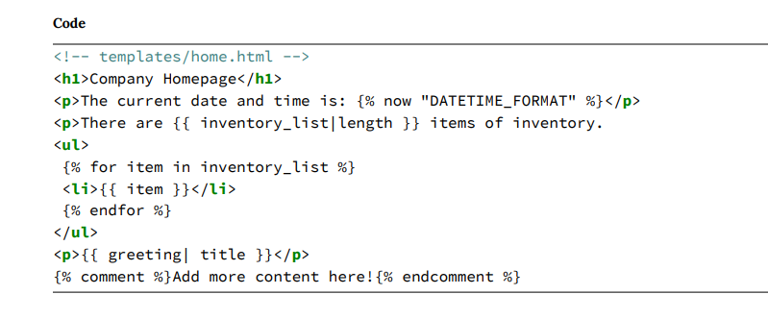

Slide 14
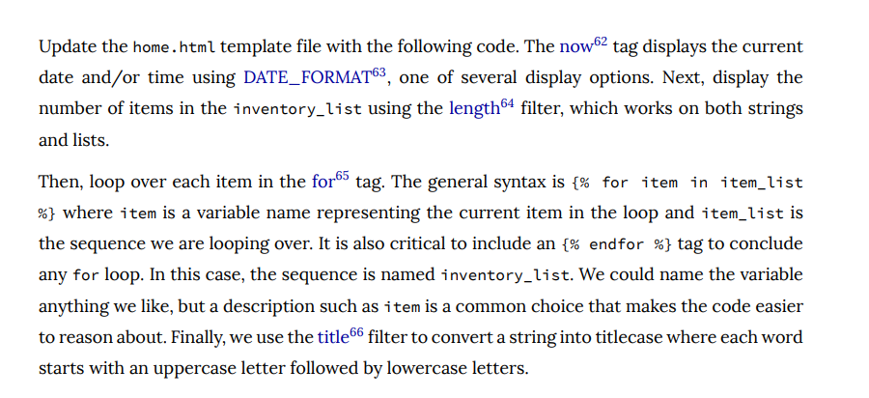

Slide 15
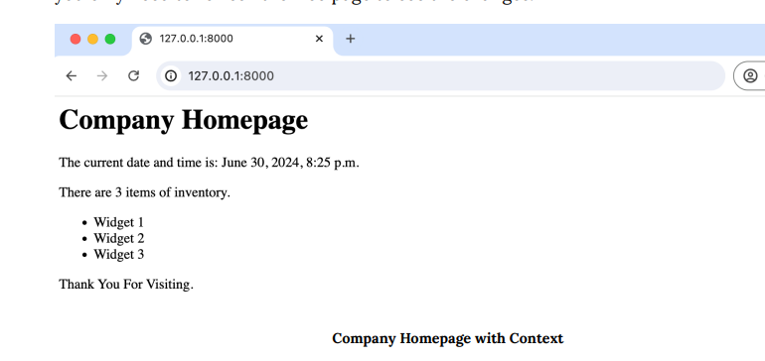

Slide 16
Django has function-based views and class-based views.
The problem with function-based views was that there was no easy way to extend or customize them. As projects grow, this becomes more and more of an issue.
Classes are a fundamental part of Python that rely on object oriented programming (OOP) and inheritance, so one class can inherit attributes and methods from another. That means we don’t have to include all the logic for a view in one place but rather can abstract common patterns and then customize or extend them as needed.

Slide 17
Once you have used generic class-based views for a while, they become elegant and efficient ways to write code. You can often modify a single method on one to do custom behavior rather than rewriting everything from scratch, which makes it easier to understand someone else’s code.
However, this comes at the cost of complexity and requires a leap of faith because it takes a long time to understand how they work under the hood.

Slide 18
Template View
Create a second web page for our Company site, this time using TemplateView, a generic class-based view.

Slide 19
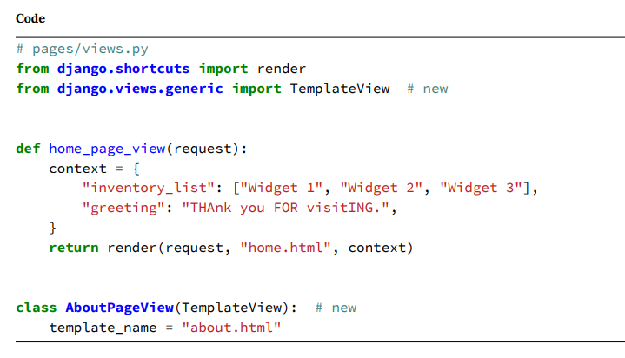

Slide 20
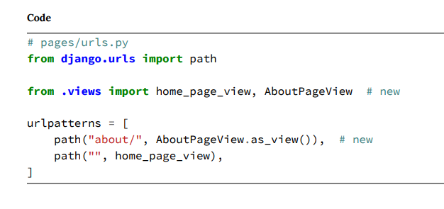
Note the addition of the as_view() method that returns a callable view.

Slide 21
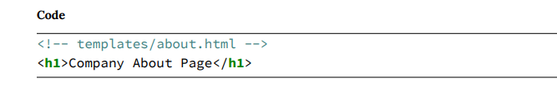

Slide 22
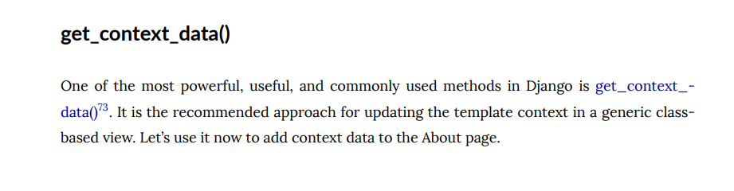

Slide 23
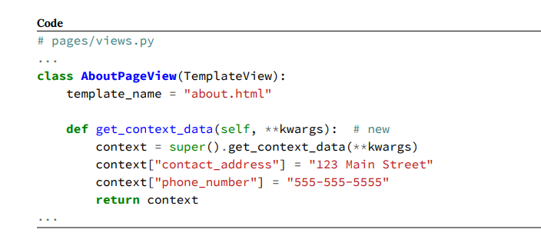

Slide 24
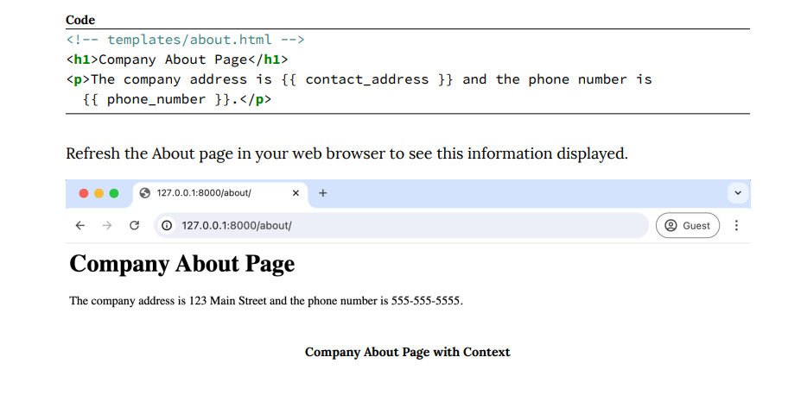

Slide 25
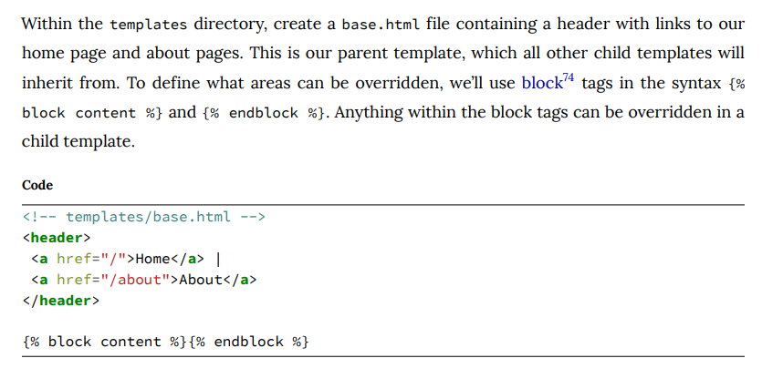

Slide 26
The extends tag allows us to establish parent/child relationships between our templates by specifying the parent template.
Add it to the top of the home.html and about.html templates. Then define our child template content with {% block content %} and {% endblock %} tags.

Slide 27
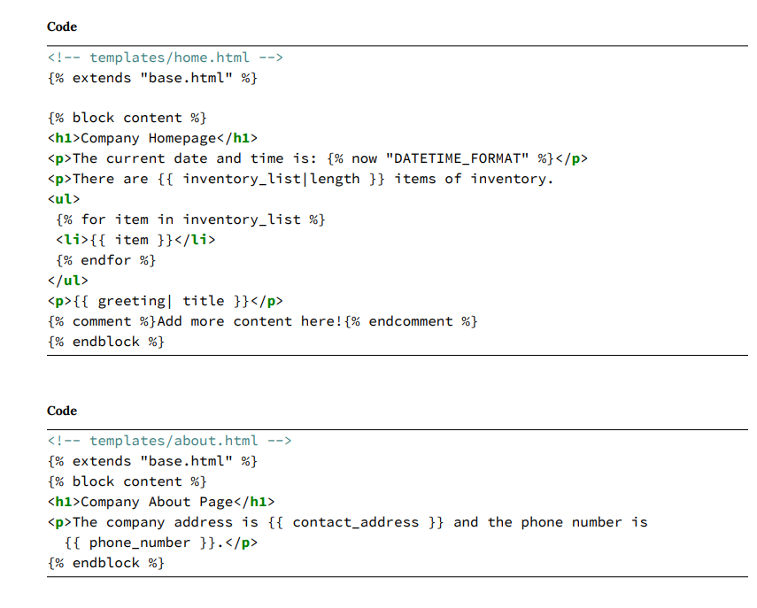

Slide 28
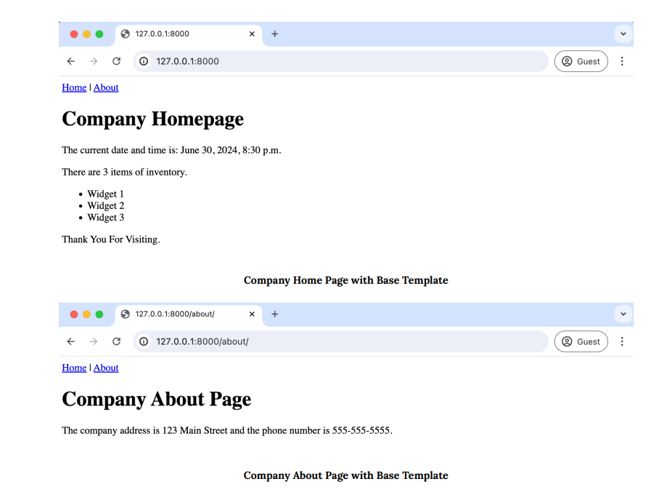

Slide 29
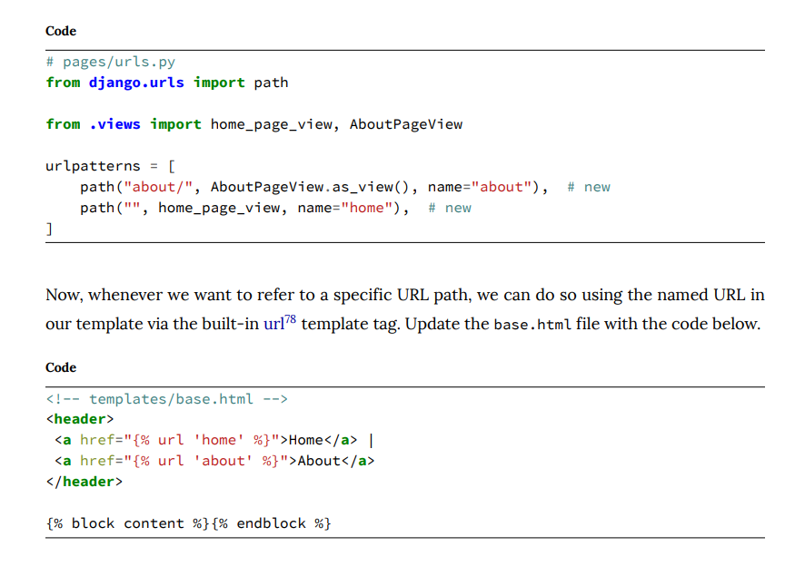

Slide 30
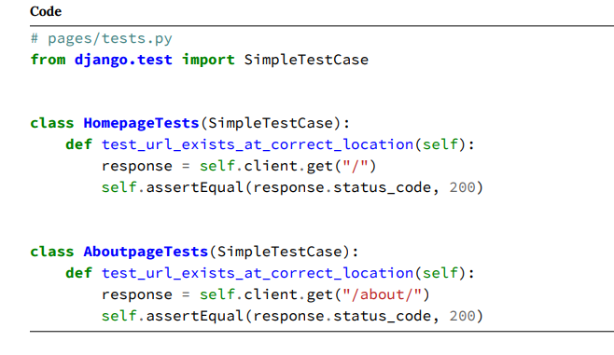

Slide 31
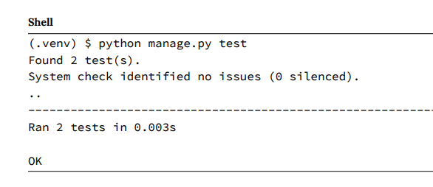

Slide 32
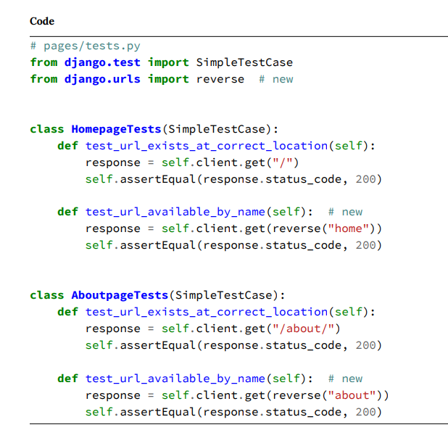

Slide 33
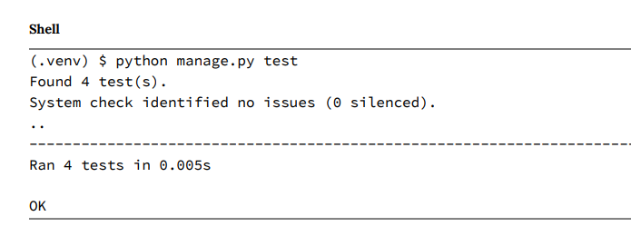

Slide 34
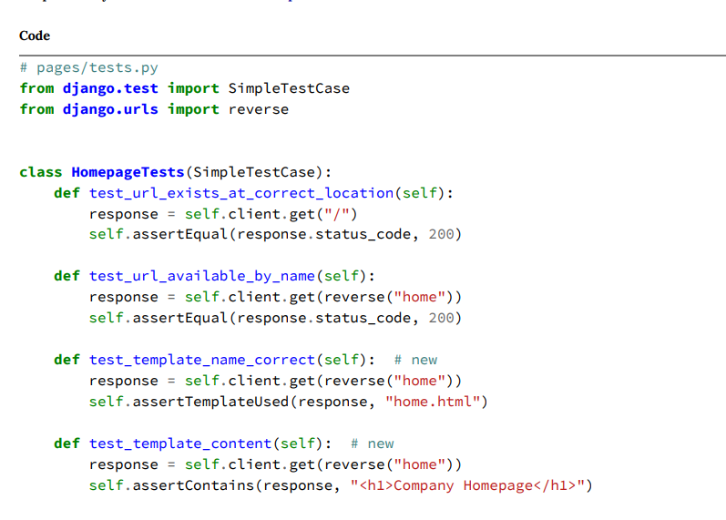

Slide 35
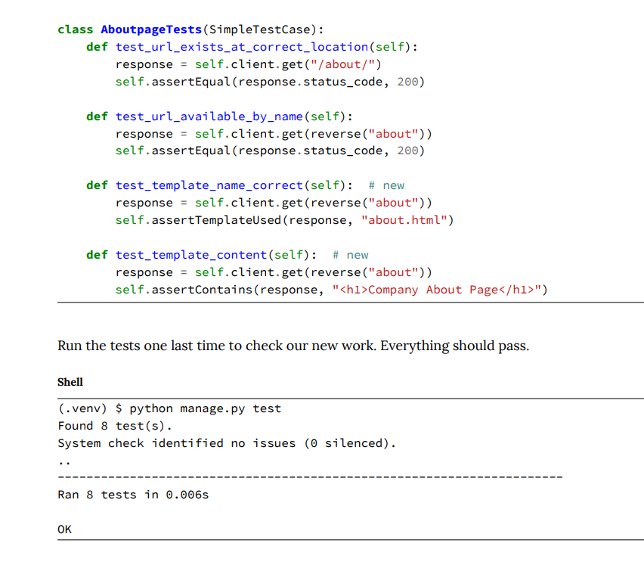

Slide 36
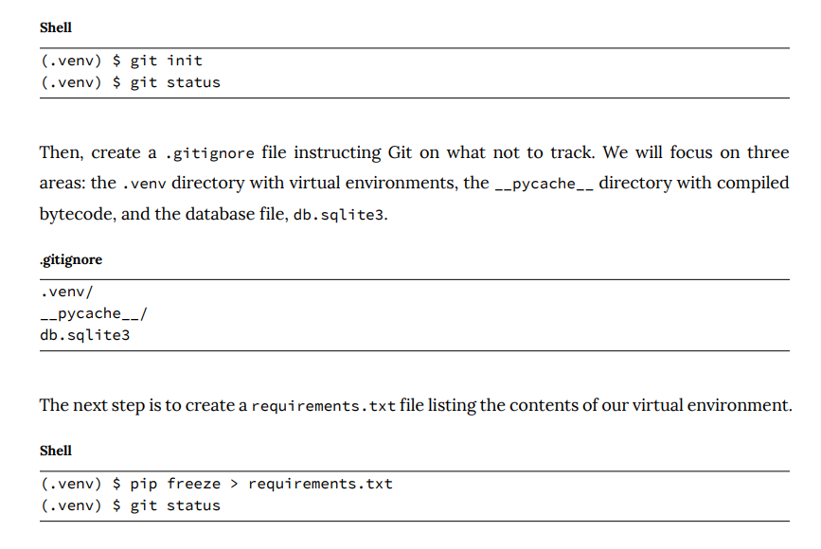

Slide 37
