Slide 1
Django for Beginners Chapter 1: Initial Setup

Slide 2
Django is a free, open source web framework written in the Python programming language

Slide 3
Python installed?
https://www.python.org/
python --version
python3 --version
py --version

Slide 4
Virtual Environments
Virtual environments are an indispensable part of Python programming. They are an isolated container containing all the software dependencies for a given project.
This is important because by default software like Python and Django is installed in the same directory. This causes a problem when you want to work on multiple projects on the same computer.

Slide 5
Virtual Environments
What if ProjectA uses Django 3.0 but ProjectB from last year is still on Django 1.11?
Without virtual environments this becomes very difficult; with virtual environments it’s no problem at all. There are many areas of software development that are hotly debated, but using virtual environments for Python development is not one.
Virtual environments allow you to create and manage separate environments for each Python project on the same computer. You should use a dedicated virtual environment for each new Python and Django project.

Slide 6
venv
There are several ways to implement virtual environments but the simplest is with the venv module already installed as part of the Python 3 standard library.

Slide 7
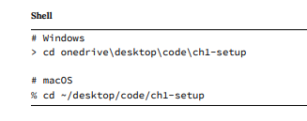

Slide 8
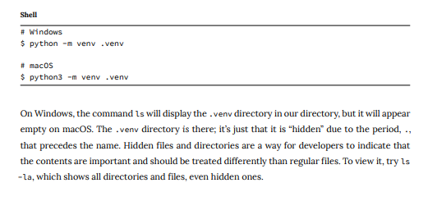

Slide 9
Once created, a virtual environment must be activated. On Windows an Execution Policy must be set to enable running scripts. This is a safety precaution. The Python docs recommend allowing scripts for the CurrentUser only, which is what we will do.
On macOS there are no similar restrictions on scripts so it is possible to directly run source .venv/bin/activate.

Slide 10
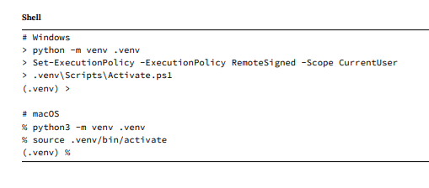

Slide 11
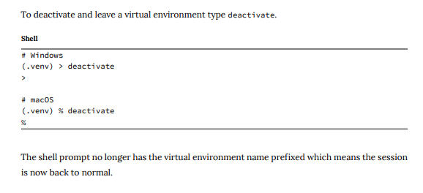

Slide 12
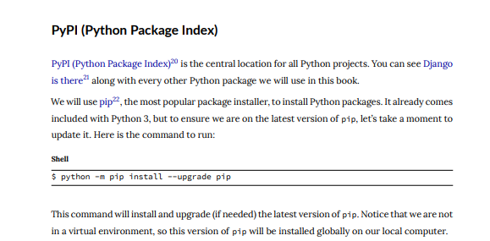

Slide 13
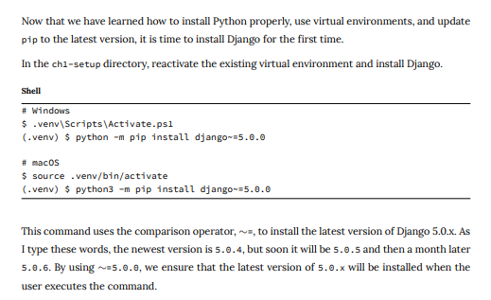
Install Django

Slide 14
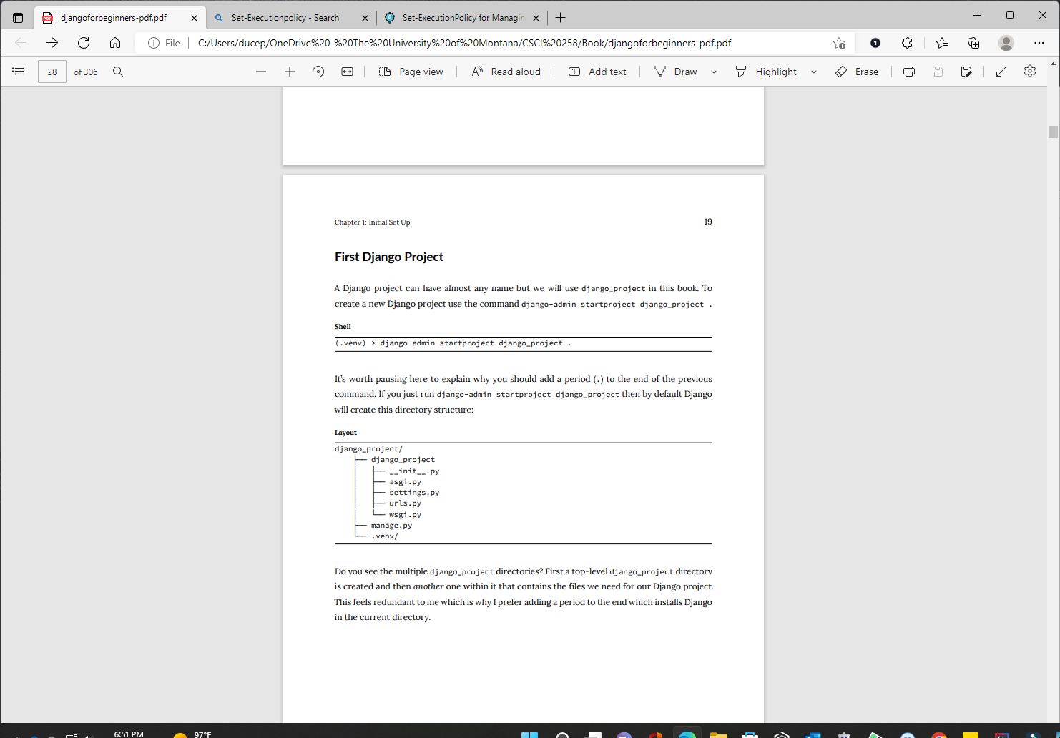

Slide 16
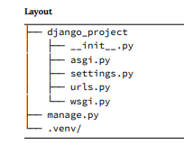

Slide 17
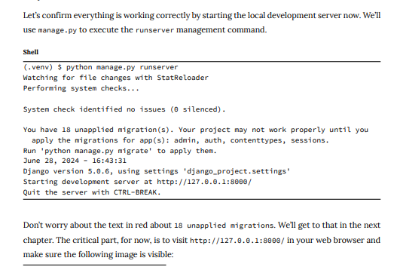

Slide 18
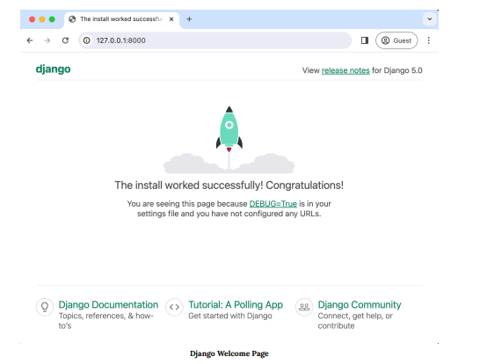

Slide 19
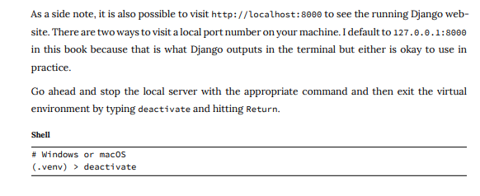

Slide 20
Django
https://www.djangoproject.com/

Slide 21
Editor
The command line is where we execute commands for our programs but a text editor is where actual code is written. The computer doesn’t care what text editor you use–the end result is just code–but a good text editor can provide helpful hints and catch typos for you.
There are many modern text editors available but a very popular one is Visual Studio Code, which is free, easy to install, and enjoys widespread popularity. If you’re not already using a text editor, download and install VSCode from the official website.

Slide 22
An optional–but highly recommended–additional step is to take advance of the large ecosystem of extensions available on VSCode.
On Windows, navigate to File -> Preferences ->Extensions or on macOS Code -> Preferences -> Extensions. This launches a search bar for the extensions marketplace.
Enter “python” which will bring up the Microsoft extension as the first result.
Install it.

Slide 23
A second extension to add is Black, which is a Python code formatter that has quickly become the default within the Python community.
To install Black, open a Terminal window within VSCode by going to Terminal -> New Terminal at the top of the page. In the new terminal window opened at the bottom of the page, type python -m pip install black.
Next, open up the VSCode settings by navigating to File -> Preferences -> Settings on Windows or Code-> Preferences -> Settings on macOS. Search for “python formatting provider” and select black from the dropdown options. Then search for “format on save” and enable “Editor: Format on Save”. Black will now automatically format your code whenever a *.py file is saved.

Slide 24
To confirm this is working, use your text editor to create a new file called hello.py and type in the following using single quotes:
print('Hello, World!’)
On save, it should be automatically updated to using double quotes which is Black’s default
print("Hello, World!")
That means everything is working properly.

Slide 25
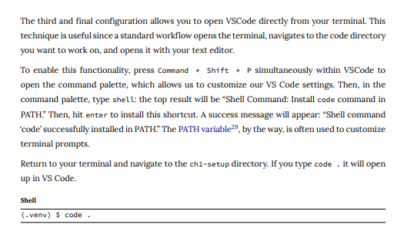

Slide 26
Git
The final step is to install Git, a version control system that is indispensable to modern software development.
With Git you can collaborate with other developers, track all your work via commits, and revert to any previous version of your code even if you accidentally delete something important!

Slide 27
Windows
On Windows, navigate to the official website at https://git-scm.com/ and click on the “Download” link which should install the proper version for your computer.
Save the file and then open your Downloads folder and double click on the file. This will launch the Git for Windows installer.

Slide 28
Click the “Next” button through most of the early defaults as they are fine and can always be updated later as needed.
There are two exceptions however: under “Choosing the default editor used by Git” select VS Code not Vim.
And in the section on “Adjusting the name of the initial branch in new repositories” select the option to use “main” as opposed to “master” as the default branch name.
Otherwise the recommended defaults are fine and can always be tweaked later if needed. To confirm Git is installed on Windows, close all current shell windows and then open a new one which will load the changes to our PATH variable. Type in git --version which should show it is installed.

Slide 29
mac
On macOS, installing Git via Xcode is currently the easiest option. To check if Git is already installed on your computer, type git --version in a new terminal window.
If you do not have Git installed, a popup message will ask if you want to install it as part of “command line developer tools.” Select “Install” which will load Xcode and its command line tools package.

Slide 30
mac
Or if you do not see the message for some reason, type xcode-select --install
instead to install Xcode directly. Be aware that Xcode is a very large package so the initial download may take some time.
Xcode is primarily designed for building iOS apps but also includes many developer features need on macOS. Once the download is complete close all existing terminal shells, open a new window, and type in git --version to confirm the install worked

Slide 31
Once Git is installed on your machine we need to do a one-time system configuration by declaring the name and email address associated with all your Git commits. We will also set the default branch name to main. Within the command line shell type the following lines:
> git config --global user.name "Your Name"
> git config --global user.email "yourname@email.com"
> git config --global init.defaultBranch main
You can always change these configs later if you desire by retyping the same commands with a new name or email address.
>git config --list

Slide 32
If you previously had git installed – commands to update using Windows
> git update-git-for-windows
> git config --global core.editor "code --wait"

Slide 33
Material in these slides was taken from DJANGO for Beginners – William S. Vincent

