Slide 1
Django
Pages App – Chapter 3
Material in these slides was taken from DJANGO for Beginners – William S. Vincent

Slide 2
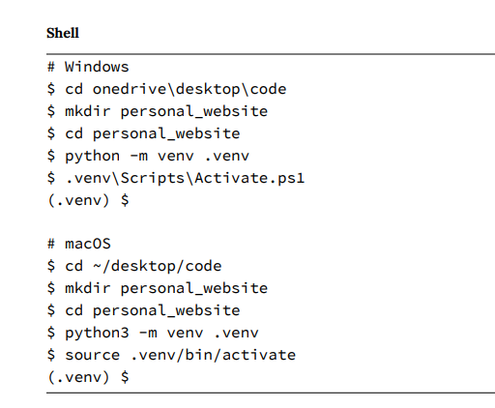
Initial Set Up

Slide 3
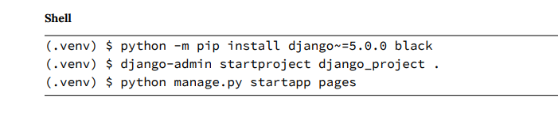
Initial Set Up

Slide 4
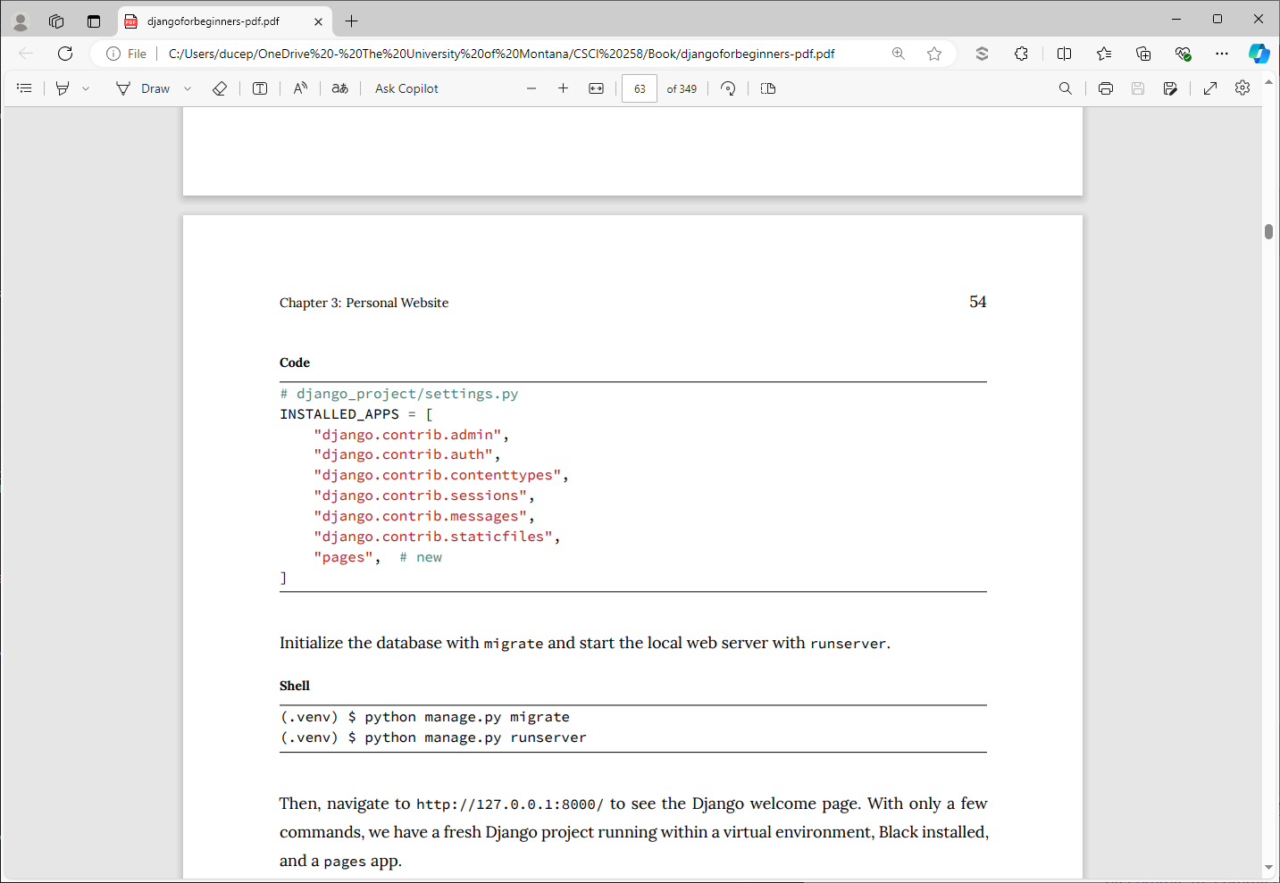

Slide 6
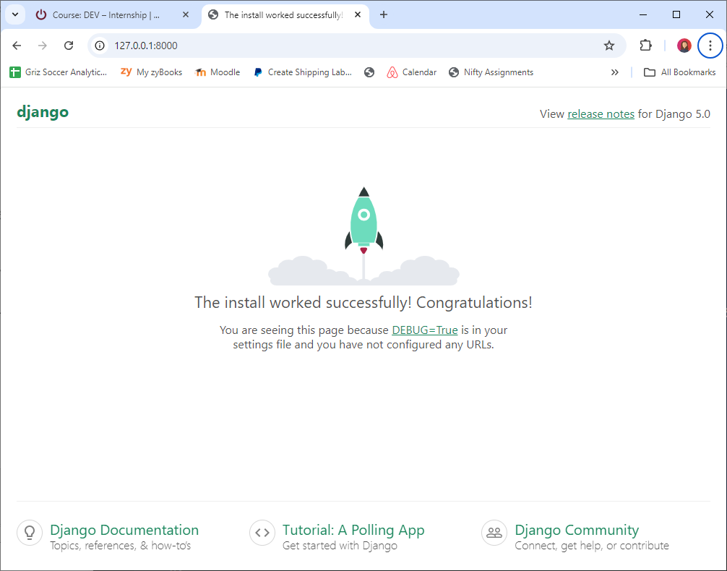

Slide 7
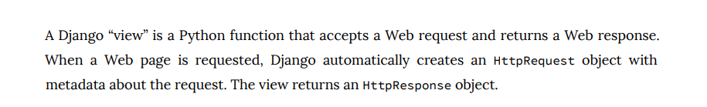

Slide 8
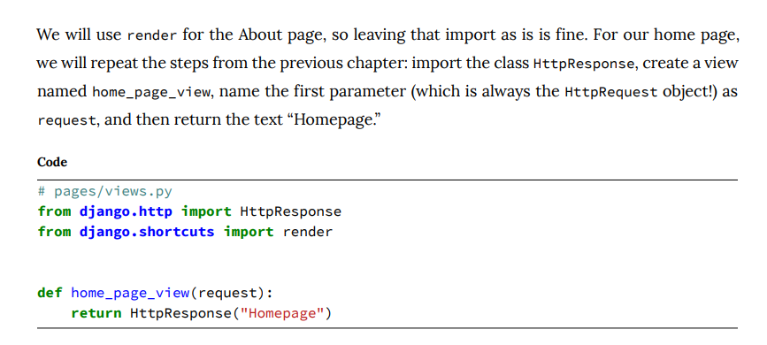

Slide 9
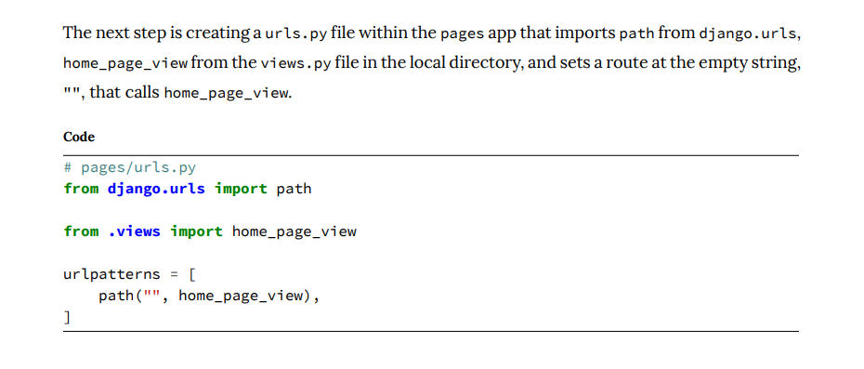

Slide 10
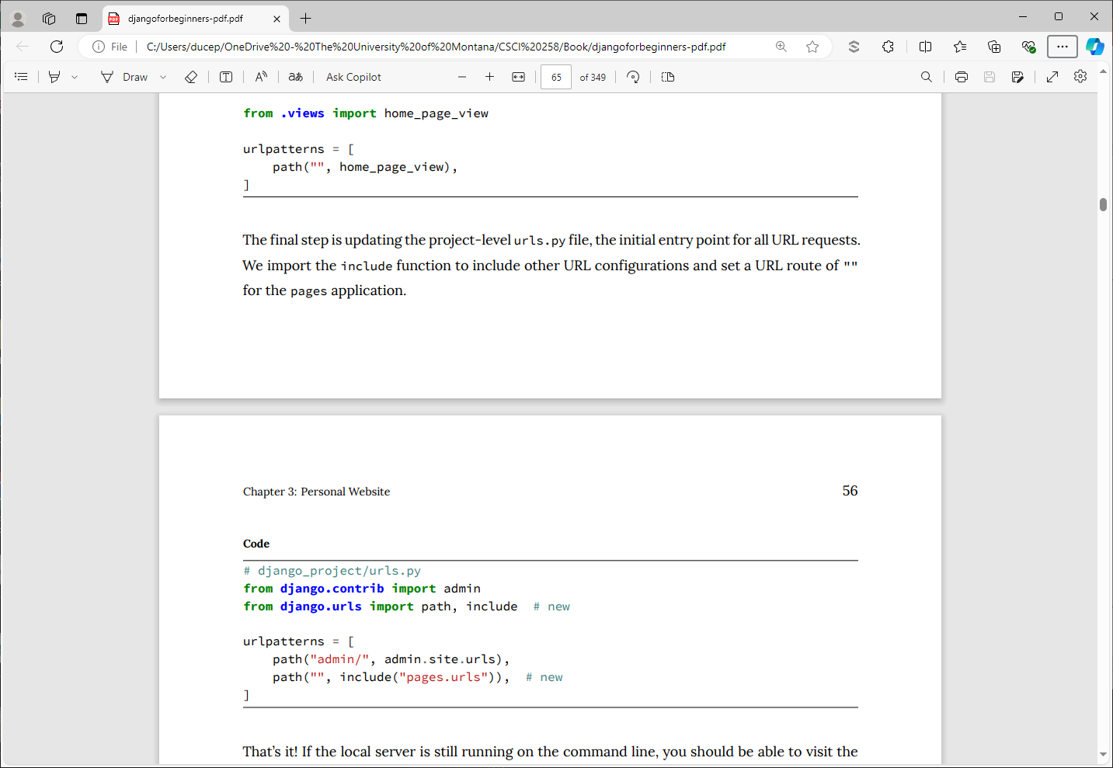

Slide 11
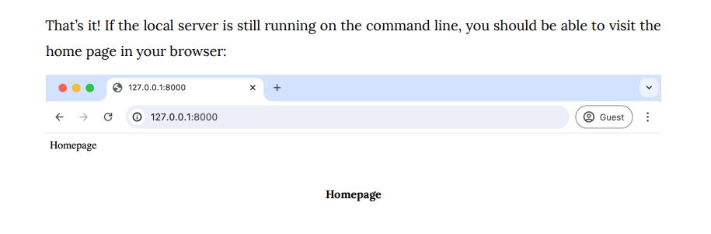

Slide 12
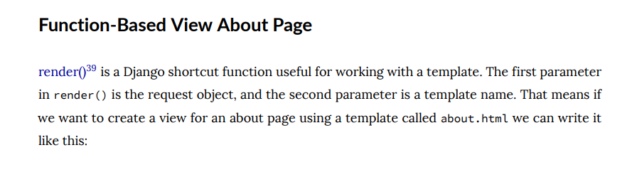
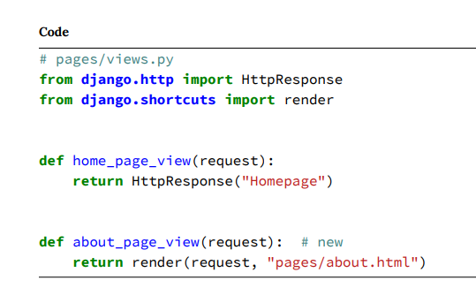

Slide 13
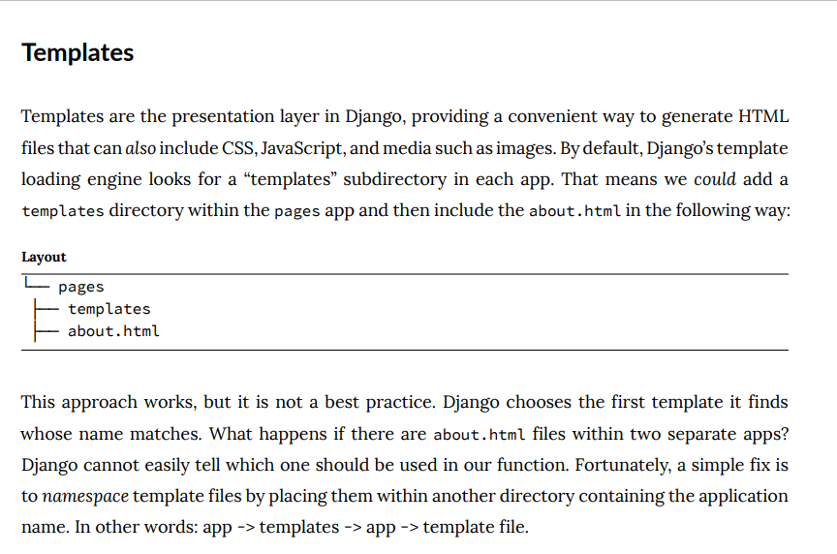

Slide 14
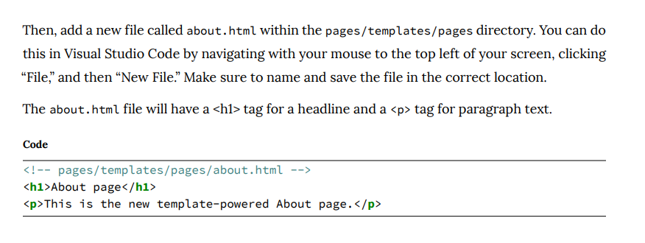

Slide 15
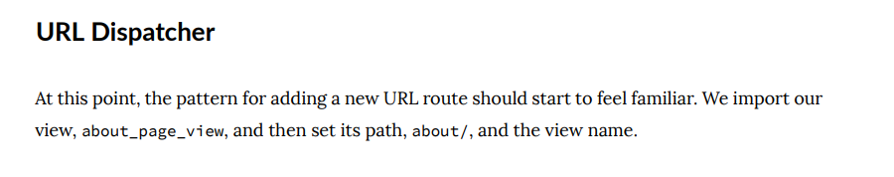
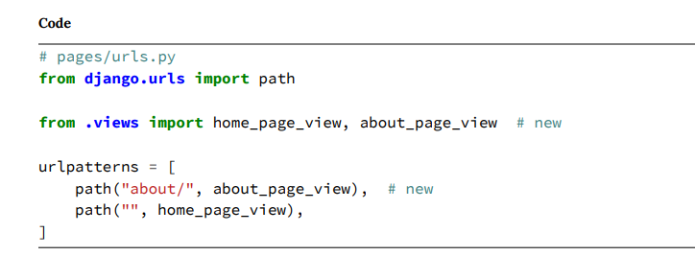

Slide 16
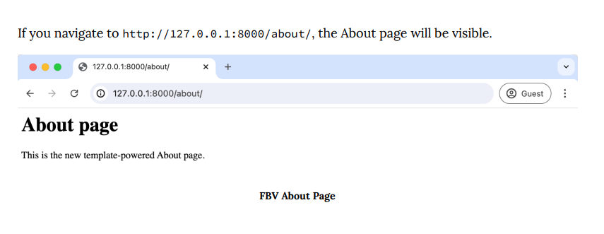

Slide 17
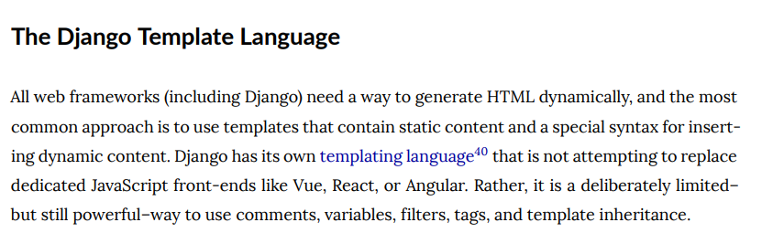

Slide 18
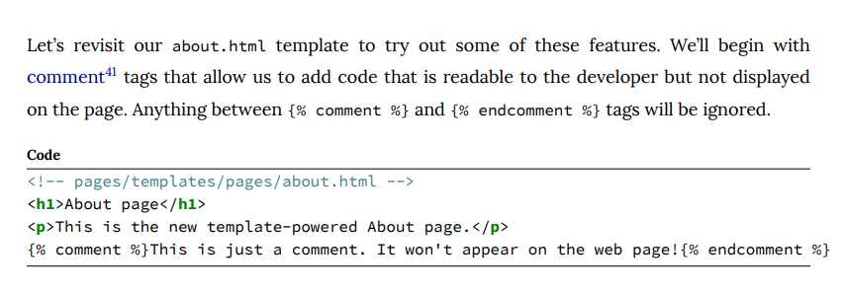

Slide 19
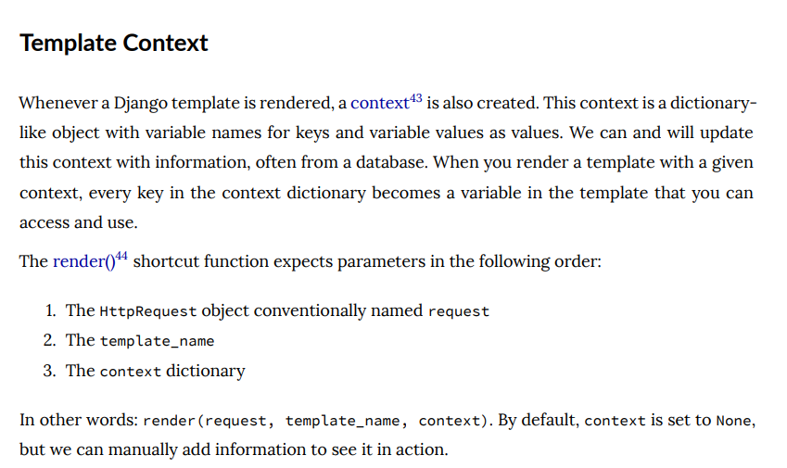

Slide 20
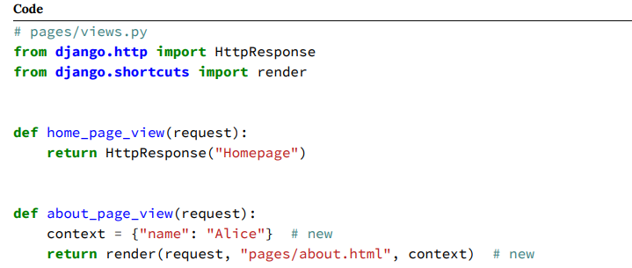

Slide 21
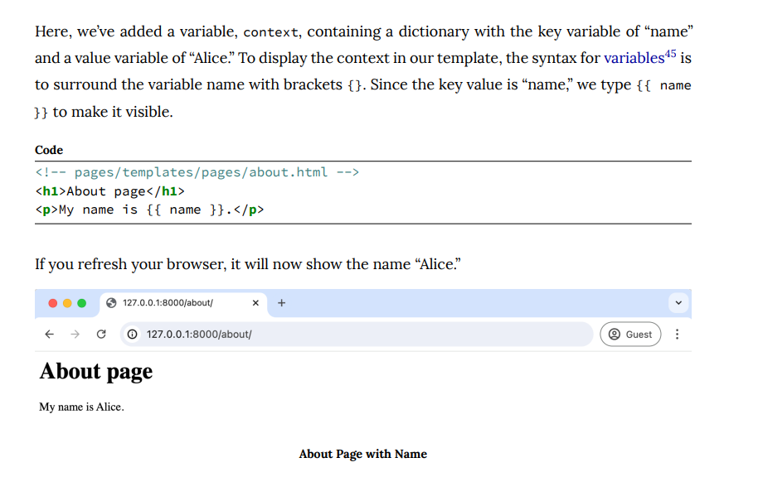

Slide 22
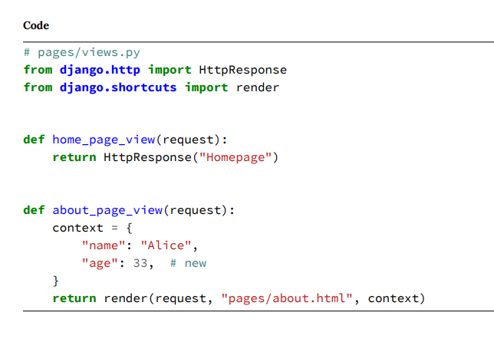

Slide 23
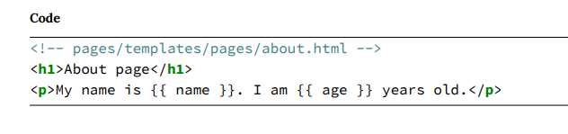

Slide 24
Tests
Writing tests for your code is as important as writing the code itself. Without accompanying tests, you can’t submit new code changes to an open-source project or within any well-structured company.
The reasoning is simple: while your code change may be small, there is no telling what else it might inadvertently break in the project.
Writing good tests provides confidence in your codebase, doesn’t take too long, and can be automated to run automatically on any new code changes.

Slide 25
Testing can be divided into two main categories: unit and integration.
Unit tests check a piece of functionality in isolation, while Integration tests check multiple linked pieces.

Slide 26
Anytime you create new functionality, a test is necessary to confirm that it works as intended. For example, in our project, we have a home page and an about page, and we should test that both exist at the expected URLs. It may seem unnecessary now, but as a project grows in size, there’s no telling what can change.

Slide 27
The Python standard library contains a built-in testing framework called unittest that uses TestCase instances and a long list of assert methods to check for and report failures. Django’s testing framework provides several extensions on top of Python’s unittest.TestCase base class.

Slide 28
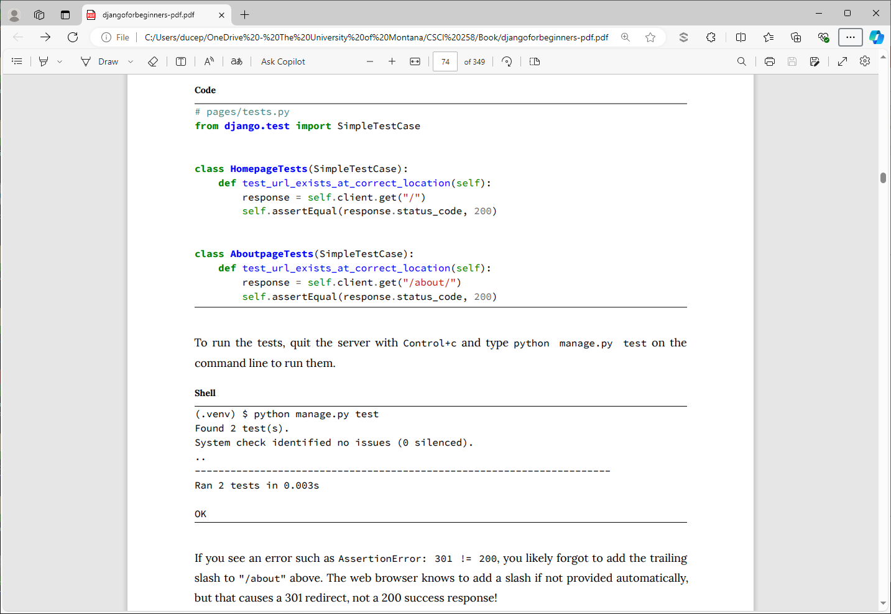
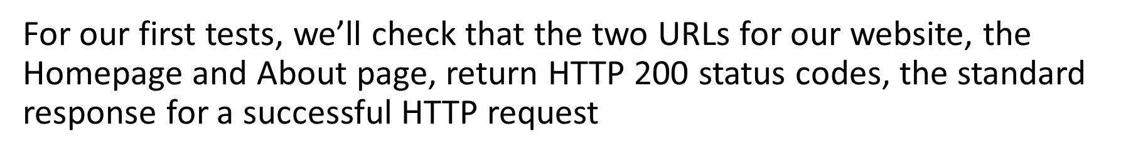

Slide 30
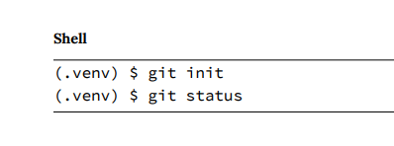
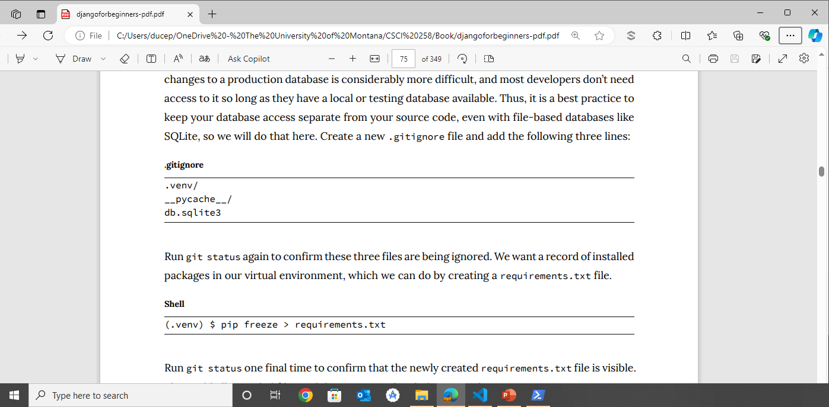

Slide 31
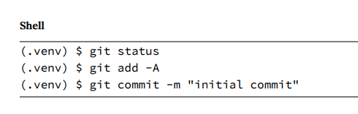

Slide 32
