Slide 1
E-Portfolio

Slide 2
E-Portfolio
A portfolio is a way of showcasing work samples and skills stated in your resume.
One of the ways of creating a simple portfolio is using GitHub pages. This is a site hosting service that takes HTML, CSS and JavaScript files directly from a repo on GitHub.

Slide 3
You can create a Project site and/or Personal site
create a new repository named username.github.io. Say if your name is trishduce, your repository name will be trishduce.github.io. This will be your homepage.

Slide 4
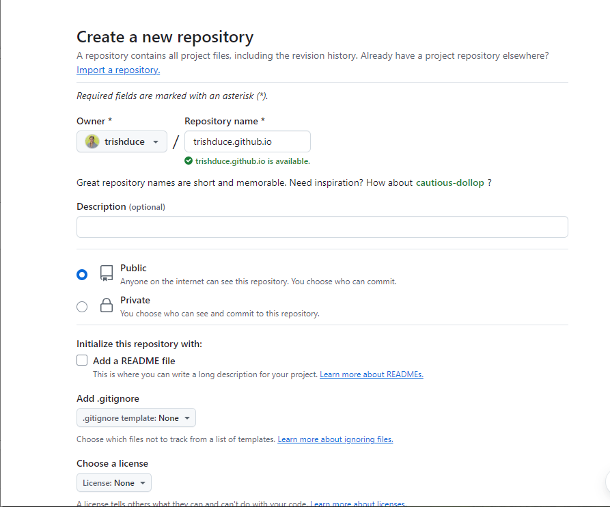
Create a new repository

Slide 5
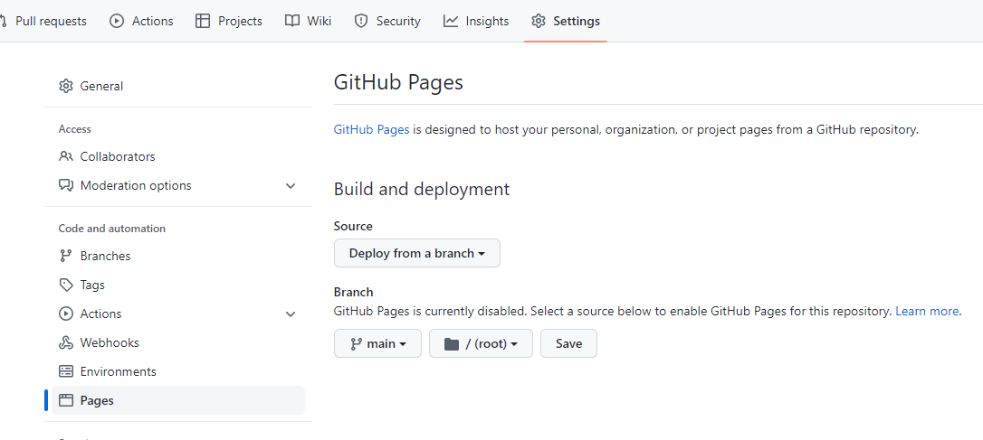
Go to repository Settings and click on “Pages” on the left. Select “main branch” under the “Source”.

Slide 6
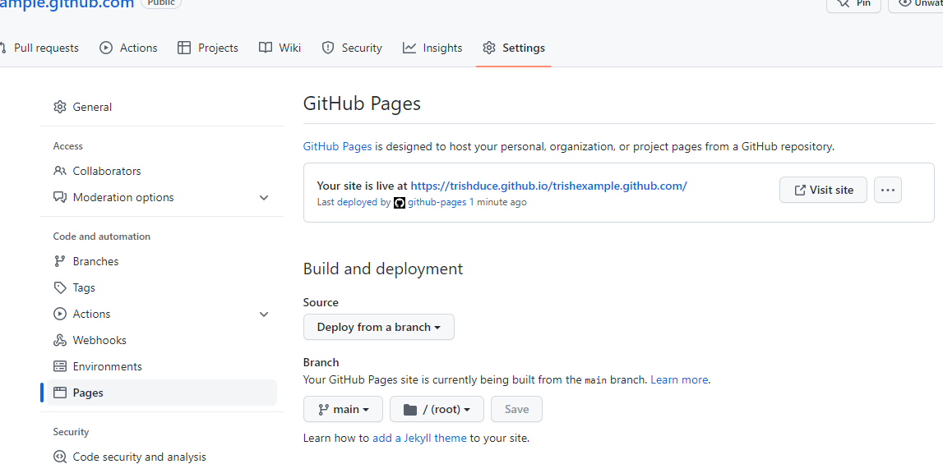
Might take a few minutes

Slide 7
Check out the following websites to download free portfolio website templates from colorlib, Start Bootstrap, Themezy, BootStrap zero or Bootstrap made.

Slide 8
Each project can have a site – could put web site on a different branch.

