Slide 1

#01# Introduce about ReactJS
Trainer: Bach Ngoc Toan – TEDU.COM.VN

Slide 2
Prerequisition and Goals
Prerequisition:
Javascript basic
Goal
Basic knowledge about ReactJS
Understand how to use ReactJS
Create basic for future courses.

Slide 3
What is ReactJS?
React is a Javascript library for building User Interfaces
Home page: https://reactjs.org/
Current version: 16.13.1
Github: https://github.com/facebook/react/
MIT Lisence: https://github.com/facebook/react/blob/master/LICENSE
Initial release: May 29, 2013
Developers: Facebook and community

Slide 4
Component

Slide 5
Example SPA in real world
https://reactjs.org/
https://tedu.com.vn

Slide 6
Editors
Visual Studio Code (https://code.visualstudio.com/)
https://codepend.io

Slide 7
Why should we choose React?
UI State become difficult to handle with Vanilla Javascript
Focus on Business logic, not on preventing your App from exploding.
Huge Ecosystem, Active community and High Performance

Slide 8
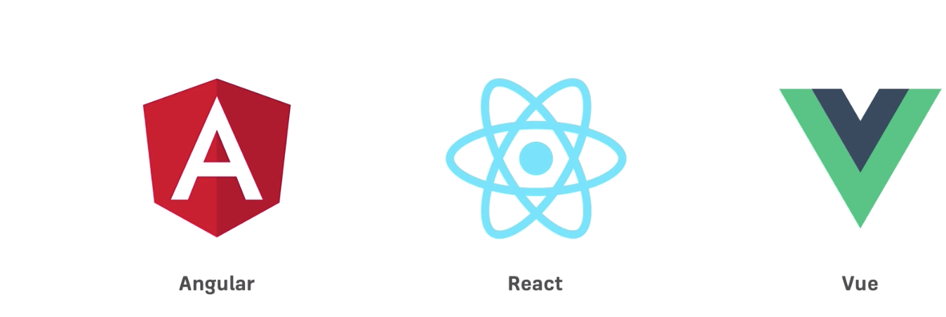
React Alternatives

Slide 9
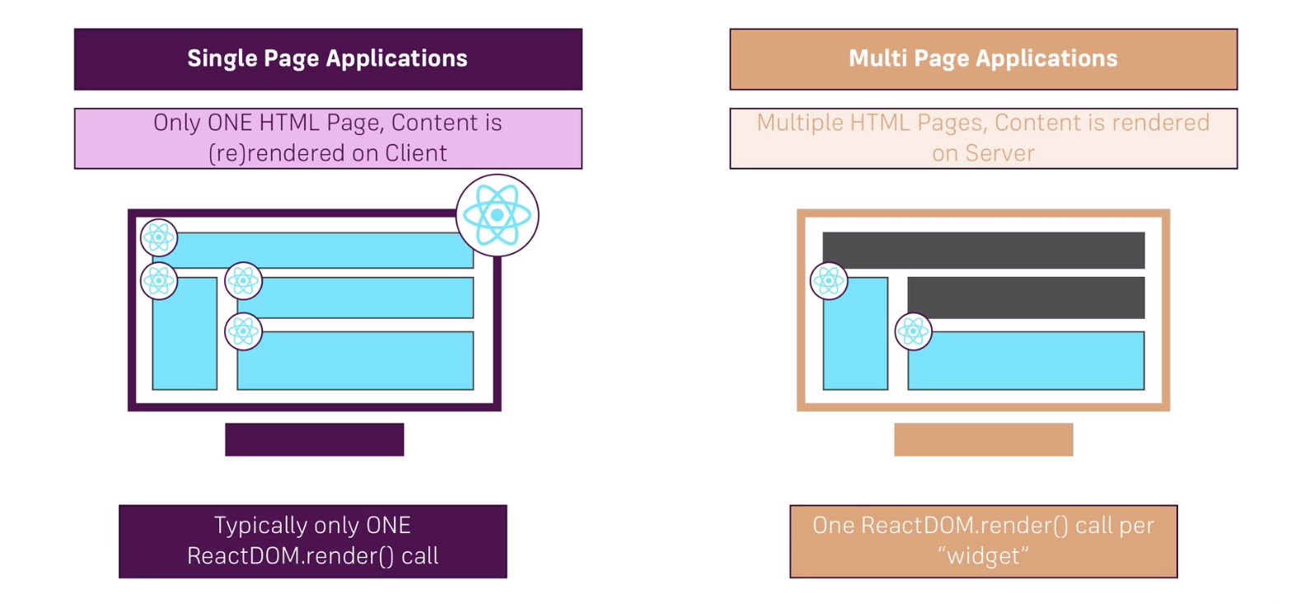
Difference between SPA and Multi Page Application

