Slide 1

#12# Build work flow

Slide 2
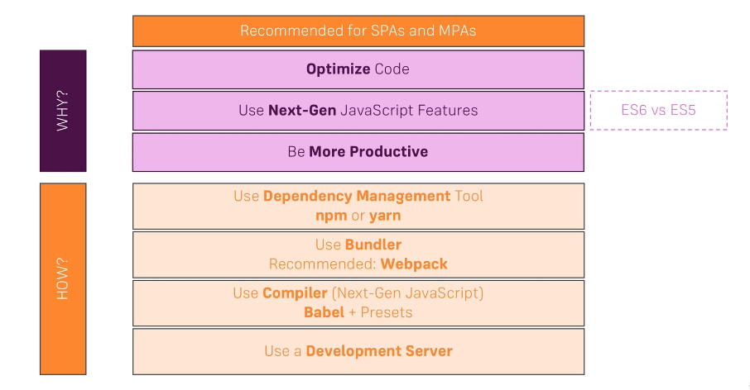
Build workflow

