Slide 1

#19# Props and State

Slide 2
Props & State
props and state are CORE concepts of React.
Actually, only changes in props and/ or state trigger React to re-render your components and potentially update the DOM in the browser.

Slide 3
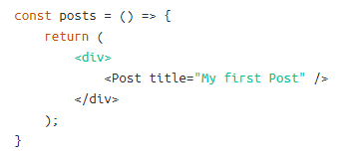
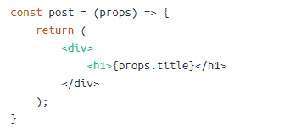
Props
props allow you to pass data from a parent (wrapping) component to a child (embedded) component.

Slide 4
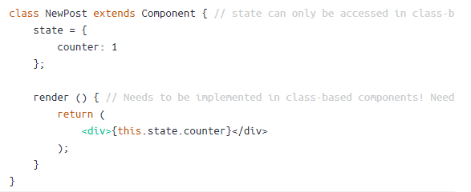
State
Whilst props allow you to pass data down the component tree (and hence trigger an UI update), state is used to change the component, well, state from within.
Changes to state also trigger an UI update.

Slide 5
Difference
The difference to props is, that this happens within one and the same component - you don't receive new data (props ) from outside!
https://reactjs.org/docs/components-and-props.html
https://reactjs.org/docs/state-and-lifecycle.html

