Slide 1

#21# Using useState() hook

Slide 2
What is hook?
Hooks are a new addition in React 16.8.
They let you use state and other React features without writing a class.
https://reactjs.org/docs/hooks-intro.html

Slide 3
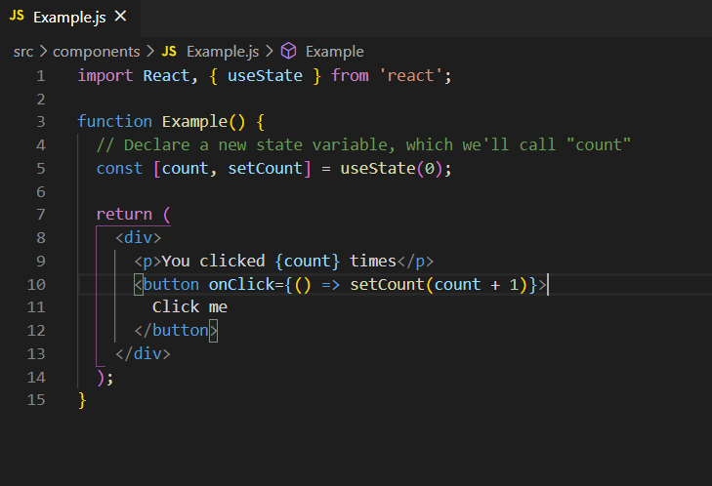
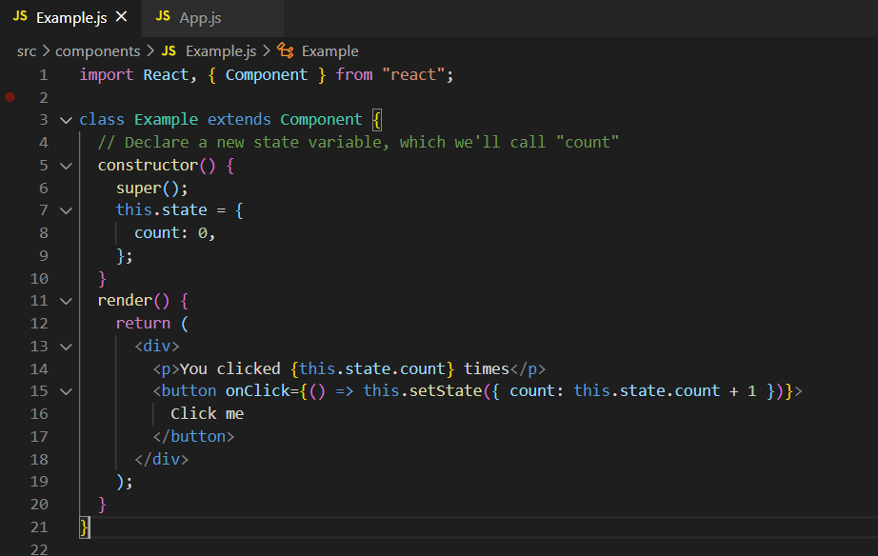
Example

