Slide 1

#03# let & const keyword

Slide 2
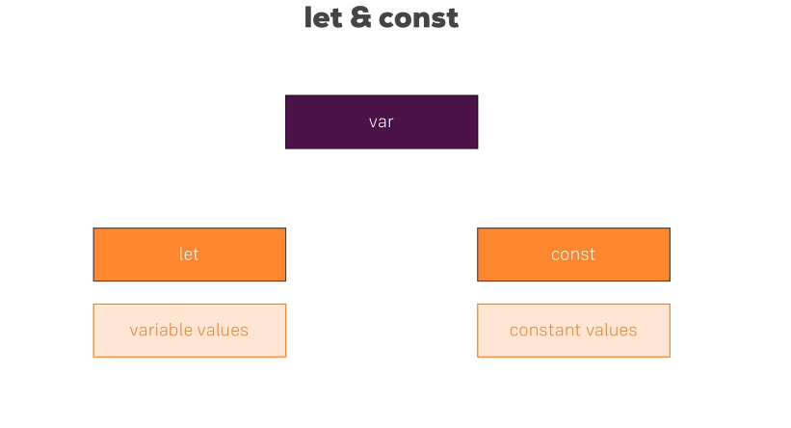
Let & const keyword

