Slide 1

#06# Classes

Slide 2
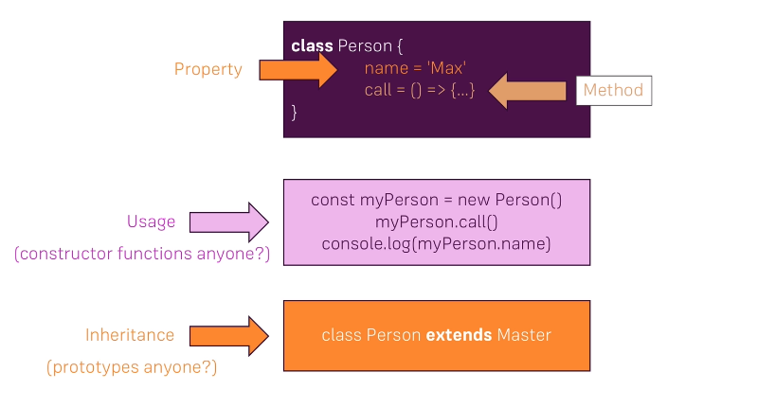
Import & export modules

