Slide 1

#07#
Classes, Properties and Methods

Slide 2
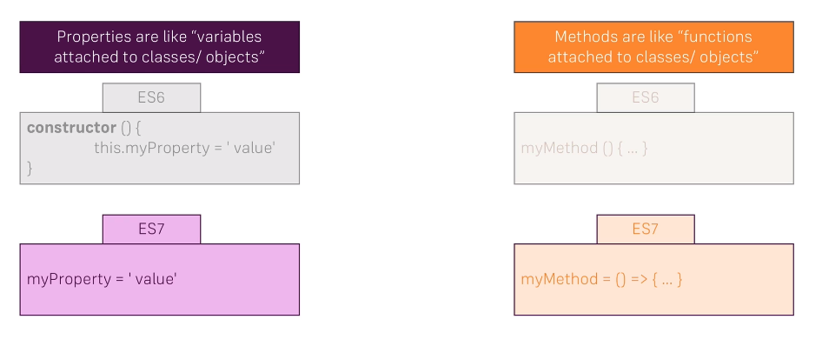
Classes, Properties and Methods

