Slide 1

#08# Spread and Rest operators

Slide 2
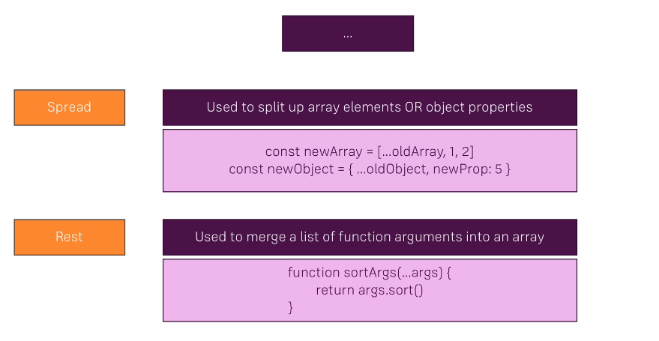
Spread and Rest operators

