Slide 1

#09# Destructuring

Slide 2
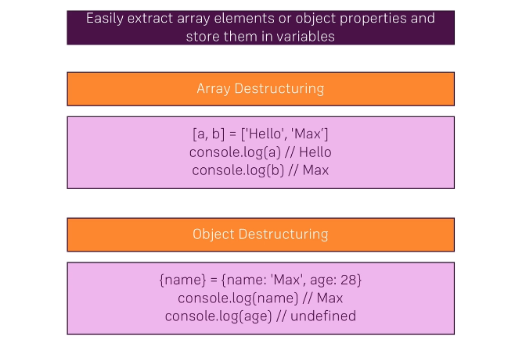
Destructuring

