Slide 1
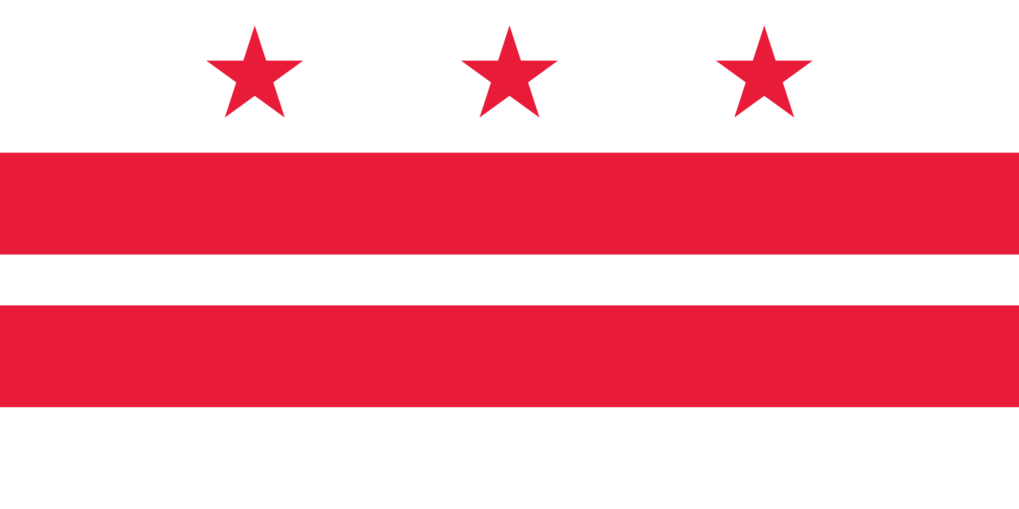
Capstone – The Battle of Neighborhoods
Food Venues Analysis: The case of Washington DC

Slide 2
Introduction
Washington DC Background
The capital city of the United States
In 2018 US census bureau estimated more than 702,000 people live in the city
Annually receives more than 20 million visitors. Most of them are internally
Prospects
Visitors number is increasing each year
Number of workforce entering the city by day is expanding
City’s expanding economy each year and high consumer’s outlook push restaurant industry to expand
Restaurants Background
In 2018 the restaurant industry's estimated total sale was $4.4 billion with 2,447 eating and drinking locations in the District

Slide 3
Business plan
In this study three major tasks were conducted
Criterion for choosing optimal location
Exploratory statistical analysis of food venues in Washington DC
The area is not populated with many restaurants
Close to the center of Washington D.C
Exploratory statistical analysis of restaurant distribution in Washington DC
No American restaurant exists in a certain distance range
Finding optimal locations for opening American restaurant in the city

Slide 4
Data sources
US Government’s open data portal
Geospatial data of US and its states was retrieved from it
Mapbox reverse geocoding API
Reverse geocoding (finding area addresses) was done using this API
Washington DC Government’s open data portal
The city’s neighborhood’s are arranged in Clusters. The clusters boundary and its geometry was retrieved from this portal
Candidate neighborhoods generated algorithmically
Grids were generated throughout Washington DC
Foursquare location data and intelligence API
Food venues dataset in the city was obtained from it

Slide 5
Data collection steps
Candidate neighborhoods generation
Generated throughout the city
Circular shape of radius of 300 meters
Square grid objects were used to generate
The grids were first produced inside a rectangular object that completely contained Washington DC map
All the grids fall inside Washington DC were selected for further analysis
Mapbox reverse geocoding
During this step addresses for each center of neighborhoods were obtained
Mapbox reverse geocoding was used to convert latitude/longitude coordinate systems to physical addresses.
In order to access datasets from Mapbox, latitude/longitude information and Mapbox key are required

Slide 6
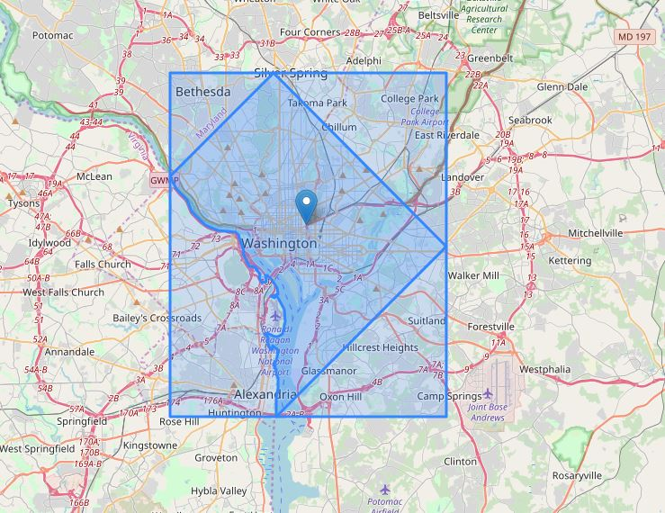
Folium visualization
Grids were generated inside the rectangular object. Only grids lied inside Washington DC were selected
Geographical centroid was used as center of Washington DC

Slide 7
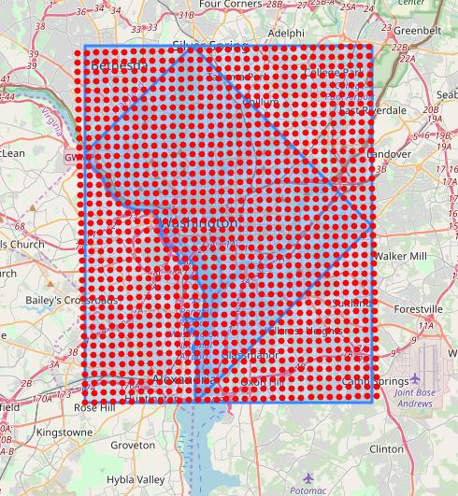
Grids generated throughout the rectangular object
Red dot are grids generated throughout the rectangular object
1216 grids were generated inside the rectangular object
The geometry of Washington DC was extracted from the geometry of US containing all the states geometry
However we only need the grids contained inside Washington DC map
We need only those grids contained inside DC map

Slide 8
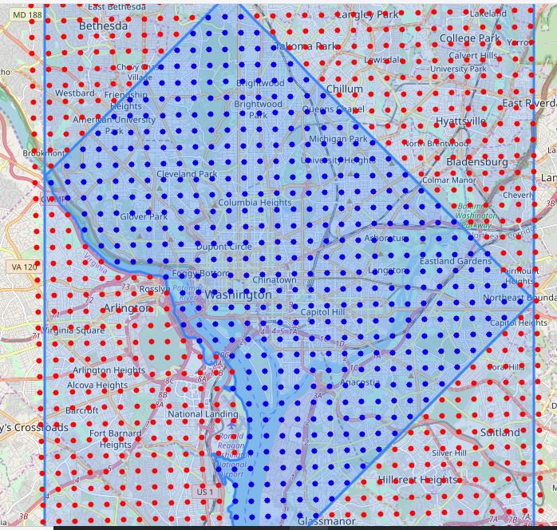
The blue dots are centers of candidate neighborhoods we are interested in further analysis
Among the 1216 grids only 496 are contained inside Washington DC map

Slide 9
Foursquare: Food venues located in Washington DC were collected by calling API from Foursquare.com
Required information for retrieving food venues dataset in a certain neighborhood are:
Radius of the candidate neighborhood
Latitude/Longitude of the center
Food venue ID
Client secrete and client id obtained from Foursquare
R
To obtain restaurants throughout Washington DC Foursquare API will be called for all 1217 candidate neighborhoods generated
The dataset obtained will be sorted out according to their type and stored into a dataframe object and saved

Slide 10
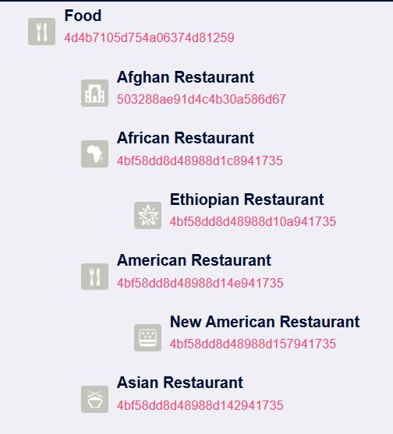
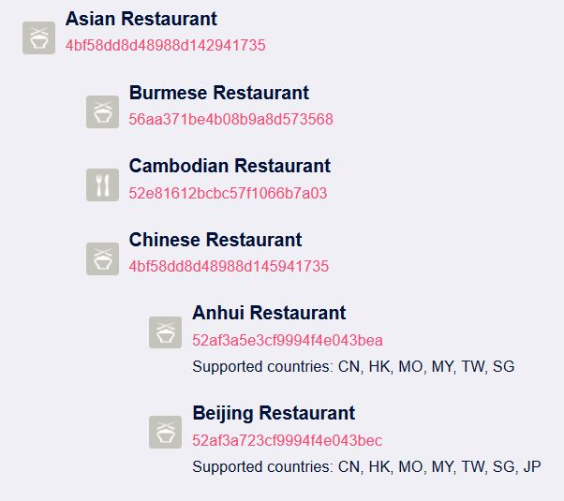
Sample snippets showing how dataset are arranged in Foursquare database
Images were extracted from Foursquare

Slide 11
Methodology
American restaurant data analysis
During this stage of analysis folium visualizing tool will be used
Restaurant number distribution will be visualized using folium heat map plot
American restaurant density distribution will be visualized using folium heat map
Regions of low distribution of restaurants will be identified visually
Exploratory data analysis
Food venues dataframe will be manipulated and restaurant dataframe will be produced
Both food venues and restaurant dataframes will be grouped according to their category.
The results will be visualized using matplotlib bar charts
cont’d …

Slide 12
… cont’d
Methodology
Finding optimal locations for opening new American restaurant
New neighborhoods having radius of 100 meters will be generated within 2000 meters of radius from the center
Addresses of each neighborhood generated will be obtained using reverse geocoding method by calling Mapbox API.
Number of restaurants lied within 250 meters of radius from the center of each neighborhood generated will be counted and stored in a dataframe
Distance of the closest American restaurant from center of each neighborhood will be calculated and stored in a dataframe
Cont’d …

Slide 13
Methodology
Neighborhoods having less than 2 restaurants in 250 meters of radius from their respective center will be kept
The locations selected above were further subjected to a test condition. Those locations where the closest American restaurant is not in 400 meters radius will be identified as potential locations
These potential locations will be clustered using k-means algorithm and their centers will be identified
Addresses for these cluster centers will be obtained using reverse geocoding technique by using Mapbox API
Distance will be calculated from White House to each cluster's centers

Slide 14
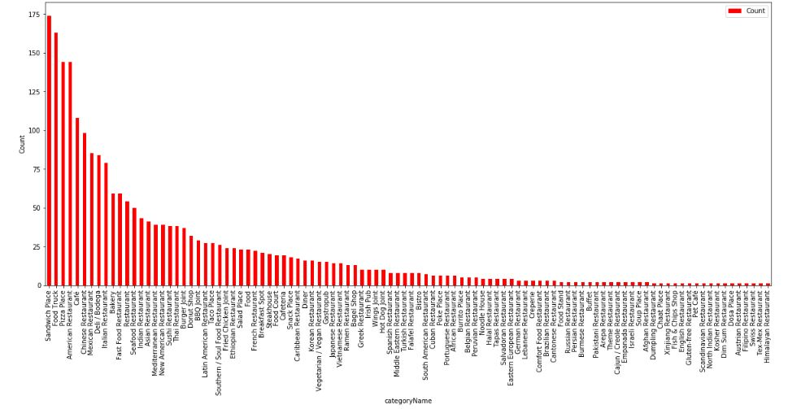
Results and Discussions
Sandwich Place is the number one most populated food venue in Washington DC and followed by food truck, American restaurant and Pizza place.
The restaurants variety ranges from South America to Asia and from Africa to Europe spanning all over the entire world.
Among the exotic restaurants Chinese restaurant is the most common and followed by Mexican, Italian and Indian restaurants.
By far American restaurants are the most populated restaurants in DC

Slide 15
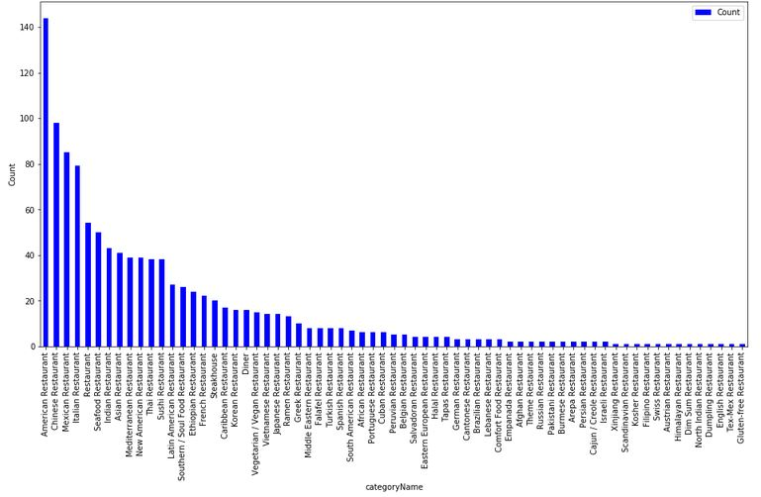
Results and Discussions
Food venues were filtered out to fit the conventional definition of restaurant criteria and the result was categorized plotted as shown in the bar plot
Among the restaurants American restaurant is the number one most populated restaurant in Washington DC and followed by Chinese restaurant
Mexican and Italian restaurants trailed third and fourth
A lot of restaurants have single or couple of venues in Washington DC area

Slide 16
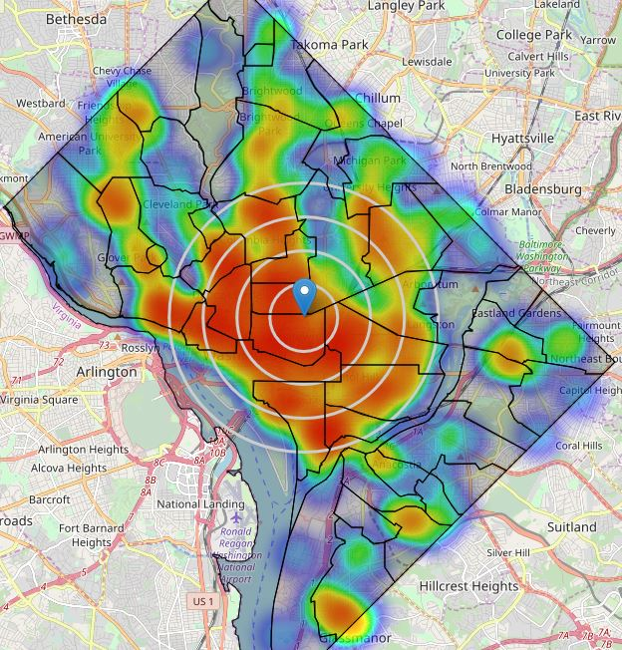
Results and Discussions
Restaurants distribution was plotted as folium heat map as shown
The heat map shows most of the restaurants are distributed with in 4000 meters of radius range from the centroid
Areas of highest density of restaurants are West, North West and South West of Washington DC
In fact most of the restaurants are found in Cluster 1,2 3, 4, 5, 6, 7 and 8
The actual folium multi layered heat map shows restaurants distribution in the actual neighborhoods

Slide 17
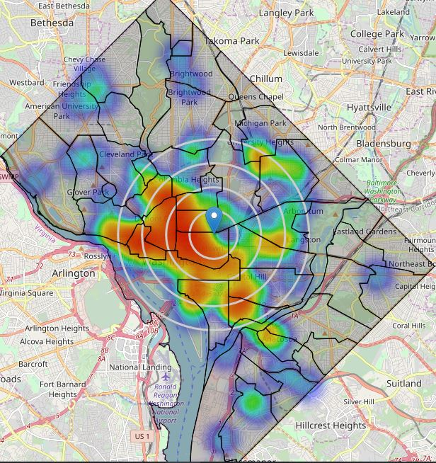
Results and Discussions
American restaurants density distribution was plotted on folium heat map as shown
American restaurant represents less than 16.5 percent of the total restaurants. It is evident from the map above the density of American restaurants is low
From restaurant heat map low concentration of restaurants observed along east, north east and south east areas
Most of restaurant activities are limited within 4000 meters distance range from the center

Slide 18
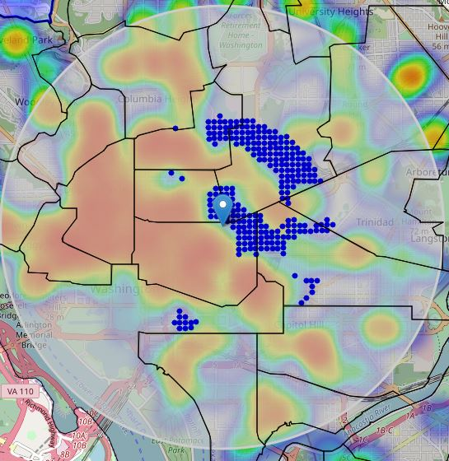
Results and Discussions
The map shows potential areas for opening new American restaurant
These areas are located in 2000 meters of radius range from the center of Washington DC
Each of those locations has no more than two restaurants in radius of 250m
No American restaurant is to be found in 400 meters of radius from the center

Slide 19
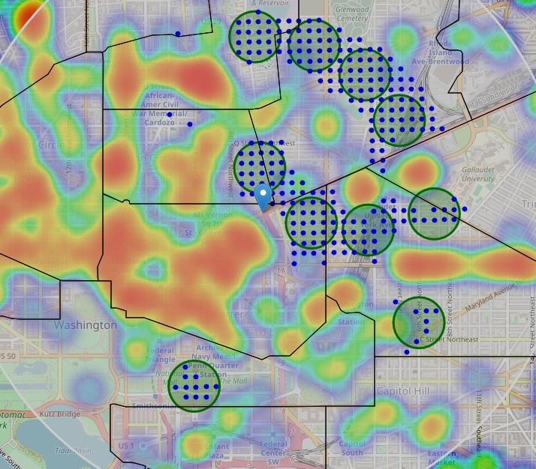
Results and Discussions
Further narrowing the location detected 10 clusters were created based on k-means algorithm
The folium map shows 10 clustered regions where the centers were found from k-mean algorithm
The addresses of each clusters was also obtained by calling Mapbox API

Slide 20
Conclusions
This study shows sandwich places, food trucks and pizza places are the three most popular food venues in Washington DC. Most of them as the rest of food venues are populated near the center of the city
Final decision on optimal restaurant location will be made by stakeholders based on specific characteristics of neighborhoods and locations in every recommended zone
Additional factors considered for deciding the final location are: attractiveness of each location (proximity to park or water), levels of noise / proximity to major roads, parking garages availability, prices, crime rate, social and economic dynamics of every neighborhood
The main purpose of this study was to detect optimum locations for opening American restaurant in Washington DC
The 10 narrowed locations obtained are located in Clusters 3,7,8,21,23 and 25 whose natural neighborhoods can be easily identified from the interactive map generated
Parallelly some basic exploratory analysis were done on food venues located in Washington DC
The study reveals some restaurants have got only one or couple of venues
many locations of the city food venues were hardly to find specially as we go further from center

