Slide 1
Group2 Lab6 Project
Xuan Yan, ShuHan Sun, MaoXuan Li
6/6/2019

Slide 2
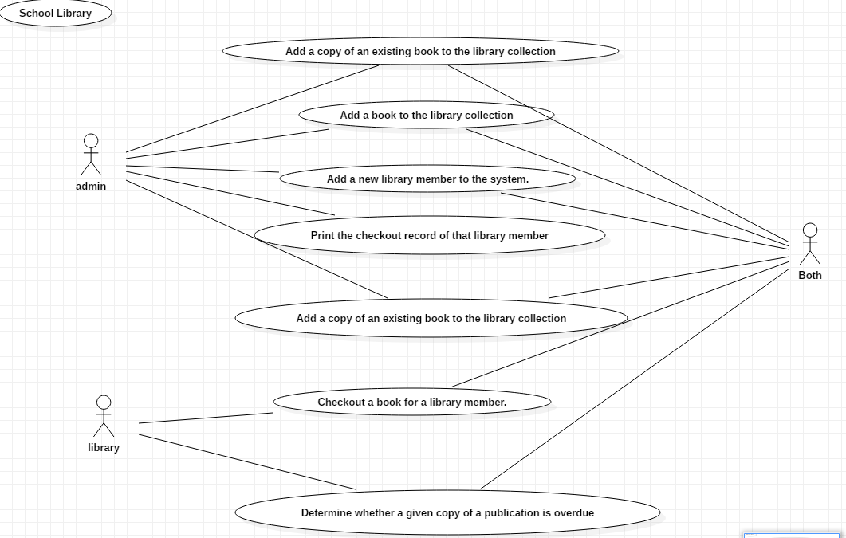
Use cases

Slide 3
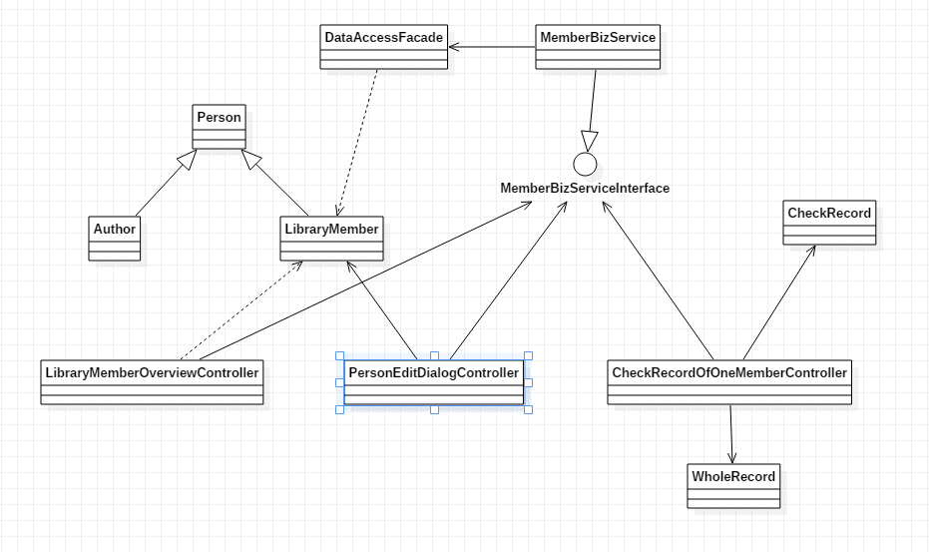
Class Diagram(Member Related)

Slide 4
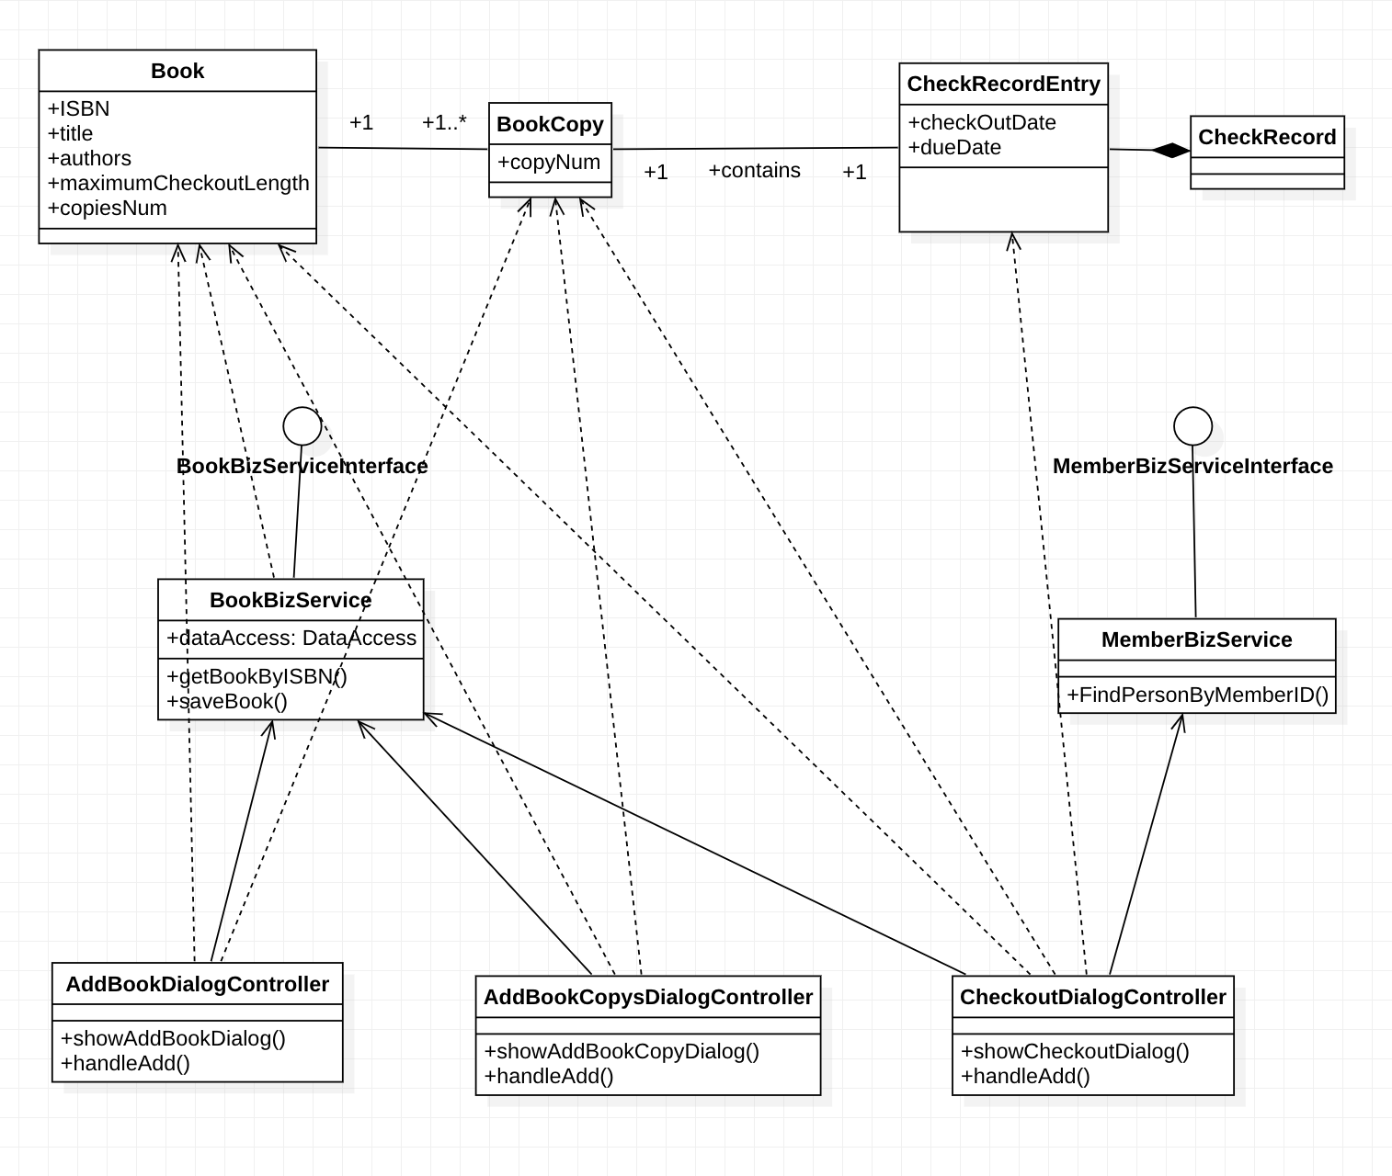
Class Diagram(Book Related)

Slide 5
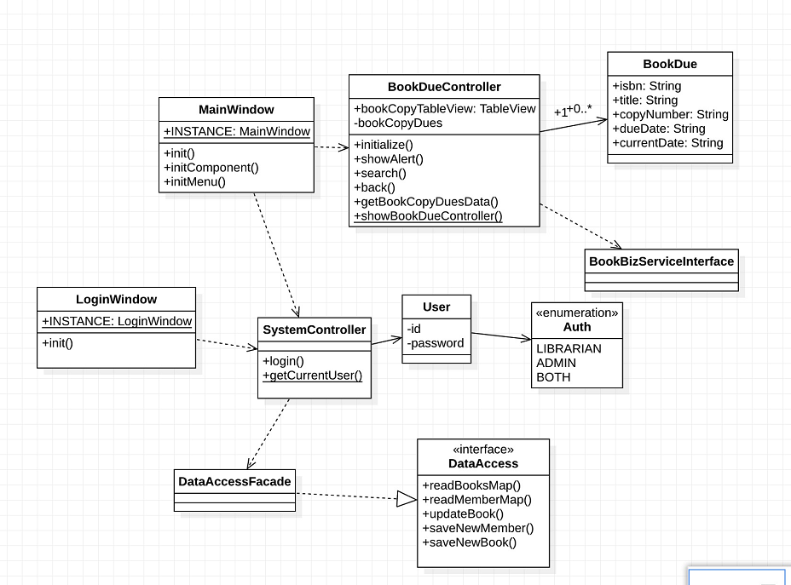
Class Diagram(Due Book Related)

Slide 6
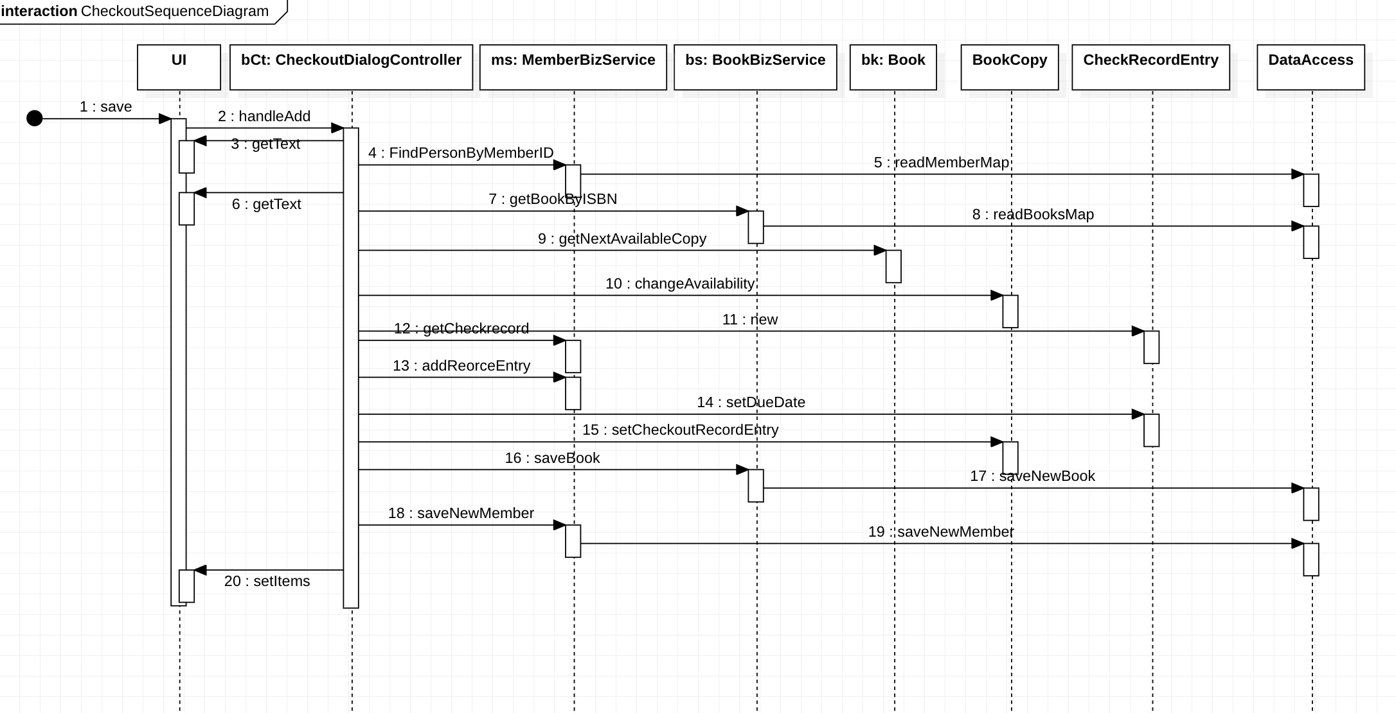
Sequence (Checkout a book)

Slide 7
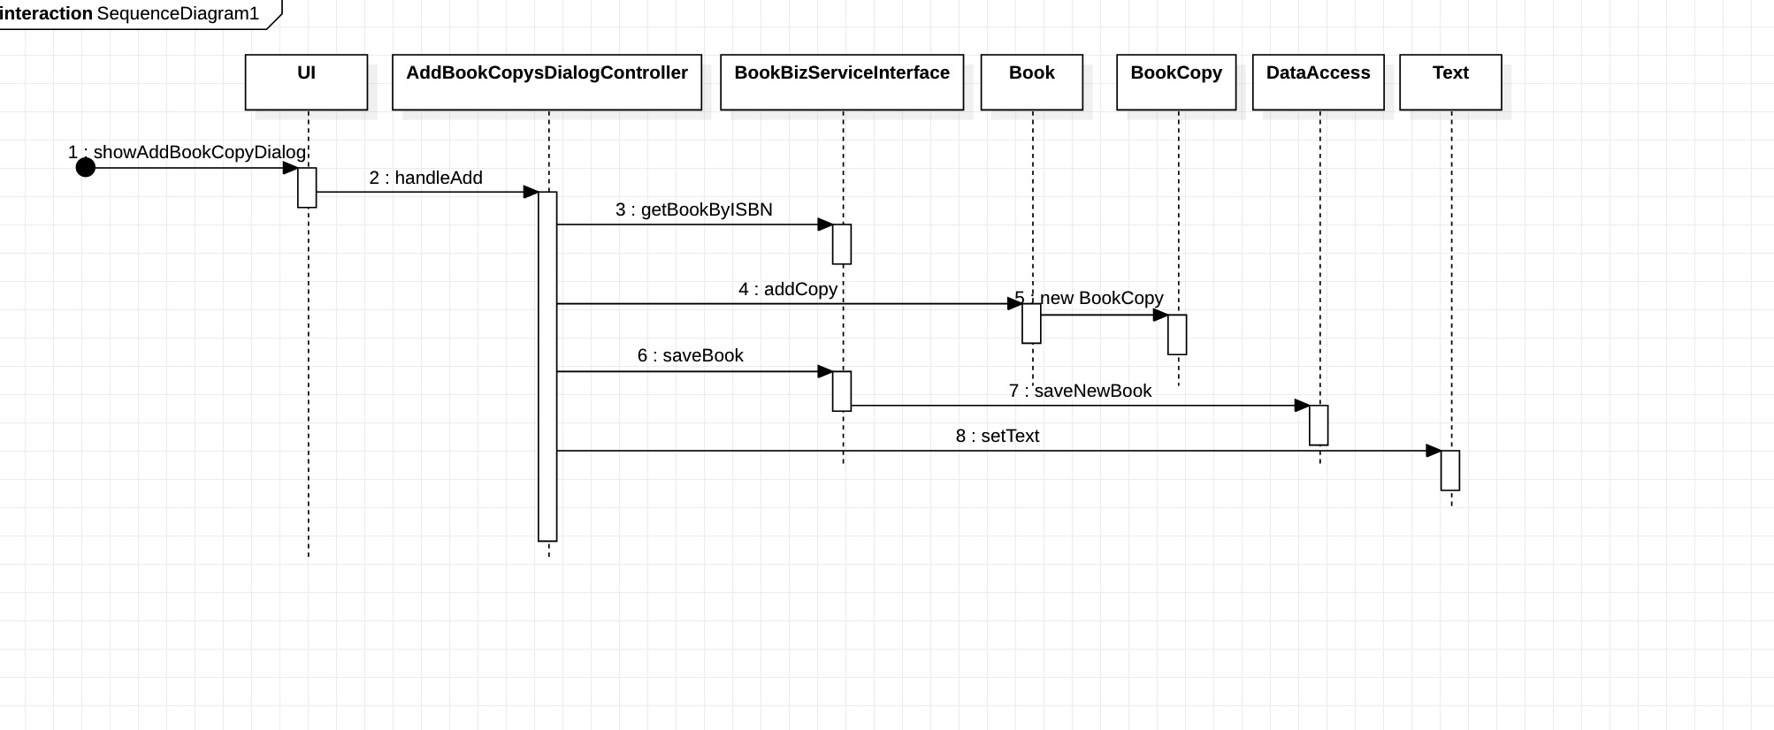
Sequence (add a copy of book)

Slide 8
Validation Rules of UI
When user input, the wrong value can’t be input
When user press save button, UI controller should check the input data and relative.
Before save to object, check the correction of data
Before serialize the object to file, also check the correction of data

Slide 9
Optional Use Cases
The three optional use cases have been implement.
Operator can fuzzy search a user by member id.
Operator can delete a member.
Operator can edit a member.

Slide 10
Conclusion with SCI Knowledge
Life is found in layers. We abstract the UI layer, the control layer, the service layer, and the data persistence layer.
Outer depends on Inner. The UI features depends on the rules defined by business layer.

