Slide 1
Group MLMaster
Group 10

Slide 2
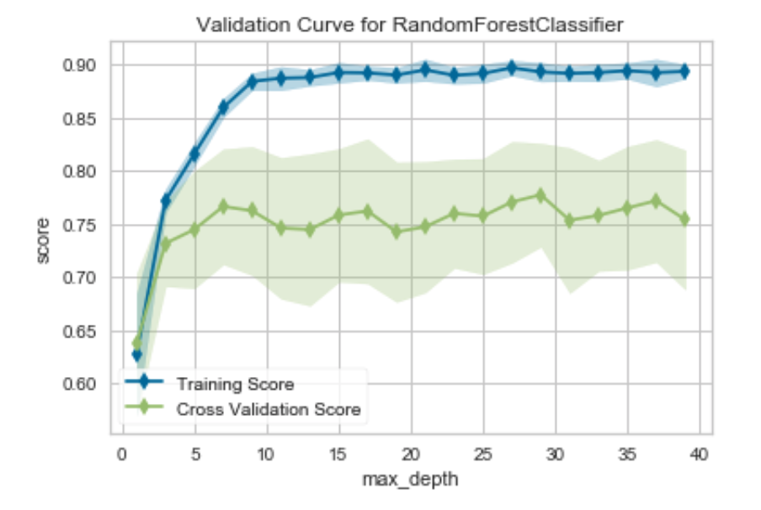
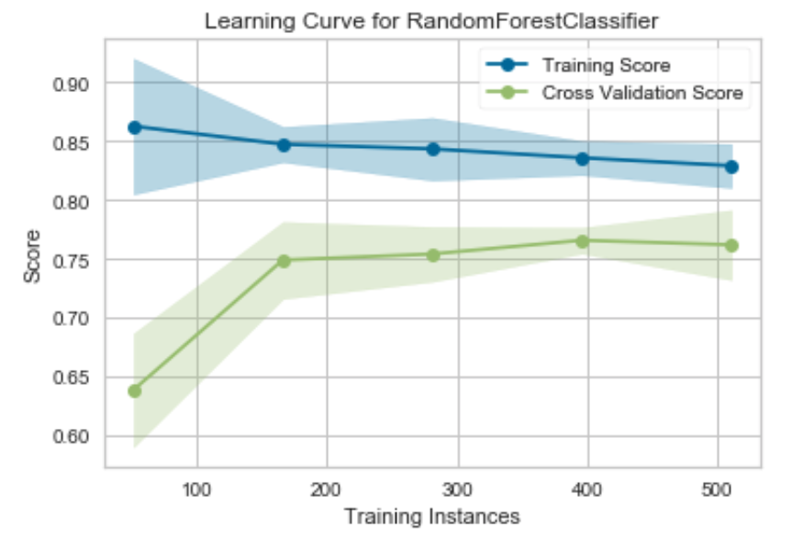
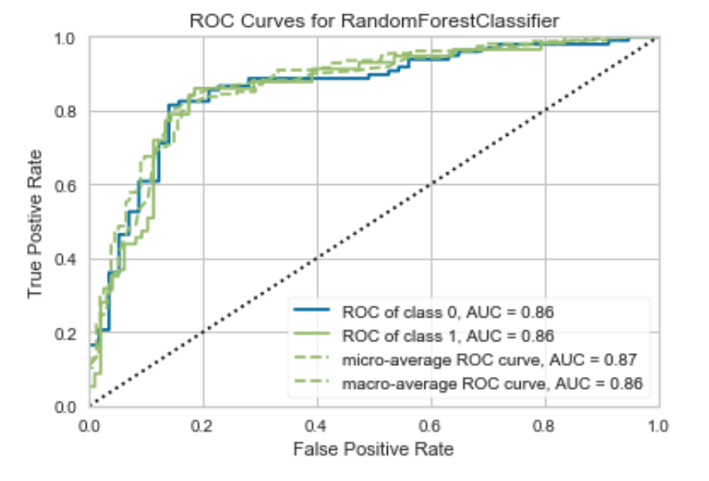
Random Forest

Slide 3
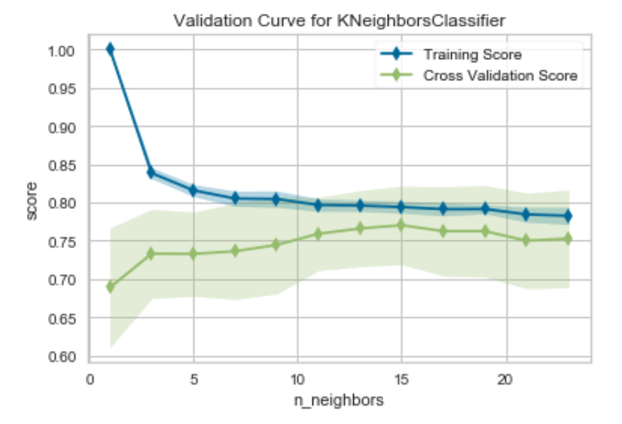
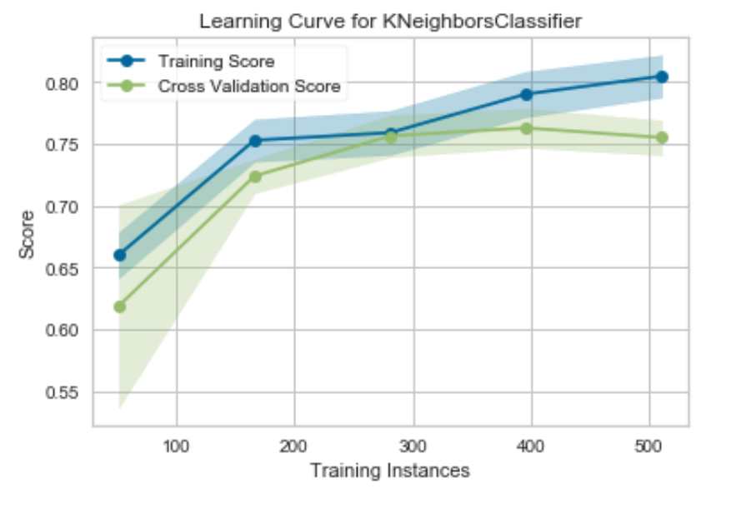
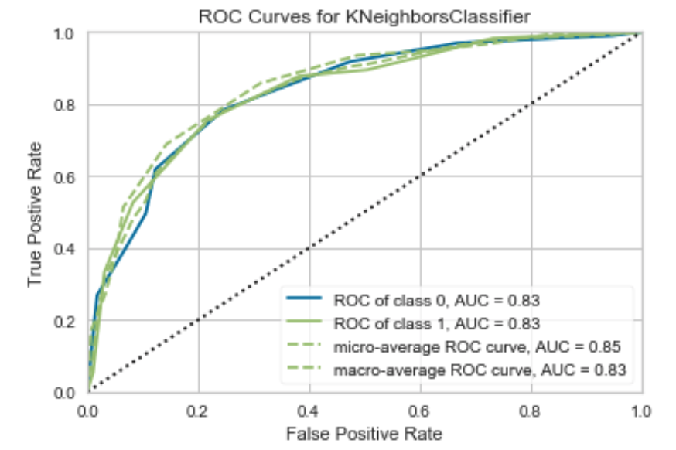
KNN

Slide 4
SVM

Slide 5
Logistic Regression

Slide 6
AUTOML
import autosklearn.classification
import sklearn.metrics
cls = autosklearn.classification.AutoSklearnClassifier()
cls.fit(X_train, Y_train)
predictions = cls.predict(X_test)
print("Accuracy score", sklearn.metrics.accuracy_score(Y_test, predictions))

Slide 7
AUTOML
Using Docker to run it
On laptop, spend around 1 hour to traing it
The result is 0.74

Slide 8
Docker and API
Build a docker base on felixleung/auto-sklearn of hub.docker.io
Uploader docker image to hub.docker.io named by tedyyan/mumml
docker run -it -v D:/CSTech/_AI/ml/mum:/opt/nb -p 8889:8888 -p 5000:80 tedyyan/mumml /bin/bash
Use Flask create a API and can save RFModle to file.

