Slide 1

START NOW!
Professional Package
Basic Package
Adavanced Package
119,90
€
0,-
€
89,90€
monthly
monthly
montly
START NOW
START NOW
START NOW
INSENTIV: Each 6 months active professional Package, you will receive one “NSW Taler Silver” for the international sales pool!

Slide 2

Commission for Merchant Package (License)
LEVEL | V | License from merchant (via API) | Disagio (via API) | Setup fee (we must create an API or CSV import)
Self |  | 20% | 1% | 60%
1. Direct |  | 10% |  | 10%
2. In-Direct |  | 3%
3. In-In-Direct |  | 7%*
20% goes in a pool
*only with Professional Pack

Slide 3
Commission for sales packages
Level |  | Sales packages
1. Direct |  | 20%
2. In-Direct |  | 5%
3. In-In-Direct |  | 10%*
*only with professional pack

Slide 4






INTERNATIONAL SALES POOL
(maybe 2 pools?)
THE ISP IS FED BY:
0,3% from disagio (we get it via API)
20% from setup fee
13% from all sales packages
New Sales Way
„TALER“
GOLD Taler have access
100% from ISP!
=
100%
Silber Taler have access
40% from ISP!*
40%
Gold
Silber
The more "NSW Taler"
the higher your share!
Digital accounting unit
*only with professional package

Slide 5

INTERNATIONAL SALES POOL
(first pool)
The more "NSW Taler"
the higher your share!
STEP 1:
STEP 2:
Each 100 active
Sales agent you will get one NSW Gold Taler (hole network)
=
100%
5 direct sales agents
5 in-direct active merchants
YOU
Digital accounting unit

Slide 6

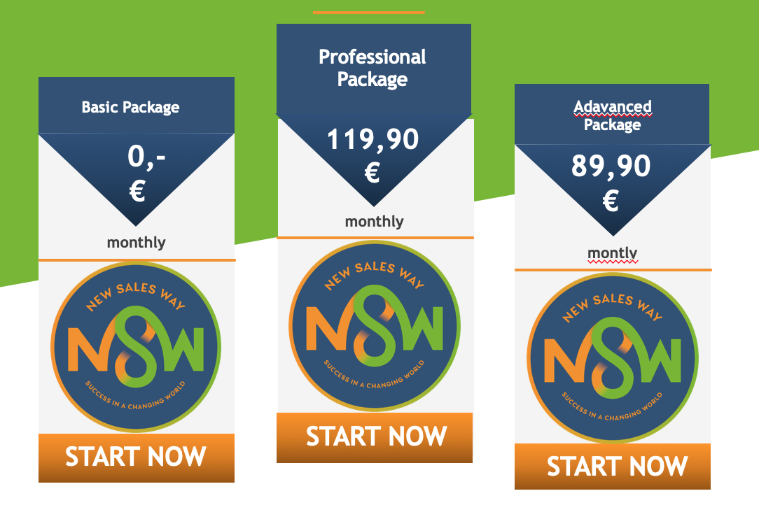
INTERNATIONAL SALES POOL
(second pool)
Each 6 months active PP* you receive one
“NSW Taler Silver” and you get access to the 40% ISP
=
=
40%
Digitale Verrechnungseinheit
*only with professional package
Digitale Einheit

