Slide 1
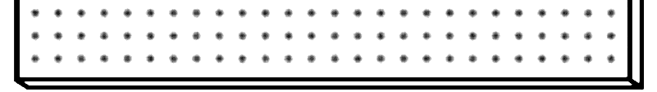

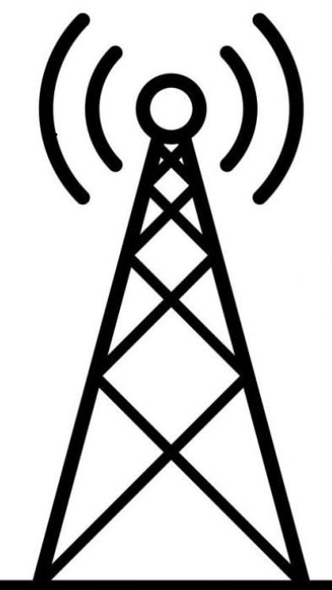


Deployment of
Reconfigurable Intelligent Surfaces (RIS)
Huy Viet Le
hvl3
UE
Supervisor: Dr Huiling Zhu
BS

Slide 2
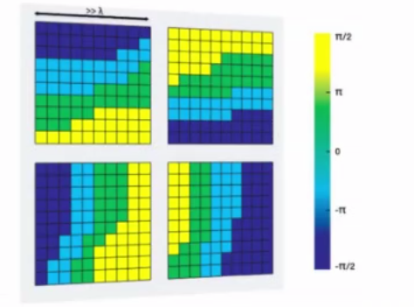
Introduction
MIMO-based communication systems suffer from hostile channel characteristics
Planar surface that reflects incident EM waves in a controllable manner
Nearly passive object – does not require higher transmit power
Alters propagation characteristics of the channel
Enables controllable channel
Improves performance of the channel
Both indoor and outdoor
Thin, easy to deploy

Slide 3
Objectives
Set up RIS-assisted communication system simulation
Performance evaluation: Bit-error rate, Signal-to-noise ratio, Outage probability, Data rate
Comparison to conventional cellular communication systems

Slide 4
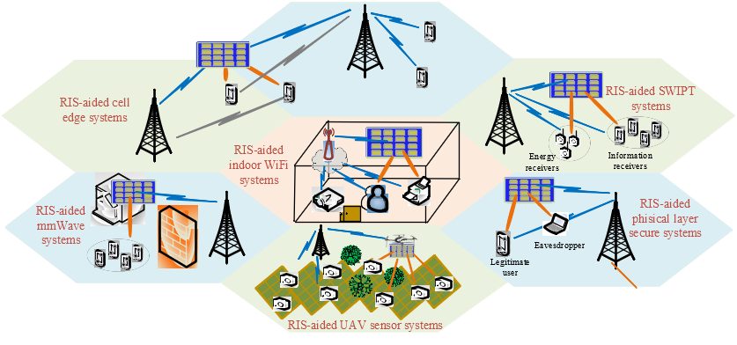
Background
planar surfaces made of closely spaced transmitter elements
close spacing (< wavelength) offers manipulation of the incident wave
Vast flexibility of manipulation can impose amplitude and phase change on the incident wave (beamforming)
Each element has an installed diode altering impedances patterns through instructions
Can potentially function with energy obtained from the incident EM waves

Slide 5
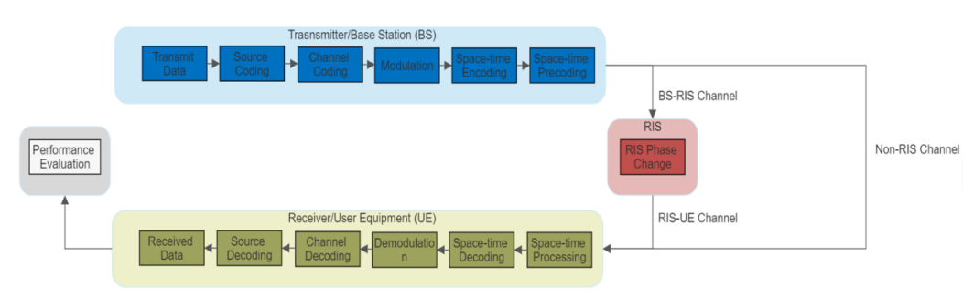
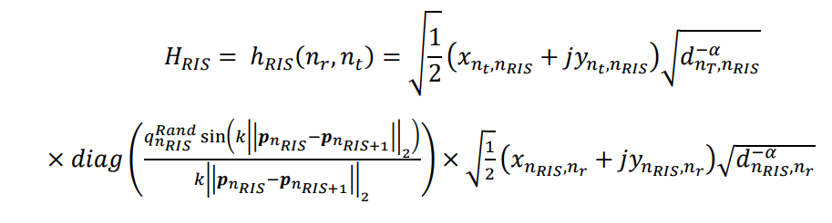
System Description
Signal transmission: Encoding, modulation, and precoding (zero-forcing and block diagonalization)
Channels: Direct transmitter to receiver (Rayleigh channel model) and second channel (transmitter to RIS, RIS to receiver)
RIS beamforming: Phase shift matrix (randomized matrix multiplied by correlation matrix)
Receiver-side processing: Equal gain combining technique for decoding and demodulation of received signal

Slide 6
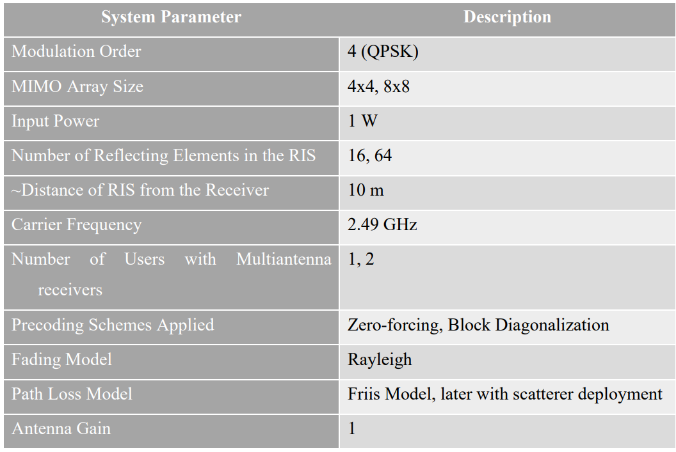
System Parameters

Slide 7
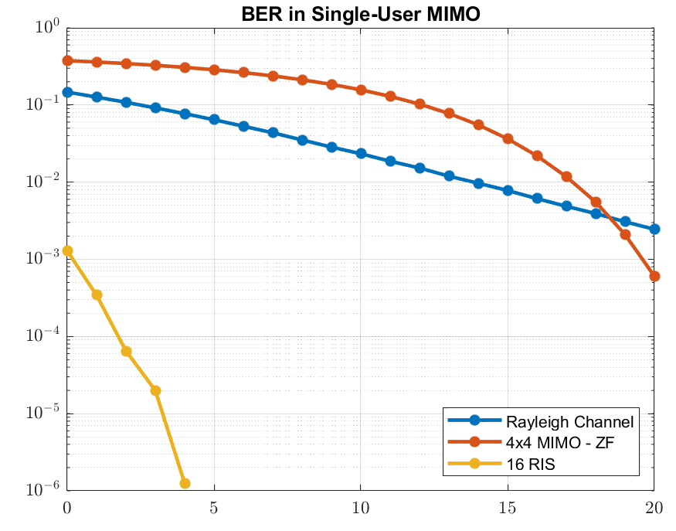
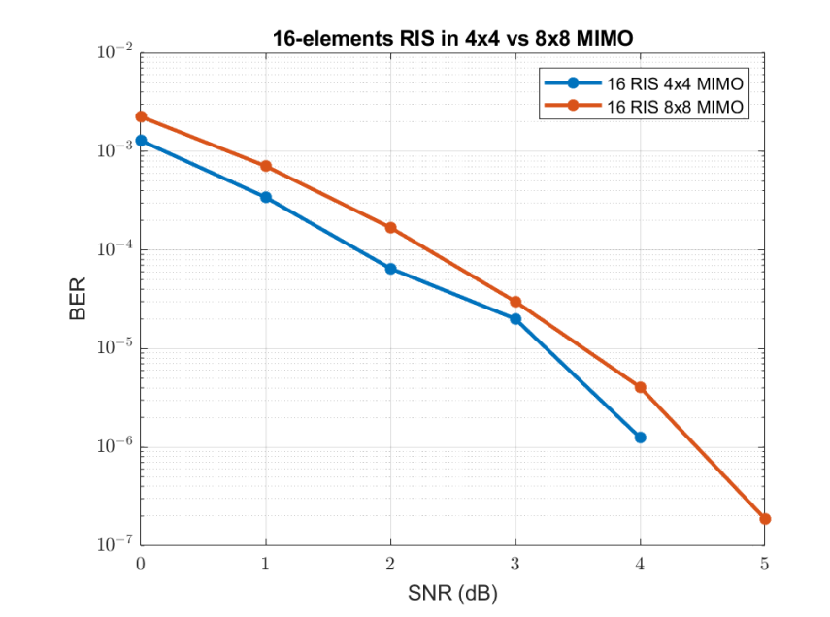
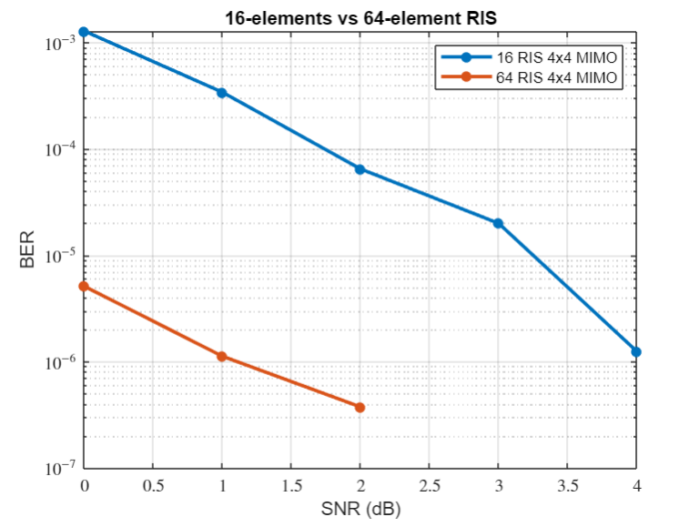
Results
Significant improvement compared to conventional MIMO system
Conventional MIMO 4x4 channel requires around 25 dB SNR for BER of 10^(-4)
RIS panel with 16 elements requires SNR less than 5 dB for the same BER
increasing MIMO array size worsens system performance
Conventional 4x4 MIMO system needs around 25 dB SNR for BER of 10^(-6)
RIS-assisted model requires only 4 dB SNR for the same BER

Slide 8
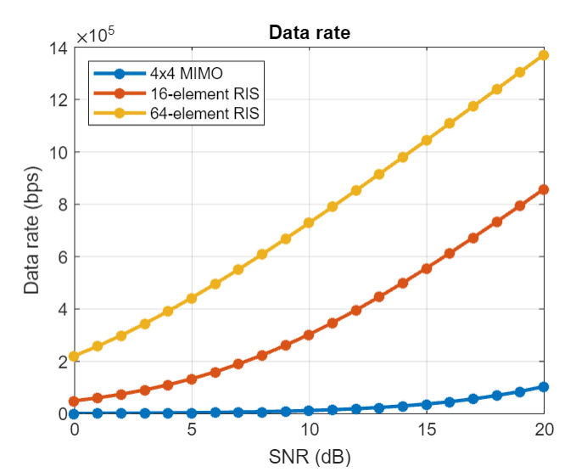
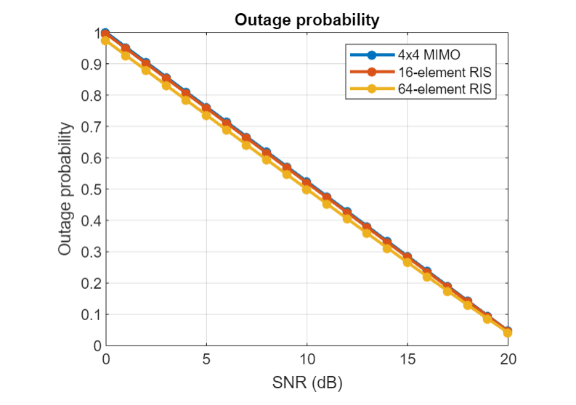
RIS implementation in a communication system results in significant data rate increases
Conventional 4x4 MIMO system achieves around 100 Mbps at 20 dB SNR
RIS-assisted systems with 16 elements achieve 800 Mbps, 64 elements achieve over 1 Gbps
Outage probability shows negligible improvement
Increased interference due to a higher number of transmission-capable elements in RIS-assisted systems may contribute to this observation

Slide 9
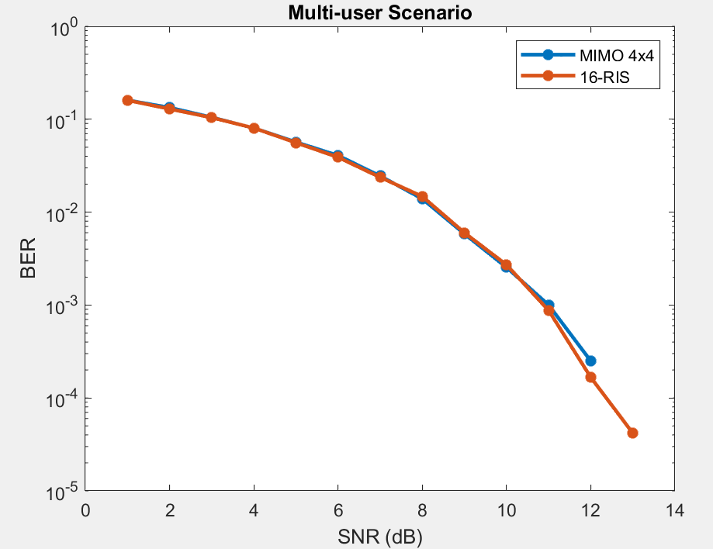
Multi-user Scenario
RIS deployment in multi-user MIMO system improves system performance, but not as optimized as in the single-user scenario
Multi-user interference is observed to be a weakness of RIS-assisted systems

Slide 10
Discussion
RIS deployment in MIMO systems provides significant improvement in BER, particularly in single-user scenarios.
The number of scattering elements in the RIS panel and the choice of precoding scheme are critical factors for system performance
In multi-user scenarios, interference between users can impact overall system performance – this can be improved by implementing spatial modulation techniques
CSI acquisition for RIS: Pilot elements, feedback loop, machine learning
The complexity of the system is further increased if the receiver is moving – observe effect of Doppler shift

Slide 11
Thank You!
Viet

