Slide 1
Ansible
Task Automation for Fun and Profit
Notes:
- Something we use in CFPS is a tool called ansible
- In a nuthshell, Ansible is a simple and easy to use task automation.

Slide 2
History of Anisble
Initial release February 2012
Created by Michael DeHaan (author of Cobbler and Func)
Written in Python
Notes:
- It was created by a former RedHat engineer named Michael DeHaan back in 2012, and it is written entirely in python. It quickly gained popularity and

Slide 3
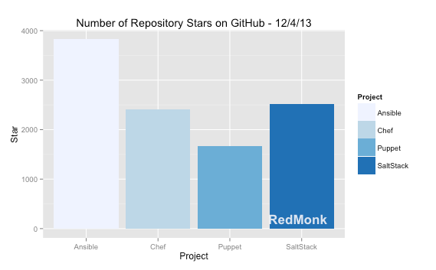
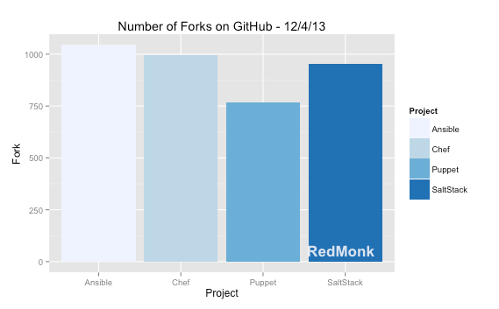
History of Anisble
Notes:
by around December 2013 it seemed to surpass most of its major competitors on Github.
I believe Michael DeHaan said in his presentation at PyCon in 2014 that they were one of the Top 5 in terms of contributors on github.

Slide 4
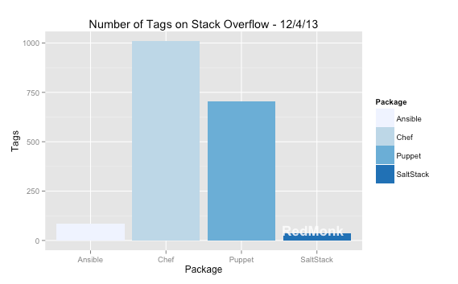
History of Anisble
Notes:
- Even on Stack overflow, it was gaining popularity, surpassing SaltStack. Compared to other automation frameworks like Chef and Puppet it still had a long way to go but this is mainly due to the fact that Chef and Puppet are older.

Slide 5

What’s with the name?
Instantaneous communication device in Orson Scott Card’s Ender’s Game series
Original coined by Ursula K. LeGuin
Notes:
If you’re curious, the name comes from Orson Scott Card’s Ender’s Game series.
All that can be found on wikipedia

Slide 6
What is Ansible?
Application deployment
Configuration management
Multi-tiered orchestration
Zero downtime rolling updates
Ad-hoc / repeated task execution
Notes:
So what is ansible?
As I said Ansible is a task automation tool.
Its chiefly geared towards application deployment and configuration management.
We have a system, an application of some kind such as a web application, it has services & dependencies that need to be installed, set up, configured
We want to make sure this is all done safely and consistently
And we need this to operate over multiple machines, and components on different machines need to be specifically orchestrated
We want to do this with a minimal of hassle and effort. As Michael DeHaan said in his presentation, “writing automation shouldn’t be your day job”
We also want to be able to updated all our machines with zero downtime
That’s something ansible can handle with rolling updates
You can tell ansible to update your machines in batches so there’s no disruption of service
We also want to execute the odd task here and there as needed
Ansible works just fine with random ad-hoc tasks

Slide 7
How does it work?
Operates over SSH (openSSH or paramiko)
Agentless
Easy-to-read and write language (YAML)
Large (and growing) number of modules
As of Jan 20 2016, currently 463 modules
Notes:
One of the major ways it differs from other task automation tools is that it operates over SSH as a transport mechanism to deploy small self-contained packages, called modules, that handle the execution of tasks.
Ansible does not directly run commands through SSH, it executes the module to handle the task
Ansible is agentless.
There’s no software to install on the target node.
There’s no need for a cumbersome management system.
There are no daemons that operate on the node consuming resources.
Ansible playbooks, which I’ll get to later, are written in YAML, which is a very simple, syntactically light human-readable data format
this means that ansible playbooks are easily auditable by people without significant, or even any programming experience
And as I said before, ansible operates using a library of modules that are transported to the target node and executed.
At last count, there are currently 463 modules, everything from package installers like yum, apt, django app configuration, database configuration like postgres and mysql, nginx, even modules for handling raw shell command execution.

Slide 8
Idempotency
System should remain unchanged after reapplying the same ansible command / playbook
Playbook describes the state of the system, not “how” to get there
Notes:
Another awesome feature of ansible is this idea of Idempotency, which in a nutshell means that ansible will bring your system up to the state described by your playbook, and will remain in that state even after multiple runs of your command or playbook
When you change your playbook and rerun, only that which needs changing will execute, and your system will update to this new state
For each task that ansible will run, it’ll perform a check to determine whether it needs to execute the task

Slide 9
Examples!

Slide 10
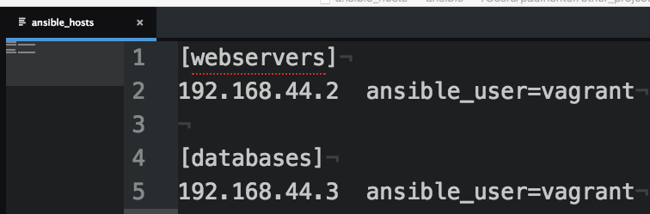
The Ansible Inventory
Notes:
Ansible has something called an “inventory” which is just a simple INI file, which describes all of the nodes ansible is going to need to know about.
I have 2 servers in this case, they’re VMs I started up using Vagrant which Lee will talk about later.
and I’m specifying the user for both nodes which in this case they’re the same, and I can actually specify the user from the command line if I want, but this might be how you would handle a scenario in which you had a lot of nodes that had different users, and wanted to call a single playbook or command to operate on all of them at once.

Slide 11
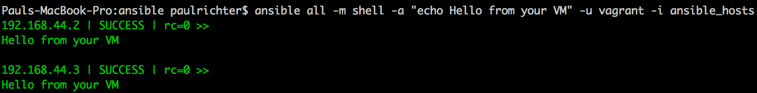
Executing Ansible Commands
Notes:
So this is a simple command I can run an arbitrary shell command and get my servers to talk to me.
So the ansible command consists of a minimum of 2 parameters:
ansible needs to know which hosts you want to target with this operation
In this case, I’m saying “all”, meaning all the servers I’ve listed in the inventory
which module I want to run, and any module arguments required by that module
in this case, I’m telling ansible to run the shell module.
the -a indicates module parameters, in this case I’m merely giving it a string to be executed
The “-u vagrant” is the user on the remote nodes
The “-i ansible_hosts” tells ansible which inventory file to use. In this case I’m explicitly telling it to use the one in the current directory, but by default, if you don’t specify this, ansible will look in your /etc/ansible/hosts. This value can be configured in your ansible config.

Slide 12
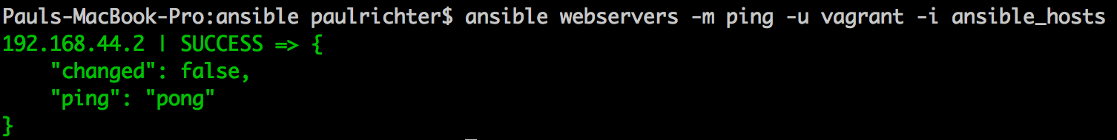
Executing Ansible Commands
Notes:
Another module I can use is called ping, which is probably previous obvious what it does.
It doesn’t take any parameters
And in this case it successfully received an acknowledgement from the server with a “pong”
Note that this is actually not the ping command, its an SSH connection test
Note the “changed” here, we’ll see this come up and I’ll explain it more fully in a minute but this is part of the mechanism that ansible uses to ensure idempotency.

Slide 13
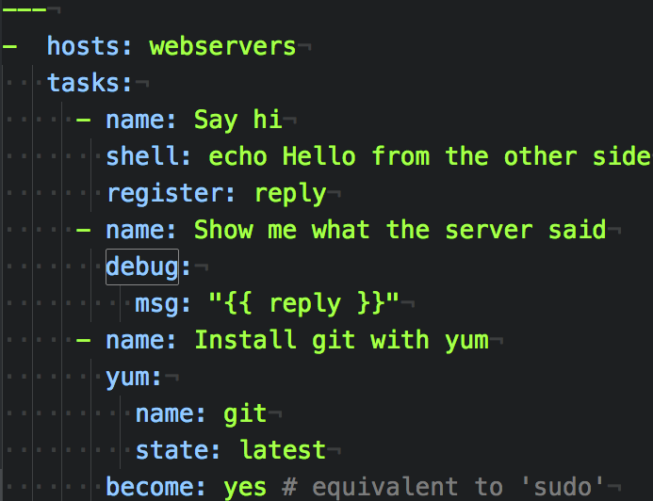
Ansible Playbooks
Notes:
This is an example of a simple ansible playbook
Like we saw on the command line, we have a host specification (which again I could have put all)
and we have a list of tasks that we’re telling ansible to run
We have 3tasks:
we have a shell task just like we saw earlier
but we have a key called register, which will take out the output of the module and put it in a variable called ‘reply’
We have a new module called ‘debug’ we’re using to output the value of the ‘reply’ variable
and another new module called yum which will try and install git using yum
the state key indicates how we want ansible to establish the state of this task
in this case, we’re telling it to install the latest version of git. Each successive run will check to determine whether the latest is installed, and update if necessary and signal a change. Otherwise it’ll leave it alone and signal no change.
There are other states, such as “present” which I believe will ensure that git, regardless of version, is installed, or other states such as “removed” which as it implies will ensure git does not exist on the system
become as you can see is whether to elevate privileges to sudo

Slide 14
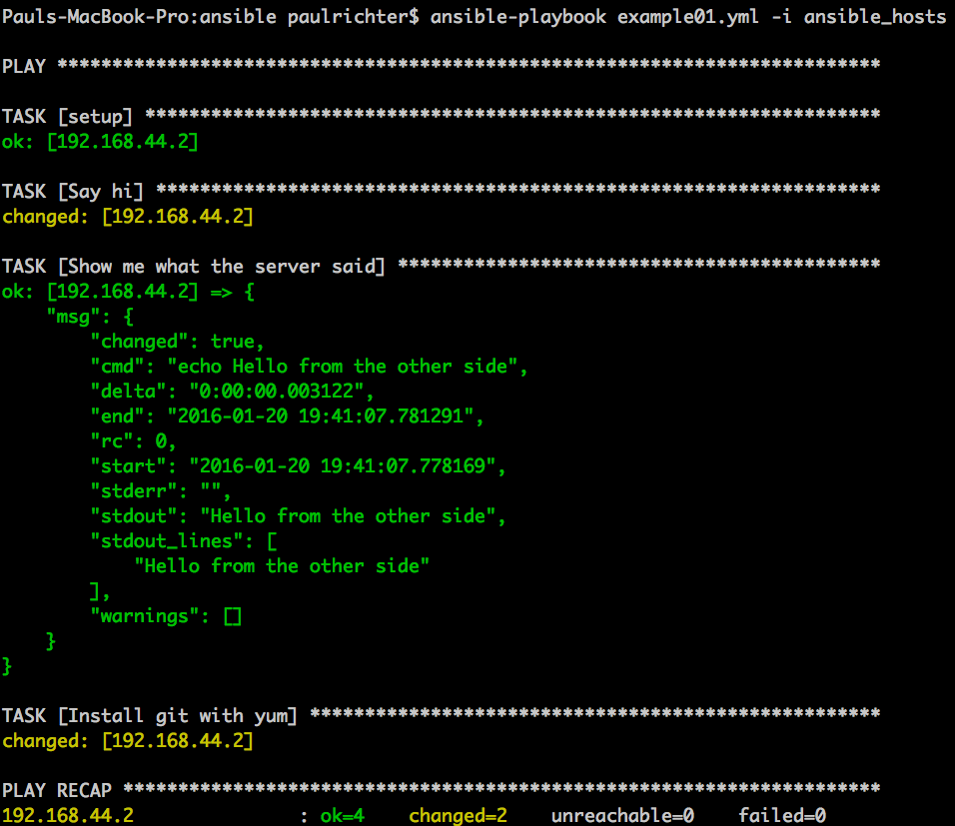
Ansible Playbooks
Notes:
So when I run this, this is the output I get.
The shell module doesn’t understand whether anything changed, so it always reports “changed”
It looks like our git installation succeeded
So in total we have 4tasks which succeeded, 2 reported as changed, and nothing failed. Awesome.
Now if I run this again…

Slide 15
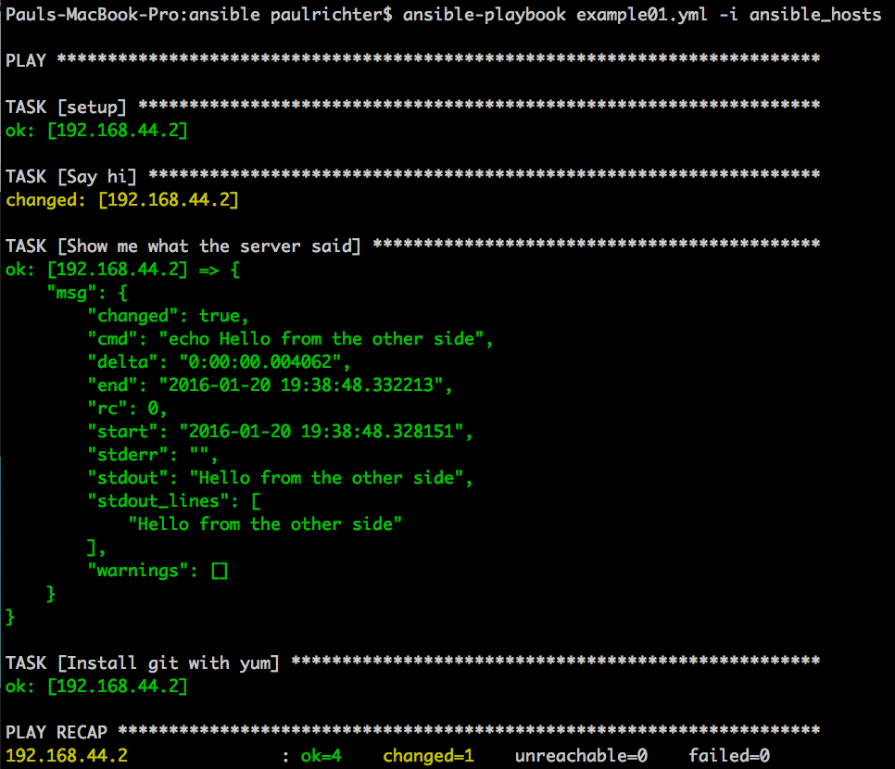
Ansible Playbooks
Notes:
This time ansible detected that git was already installed, is the latest version, and so did not change anything. The system remains exactly the same.

Slide 16
More examples!
https://github.com/glenjarvis/ansible_tutorial/tree/develop/src/roles_examples
https://github.com/teeg82/ansible_presentation

Slide 17

Ansible Tower
Commercial product providing GUI wrapper for ansible features

Slide 18

Ansible Galaxy
https://galaxy.ansible.com/
Repo containing large amount of ansible roles

Slide 19
Resources
Michael DeHaan’s PyCon 2014 youtube presentation:
www.youtube.com/watch?v=Qi0AhK7PMCI
Ansible docs
http://docs.ansible.com/
Ansible django playbook with vagrant
https://github.com/jcalazan/ansible-django-stack
Presentation repo:
https://github.com/teeg82/ansible_presentation
Glen Jarvis Google Hangout tutorial
https://www.youtube.com/watch?v=w8fOEEMqpOw

