Slide 1
Academic Paper Recommendation System
Comparing SPECTER2, SciBERT and a hybrid embedding for content-based recommendation
Tajamal Hussain | 106061
Data
→
Embeddings
→
Recommender
→
Experiments
→
Evaluation

Slide 2





Research questions
Which scientific embedding best powers a content-based recommender?
SPECTER2 vs SciBERT, head-to-head.
answered
Does a metadata category boost improve ranking and how much?
An α-sweep finds the sweet spot.
answered
Can combining both models beat either alone?
A SPECTER2 + SciBERT weight sweep.
answered
How do we measure all this without manual relevance labels?
Known-item + proxy ground truth.
answered

Slide 3









System architecture & roadmap
Data Acquisition
Quality & Cleaning
Annotation & Keywords
Embeddings
Recommender
Evaluation
Vector Embeddings
Recommender + Tuning
Performance Eval.
Data Scraping
Data Quality
Data Annotation

Slide 4
PART 1
Data & Feature Engineering

Slide 5


Data Acquisition & Enrichment
WORK PACKAGE: DATA SCRAPING
Sources
arXiv API: Metadata extraction including title, abstract, authors, category, and publication year..
50,000
papers collected
Semantic Scholar API: Enrichment with citation and reference counts via efficient batch endpoints.
4
CS categories
Query Design
Automated per-category/year requests:
2021–2026
balanced by year
Target: ~8,333 papers/year across core CS domains:
Architecture: Robust, checkpointed & resumable.

Slide 6




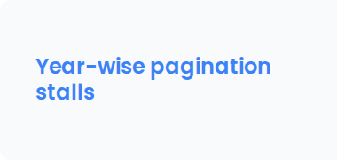


Challenges: data collection
Problems hit while scraping - and how they were solved
Problem arXiv cross-lists papers, so one paper appears under multiple category queries.
Fix Scan all listed categories, assign the first matching CS one; later de-dup by arXiv ID + title.
Problem arXiv pagination becomes unreliable past a few thousand results on date-range queries.
Fix Advance the cursor by the raw payload count and checkpoint every page to resume safely.
Problem A year's date-range batch can include papers first published in another year (revised versions).
Fix Derive the year from the published date and balance per-year targets.

Slide 7

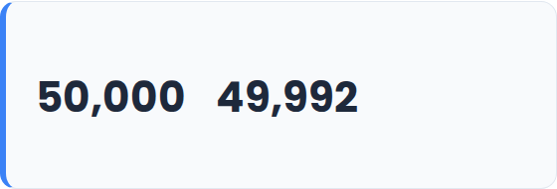

Data Quality & Cleaning
WORK PACKAGE: DATA QUALITY
Cleaning Steps
RETENTION
De-duplicate by arXiv ID and case-insensitive title across years and categories.
papers
Drop records with empty critical fields.
6 duplicate titles removed — 99.99% retained.
Filter specifically to the 4 targeted CS categories.
Exclude abstracts with fewer than 50 characters for quality.
CITATION COVERAGE
Mojibake Repair
58.3% Cited ≥ once
79.7% Have references
Broken UTF-8 encoding (e.g. "KÃ¶cher" → "Köcher") fixed using the library
Whitespace normalization performed to provide clean input for downstream tokenization tasks.

Slide 8
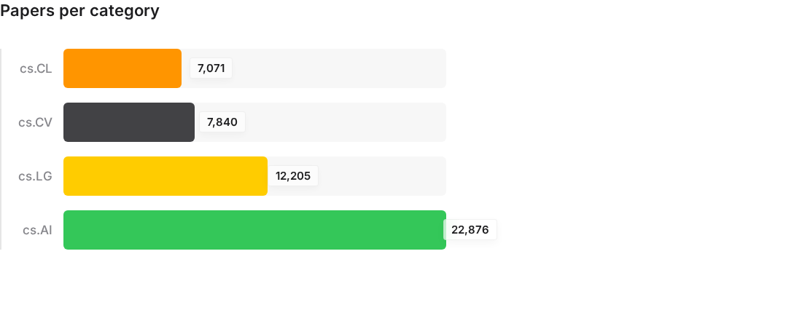
Dataset composition
49,992 papers · balanced ≈ 8,333 per year (2021–2026) · 768-dim embeddings
Composition notes
•
cs.AI dominates (45.8%) - a known, real imbalance,
not a sampling error.
•
cs.LG 24.4%, cs.CV 15.7%, cs.CL 14.1%.
•
Years balanced by design (~8,333/yr).
•
Citations long-tailed: many recent papers uncited
(citation lag, not low quality).

Slide 9

Annotation
Work package: Data Annotation - automated
Domain labels
How tags are used
•
Each arXiv category -> readable label (cs.CL -> Natural Language Processing).
Automated end-to-end - no Label Studio, no manual labelling. A tag is assigned only when its keyword literally appears in the abstract, so the rule is fully transparent.
Local keyword dictionary
•
Per-category keyword lists; tags assigned by word-boundary matching against each abstract.
•
Used for filtering, analytics and proxy-relevance only - never to train the models.
Tags drive filtering and analytics - they never train the models.

Slide 10


Keyword extraction (KeyBERT)
A second, model-based tagging pass over title + abstract
KeyBERT with all-MiniLM-L6-v2
•
Embeds candidate phrases and ranks them by similarity to the document - the backend is MiniLM (a sentence-transformer)
Challenge: batching
Running KeyBERT over all ~50k papers in one pass is memory-heavy; extraction had to be managed carefully on the available hardware.
Settings (tuned v1 → v2)
•
v1: abstract only, threshold 0.35 → too few tags.
•
v2: title + abstract, 1–2-gram, extract 8, keep top 5 with score.

Slide 11
PART 2
Embeddings

Slide 12
Embeddings: SPECTER2 vs SciBERT
The core comparison - Work package: Vector Embeddings
SPECTER2
SciBERT
primary model
baseline
allenai/specter2_base + proximity adapter
CLS-token pooling
Citation-trained → document-level similarity
allenai/scibert_scivocab_uncased
Mean-pooled token embeddings
General scientific LM
Shared Pipeline Details: Both architectures utilize a title [SEP] abstract mapping → 768-d vector, generated on an A100 GPU pod. Models are frozen, off-the-shelf - no fine-tuning.
◆

Slide 13



A third option: hybrid late fusion
Can the two models together beat either alone?
Late fusion (score combination)
•
Each model scores a paper in its own space; we blend the two cosine scores by weight w.
•
Not vector concatenation - the two spaces differ (adapter+CLS vs mean-pool), so scores are fused, not vectors.
w = 1.0 → SPECTER2 only
w = 0.0 → SciBERT only

Slide 14


Embedding-space analysis
Do the models cluster the four categories?
Category separation is weak - by design of the data
SPECTER2 silhouette ≈ 0.013
SciBERT silhouette ≈ −0.022
Silhouette ≈ 0.013 (SPECTER2), ≈ −0.02 (SciBERT): categories do NOT form clean clusters.
Expected: the 4 CS fields overlap heavily and papers are cross-listed.
Same- vs different-category similarity
The embeddings organize papers by fine-grained topic, not by coarse category - which is why instance-level retrieval is the real strength.
Cosine distributions for same- vs different-category pairs nearly overlap - SPECTER2 shows a slight gap, SciBERT almost none. Primary category is not a strong axis of separation.

Slide 15
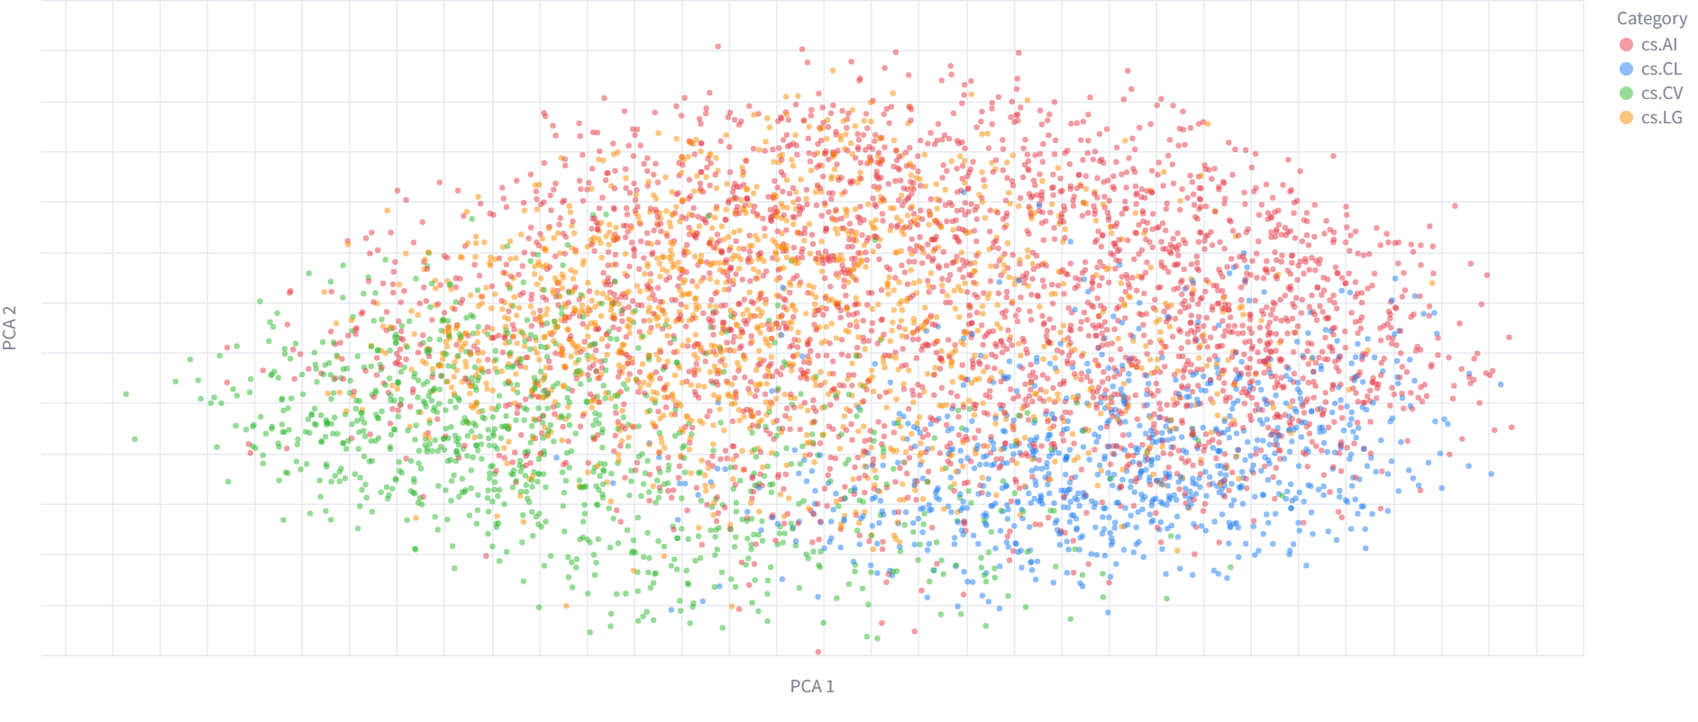
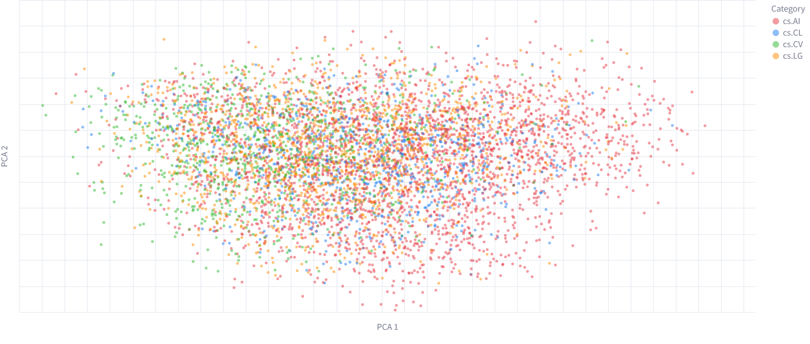
Embedding-space maps
SPECTER2 SciBERT
[ t-SNE / PCA map — SPECTER2 ]
Analytics tab → Embedding space (SPECTER2), or results/figures/projections_specter2.csv
[ t-SNE / PCA map — SciBERT ]
Analytics tab → Embedding space (SciBERT), or results/figures/projections_scibert.csv
6,000-paper stratified sample, colored by category

Slide 16
PART 3
Recommendation Engine

Slide 17
Recommendation engine
Work package: Recommender System
Query
(title / free text)
→
Embed
→
Cosine similarity
vs 50k corpus
→
Category boost
(title mode)
→
Ranked results
Final score = cosine similarity × (1 + α × same-category)
Two search modes
Title - fuzzy-match a known paper, recommend similar work.
Free text - rank on pure cosine. Plus hard filters by category & year.
Display metadata only
Category, tags and citations are shown but do NOT change the ranking (apart from the boost).

Slide 18
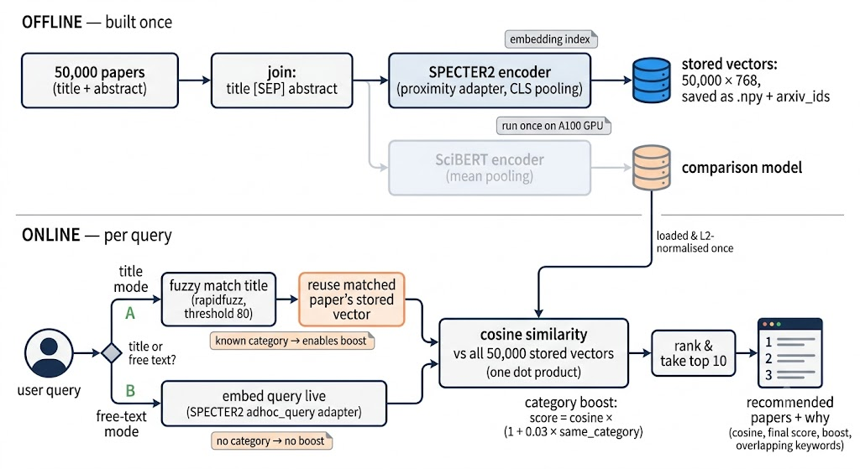
Recommendation engine

Slide 19


Transparent by design
Every recommendation explains itself
RESULT CARD (SCHEMATIC)
Attention Is All You Need
“Why was this recommended?”
Each result card shows its cosine score, final score, and whether the category boost applied.
It lists the paper's key concepts and any keywords overlapping the query.
Ranking = similarity + boost; keywords are shown for context only - the card says so explicitly.
Title mode also shows a “your search matched” confirmation box.
cs.LG · 2021 · 1240 citations
▼ Why was this recommended?
• Ranked by semantic similarity (0.812)
• Category boost applied (cs.LG)
• Overlapping: transformers, attention

Slide 20
PART 4
Experiments & Evaluation

Slide 21
Evaluation strategy
Two independent ground truths - plus a fusion study
Proxy experiments
Automatic ground truth on a 2026 temporal hold-out: a hit shares the query's category AND a keyword. Cheap & reproducible.
Used to choose the configuration.
Known-item retrieval
Provenance ground truth: each query is generated from a source paper, so that paper is the one relevant result. Clean, label-free
Primary headline result
Hybrid late-fusion sweep
Blends SPECTER2 + SciBERT scores across weights to test whether two models beat one.
Marginal-gain study

Slide 22
Proxy experiments - method
An automatic, reproducible second evaluation
Temporal hold-out
•
Corpus = papers up to 2025; queries = 2026 papers (8,330) - a realistic “retrieve prior work” setup.
Four sub-experiments
1. Model × distance SPECTER2 vs SciBERT; cosine vs Euclidean.
Automatic relevance rule
•
2. α sweep how strong the category boost should be.
A retrieved paper counts as relevant if it shares the query's category AND at least one KeyBERT tag.
3. Per-category which fields are easier to retrieve.
Purpose
•
Cheap and fully reproducible - used to choose model, distance metric and boost.
4. Boost vs restrict soft boost vs a hard same-category filter.

Slide 23
The category boost & α
The idea
A paper in the SAME arXiv category as the query is a little more likely relevant - so nudge it up, without hiding strong cross-category matches.
In words
Multiply each paper's cosine score by a small bonus if it shares the query's category.
α = how big the nudge is
α = 0 → no boost (pure cosine); larger α → stronger same-category preference. The sweep finds the best α.
final = cosine × (1 + α × same-category)
cosine - semantic similarity (0–1)
same-category - 1 if same category, else 0
α - boost strength

Slide 24
Proxy - model & distance metric
NDCG@10 on the 2026 proxy hold-out
Findings
SPECTER2 ≈ 2.4× SciBERT on the proxy too - the model gap is consistent across both evaluations.
Cosine ≈ Euclidean (the embeddings are L2-normalised), so cosine is used.

Slide 25
Proxy - category-boost α sweep
Global NDCG@10 vs boost strength - the knee is at α = 0.03
The knee is at α = 0.03
NDCG@10 jumps 0.120 → 0.165 by α = 0.03, then plateaus at ~0.166.
A small boost captures almost all the gain without distorting semantic ranking - so the app uses 0.03.

Slide 26
Proxy - per-category difficulty
SPECTER2 NDCG@10 by category (no boost)
Some fields are easier
cs.CV (0.184) and cs.LG (0.143) retrieve best; cs.AI (0.097) is hardest - it is the largest, most topically diverse category.
Query counts per category: AI 4,541 · LG 1,858 · CV 1,050 · CL 881.

Slide 27
Proxy - boost vs hard restriction
Does a soft boost match forcing same-category results?
Soft boost ≈ hard restriction
The α = 0.03 boost (0.165) reaches almost exactly the same proxy NDCG@10 as forcing same-category retrieval (0.166).
But the boost keeps cross-category results possible - best of both: relevance lift without locking the user into one field.

Slide 28

Why moved to known-item
From a useful heuristic to objective ground truth
The limit of the proxy
•
Proxy → Known-item
“Same category + shared tag” only approximates relevance - two papers can share a tag yet be unrelated, or be relevant without sharing one.
Proxy
•
heuristic relevance · cheap · tunes config
Good for choosing configurations, but not a clean headline measure.
Known-item
provenance relevance · objective · headline result
The known-item idea
•
Generate a query FROM a known paper. The system should return THAT paper - the one guaranteed-relevant answer. No labels, no heuristic.

Slide 29


Known-item retrieval - method
Work package: Performance Evaluation
Provenance-based ground truth
•
Each query was generated (with Gemini) from a specific source paper; that paper is the one known-relevant document.
Why this design
Query set
Ground truth comes from how each query was built
no human relevance judgements needed
•
4 phrasings per paper - keyword, task, problem, natural - × 479 papers ≈ 1,916 queries.
Metrics
•
Rank of the source paper → Mean Reciprocal Rank(MRR), Recall@K, NDCG@K.

Slide 30
The four query types
Why four? Real users search very differently - we test robustness to phrasing.
Keyword
“knowledge distillation sleep monitoring electrocardiogram”
rank
1
search terms
Task
“improve sleep stage classification using single-channel heart-rate data”
rank
5
a goal to accomplish
Problem
“how to overcome low diagnostic accuracy in wearable monitors without brain waves”
rank
85
a difficulty to overcome
Natural
“Are there ways to train a cardiac sleep-scoring model by transferring knowledge from brain-wave models?”
rank
1
a full question
Same paper (arXiv 2112.07252), four phrasings generated with Gemini - very different difficulty: keyword/natural land it at rank 1, the abstractive “problem” phrasing at 85.

Slide 31
Known-item Results
Model | Query type | Recall@5 | Recall@10 | Recall@20 | NDCG@10 | Median rank
SPECTER2 | Keyword | 0.518 | 0.605 | 0.702 | 0.439 | 5
SPECTER2 | Task | 0.305 | 0.395 | 0.484 | 0.257 | 24
SPECTER2 | Problem | 0.217 | 0.269 | 0.334 | 0.184 | 53
SPECTER2 | Natural | 0.649 | 0.704 | 0.787 | 0.562 | 2
SciBERT | Keyword | 0.013 | 0.023 | 0.044 | 0.011 | 2839
SciBERT | Task | 0.015 | 0.027 | 0.042 | 0.013 | 2531
SciBERT | Problem | 0.027 | 0.042 | 0.056 | 0.021 | 3535
SciBERT | Natural | 0.073 | 0.104 | 0.125 | 0.058 | 767
Every SPECTER2 cell dominates its SciBERT counterpart. Natural-language queries are strongest (median rank 2 of ~50,000); abstractive “problem” phrasings are hardest.

Slide 32
Known-item - SPECTER2 wins decisively
Recall@10 by query type
~10–14×
SPECTER2's overall lead over SciBERT across ranking metrics.
Why? SPECTER2 is trained for document similarity; SciBERT is a general scientific LM and collapses on this retrieval task.

Slide 33
Hybrid late-fusion - results
Known-item MRR as the SPECTER2 weight varies - peak at w = 0.9
A small but real lift
Best blend at 90% SPECTER2 / 10% SciBERT: overall MRR 0.329 → 0.334.
Driven by natural queries (0.526 → 0.543); keyword/task stay flat.
Below ~80% SPECTER2 the weaker model drags results down sharply.
NDCG@10 increased slightly from 0.562 to 0.578

Slide 34


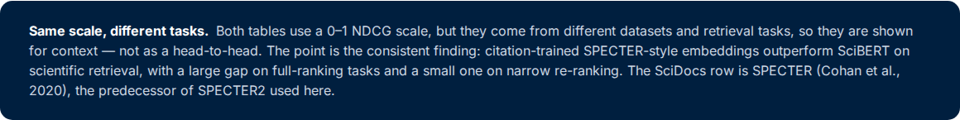

Our results vs. SciDocs - a consistent finding
My evaluation (NDCG@10)
SciDocs benchmark (nDCG)
 | SPECTER2 | SciBERT
Known-item (natural) | 0.562 | 0.058
Proxy (temporal) | 0.120 | 0.051
 | SPECTER | SciBERT
Recommendation | 0.539 | 0.521
Co-View (full ranking) | 0.915 | 0.731

Slide 35







Experiment tracking
Work package: Experiments Logging - Weights & Biases
Everything logged & reproducible
•
Every proxy run - model, distance, α value, per-category - logged to W&B with its config and metrics.
Model × distance
•
Results exported to CSV and read directly by the dashboard's Evaluation tab
α sweep
•
Makes the configuration choices auditable: anyone can trace why cosine, why α = 0.03, why SPECTER2.
Per-category
Restricted

Slide 36
PART 5
System & Reflection

Slide 37
Interactive dashboard
Work package: Frontend Application - Streamlit
Browse
Filter & sort the full corpus - no query needed.
▶
Recommendations
Title or free-text search, with the “why” breakdown.
Analytics
Corpus stats, citation trends, embedding-space maps.
LIVE DEMO
Evaluation
Known-item, proxy & hybrid results from the files.
Recommendations + Evaluation tabs, on the running app.
Project Info
Pipeline, models, work-package coverage.

Slide 38
Infrastructure
Work package: Kubernetes cluster
GPU compute
Embeddings generated on an NVIDIA A100 GPU pod on a Kubernetes cluster (PVC-backed storage).
Reproducible environment
Dockerised app; pinned requirements (Python 3.13); secrets via .env no keys in code.
Workflow
Heavy jobs (embeddings, experiments) on the cluster; the Streamlit app runs on CPU from the saved vectors.
A100
GPU pod
768
embedding dim
Docker
+ Kubernetes

Slide 39
Work-package coverage
10 of 11 delivered · all 5 mandatory done
Work package | Mandatory | Status | How
Data Scraping |  | Done | arXiv API + Semantic Scholar
Data Annotation |  | Done | Automated labels + dictionary tags
Data Quality | Yes | Done | Dedup, mojibake, validation
Kubernetes Cluster |  | Done | A100 GPU pod (PVC)
Experiments Logging | Yes | Done | Weights & Biases
Vector Embeddings | Yes | Done | SPECTER2 + SciBERT (+ hybrid)
Hyperparameter Tuning |  | Done | α sweep (knee 0.03)
Recommender System | Yes | Done | Cosine + category boost
Performance Evaluation | Yes | Done | Known-item + proxy
Perturbation Analysis |  | Not done | Optional — not attempted
Frontend Application |  | Done | Streamlit (5 tabs)

Slide 40
Conclusion
Built
Found
Next
End-to-end system on 49,992 papers
SPECTER2, SciBERT & hybrid
Transparent recommender + 5-tab app
10 of 11 work packages
SPECTER2 wins by ~10–14×
α = 0.03 boost ≈ category restriction
90/10 hybrid: small real lift
Best on natural-language queries
Click-through personalisation
FAISS for larger corpora
Perturbation analysis
Human-validated eval set
SPECTER2 is the right embedding for content-based academic recommendation - shown across a known-item test, proxy experiments, and a hybrid study.

Slide 41
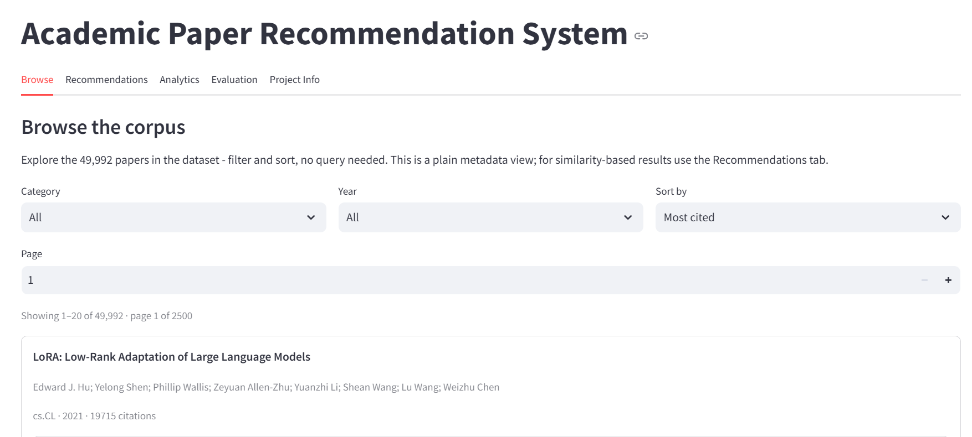

Slide 42
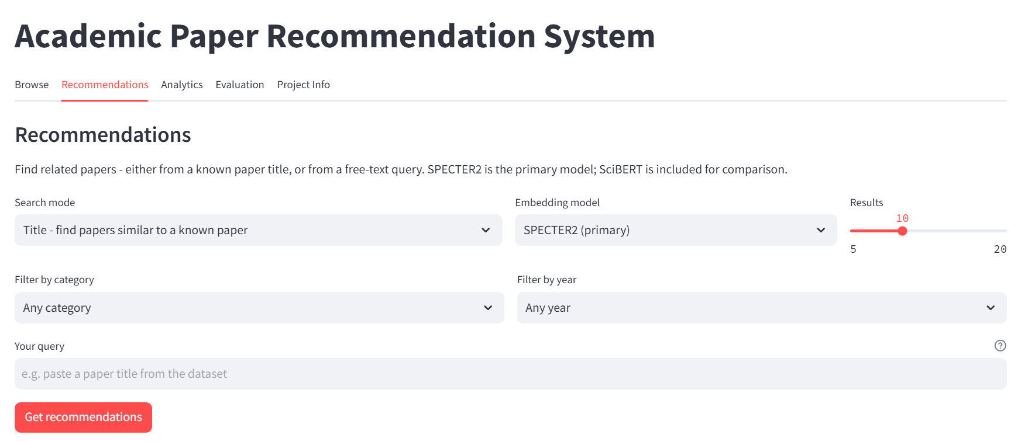

Slide 43
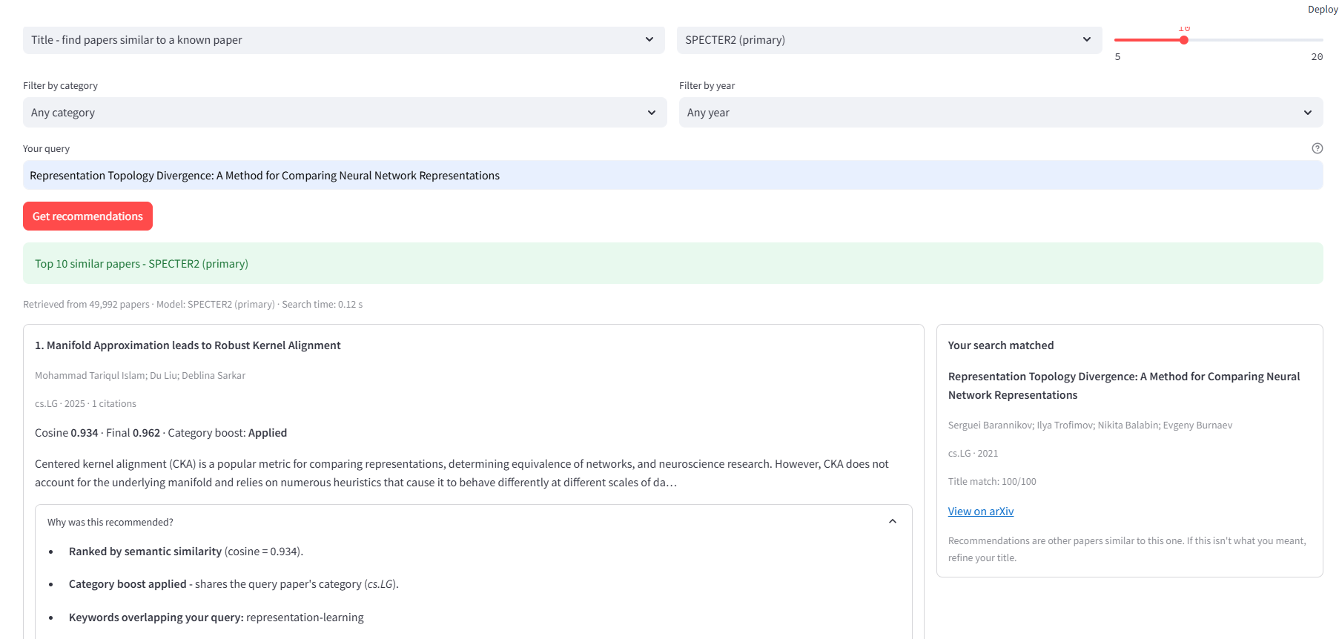

Slide 44
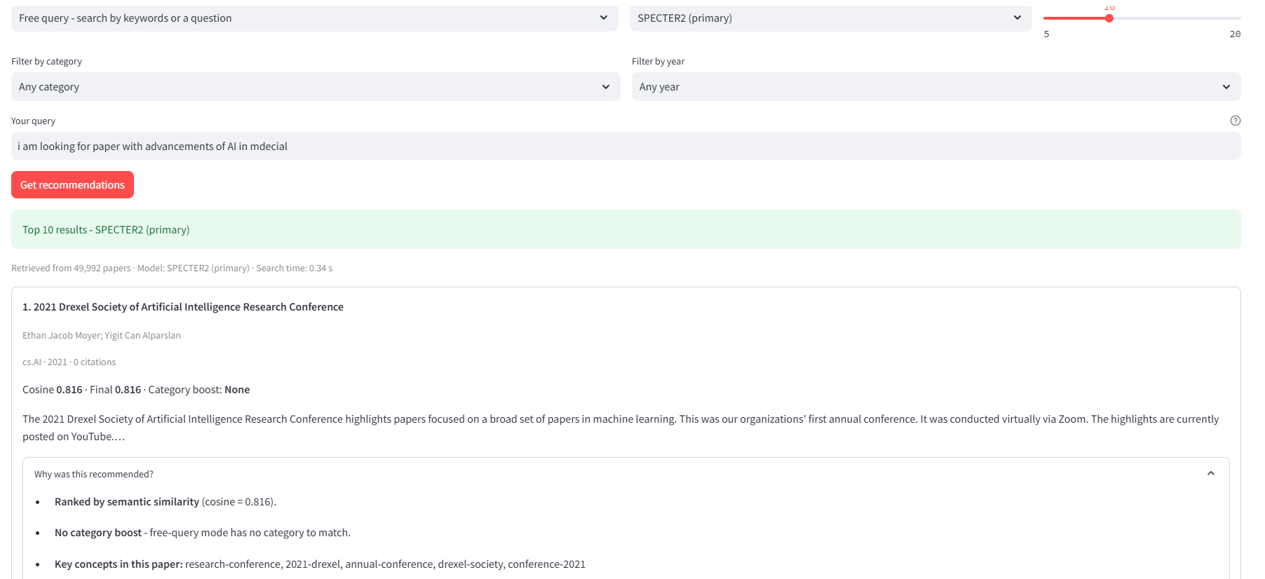

Slide 45
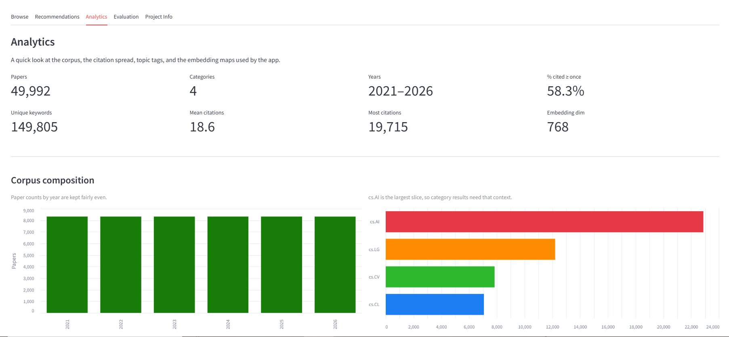

Slide 46
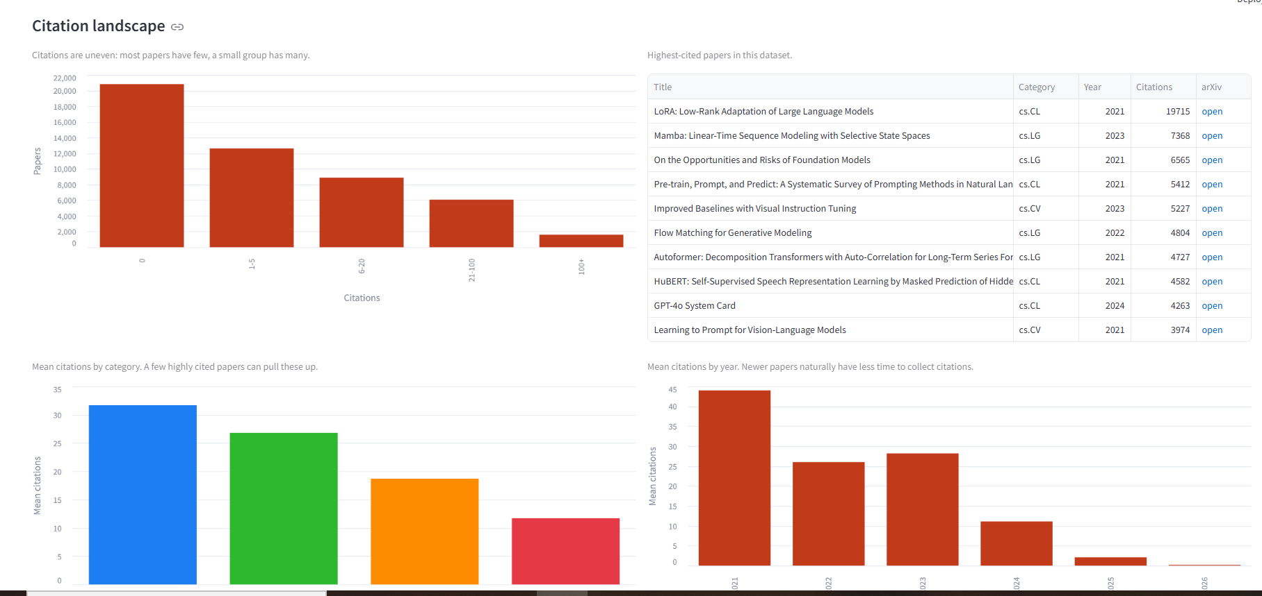

Slide 47
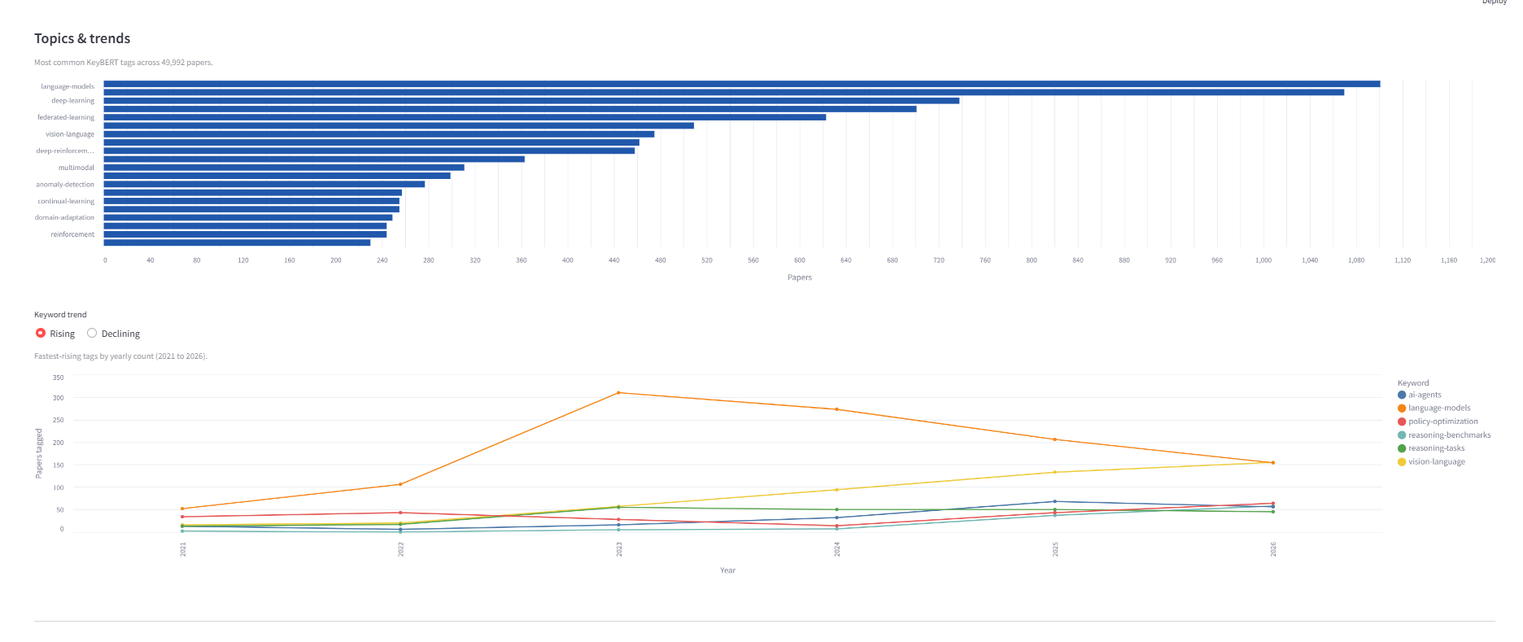

Slide 48
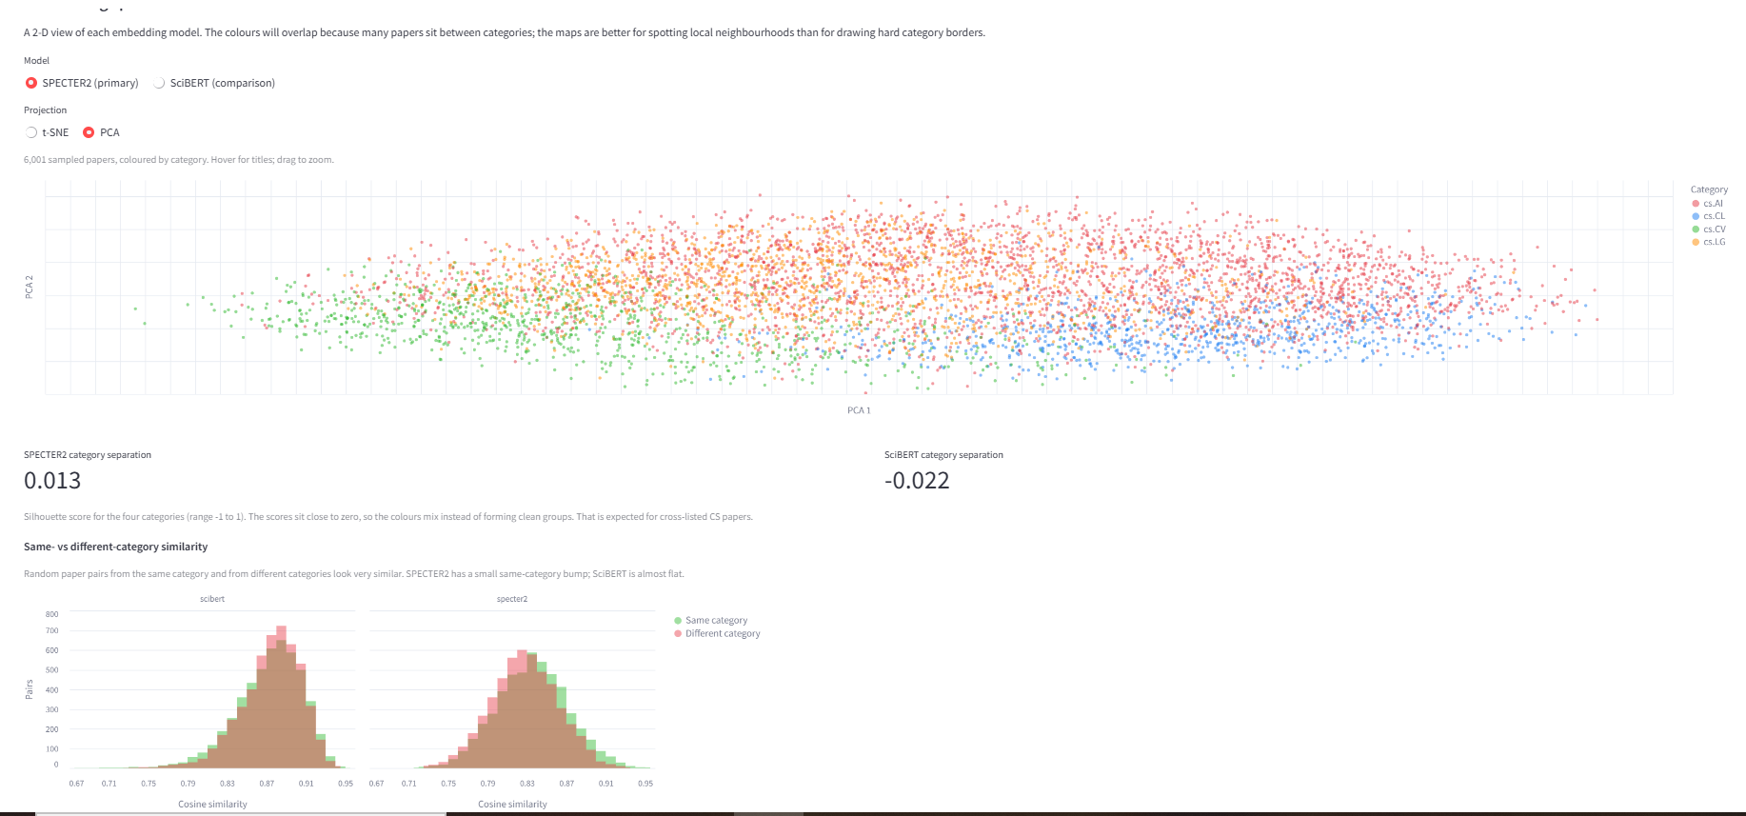

Slide 49
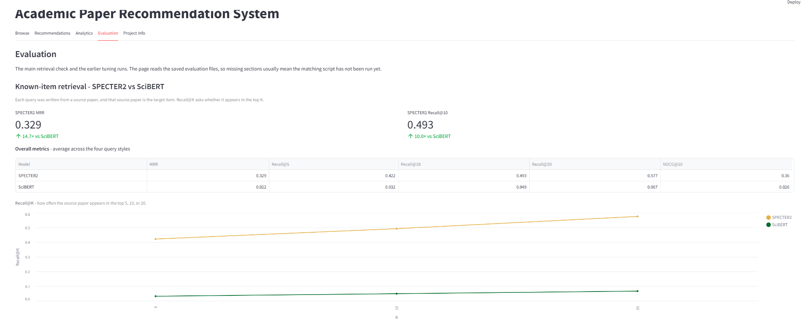

Slide 50
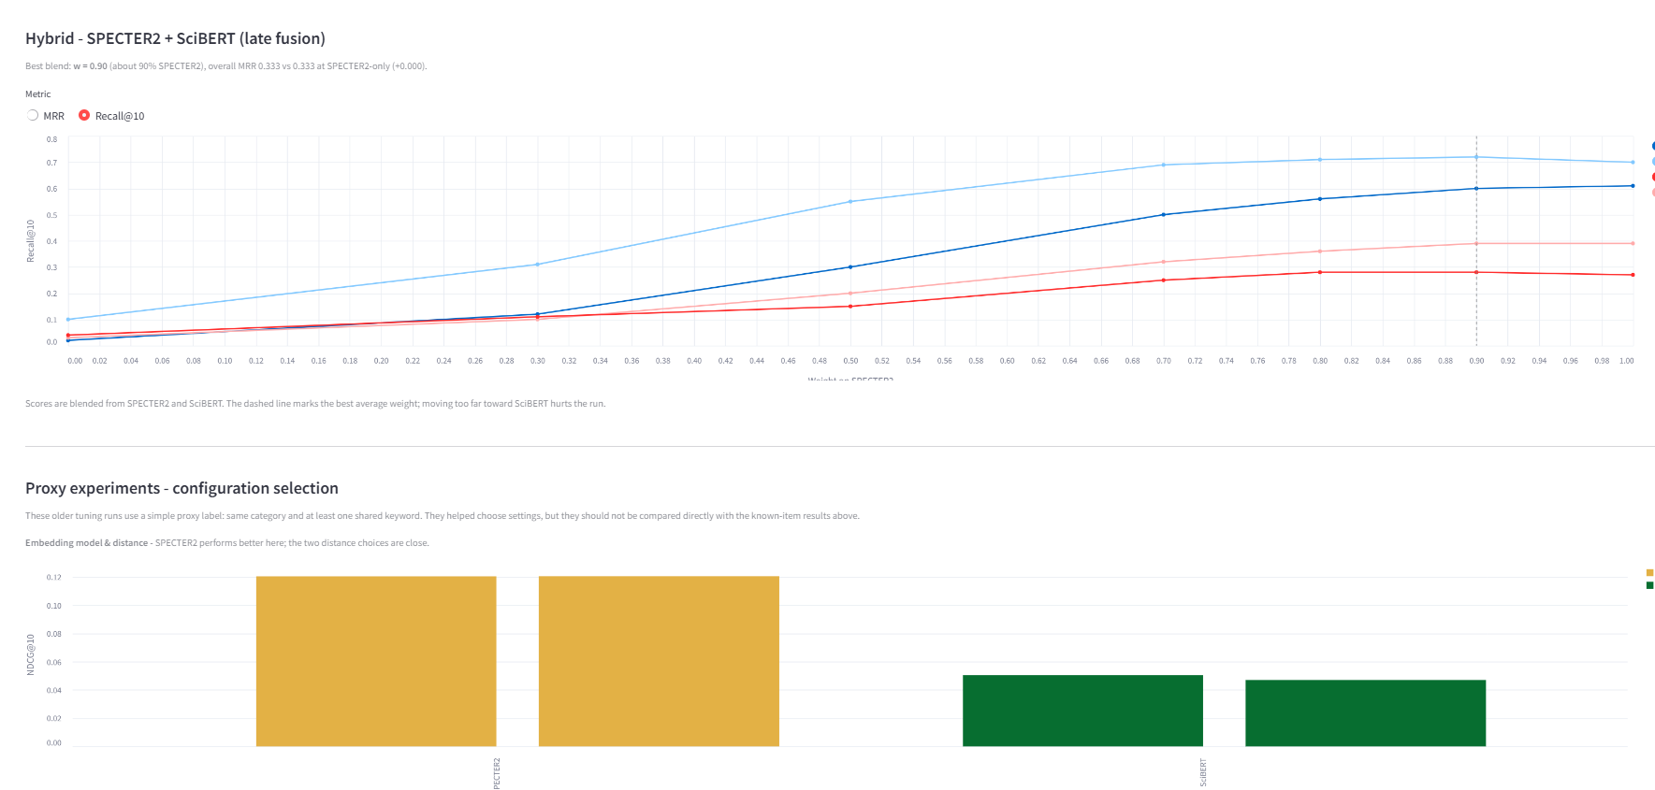

Slide 51
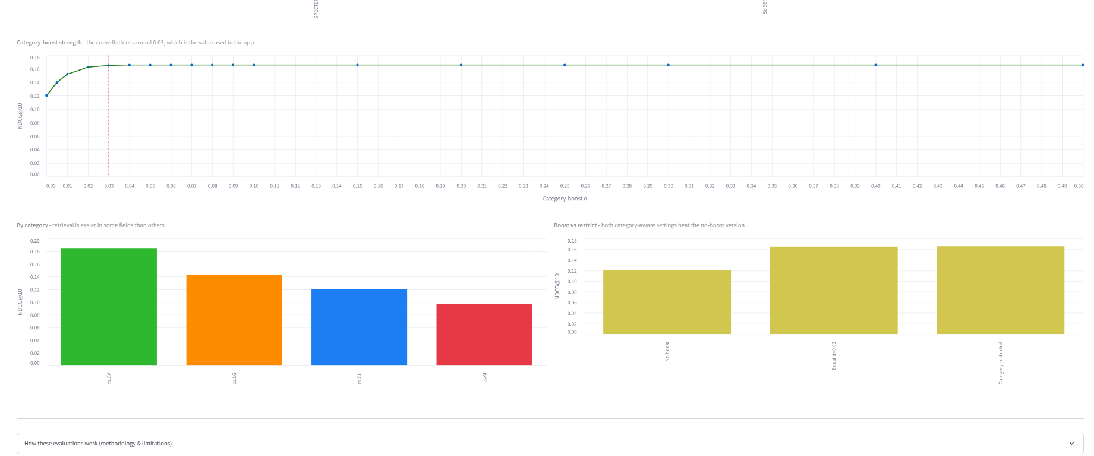

Slide 52
